Slide 1
CLINICAL AI • RAG • FINAL PRESENTATION
Asthma Care
Evidence-grounded asthma support for safer, faster patient decisions
A patient-centered RAG prototype built on the NICE NG245 asthma guideline — presented for final judge evaluation on Day 5.
Patient
→
Assistant
→
Evidence
→
Risk Awareness
→
Appropriate Care
Triple SSS • Sama Yasser • Salma Ahmed Hussien • Salma Ahmed Mohamed • 2026

Slide 2
FINAL PRESENTATION • DAY 5
Stabilize. Demonstrate. Defend.
Our goal today is not to add more features to Asthma Care — it is to prove the system is reliable, evidence-grounded, and safe.
01
02
03
Stabilize
Demonstrate
Defend
Freeze scope. Fix broken flows. Re-run evaluation on a locked build so results are trustworthy.
Run a short, predictable live demo that shows one success case and one honest refusal case.
Answer judge questions with evidence — metrics, citations, and clearly stated limitations.
Asthma Care • Triple SSS • Final Presentation
02

Slide 3
02 — THE PROBLEM
When asthma symptoms happen, uncertainty matters.
Asthma Care is designed around the patient's need for clear, evidence-grounded guidance and timely escalation.
The patient challenge
The product opportunity
What Asthma Care does not do
Understanding asthma information can be difficult.
Symptoms may create uncertainty about urgency.
Knowing when to seek emergency care is critical.
Make trusted asthma information easier to access.
Translate retrieved guideline evidence into a clear response.
Highlight risk and direct emergency cases to appropriate care.
No independent diagnosis.
No medication prescribing or personalized treatment plans.
No replacement for doctors or emergency services.
Asthma Care • Triple SSS • Final Presentation
03

Slide 4
03 — PRODUCT
A simple patient journey, grounded in clinical evidence.
The prototype focuses on support, risk awareness, emergency direction, and access to appropriate care.
01
→
02
→
03
→
04
→
05
Ask / Describe
Retrieve
Respond
Assess
Escalate
Asthma question or symptoms
Relevant NICE evidence
Answer + source + confidence
Risk-level awareness
Emergency guidance + nearby hospitals
CORE VALUE PROPOSITION
Reliable asthma information • Less uncertainty during symptoms • Safer escalation when emergency care is needed • Nearby-hospital access
Asthma Care • Triple SSS • Final Presentation
04

Slide 5
04 — USERS & VALUE
Designed for patients — with healthcare context in mind.
Doctors and clinics are supporting stakeholders; the current prototype is primarily patient-facing.
What the patient gains
Supporting stakeholders
P
Clear, source-grounded asthma information.
A high-level indication of urgency.
Clear direction when emergency care is needed.
Nearby-hospital information when indicated.
Doctors / healthcare professionals.
Clinics and healthcare facilities.
Future connections remain subject to clinical, safety, privacy, and product validation.
Patient
Main user of the Asthma Care experience.
Asthma Care • Triple SSS • Final Presentation
05

Slide 6
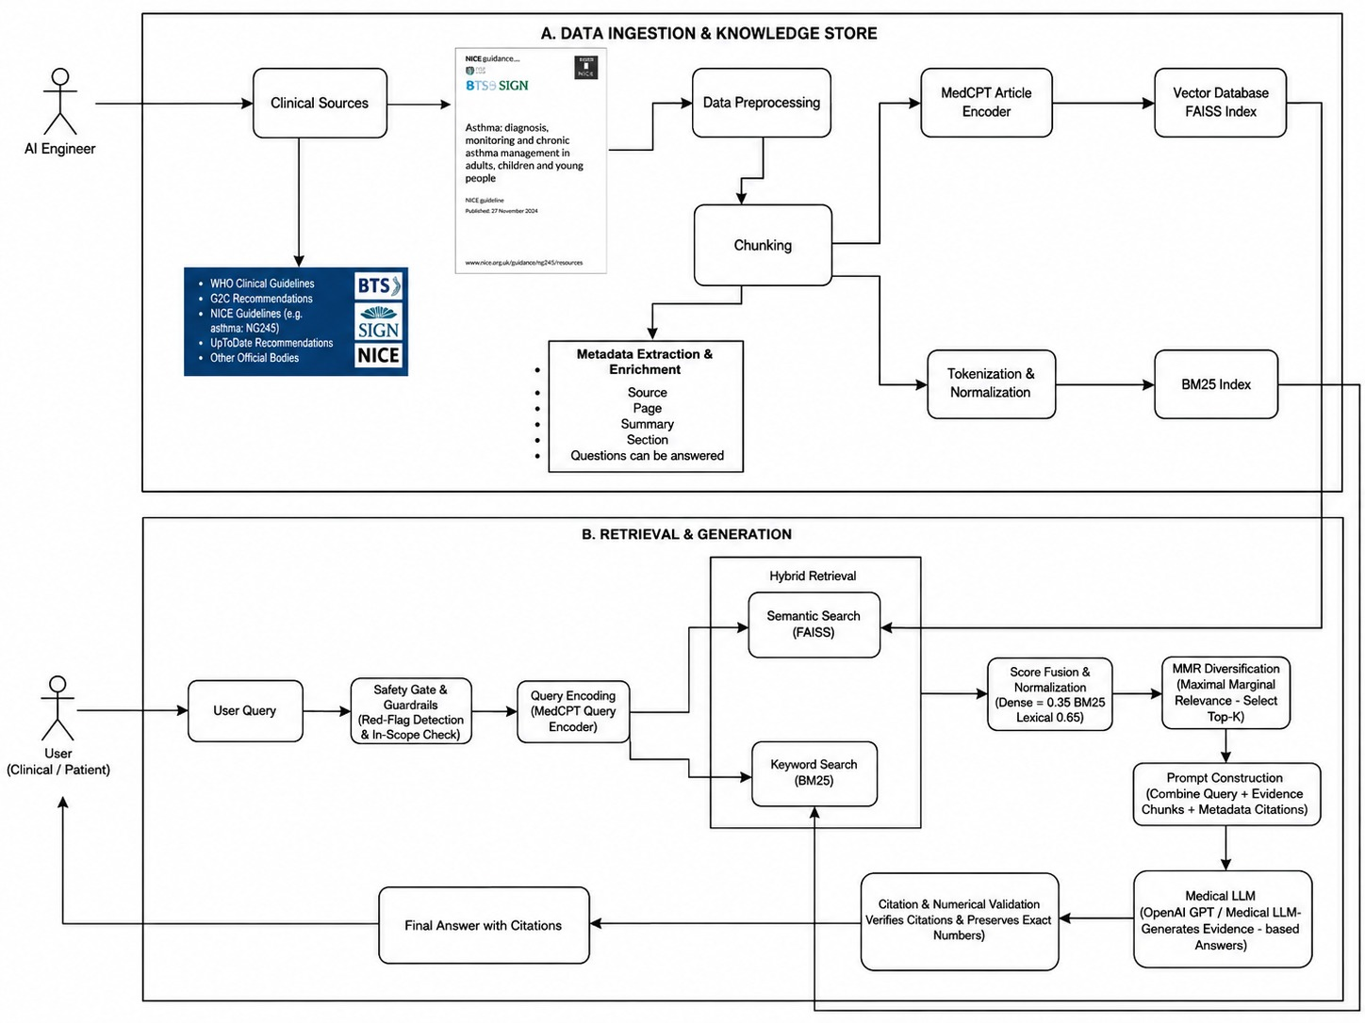

Slide 7
06 — CLINICAL SAFETY
Safety is a product requirement, not an afterthought.
The prototype has explicit boundaries for what it can answer and when it must escalate.
Grounding rules
Hard boundaries — outside product scope
Responses are grounded in retrieved NICE NG245 knowledge-base chunks only.
No claim is presented without a traceable evidence source.
Independent diagnosis.
Prescribing or recommending specific medicines.
Personalized treatment plans.
Autonomous clinical decision-making.
Replacing doctors, emergency services, or emergency treatment.
01
02
03
NICE-only evidence
Abstain when evidence is insufficient
Keep the clinician in the loop
Responses are grounded in retrieved NICE NG245 knowledge-base chunks.
The assistant does not guess or invent unsupported clinical facts.
The product supports patients; final medical decisions remain with qualified professionals.
Asthma Care • Triple SSS • Final Presentation
07

Slide 8
07 — KNOWLEDGE BASE
The knowledge base is deliberately narrow and traceable.
The assistant is defined around one NICE guideline and a strict output contract.
Assistant output contract
NICE NG245
Answer
Evidence-grounded response.
Asthma: diagnosis, monitoring and chronic asthma management
Confidence
High / Medium / Low.
BTS
NICE
SIGN
Reason
Brief explanation.
Published: 27 November 2024
Population: adults, young people and children. Age-specific recommendations apply.
Abstain
Explicit abstention when evidence is insufficient.
Current scope excludes managing severe asthma or acute asthma attacks.
Citation
Fixed NICE citation format tied to the retrieved evidence.
Asthma Care • Triple SSS • Final Presentation
08

Slide 9
08 — EVALUATION FRAMEWORK
Turning metrics into an evaluation story
Metrics are not decoration — they explain what Asthma Care can and cannot do.
Dataset
Retrieval
Grounding
Safety
20 asthma-related test questions
Grouped by topic / question type
Includes out-of-scope cases
Expected source page / section labeled
Precision@3
MRR (optional)
Top-k example review
Documented failure examples
Citation accuracy
Unsupported-claim rate
Claim-to-evidence spot checks
One annotated example trace
Refusal rate on out-of-scope prompts
Confidence-threshold behavior
Disclaimer always shown
Risky / red-flag prompt tests
Asthma Care • Triple SSS • Final Presentation
09

Slide 10
09 — EVALUATION RESULTS
Evaluation results — grounding the story in numbers
Keep the dashboard simple enough for a judge to read in under one minute. Replace the values below with the live evaluation run.
TBD
TBD
TBD
TBD
Retrieval Precision@3
Citation Accuracy
Faithfulness (unsupported-claim rate)
Refusal Rate (out-of-scope)
Relevant chunks in top 3 / 3
Correct citations / total citations
Unsupported claims / total claims
Correct refusals / out-of-scope prompts
Method, in one line
Each metric is computed on the frozen build against the 20-question evaluation set, with results and one insight per metric reported alongside the method used — not just a final score.
Asthma Care • Triple SSS • Final Presentation
10

Slide 11
10 — INTERPRETATION
What the metrics tell us
A strong team explains both success and failure honestly.
How to read the results
Never do
High retrieval score but low faithfulness → likely a prompt / generation issue.
Low retrieval score → likely a chunking or embedding issue.
Low citation accuracy → likely a metadata or citation-formatting issue.
Consistent refusal on out-of-scope prompts → the safety gate is working as intended.
Present fake or estimated metrics.
Show a score with no explained method.
Rely only on screenshots as evidence.
Omit known limitations.
Asthma Care • Triple SSS • Final Presentation
11

Slide 12
11 — ANSWER FORMAT
One consistent answer structure, every time
Formatting is part of safety: it makes every answer auditable.
1
Recommendation
2
Evidence used
3
Safety block
Brief answer to the patient's question
No overconfident diagnosis
Clear scope boundaries
Practical, but not personalized
Short extracted evidence
NICE NG245 document name
Section title and page number
Retrieval score (optional)
Confidence level: High / Medium / Low
Insufficient-evidence warning when relevant
Non-medical-advice disclaimer
When to consult a clinician
Asthma Care • Triple SSS • Final Presentation
12

Slide 13
12 — LIVE DEMO SCRIPT
A predictable, judge-mapped demo
A refusal case is not a weakness — it proves responsible AI behavior.
Open app
Ask query
Show chunks
Generate answer
Show citation
Show refusal
Case A — Success
Case B — Multi-step
Case C — Refusal
Question clearly covered by NICE NG245
Relevant chunks appear in top-k
Answer cites document + section/page
Confidence level is justified
Question needs more than one chunk
Answer combines evidence safely
Citations cover each major claim
No unsupported expansion
Question outside the NICE NG245 scope
System states evidence is insufficient
No invented recommendation
Patient directed to professional judgment
Asthma Care • Triple SSS • Final Presentation
13

Slide 14
13 — EXPERIENCE
From question to appropriate care
The product journey connects evidence retrieval with a clear safety response.
1
→
2
→
3
→
4
→
5
Patient Login
Asthma Assistant
RAG Retrieval
Answer
Risk Awareness
Access the assistant
Ask a question or describe symptoms
Retrieve relevant NICE evidence
Evidence + sources + confidence
High-level urgency indication
Emergency guidance & nearby hospitals
Directs the user toward appropriate medical care when risk indicators are present.
Shows nearby hospitals when emergency care is indicated.
Asthma Care • Triple SSS • Final Presentation
14

Slide 15

LIVE PROTOTYPE
Try Asthma Care
Scan the QR code to open the system prototype.
1
Ask
Submit an asthma-related question or symptoms.
2
Understand
Receive a grounded response with source information.
3
Act safely
See risk awareness and emergency direction when indicated.
PATIENT-FACING PROTOTYPE • Evidence-grounded asthma support
Asthma Care • Triple SSS • Final Presentation
15

Slide 16
17 — ROADMAP
A focused prototype with room to grow
Future expansion is intentionally separated from current functionality.
Current prototype
Future direction
✓
Patient-facing asthma assistant
1
Validated expansion beyond the current prototype
✓
Guideline-grounded responses
2
Potential connection with verified doctors / healthcare facilities
✓
Source / citation presentation
✓
Risk-level indication
3
Broader patient-to-care pathways
✓
Emergency guidance
✓
Nearby-hospital information
Any new capability must be clinically, safely, and technically validated before being presented as implemented.
Asthma Care • Triple SSS • Final Presentation
19

Slide 17
CLOSING
Asthma Care in one sentence
A patient-centered RAG assistant that turns trusted asthma guideline evidence into clear, source-grounded support — while knowing when to step back and direct the patient to professional care.
EVIDENCE
SAFETY
CLARITY
Triple SSS
Sama Yasser • Salma Ahmed Hussien • Salma Ahmed Mohamed
Thank you — questions welcome.
Asthma Care • Triple SSS • Final Presentation
20

