Slide 1








Creating a Simple Mobile Screen
Learn how to build responsive mobile user interfaces using Flutter's core layout and content widgets.

Slide 2
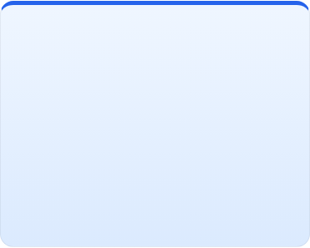
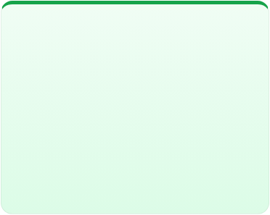
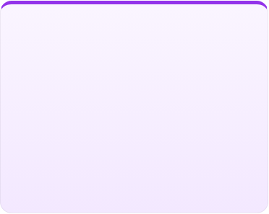



Core Flutter UI Widgets
Layout & Structure
Visual Content
User Interaction
Column, Row, and Container arrange elements vertically, horizontally, and control spacing with padding and background styling.
Text displays styled typography while Image presents graphical assets or network photos to deliver rich visual information.
Buttons like ElevatedButton and TextButton capture user touch events to trigger actions and navigate through app workflows.

Slide 3
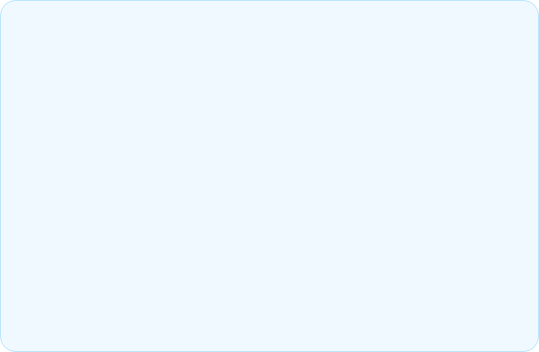
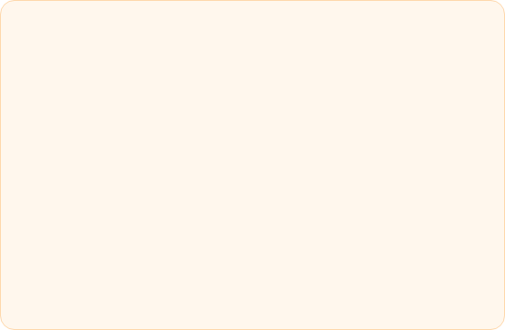
Layout & Structure Widgets
Column & Row Widgets
Container Widget
The primary building blocks for multi-child directional layouts:
A versatile single-child styling box for customization:
Explicit width and height constraints.
Arranges children vertically top-to-bottom.
External margin and internal padding.
Arranges children horizontally left-to-right.
Custom background colors, rounded borders, and subtle drop shadows.
Key properties: mainAxisAlignment and crossAxisAlignment control positioning along primary and perpendicular axes.

Slide 4
Content & Interactive Elements
Text Widget: Displays user interface text. Customize typography using TextStyle to set font size, font weight, letter spacing, and colors.
Image Widget: Renders visual assets using Image.asset() for local files or Image.network() for online photos with BoxFit attributes.
Button Widgets: Use ElevatedButton for filled action triggers or TextButton for secondary actions, configured with the onPressed callback.
Widget Tree Composition: Nest these elements together seamlessly inside scaffold bodies to create intuitive, highly responsive mobile screens.

Slide 5
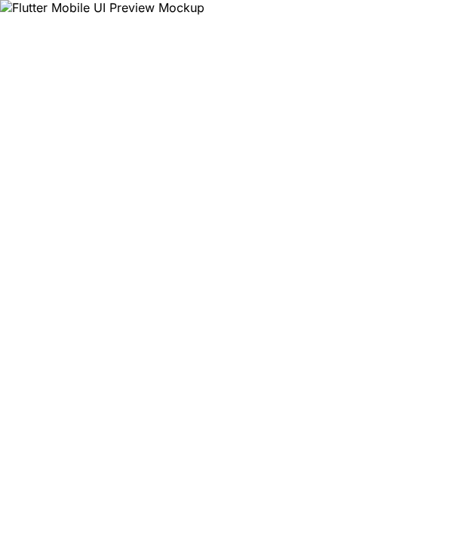
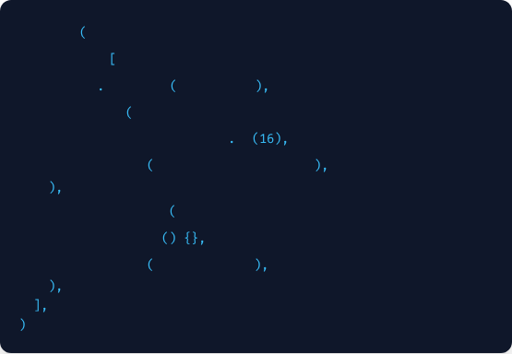
Assembling the Mobile Screen
By nesting our basic widgets into a logical hierarchy, we turn simple components into a complete mobile user screen.
Column
children:
Image
network
'https://...'
Container
padding:
EdgeInsets
all
child:
Text
'Welcome to Flutter'
ElevatedButton
onPressed:
child:
Text
'Get Started'

Slide 6

Start Building Your Flutter UI!
You now have all the core widgets needed to design clean, responsive mobile application screens.

Slide 7

Image Sources
https://www.codester.com/static/uploads/items/000/061/61919/preview.jpg
Source: www.codester.com

