Slide 1
University Events and Workshops Electronic Portal

Slide 2
General Concept:
A unified and intelligent platform connecting students, event organizers, university administration, and companies to streamline the management of academic activities.

Slide 3
The Problem, The Impact & Our Solution
The Problem:
Traditional Fragmentation
Booking Conflicts
Low Student Engagement
The Impact:
Wasted time, administrative inefficiency,
and low student engagement due to a lack of personalized recommendations matching events to academic majors.
Our Solution:
A unified, multi-role digital platform
(Built with Streamlit & Supabase) featuring smart tracking, seamless approvals, and dynamic major-based event recommendations.

Slide 4
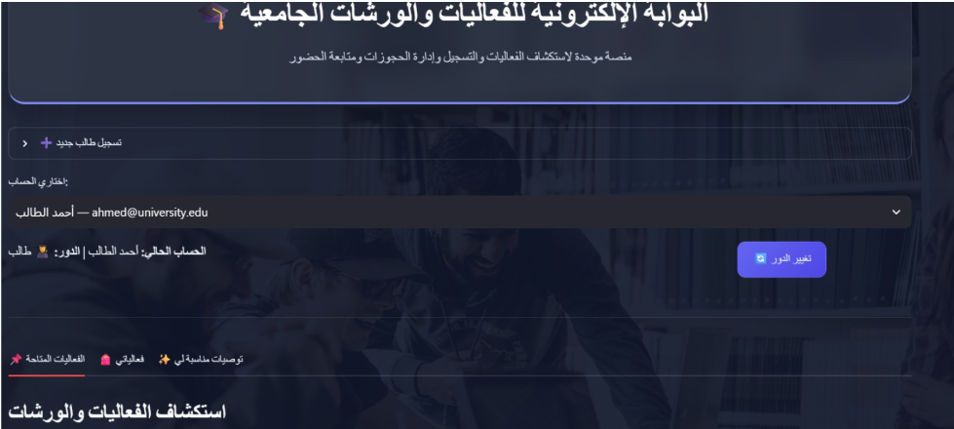
Functional Requirements & Interface Preview
1-Student Portal
Event discovery & major-based recommendations.
One-click event registration & hisory.

Slide 5
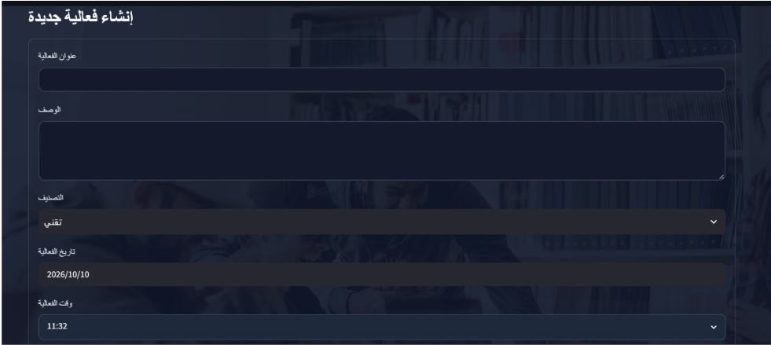
2.Event Organizer
Create events & select hall capacity.
Track request status & record attendance.

Slide 6
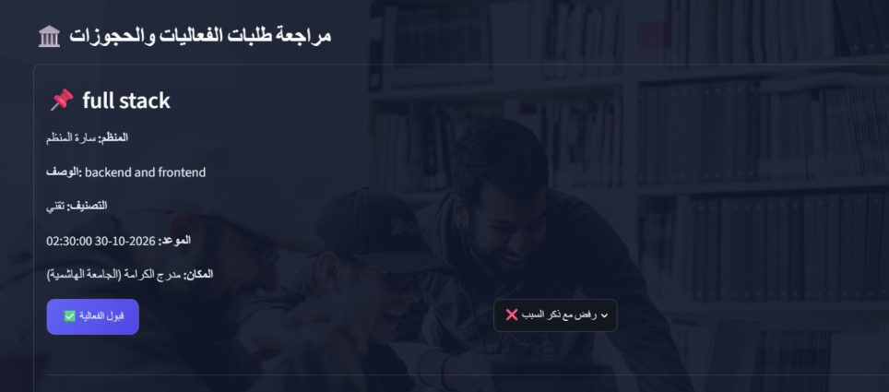
3. University Admin
Review pending venue booking requests.
Approve/reject with justification logs.

Slide 7
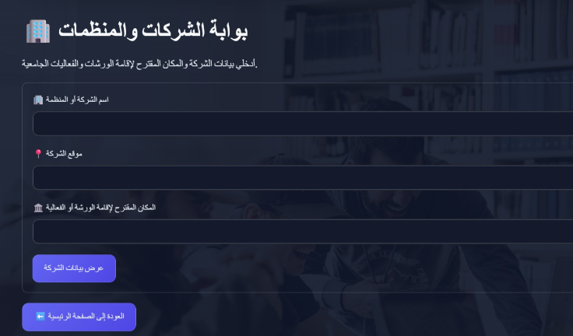
4. Companies & External
Submit event proposal details & venue.
Safe temporary session storage.

Slide 8
Project Team
Sara Hamadeh
Ayah Al-Nawafleh
Sadeen Ramadan
Salma Awawdeh

Slide 9
Thank you

