Slide 1

MyWelly
.Project Title:
MyWelly : Health Consultation Booking App
.Prepared by:
Safar Fatima Ezzahra, Elansari Zineb, Bellaou Salma

Slide 2
Feasibility Study Report

Slide 3
Project Overview
MyWelly is a mobile health consultation and management app connecting patients, doctors, and laboratories through one secure platform.
Aspect | Key Points
Technical | Android app built with Python (Django/Flask) and PostgreSQL/MySQL. Secure data management, GDPR & Moroccan compliance. Testing on computers and smartphones.
Economic | Low cost – team owns hardware. Revenue from 5% doctor + 5% lab fees. Benefits outweigh costs → economically sustainable.
Market/user | Serves patients, doctors, and labs. Simplifies booking, communication, and results sharing. Improves efficiency and trust.
Operational | Easy adoption into existing workflows. Minimal training, strong data protection, and proactive task management.
Schedule | 6 Phases over one semester: Requirements & Feasibility (1 week) 2. IEEE 830-1998 SRS (1 week) 3.Design (40 days) 4.Implementation (40 days) 5.Testing (3 weeks) 6.Deployment & Docs (3 weeks)

Slide 4
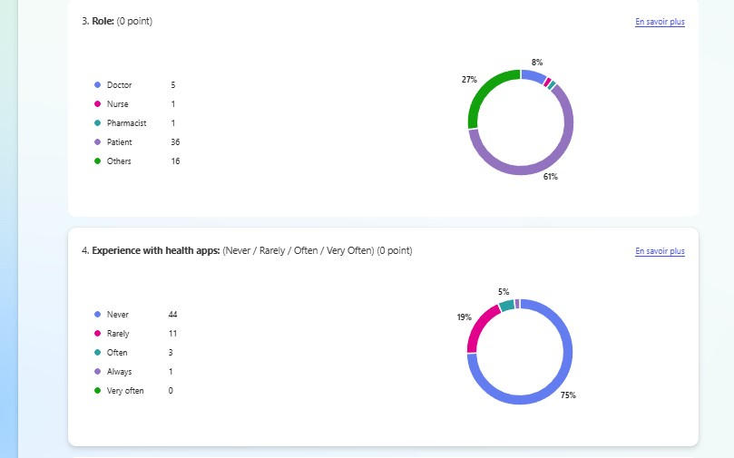
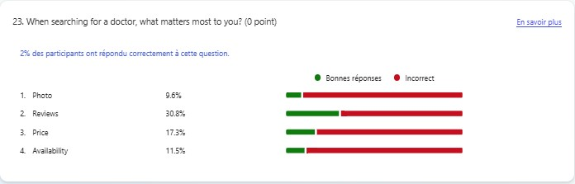
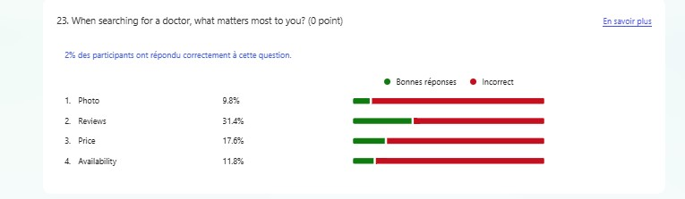

Slide 5
SRS Report

Slide 6
SRS Report
Users and Benefits:
Patients: 24/7 booking, access to records, verified reviews.
Doctors: Manage schedules, prescriptions, patient history.
Laboratories: Secure result upload and sharing.
Admins: System monitoring, data security, analytics.
Main functinalities :
Sign-up/Login
Search
Appointment Management
ReviewsStatus Tracking

Slide 7
Non-Functional requirements :
99% availability
Secure data encryption
Daily automatic backups
Fast response (<3s), support 10,000+ users
Goal:
Enhance Morocco’s healthcare experience by improving efficiency, security, and accessibility.

