Slide 1
DNA Sequencing Error Correction Algorithms
College of Computing and Information Technology, AASTMT
2017
Student:
  Salma Gomaa
Supervisors:
  Prof. Dr. Yasser El-sonbaty
  Dr. Nahla Belal

Slide 2
Table of Contents
Introduction
Problem Definition
Objective
Background
Related Work
K-mer Grouping Error Correction Proposal
H-RACER Proposal
Evaluation
Conclusion
Future Work

Slide 3
Table of Contents
Introduction
Problem Definition
Objective
Background
Related Work
K-mer Grouping Error Correction Proposal
H-RACER Proposal
Evaluation
Conclusion
Future Work

Slide 4
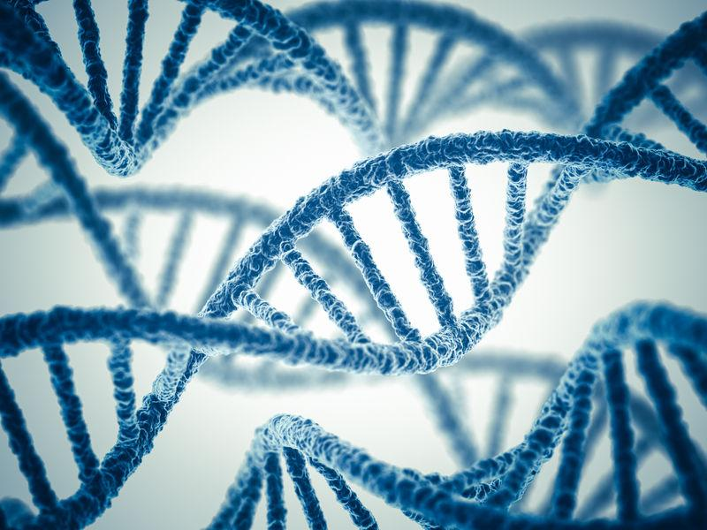
Deoxyribonucleic Acid (DNA)

Slide 5
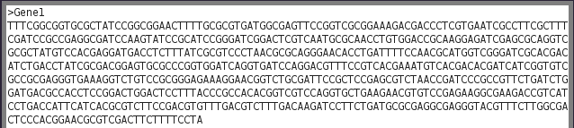
DNA Sequencing
DNA sequence - a single format onto which a broad range of biological phenomena can be projected for high-throughput data collection

Slide 6
DNA Sequencing
Next-generation DNA sequencing has the potential to dramatically accelerate biological and biomedical research
NGS generates too many reads in a suitable time, which negatively affected the output accuracy

Slide 7
NGS Errors Corrections:
Nucleotide Error Types:
Substitution
Insertion
Deletion

Slide 8
Table of Contents
Introduction
Problem Definition
Objective
Background
Related Work
K-mer Grouping Error Correction Proposal
H-RACER Proposal
Evaluation
Conclusion
Future Work

Slide 9
Problem Definition
DNA Next Sequencing Generation - generates reads with many errors with different types
DNA Reads Accuracy - is a vital factor in all of the DNA reads processes

Slide 10
Table of Contents
Introduction
Problem Definition
Objective
Background
Related Work
K-mer Grouping Error Correction Proposal
H-RACER Proposal
Evaluation
Conclusion
Future Work

Slide 11
Objective
Raising the DNA reads accuracy
Correcting all of the different types of errors
Accomplishing the correction process within the shortest time

Slide 12
Table of Contents
Introduction
Problem Definition
Objective
Background
Related Work
K-mer Grouping Error Correction Proposal
H-RACER Proposal
Evaluation
Conclusion
Future Work

Slide 13
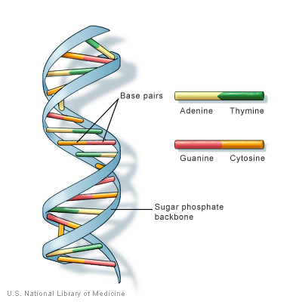
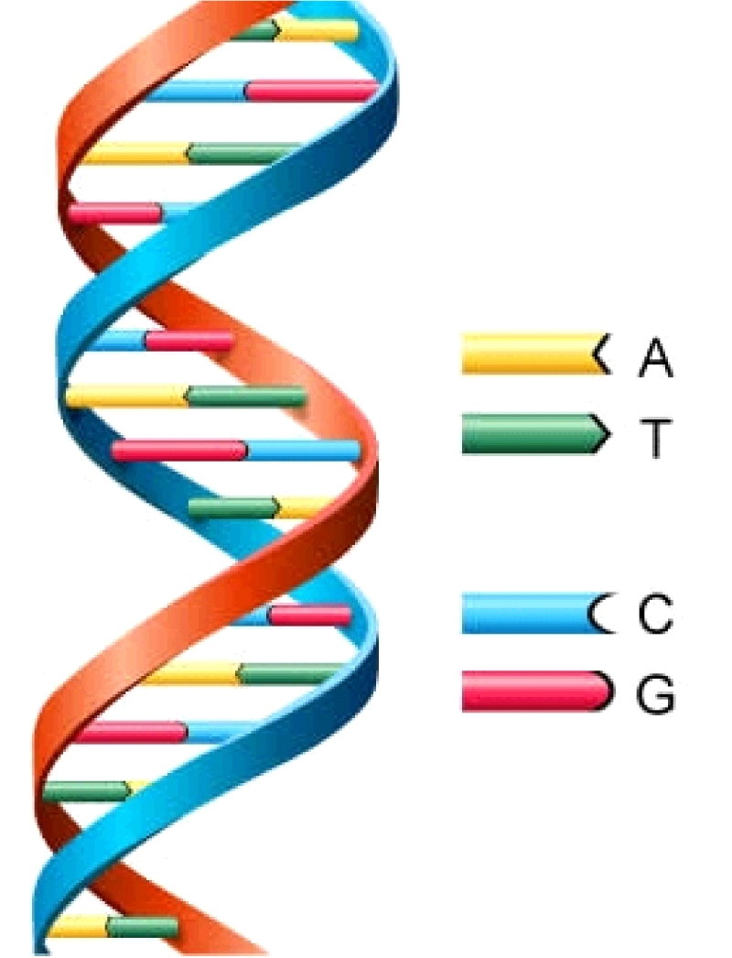
Deoxyribonucleic Acid (DNA)

Slide 14
Deoxyribonucleic Acid (DNA)
Human DNA consists of about 3 billion bases
The bases order determines the information available for building and maintaining an organism

Slide 15

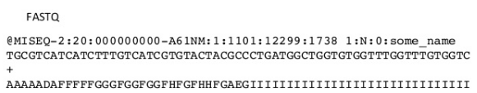
DNA Sequencing
DNA sequencing - outputs fasta or fastq file.

Slide 16
Next-Generation sequencing (NGS):
NGS generates too many reads in a suitable time
NGS introduced two painful issues:
Read Length Shortness
Reads Accuracy Decrement

Slide 17
NGS Errors Corrections:
Reads accuracy is a vital factor in all reads processes
Detecting and Correcting errors is an essential step, and can be either:
Standalone Program
Process Preceding Step

Slide 18
NGS Errors Corrections:
Detecting and Correcting errors depends on:
Nucleotide Frequency
Nucleotide Quality Value
Nucleotide Error Types:
Substitution
Insertion
Deletion

Slide 19
NGS Errors - Substitution Error
T | C | T | C | G

Slide 20
NGS Errors - Substitution Error
Substitution Error
T | C | T | C | G
T | C | A | C | G

Slide 21
NGS Errors - Substitution Error
T | C | A | C | G

Slide 22
NGS Errors - Insertion Error
T | C | T | C | G

Slide 23
NGS Errors - Insertion Error
T | C | T | C | G
T | C |  | C | G
G | T

Slide 24
NGS Errors - Insertion Error
T | C | G | T | C | G

Slide 25
NGS Errors - Deletion Error
T | C | T | C | G

Slide 26
NGS Errors - Deletion Error
T | C | T | C | G
T | C | - | C | G

Slide 27
NGS Errors - Deletion Error
T | C | C | G

Slide 28
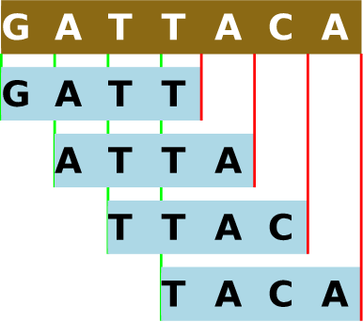
Correction Concepts and Definitions
K-mer - All the possible sub-sequences (of length k) from a read
K-mer Frequency - Number of a k-mer repetition in all the reads
K-mer Frequency Threshold - A preset threshold used in classifying k-mers

Slide 29
Correction Concepts and Definitions
Coverage - Number of reads that include a given nucleotide in the sequence
C = LN/G
Spectrum Alignment - A filtration step that classifies the k-mers into strong and weak k-mers
Spectrum alignment depends on the k-mers frequencies and/or the nucleotides quality values

Slide 30
Correction Concepts and Definitions
Correction can take place with:
Spectrum Alignment - by obtaining the nucleotides substitutions that leads to reduce the weak k-mers count
Tree Breadth-First Search - by traversing multi out-going edges nodes, and removing fewer reads paths, then re-aligns them to the existing path

Slide 31
Correction Concepts and Definitions
Correction can take place with:
Reads Alignments - by aligning reads with a common k-mer, then fixing misaligned nucleotides based on their occurrences and quality values
Suffix Array - built using a string of reads, and the correction takes place with the letter that appears most at each position

Slide 32
Correction Concepts and Definitions
Correction can take place with:
Suffix Trie - the edges are labelled with DNA letters, where the correction is based on the number of leaves in the sub-trie rooted at the node
K-mer Hashing Table - by storing the total times each nucleotide appears before and after a k-mer, where the error is corrected via the counts

Slide 33
Correction Concepts and Definitions
Correction can take place with:
K-mer Discontinuities - the frequencies of adjacent k-mers, where the correction is based on the removal or minimizing the discontinuity

Slide 34
Table of Contents
Introduction
Problem Definition
Objective
Background
Related Work
K-mer Grouping Error Correction Proposal
H-RACER Proposal
Evaluation
Conclusion
Future Work

Slide 35
Related Work
Correction Methodologies can be classified into two categories:
Substitution only correction
Substitution, insertion and deletions correction

Slide 36
Related Work
Substitution only correction methodology, like:
 | Euler | Velvet | AllPaths | SOAP | Quake | Reptile | CUDA | HiTEC | RACER | EC
Year | 2004 | 2008 | 2008 | 2010 | 2010 | 2010 | 2010 | 2011 | 2013 | 2015
Used Concept | Spectrum Alignment | Tree BFS | Spectrum Alignment | Tree BFS | Spectrum Alignment | Spectrum Alignment | Spectrum Alignment | Suffix Array | Hash Table | Hash Table
Depends On | K-mer Freq. | Nuc. Freq. | K-mer Freq. with Nuc. QV | K-mer Freq. | K-mer Freq. with Nuc. QV | K-mer Freq. with Nuc. QV | K-mer Freq. with Votes | Nuc. Freq. | Nuc. Freq. | Nuc. Freq.

Slide 37
Related Work
Substitution, insertion and deletions correction methodology , like:
 | HSHREC | Coral | Pollx
Year | 2010 | 2011 | 2015
Used Concept | Suffix Trie | Reads Alignment | K-mer Discontinuities
Depends On | Nuc. Freq. | Nuc. Freq. with QV | K-mer Freq.

Slide 38
Related Work
RACER characteristics:
Ability to correct data sets that have varying read lengths
Hash table and k-mer nucleotides neighbours
Fastest DNA error correction algorithm existent nowadays with a high accuracy
Corrects substitutions only

Slide 39
Table of Contents
Introduction
Problem Definition
Objective
Background
Related Work
K-mer Grouping Error Correction Proposal
H-RACER Proposal
Evaluation
Conclusion
Future Work

Slide 40
K-mer Grouping Error Correction Proposal
Aiming to correct all types of errors
Hashing the k-mers into integers
Flexible to run more correction iterations

Slide 41
K-mer Grouping Error Correction Proposal
Loading Reads from the given fastq/fasta file

Slide 42
K-mer Grouping Error Correction Proposal
Loading Reads from the given fastq/fasta file
Building k-mer hash array

Slide 43
K-mer Grouping Error Correction Proposal
Loading Reads from the given fastq/fasta file
Building k-mer hash array
Grouping K-mer
(0, (k+1)/2, k-1)

Slide 44
K-mer Grouping Error Correction Proposal
Loading Reads from the given fastq/fasta file
Building k-mer hash array
Grouping K-mer
(0, (k+1)/2, k-1)
Correcting the each group by its best K-mer
(frequency and quality value)

Slide 45
K-mer Grouping Error Correction Proposal
Loading Reads from the given fastq/fasta file
Building k-mer hash array
Grouping K-mer
(0, (k+1)/2, k-1)
Non-corrected K-mer Re-grouping
(three nucleotides with lowest quality value)
Correcting the each group by its best K-mer
(frequency and quality value)

Slide 46
K-mer Grouping Error Correction Proposal
Loading Reads from the given fastq/fasta file
Building k-mer hash array
Grouping K-mer
(0, (k+1)/2, k-1)
Correcting the each group by its best K-mer
(frequency and quality value)
Non-corrected K-mer Re-grouping
(three nucleotides with lowest quality value)
Correcting the each group by its best K-mer
(frequency and quality value)

Slide 47
K-mer Grouping Error Correction Proposal
id | k-mer | Freq
0 | CCGTAAT | 9
1 | CGCTACT | 13
2 | GTACGGT | 8
3 | AGCTACT | 4
4 | GTCCTGT | 3
5 | ACGTAAT | 2
6 | GGCCACT | 2
7 | GGCCTAA | 1
8 | TGCCACC | 3

Slide 48
K-mer Grouping Error Correction Proposal
id | k-mer | Freq | Gp
0 | CCGTAAT | 9 | -1
1 | CGCTACT | 13 | -1
2 | GTACGGT | 8 | -1
3 | AGCTACT | 4 | -1
4 | GTCCTGT | 3 | -1
5 | ACGTAAT | 2 | -1
6 | GGCCACT | 2 | -1
7 | GGCCTAA | 1 | -1
8 | TGCCACC | 3 | -1

Slide 49
K-mer Grouping Error Correction Proposal
id | k-mer | Freq
0 | CCGTAAT | 9
1 | CGCTACT | 13
2 | GTACGGT | 8
3 | AGCTACT | 4
4 | GTCCTGT | 3
5 | ACGTAAT | 2
6 | GGCCACT | 2
7 | GGCCTAA | 1
8 | TGCCACC | 3
Gp
0
-1
-1
-1
-1
-1
-1
-1
-1

Slide 50
K-mer Grouping Error Correction Proposal
id | k-mer | Freq
0 | CCGTAAT | 9
1 | CGCTACT | 13
2 | GTACGGT | 8
3 | AGCTACT | 4
4 | GTCCTGT | 3
5 | ACGTAAT | 2
6 | GGCCACT | 2
7 | GGCCTAA | 1
8 | TGCCACC | 3
Gp
0
-1
-1
-1
-1
-1
-1
-1
-1

Slide 51
K-mer Grouping Error Correction Proposal
id | k-mer | Freq
0 | CCGTAAT | 9
1 | CGCTACT | 13
2 | GTACGGT | 8
3 | AGCTACT | 4
4 | GTCCTGT | 3
5 | ACGTAAT | 2
6 | GGCCACT | 2
7 | GGCCTAA | 1
8 | TGCCACC | 3
Gp
0
-1
-1
-1
-1
-1
-1
-1
-1

Slide 52
K-mer Grouping Error Correction Proposal
id | k-mer | Freq
0 | CCGTAAT | 9
1 | CGCTACT | 13
2 | GTACGGT | 8
3 | AGCTACT | 4
4 | GTCCTGT | 3
5 | ACGTAAT | 2
6 | GGCCACT | 2
7 | GGCCTAA | 1
8 | TGCCACC | 3
Gp
0
-1
-1
-1
-1
0
-1
-1
-1

Slide 53
K-mer Grouping Error Correction Proposal
id | k-mer | Freq
0 | CCGTAAT | 9
1 | CGCTACT | 13
2 | GTACGGT | 8
3 | AGCTACT | 4
4 | GTCCTGT | 3
5 | ACGTAAT | 2
6 | GGCCACT | 2
7 | GGCCTAA | 1
8 | TGCCACC | 3
Gp
0
1
-1
-1
-1
0
-1
-1
-1

Slide 54
K-mer Grouping Error Correction Proposal
id | k-mer | Freq
0 | CCGTAAT | 9
1 | CGCTACT | 13
2 | GTACGGT | 8
3 | AGCTACT | 4
4 | GTCCTGT | 3
5 | ACGTAAT | 2
6 | GGCCACT | 2
7 | GGCCTAA | 1
8 | TGCCACC | 3
Gp
0
1
-1
-1
-1
0
-1
-1
-1

Slide 55
K-mer Grouping Error Correction Proposal
id | k-mer | Freq
0 | CCGTAAT | 9
1 | CGCTACT | 13
2 | GTACGGT | 8
3 | AGCTACT | 4
4 | GTCCTGT | 3
5 | ACGTAAT | 2
6 | GGCCACT | 2
7 | GGCCTAA | 1
8 | TGCCACC | 3
Gp
0
1
-1
-1
-1
0
-1
-1
-1

Slide 56
K-mer Grouping Error Correction Proposal
id | k-mer | Freq
0 | CCGTAAT | 9
1 | CGCTACT | 13
2 | GTACGGT | 8
3 | AGCTACT | 4
4 | GTCCTGT | 3
5 | ACGTAAT | 2
6 | GGCCACT | 2
7 | GGCCTAA | 1
8 | TGCCACC | 3
Gp
0
1
-1
1
-1
0
-1
-1
-1

Slide 57
K-mer Grouping Error Correction Proposal
id | k-mer | Freq
0 | CCGTAAT | 9
1 | CGCTACT | 13
2 | GTACGGT | 8
3 | AGCTACT | 4
4 | GTCCTGT | 3
5 | ACGTAAT | 2
6 | GGCCACT | 2
7 | GGCCTAA | 1
8 | TGCCACC | 3
Gp
0
1
-1
1
-1
0
-1
-1
-1

Slide 58
K-mer Grouping Error Correction Proposal
id | k-mer | Freq
0 | CCGTAAT | 9
1 | CGCTACT | 13
2 | GTACGGT | 8
3 | AGCTACT | 4
4 | GTCCTGT | 3
5 | ACGTAAT | 2
6 | GGCCACT | 2
7 | GGCCTAA | 1
8 | TGCCACC | 3
Gp
0
1
-1
1
-1
0
1
-1
-1

Slide 59
K-mer Grouping Error Correction Proposal
id | k-mer | Freq
0 | CCGTAAT | 9
1 | CGCTACT | 13
2 | GTACGGT | 8
3 | AGCTACT | 4
4 | GTCCTGT | 3
5 | ACGTAAT | 2
6 | GGCCACT | 2
7 | GGCCTAA | 1
8 | TGCCACC | 3
Gp
0
1
-1
1
-1
0
1
-1
-1

Slide 60
K-mer Grouping Error Correction Proposal
id | k-mer | Freq
0 | CCGTAAT | 9
1 | CGCTACT | 13
2 | GTACGGT | 8
3 | AGCTACT | 4
4 | GTCCTGT | 3
5 | ACGTAAT | 2
6 | GGCCACT | 2
7 | GGCCTAA | 1
8 | TGCCACC | 3
Gp
0
1
-1
1
-1
0
1
-1
1

Slide 61
K-mer Grouping Error Correction Proposal
id | k-mer | Freq
0 | CCGTAAT | 9
5 | ACGTAAT | 2
Gp
0
0
id | k-mer | Freq
2 | GTACGGT | 8
4 | GTCCTGT | 3
7 | GGCCTAA | 1
Gp
-1
-1
-1
id | k-mer | Freq
1 | CGCTACT | 13
3 | AGCTACT | 4
6 | GGCCACT | 2
8 | TGCCACC | 3
Gp
1
1
1
1

Slide 62
K-mer Grouping Error Correction Proposal
id | k-mer | Freq
0 | CCGTAAT | 9
5 | ACGTAAT | 2
Gp
0
0
id | k-mer | Freq
2 | GTACGGT | 8
4 | GTCCTGT | 3
7 | GGCCTAA | 1
Gp
-1
-1
-1
id | k-mer | Freq
1 | CGCTACT | 13
3 | AGCTACT | 4
6 | GGCCACT | 2
8 | TGCCACC | 3
Gp
1
1
1
1

Slide 63
K-mer Grouping Error Correction Proposal
id | k-mer | Freq
2 | GTACGGT | 8
4 | GTCCTGT | 3
7 | GGCCTAA | 1
Gp
-1
-1
-1

Slide 64
K-mer Grouping Error Correction Proposal
id | k-mer | Freq
2 | GTACGGT | 8
4 | GTCCTGT | 3
7 | GGCCTAA | 1
Gp
-1
-1
-1

Slide 65
K-mer Grouping Error Correction Proposal
id | k-mer | Freq
2 | GTACGGT | 8
4 | GTCCTGT | 3
7 | GGCCTAA | 1
Gp
0
-1
-1

Slide 66
K-mer Grouping Error Correction Proposal
id | k-mer | Freq
2 | GTACGGT | 8
4 | GTCCTGT | 3
7 | GGCCTAA | 1
Gp
0
-1
-1

Slide 67
K-mer Grouping Error Correction Proposal
id | k-mer | Freq
2 | GTACGGT | 8
4 | GTCCTGT | 3
7 | GGCCTAA | 1
Gp
0
0
-1

Slide 68
K-mer Grouping Error Correction Proposal
id | k-mer | Freq
2 | GTACGGT | 8
4 | GTCCTGT | 3
Gp
0
0
id | k-mer | Freq
7 | GGCCTAA | 1
Gp
-1

Slide 69
K-mer Grouping Error Correction Proposal
id | k-mer | Freq
2 | GTACGGT | 8
4 | GTCCTGT | 3
Gp
0
0
id | k-mer | Freq
7 | GGCCTAA | 1
Gp
-1

Slide 70
K-mer Grouping Error Correction - Evaluation
Data sets
Name | Genome Length | Read Length | Number of Reads | Coverage
Lactococcus Lactis | 2,598,144 | 36 | 4,370,050 | 60.55

Slide 71
K-mer Grouping Error Correction - Evaluation
Lactococcus Lactis (G: 2,598,144 - L: 36, N: 4,370,050, C: 60.55)
 | Coral | Pollux | HSHSREC | KGEC
Accuracy in Percentage | 91.45 | 94.15 | 95.34 | 95.39
Time in Minutes | 5 | 3 | 15 | 61

Slide 72
K-mer Grouping Error Correction Defects
This algorithm is mainly dependent on the k-mers grouping
kmers grouping takes place by generating all of the possible cases of the corrections of every kmer, and here goes the time defect (exponential)
On removing the method with the exponential complexity, the accuracy of the algorithm has been greatly negatively affected.

Slide 73
K-mer Grouping Error Correction Defects
The main major step of the proposal implies to it's weakness point, which proves that this proposal won't get a better results
So, it fails to run on big data
Using real data sets to get a good indication of real life performance

Slide 74
Table of Contents
Introduction
Problem Definition
Objective
Background
Related Work
K-mer Grouping Error Correction Proposal
H-RACER Proposal
Evaluation
Conclusion
Future Work

Slide 75
H-RACER Proposal
H-RACER is a newly correction approach for correcting all types of errors.
H-RACER is inherited from RACER
RACER is the fastest algorithm specialized in correction substitution errors only

Slide 76
H-RACER Proposal
RACER characteristics:
Ability to correct data sets that have varying read lengths
Hash table and k-mer nucleotides neighbours
Fastest DNA error correction algorithm existent nowadays with a high accuracy
Corrects substitutions only

Slide 77
H-RACER Proposal
H-RACER uses the same algorithm of RACER in detecting errors and deciding corrections values
H-RACER detects the error type for an erroneous nucleotide by studying its correction value against its neighbours
H-RACER decides the corrective action (substitute, insert, delete) according to the detected error type

Slide 78
H-RACER - Error Type Detection

Slide 79
H-RACER - Error Type Detection
N_{i} is erroneous with correction value C_{i}

Slide 80
H-RACER - Error Type Detection
N_{i} is erroneous with correction value C_{i}
N_{i +1} is
erroneous

Slide 81
H-RACER - Error Type Detection
N_{i} is erroneous with correction value C_{i}
Yes
C_{i} =N_{i + 1}
N_{i +1} is
erroneous

Slide 82
H-RACER - Error Type Detection
N_{i} is erroneous with correction value C_{i}
Yes
C_{i} =N_{i + 1}
N_{i +1} is
erroneous
Yes
Delete N_{i}

Slide 83
H-RACER - Error Type Detection
N_{i} is erroneous with correction value C_{i}
No
Yes
N_{i} = C_{i + 1}
C_{i} =N_{i + 1}
N_{i +1} is
erroneous
Yes
Delete N_{i}

Slide 84
H-RACER - Error Type Detection
N_{i} is erroneous with correction value C_{i}
No
Yes
N_{i} = C_{i + 1}
C_{i} =N_{i + 1}
N_{i +1} is
erroneous
Yes
Yes
Insert C_{i} before N_{i}
Delete N_{i}

Slide 85
H-RACER - Error Type Detection
N_{i} is erroneous with correction value C_{i}
No
Yes
No
N_{i} = C_{i + 1}
C_{i} =N_{i + 1}
N_{i +1} is
erroneous
Yes
Yes
Insert C_{i} before N_{i}
Delete N_{i}
N_{i} will be substituted by C_{i}

Slide 86
H-RACER - Error Type Detection
N_{i} is erroneous with correction value C_{i}
No
Yes
No
N_{i} = C_{i + 1}
C_{i} =N_{i + 1}
N_{i +1} is
erroneous
Yes
Yes
No
Insert C_{i} before N_{i}
Delete N_{i}
N_{i - 1} is
erroneous
N_{i} will be substituted by C_{i}

Slide 87
H-RACER - Error Type Detection
N_{i} is erroneous with correction value C_{i}
No
Yes
No
N_{i} = C_{i + 1}
C_{i} =N_{i + 1}
N_{i +1} is
erroneous
Yes
Yes
No
Insert C_{i} before N_{i}
Delete N_{i}
Yes
C_{i}=N_{i - 1}
N_{i - 1} is
erroneous
N_{i} will be substituted by C_{i}

Slide 88
H-RACER - Error Type Detection
N_{i} is erroneous with correction value C_{i}
No
Yes
No
N_{i} = C_{i + 1}
C_{i} =N_{i + 1}
N_{i +1} is
erroneous
Yes
Yes
No
Insert C_{i} before N_{i}
Delete N_{i}
Yes
Yes
N_{i - 1} is
erroneous
C_{i}=N_{i - 1}
N_{i} will be substituted by C_{i}

Slide 89
H-RACER - Error Type Detection
N_{i} is erroneous with correction value C_{i}
No
Yes
No
N_{i} = C_{i + 1}
C_{i} =N_{i + 1}
N_{i +1} is
erroneous
Yes
Yes
No
Insert C_{i} before N_{i}
Delete N_{i}
Yes
Yes
N_{i - 1} is
erroneous
C_{i}=N_{i - 1}
N_{i} = C_{i - 1}
No
N_{i} will be substituted by C_{i}

Slide 90
H-RACER - Error Type Detection
N_{i} is erroneous with correction value C_{i}
No
Yes
No
N_{i} = C_{i + 1}
C_{i} =N_{i + 1}
N_{i +1} is
erroneous
Yes
Yes
No
Insert C_{i} before N_{i}
Delete N_{i}
Yes
Yes
N_{i - 1} is
erroneous
C_{i}=N_{i - 1}
Insert C_{i} after N_{i}
Yes
N_{i} = C_{i - 1}
No
N_{i} will be substituted by C_{i}

Slide 91
H-RACER - Error Type Detection
N_{i} is erroneous with correction value C_{i}
No
Yes
No
N_{i} = C_{i + 1}
C_{i} =N_{i + 1}
N_{i +1} is
erroneous
Yes
Yes
No
Insert C_{i} before N_{i}
Delete N_{i}
Yes
Yes
N_{i - 1} is
erroneous
C_{i}=N_{i - 1}
Insert C_{i} after N_{i}
Yes
N_{i} = C_{i - 1}
No
N_{i} will be substituted by C_{i}
No

Slide 92
H-RACER - Error Type Detection
N_{i} is erroneous with correction value C_{i}
No
Yes
No
N_{i} = C_{i + 1}
C_{i} =N_{i + 1}
N_{i +1} is
erroneous
Yes
Yes
No
Insert C_{i} before N_{i}
Delete N_{i}
Yes
Yes
N_{i - 1} is
erroneous
C_{i}=N_{i - 1}
Insert C_{i} after N_{i}
Yes
N_{i} = C_{i - 1}
No
No
N_{i} will be substituted by C_{i}
No

Slide 93
H-RACER - Error Type Detection
Erroneously Inserted Nucleotide
. . . A C C A T G . . .

Slide 94
H-RACER - Error Type Detection
Erroneously Inserted Nucleotide
. . . A C C A T G . . .

Slide 95
H-RACER - Error Type Detection
Erroneously Inserted Nucleotide
. . . A C C A T G . . .
Correction Value
G

Slide 96
H-RACER - Error Type Detection
Erroneously Inserted Nucleotide
. . . A C C A T G . . .
equals
Correction Value
G

Slide 97
H-RACER - Error Type Detection
Erroneously Inserted Nucleotide
. . . A C C A T G . . .
equals
Correction Value
G
∴ T - erroneously inserted nucleotide

Slide 98
H-RACER - Error Type Detection
Erroneously Inserted Nucleotide
. . . A C C A T G . . .
equals
Correction Value
G
∴ T - erroneously inserted nucleotide
∴ Correction - delete T

Slide 99
H-RACER - Error Type Detection
Erroneously Inserted Nucleotide
. . . A C C A T G . . .
equals
Correction Value
G
∴ T - erroneously inserted nucleotide
∴ Correction - delete T
. . . A C C A G . . .

Slide 100
H-RACER - Error Type Detection
Erroneously Deleted Nucleotide
. . . A A C C T G . . .

Slide 101
H-RACER - Error Type Detection
Erroneously Deleted Nucleotide
. . . A A C C T G . . .

Slide 102
H-RACER - Error Type Detection
Erroneously Deleted Nucleotide
. . . A A C C T G . . .
Correction Value
Correction Value
A
T

Slide 103
H-RACER - Error Type Detection
Erroneously Deleted Nucleotide
. . . A A C C T G . . .
Correction Value
Correction Value
A
NOT
equals
T

Slide 104
H-RACER - Error Type Detection
Erroneously Deleted Nucleotide
. . . A A C C T G . . .
Correction Value
Correction Value
equals
A
T

Slide 105
H-RACER - Error Type Detection
Erroneously Deleted Nucleotide
. . . A A C C T G . . .
Correction Value
Correction Value
equals
A
T
∴ A - erroneously deleted nucleotide

Slide 106
H-RACER - Error Type Detection
Erroneously Deleted Nucleotide
. . . A A C C T G . . .
Correction Value
Correction Value
equals
A
T
∴ A - erroneously deleted nucleotide
∴ Correction - insert A

Slide 107
H-RACER - Error Type Detection
Erroneously Deleted Nucleotide
. . . A A C C T G . . .
Correction Value
Correction Value
equals
A
T
∴ A - erroneously deleted nucleotide
∴ Correction - insert A
. . . A A C C A T G . . .

Slide 108
H-RACER - Error Type Detection
Erroneously Substituted Nucleotide
. . . A A C C T G . . .

Slide 109
H-RACER - Error Type Detection
Erroneously Substituted Nucleotide
. . . A A C C T G . . .

Slide 110
H-RACER - Error Type Detection
Erroneously Substituted Nucleotide
. . . A A C C T G . . .
Correction Value
Correction Value
A
C

Slide 111
H-RACER - Error Type Detection
Erroneously Substituted Nucleotide
. . . A A C C T G . . .
Correction Value
Correction Value
A
NOT
equals
C

Slide 112
H-RACER - Error Type Detection
Erroneously Substituted Nucleotide
. . . A A C C T G . . .
Correction Value
Correction Value
NOT
equals
A
C

Slide 113
H-RACER - Error Type Detection
Erroneously Substituted Nucleotide
. . . A A C C T G . . .
Correction Value
Correction Value
A
C
∴ A - erroneously substituted by T, and, C - erroneously substituted by G

Slide 114
H-RACER - Error Type Detection
Erroneously Substituted Nucleotide
. . . A A C C T G . . .
Correction Value
Correction Value
A
C
∴ A - erroneously substituted by T, and, C - erroneously substituted by G
∴ Correction - substitute T by A and G by C

Slide 115
H-RACER - Error Type Detection
Erroneously Substituted Nucleotide
. . . A A C C T G . . .
Correction Value
Correction Value
A
C
∴ A - erroneously substituted by T, and, C - erroneously substituted by G
∴ Correction - substitute T by A and G by C

Slide 116
H-RACER - Error Type Detection
Erroneously Substituted Nucleotide
. . . A A C C T G . . .
Correction Value
Correction Value
A
C
∴ A - erroneously substituted by T, and, C - erroneously substituted by G
∴ Correction - substitute T by A and G by C
. . . A A C C A C . . .

Slide 117
Table of Contents
Introduction
Problem Definition
Objective
Background
Related Work
K-mer Grouping Error Correction Proposal
H-RACER Proposal
Evaluation
Conclusion
Future Work

Slide 118
Evaluation Definitions
True Positive - Properly detected as erroneous and properly corrected
False Positive - Improperly counted as erroneous and improperly corrected
False Negative - Improperly considering as not erroneous

Slide 119
Evaluation Definitions
True Negative - Properly considering as not erroneous
Sensitivity - Ability to detect the erroneous nucleotides
Sensitivity = TP/(TP+FN)

Slide 120
Evaluation Definitions
Specificity - Ability to properly corrects the erroneous nucleotides
Specificity = TN/(TN+FP)
Accuracy - All over error rate
Accuracy = (TP+TN)/(TP+FP+FN+TN)

Slide 121
H-RACER - Evaluation
Data sets were brought from the National Center for Biotechnology Information (NCBI)
Executing on amazon elastic cloud (AWS EC2) instance with 32 vCPU and 244GiB RAM, with Linux (Ubuntu) operating system
Verified by a standalone C/C++ program implemented by RACER, that has the advantage of avoiding the interference of mapping/assembling programs

Slide 122
H-RACER - Evaluation
Data sets
Name | Genome Length | Read Length | Number of Reads | Coverage
Lactococcus Lactis | 2,598,144 | 36 | 4,370,050 | 60.55
Treponema Pallidum | 1,139,417 | 35 | 7,133,663 | 219.13
E.coli 75a | 4,639,675 | 75 | 3,454,048 | 55.83
E.coli 75b | 4,639,675 | 75 | 4,341,061 | 70.17

Slide 123
H-RACER - Evaluation
Lactococcus Lactis
 | Coral | Pollux | HSHSREC | H-RACER
True Positive in Millions | 15.4 | 25.3 | 25.5 | 21.2
False Positive in Millions | 2.0 | 7.7 | 6.1 | 0.02
False Negative in Millions | 11.4 | 1.5 | 1.3 | 5.6
True Negative in Millions | 128.5 | 122.8 | 124.5 | 130.5
Sensitivity in Percentage | 57.43 | 94.46 | 95.25 | 79.22
Specificity in Percentage | 98.44 | 94.08 | 95.36 | 99.98
Accuracy in Percentage | 91.45 | 94.15 | 95.34 | 96.45
Time in Minutes | 5 | 3 | 15 | 1

Slide 124
H-RACER - Evaluation
Treponema Pallidum
 | Coral | Pollux | HSHSREC | H-RACER
True Positive in Millions | 25.60 | 63.9 | 64.4 | 56.3
False Positive in Millions | 3.5 | 8.8 | 8.1 | 0.2
False Negative in Millions | 41.6 | 3.3 | 2.7 | 10.8
True Negative in Millions | 179.1 | 173.7 | 174.4 | 182.4
Sensitivity in Percentage | 38.08 | 95.15 | 95.95 | 83.87
Specificity in Percentage | 98.10 | 95.16 | 95.55 | 99.88
Accuracy in Percentage | 81.97 | 95.16 | 95.65 | 95.58
Time in Minutes | 12 | 3 | 22 | 2

Slide 125
H-RACER - Evaluation
E.coli 75a
 | Coral | Pollux | HSHSREC | H-RACER
True Positive in Millions | 26.4 | 80.0 | N/A | 76.3
False Positive in Millions | 5.6 | 31.7 | N/A | 0.03
False Negative in Millions | 73.7 | 20.2 | N/A | 23.8
True Negative in Millions | 153.4 | 127.2 | N/A | 158.9
Sensitivity in Percentage | 26.40 | 79.87 | N/A | 76.21
Specificity in Percentage | 96.51 | 80.07 | N/A | 99.98
Accuracy in Percentage | 69.40 | 79.99 | N/A | 90.79
Time in Minutes | 9 | 16 | N/A | 1

Slide 126
H-RACER - Evaluation
E.coli 75b
 | Coral | Pollux | HSHSREC | H-RACER
True Positive in Millions | 13.3 | 99.4 | N/A | 81.06
False Positive in Millions | 3.7 | 37.8 | N/A | 0.04
False Negative in Millions | 108.5 | 22.4 | N/A | 40.8
True Negative in Millions | 200.0 | 166.0 | N/A | 203.7
Sensitivity in Percentage | 10.93 | 81.58 | N/A | 66.54
Specificity in Percentage | 98.19 | 81.46 | N/A | 99.98
Accuracy in Percentage | 65.55 | 81.50 | N/A | 87.47
Time in Minutes | 13 | 21 | N/A | 2

Slide 127
H-RACER - Evaluation
H-RACER has the best results in accuracy and time, especially for long genomes
H-RACER uses the bitwise orientation in implementation (inherited from RACER), so it shows the best time
H-RACER error detection algorithm has a complexity O(r), where r is the number of reads

Slide 128
H-RACER - Evaluation
H-RACER has the best accuracy, as it depends on:
Lowering false positive rate
Lowering sensitivity rate
Lowering false positive rate negatively affects the true positive and false negative rates

Slide 129
H-RACER - Evaluation
Enhancing the reads overall accuracy is the main vital target. So, corrective algorithms should not introduce errors (represented in false positive rate).
H-RACER has the best accuracy although it hasn’t the best sensitivity rate

Slide 130
H-RACER - Evaluation
Using genomes with high coverage rate, negatively affects H-RACER by:
Increasing error detection ambiguity
Raising false negative rate
Lowering accuracy

Slide 131
H-RACER - Evaluation
The comparisons were established between H-RACER and algorithms specialized in correcting all types of errors
Using real data sets, to get a good indication of real life performance
Different data sets, with different read length, genome size and coverage

Slide 132
Table of Contents
Introduction
Problem Definition
Objective
Background
Related Work
K-mer Grouping Error Correction Proposal
H-RACER Proposal
Evaluation
Conclusion
Future Work

Slide 133
Conclusion
H-RACER acquires the major advantages of RACER in both aspects performance and time
H-RACER added its elegant algorithm in detecting the errors types and properly applying their corrections

Slide 134
Conclusion
H-RACER is the fastest with the highest accuracy algorithm among the algorithms that corrects all types of errors
H-RACER algorithm is an open source program implemented in C/C++
H-RACER has been published in IWBBIO - April 2017

Slide 135
Table of Contents
Introduction
Problem Definition
Objective
Background
Related Work
K-mer Grouping Error Correction Proposal
H-RACER Proposal
Evaluation
Conclusion
Future Work

Slide 136
Future Work
Enhancing the memory usage of H-RACER for long genomes, so as to be able to run long genomes within 244GiB RAM
Implementing H-RACER with parallel threads, where both time and memory will be enhanced, especially for long genomes
Inventing a new k-mer grouping algorithm for K-mer Grouping Error Correction algorithm with a reasonable complexity

Slide 137
Thank you!

