Slide 1
Sentiment Analysis of Tweets on Social Issues using Machine Learning Approach
FSJEST TANGER
Dsef 2022/2023
salma guemmout

Slide 2
iNTRODUCTION
The Internet has connected billions of devices and people globally, leading to the rapid growth of social networks and digital content. Sentiment analysis, which determines the polarity and strength of opinions expressed in text, plays a crucial role in understanding user sentiments. Financial social media platforms provide opportunities for collaboration and information sharing among investors. Sentiment analysis helps evaluate sentiments towards various subjects, such as films or investor sentiment in behavioral finance. Media influence and the impact of positive and negative content on sentiments have been studied. Sentiment analysis is a valuable tool for extracting meaning from large volumes of textual data and provides accurate reporting for organizations to understand and respond to sentiments surrounding their brand.

Slide 3
Methodology :
Removal of special characters,lowercasing,tokenizing the text
Convert the preprocessed text data into numerical features that can be used by the GMM classifier
Split your dataset into training and testing sets
Data preprocessing
Feature Extraction
Split dataset
01
02
03
06
05
04
Prediction
Model evaluation
GMM TRAINING
Once the GMM classifier is trained, evaluate its performance on the testing set
Train the GMM classifier using the training set and the extracted features. The GMM model is a generative probabilistic model

Slide 4
Machine learning model used
Gradient Boosting algorithms, such as XGBoost and LightGBM, build an ensemble of weak learners (usually decision trees) in a sequential manner. They optimize a loss function by iteratively adding models that correct the mistakes of the previous models. Gradient Boosting algorithms are known for their high predictive power and are often used in sentiment analysis tasks
GMM

Slide 5
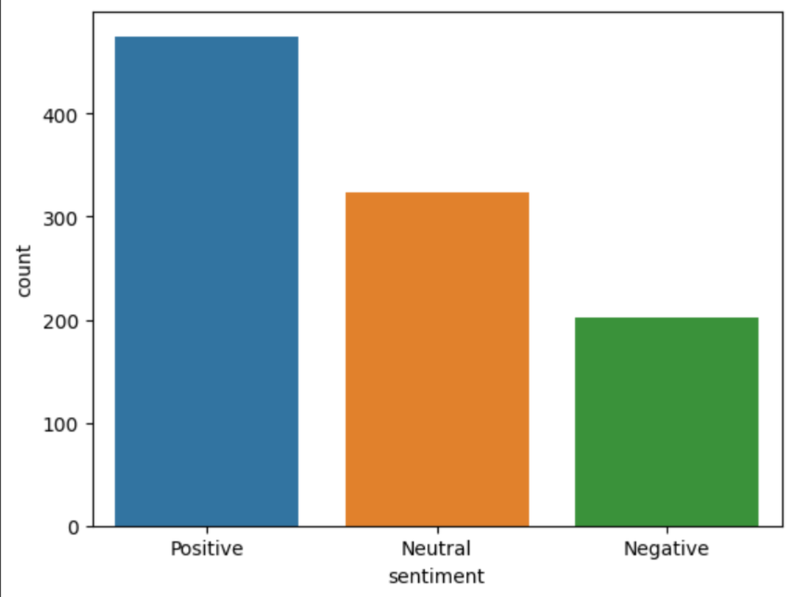
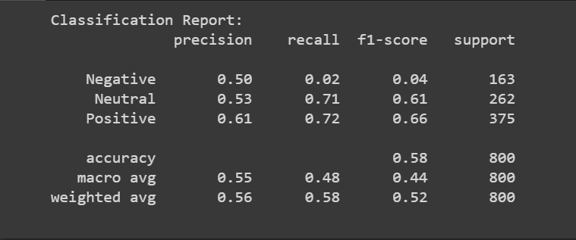
Experimental results and analysis
Results obtained using the bag of words model
Numbers obtained of tweets of each type of sentiment

Slide 6
Evaluation
Precision
Precision measures the accuracy of the positive predictions made by the model. In this case, the precision for the positive class is 0.61, indicating that out of all the tweets predicted as positive, 61% of them are correctly classified.
Recall
Recall calculates the proportion of actual positive instances correctly identified by the model. The recall for the positive class is 0.72, which suggests that the model correctly identifies 72% of the actual positive tweets.
F1-score
The F1-score is the harmonic mean of precision and recall, providing a balanced measure that considers both precision and recall. The F1-score for the positive class is 0.66, indicating a reasonable balance between precision and recall.

Slide 7
EVALUATION
Support
The support refers to the number of instances in each class in the test data. In this case, there are 375 instances of positive tweets
accuracy
Accuracy represents the overall correctness of the model's predictions. The accuracy of 0.58 suggests that the model correctly predicts the sentiment for 58% of the tweets in the test data.

Slide 8
cONCLUSION
Our study highlights the effectiveness of utilizing labeled datasets, preprocessing techniques, feature extraction methods, model optimization, and evaluation metrics in developing a robust sentiment analysis system. The insights generated from our system can aid in understanding and analyzing sentiment across various domains and applications.

