Slide 1
ECOTRIPS
Business Performance Analysis &
Strategic Recommendations
Business Intelligence Case Study
Data Modeling · KPI Framework · Sustainability Analytics · Power BI

Slide 2
EXECUTIVE SUMMARY
Key Insights at a Glance
1
2
3
4
+7.83%
23.29%
52% / 48%
67.5%
REVENUE GROWTH
LOYALTY RATE
ACCOMMODATION VS. ACTIVITY
SUSTAINABILITY INDEX
Total revenue reached $663.95K, but growth is highly volatile month-to-month — from +43.7% to -66.5% — signaling a seasonality problem, not a demand problem.
Recurring guests generate less average revenue ($824) than one-time guests ($861). The loyalty program isn't yet converting into higher lifetime value.
Reservations are nearly balanced across offer types, but Accommodation earns $880 per booking versus $795 for Activities — a clear margin gap.
Just short of the 70% target. Organic-agriculture experiences rate highest (3.2/5), pointing to a practice worth scaling platform-wide.
ECOTRIPS
2

Slide 3
PERFORMANCE SNAPSHOT
Six Metrics Anchor the Business Case
$663.95K
791
$839.38
TOTAL REVENUE
TOTAL RESERVATIONS
AVG. REVENUE / RESERVATION
FY period
Activity + Accommodation
Blended
23.29%
+7.83%
67.48%
CUSTOMER LOYALTY RATE
MONTHLY REVENUE GROWTH
SUSTAINABILITY INDEX
Recurring guests
Latest reported month
vs. 70% target
ECOTRIPS
3

Slide 4
BUSINESS CONTEXT
EcoTrips Is Well Positioned to Grow
Through Data-Driven Decisions
COMPANY OVERVIEW
ANALYTICAL GOALS
EcoTrips is a sustainable-tourism platform connecting travelers with eco-certified accommodations and conservation-linked activities. The platform tracks reservations, revenue, guest loyalty, and the environmental impact of every offer.
1
Unify the data
Model Accommodation and Activity reservations into a single supertype/subtype schema.
2
Define the KPIs
Establish revenue, loyalty, and sustainability metrics leadership can track monthly.
BUSINESS OBJECTIVE
Turn two years of reservation data into a decision-ready view of where revenue, loyalty, and sustainability performance are heading.
3
Surface the story
Translate dashboards into an executive narrative — not just charts.
ECOTRIPS
4

Slide 5
METHODOLOGY
Our Analysis Focused on Revenue,
Customer Behavior, and Sustainability
Data Model
KPI Framework
Methodology
A supertype/subtype schema unifies Accommodation and Activity reservations under one fact table, with shared guest, offer, and date dimensions.
Revenue, average revenue per reservation, loyalty rate, and a sustainability index were defined once and reused across every dashboard page.
SQL modeling of raw reservations → star-schema semantic layer → Power BI dashboards built for two audiences: Strategic Planning and Customer Experience.
DASHBOARD PAGES → Strategic Planning (executive KPIs) & Sustainability Impact (customer experience + environmental practices)
ECOTRIPS
5

Slide 6
BUSINESS PERFORMANCE OVERVIEW
Revenue Growth Indicates Strong
Market Adoption — But Not Yet Stable
$663.95K
TOTAL REVENUE
+7.83%
LATEST MONTHLY GROWTH
-66.5% to +43.7%
GROWTH SWING RANGE
Revenue climbed from $43K to a $62K peak twice in the period, but single-month swings as wide as 110 points point to seasonal demand rather than steady, compounding growth.
ECOTRIPS
6

Slide 7
CUSTOMER BEHAVIOR ANALYSIS
Customer Retention Represents the
Largest Growth Opportunity
23.29%
OVERALL LOYALTY RATE
Recurring guests spend $824 on average — less than the $861 one-time guests spend. Retention is happening, but it isn't yet translating into higher lifetime value.
ECOTRIPS
7

Slide 8
PRODUCTS & SERVICES PERFORMANCE
High-Performing Experiences
Drive Most Business Results
Offer Type | Reservations | Avg. Revenue / Res. | Total Revenue
Accommodation | 411 | $880.19 | $361.8K
Activity | 380 | $795.24 | $302.2K
Total | 791 | $839.38 | $663.95K
WHAT THIS MEANS
Accommodation and Activities are almost evenly split in bookings, so demand is not the constraint. The gap sits entirely in monetization — pricing, upsells, and packaging of Activities have room to close nearly $85 per reservation against Accommodation's benchmark.
MARGIN GAP
+$84.95
Accommodation earns $84.95 more per reservation than Activities — nearly identical volume, unequal margin.
ECOTRIPS
8

Slide 9
SUSTAINABILITY PERFORMANCE
Sustainability Has Become
a Competitive Advantage
67.48%
SUSTAINABILITY INDEX
Target: 70% | Gap: 2.5 pts
Organic agriculture leads every sustainable practice at 3.2/5, while monthly review scores hover in a tight 2.65–3.14 band — consistent quality, with room to close the 2.5-point gap to the 70% target.
ECOTRIPS
9

Slide 10
STRATEGIC RECOMMENDATIONS
Data Suggests Four Strategic Actions
to Accelerate Growth
Finding | Recommendation | Expected Impact
Recurring guests spend less ($824) than one-time guests ($861). | Launch a tiered loyalty program with rewards that scale with repeat spend. | Higher revenue per recurring guest
Monthly revenue swings from -66.5% to +43.7%. | Introduce off-season packages and dynamic pricing to smooth demand. | More predictable monthly revenue
Activities earn $84.95 less per reservation than Accommodation. | Redesign Activity pricing and bundling to close the monetization gap. | Narrower cross-category margin gap
Sustainability index sits at 67.5%, 2.5 pts below the 70% target. | Scale organic-agriculture practices — the top-rated experience — platform-wide. | Sustainability index above target
ECOTRIPS
10

Slide 11
IMPLEMENTATION ROADMAP
A Phased Implementation Plan
Will Maximize Business Impact
0–3 Months
3–6 Months
6–12 Months
Design tiered loyalty rewards
Launch loyalty program & track spend uplift
Expand loyalty tiers based on results
Audit Activity pricing & bundles
Pilot dynamic pricing for off-season months
Roll out demand-smoothing pricing platform-wide
Publish sustainability practice benchmarks
Scale organic-agriculture experiences to new regions
Reassess sustainability index against 70%+ target
ECOTRIPS
11

Slide 12
FINAL TAKEAWAYS
Turning Data into Sustainable Growth
1
Data-driven decision making
A unified reservation model and a shared KPI framework now let EcoTrips track revenue, loyalty, and sustainability from one source of truth.
2
Improve customer retention
Recurring guests are loyal but underspend — closing that gap is the single largest revenue lever identified in this analysis.
3
Promote top-performing experiences
Organic-agriculture activities and Accommodation offers set the benchmark; scaling what already works is the fastest path to the sustainability target.
EcoTrips · Business Intelligence Case Study

Slide 13
APPENDIX
Live Dashboard Views
Power BI — Strategic Planning & Sustainability Impact pages, built and formatted end-to-end in the EcoTrips brand theme.

Slide 14
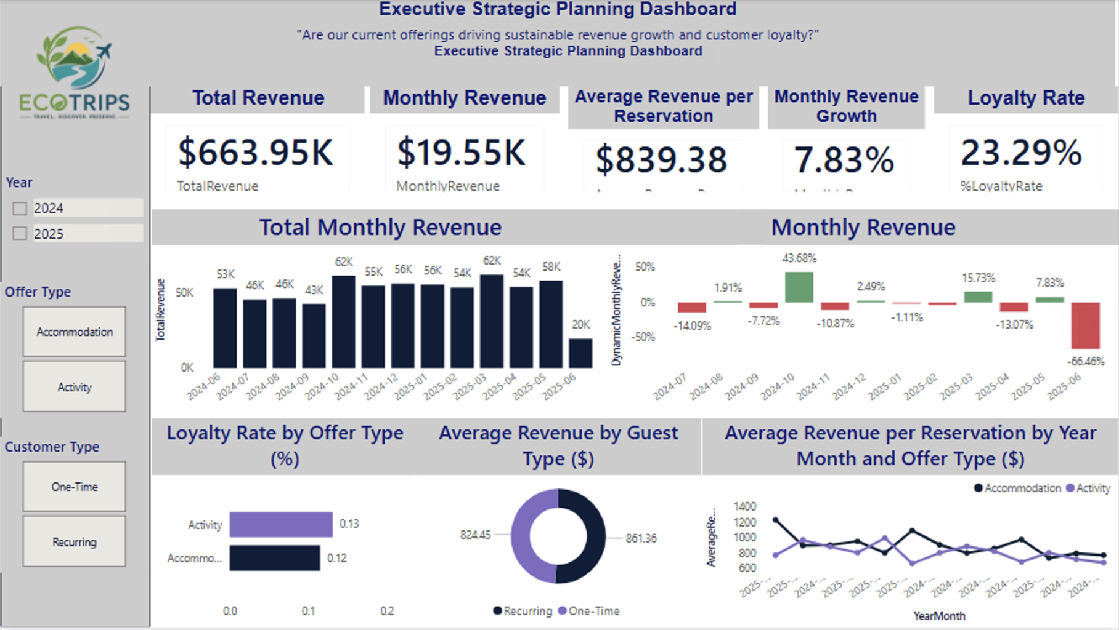
APPENDIX · DASHBOARD
Executive Strategic Planning Dashboard
Revenue, growth, and loyalty KPIs for leadership review.
ECOTRIPS
14

Slide 15
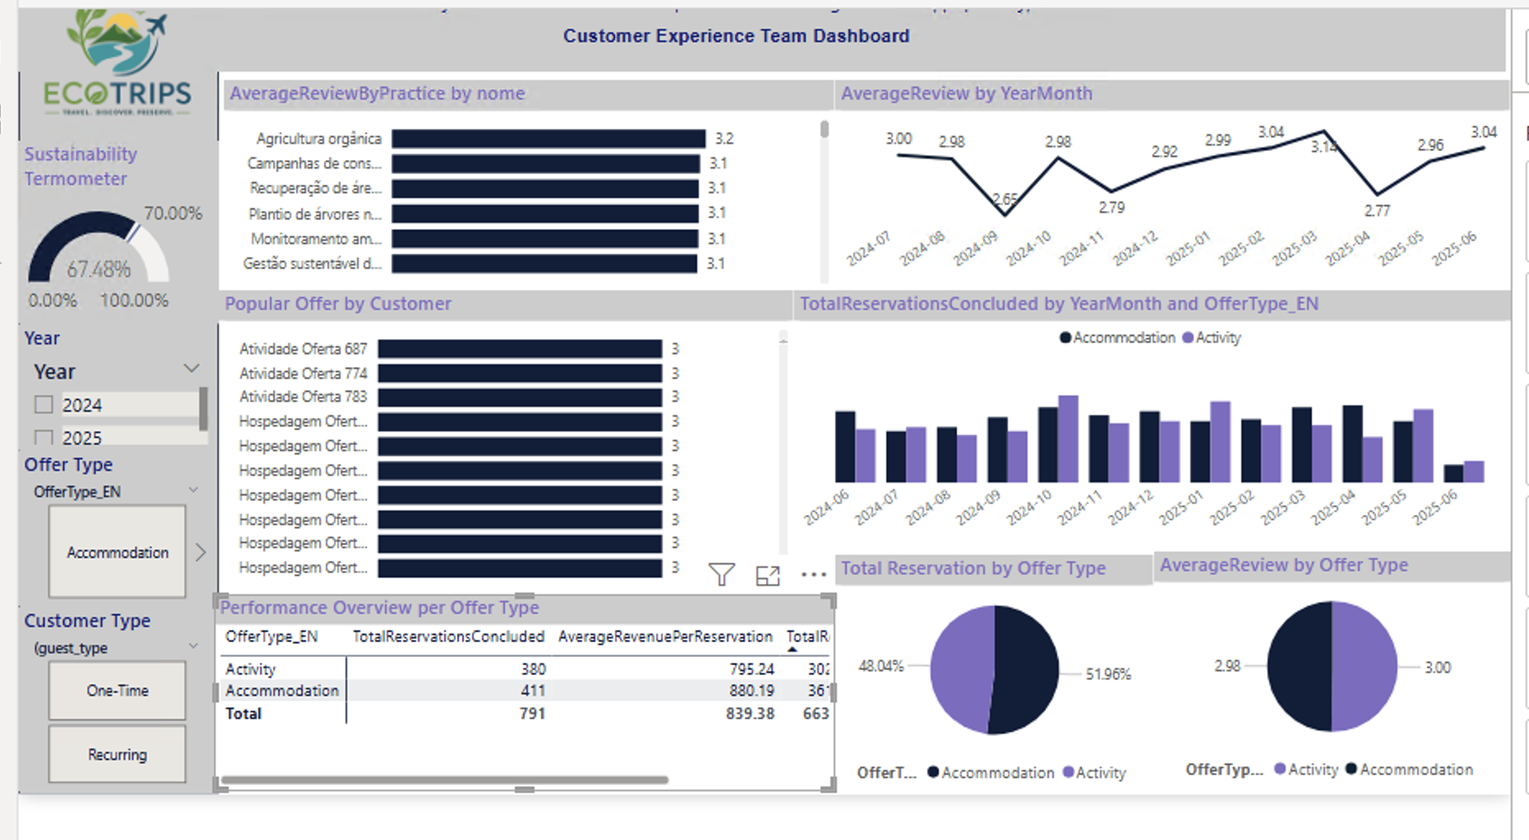
APPENDIX · DASHBOARD
Customer Experience Team Dashboard
Sustainability index, review trends, and offer-level performance.
ECOTRIPS
15

