Slide 1
Multi-Threaded File-Server
CSCI315 Operating System
Dr. Ahmed El Nokrashy
Lecture - 03
Salma Hesham Salem 211000069
Omar El Sayed 211000093
Ziad Maher 211001772
Khadija Nasser El Tarabeshy 211000738
Malak Mohamed El Samman 211001045

Slide 2
CONTENTS
Introduction
Program Features
Flowchart
Code
Output

Slide 3
INTRODUCTION
Efficient file management is essential in the digital world. File servers allow network users to access, share, and manage files. Traditional servers struggle with high demand, but multi-threaded servers handle concurrent access better. This project aims to develop a Java-based multi-threaded file server to manage simultaneous read and write operations while ensuring data integrity.

Slide 4
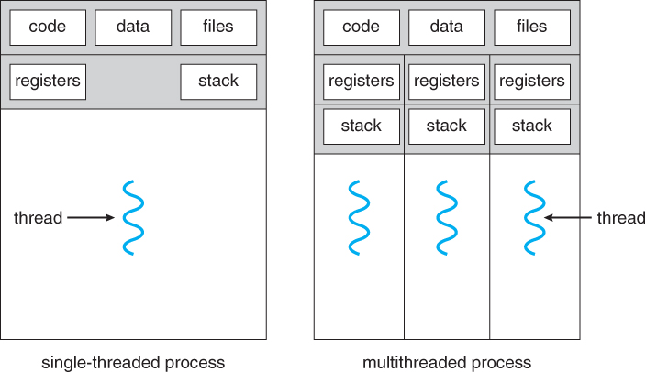

Slide 5
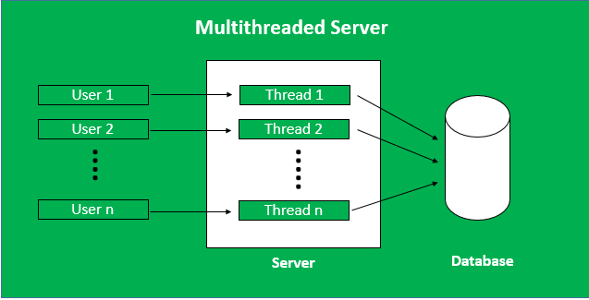

Slide 6





Program FEATURES
Read
Write
Access
Sync
GUI

Slide 7
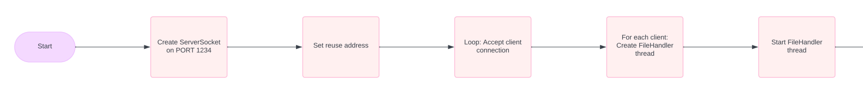
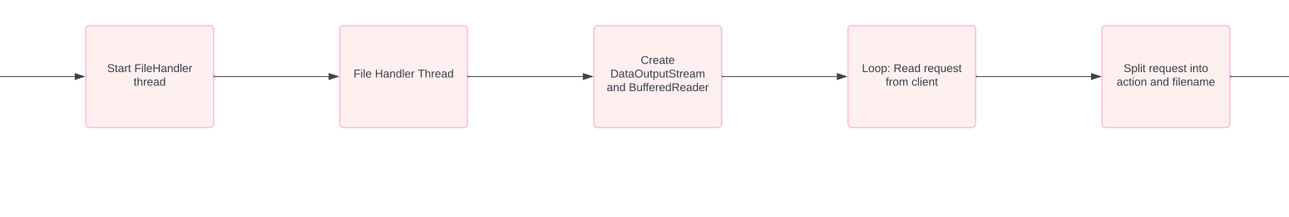
FLowCHARt
server

Slide 8
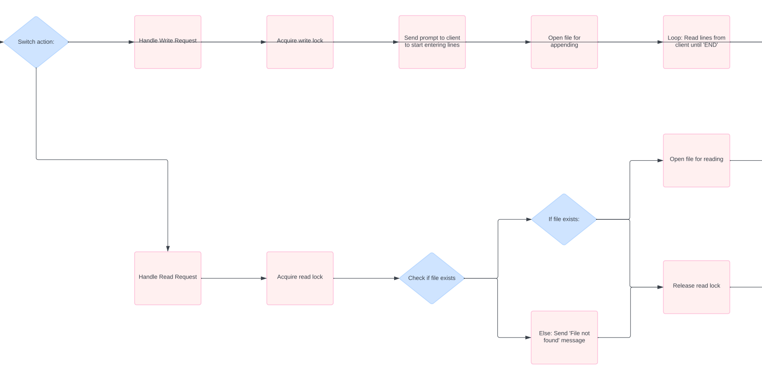

Slide 9
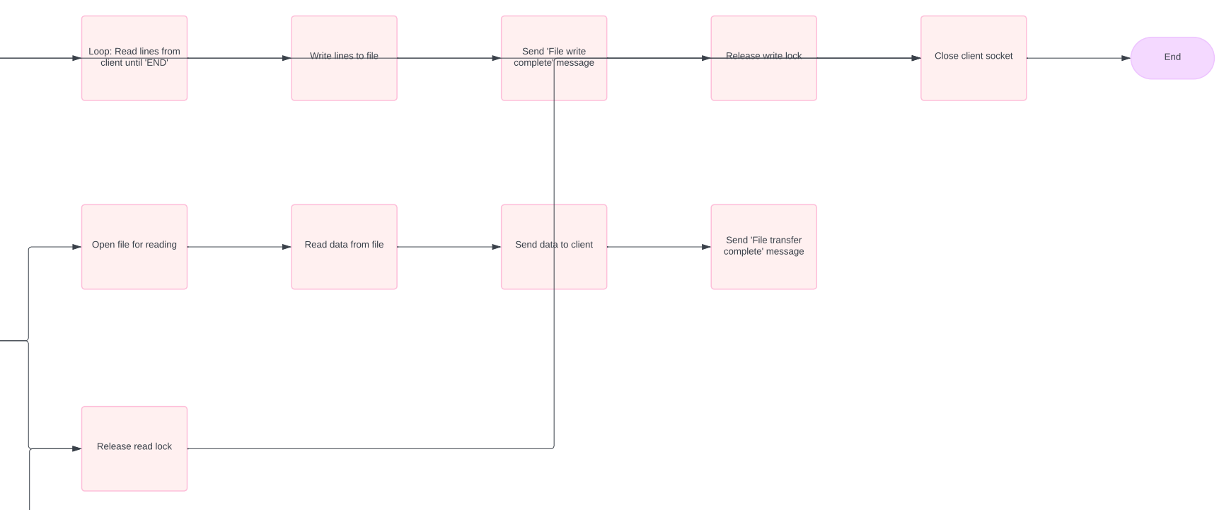

Slide 10
flowchart
client

Slide 11
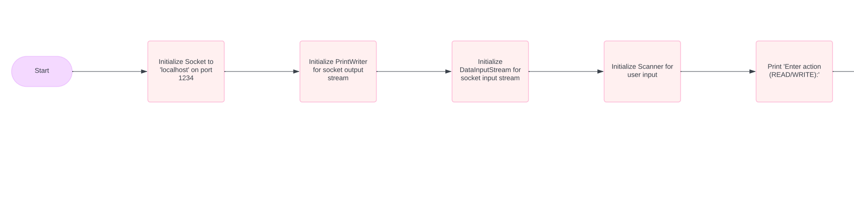
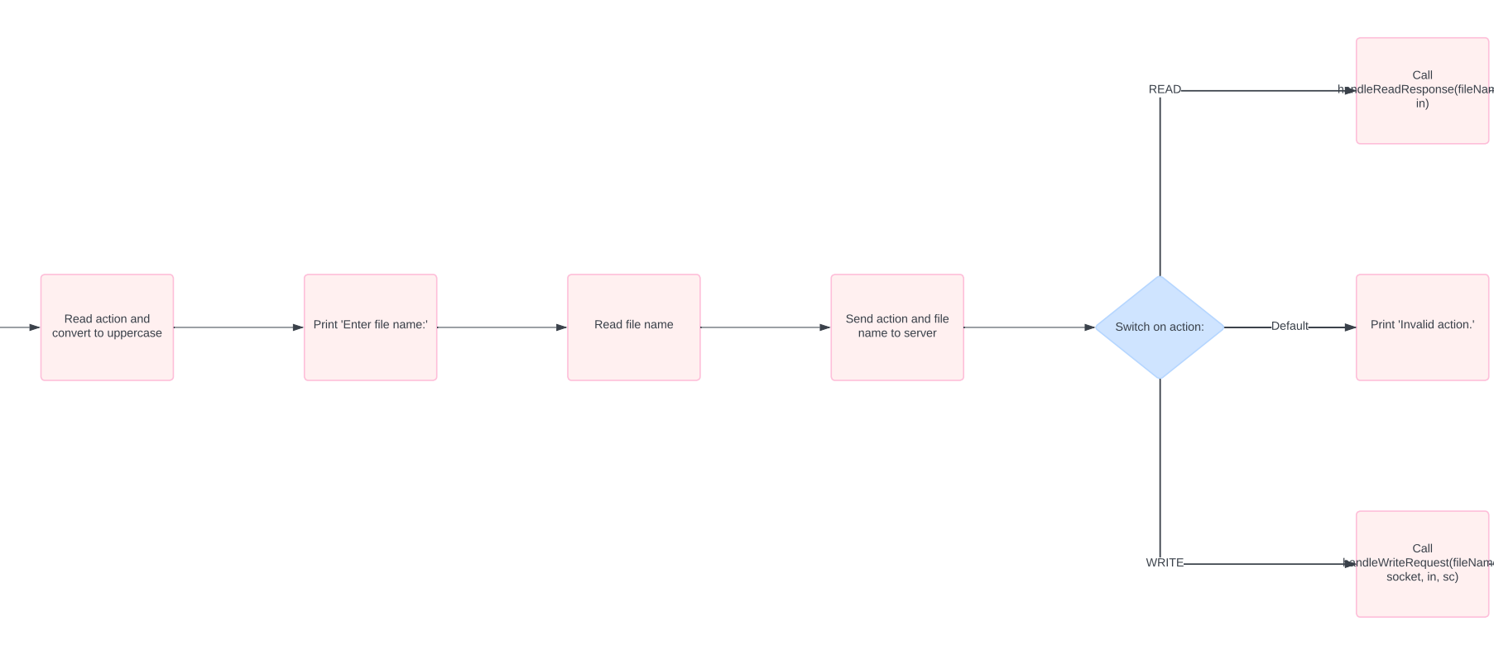

Slide 12
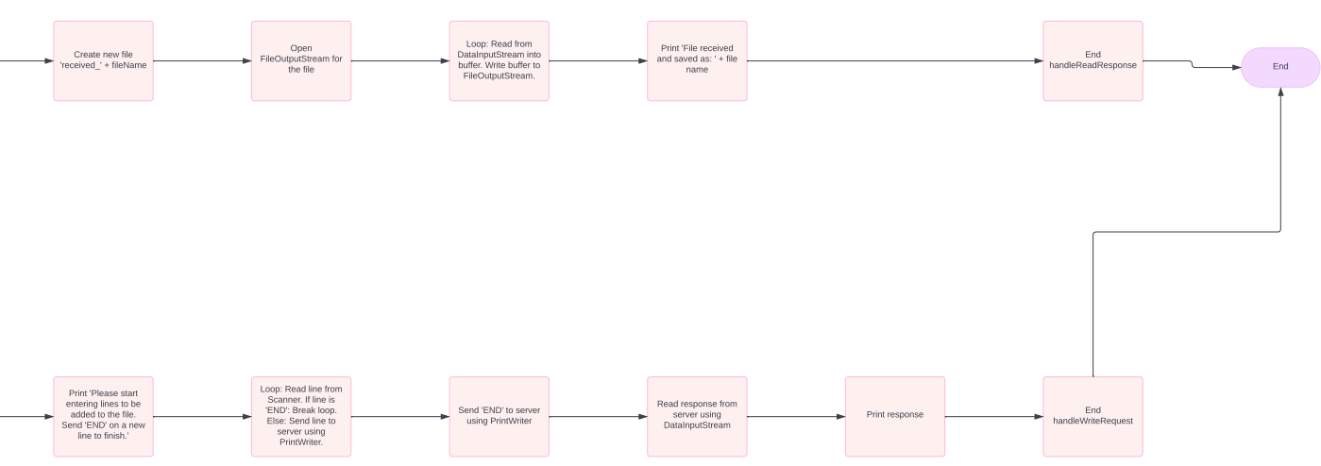

Slide 14
CODE Review
Server

Slide 15
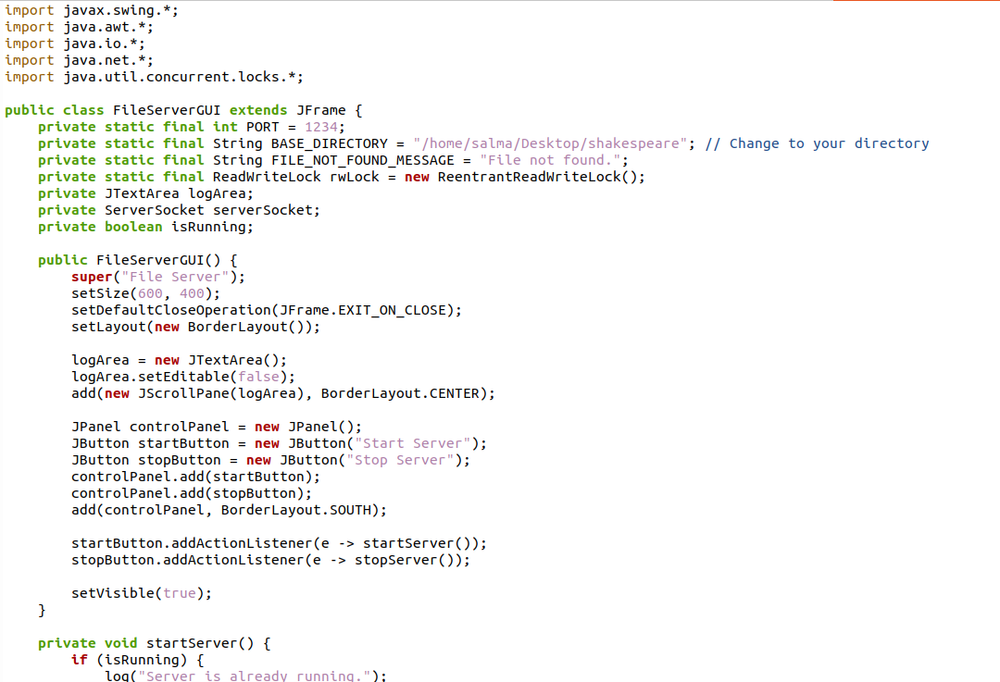

Slide 16
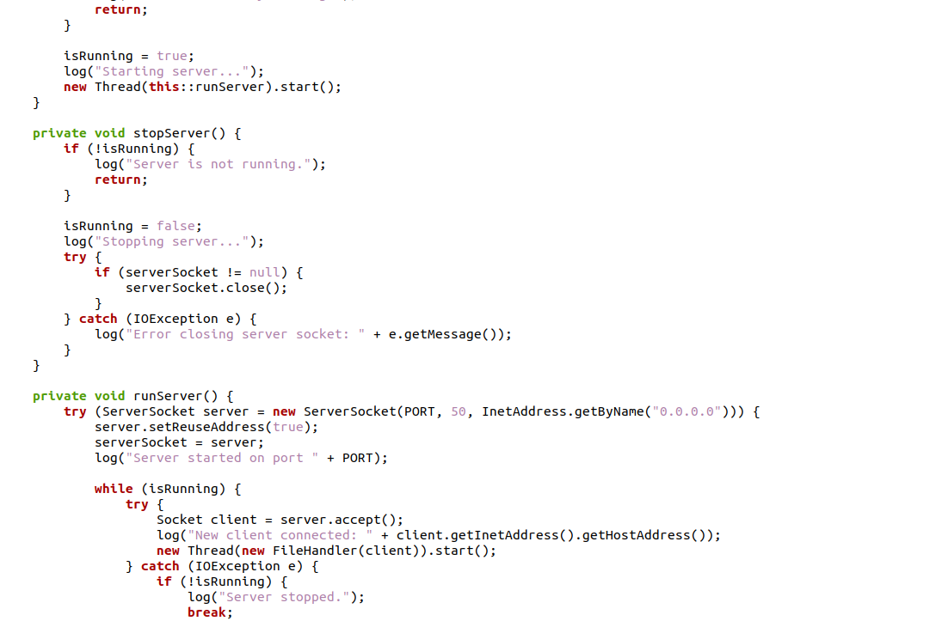

Slide 17
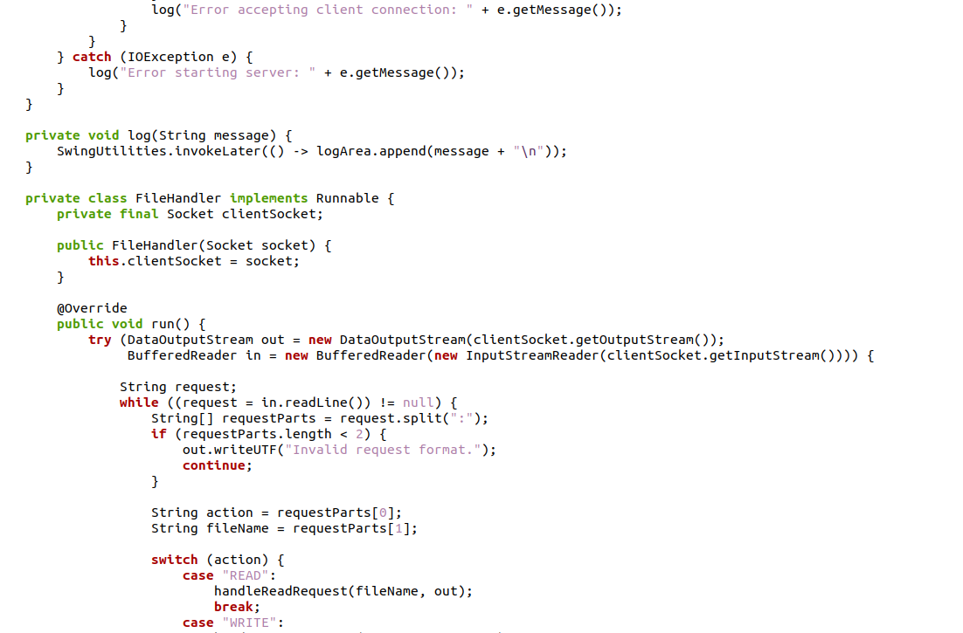

Slide 18
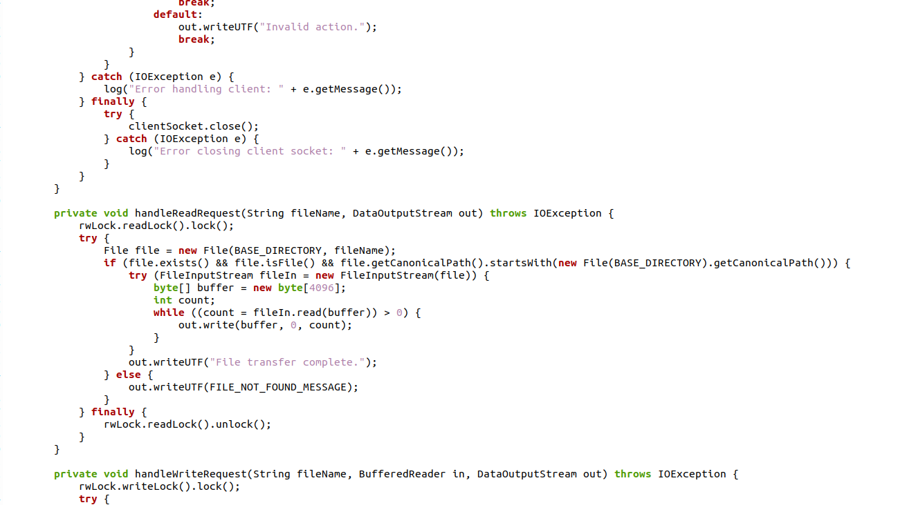

Slide 19
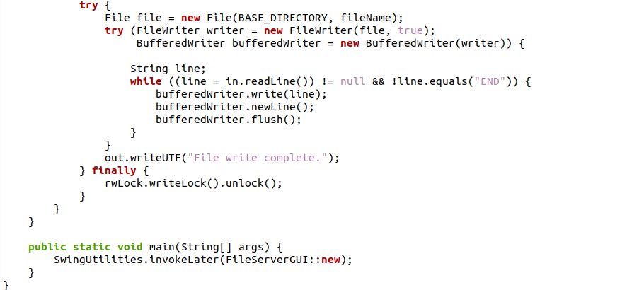

Slide 20
CODE Review
Client

Slide 21
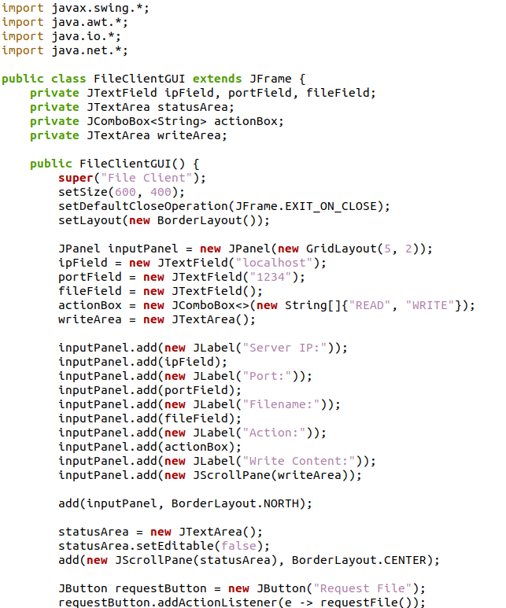
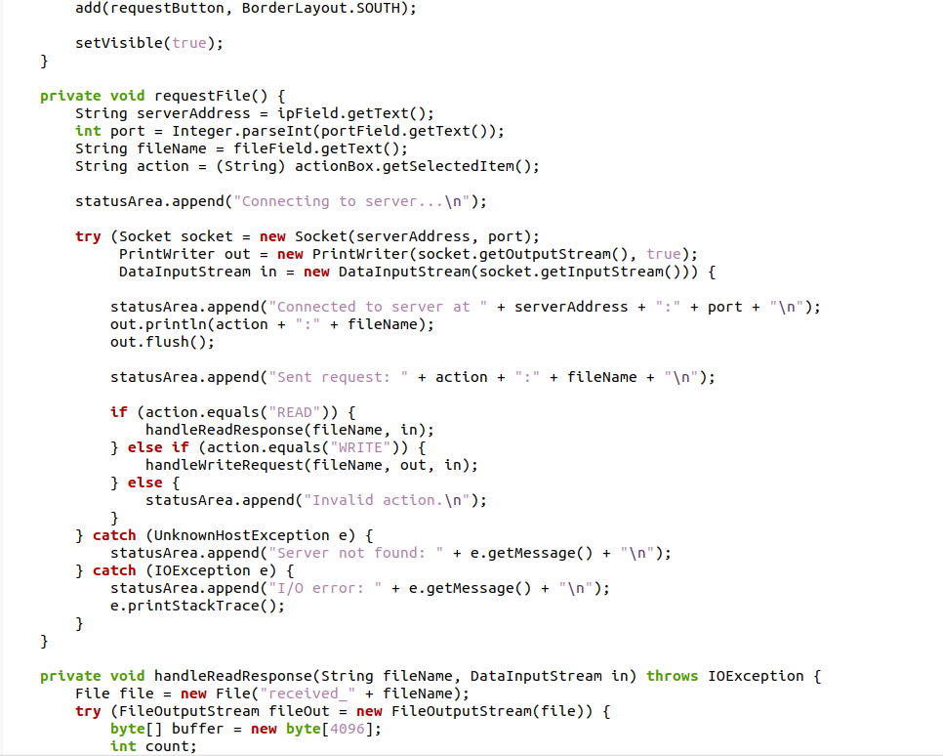

Slide 22
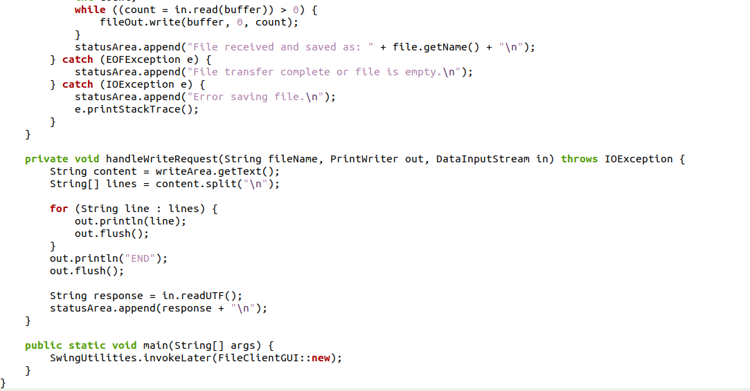

Slide 23
Program output

Slide 24
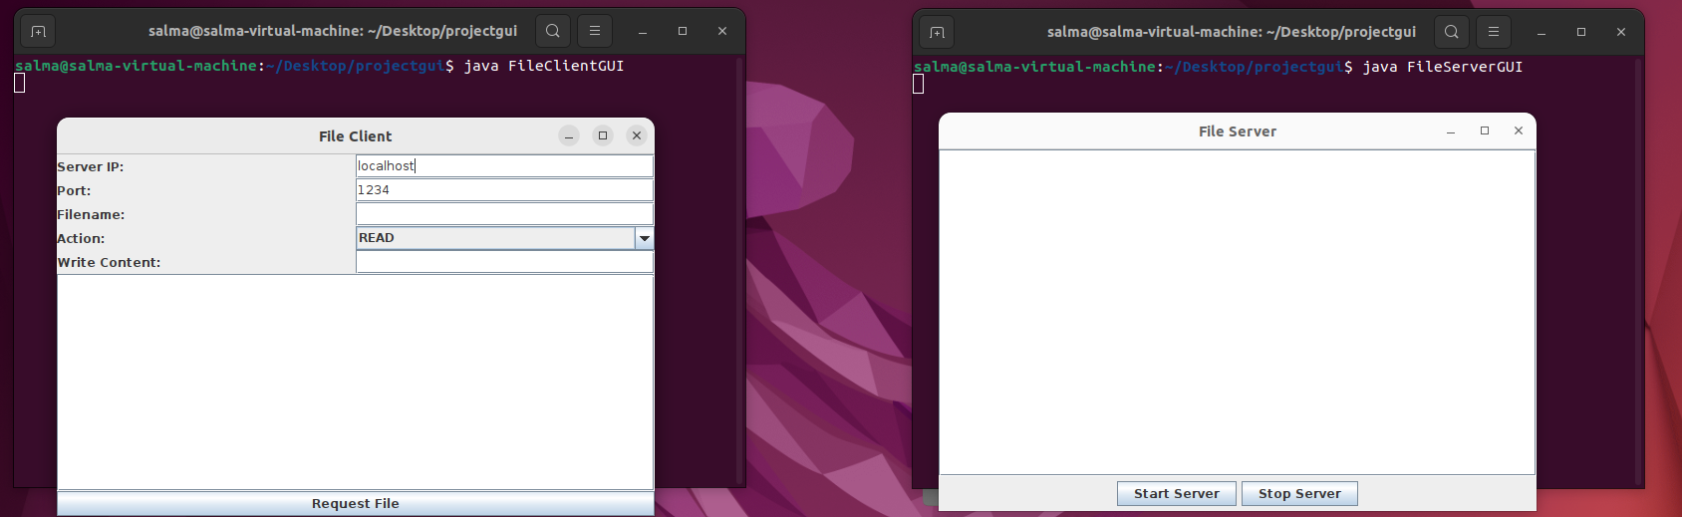

Slide 25
THANK YOU ☺

