Slide 1
Multi-Threaded File-Server
CSCI315 Operating System
Dr. Ahmed El Nokrashy
Lecture - 03
Salma Hesham Salem 211000069
Omar El Sayed 211000093
Ziad Maher 211001772
Khadija Nasser El Tarabeshy 211000738
Malak Mohamed El Samman 211001045

Slide 2
CONTENTS
Introduction
Program Features
Flowchart
Code
Output

Slide 3
INTRODUCTION
Efficient file management is essential in the digital world. File servers allow network users to access, share, and manage files. Traditional servers struggle with high demand, but multi-threaded servers handle concurrent access better. This project aims to develop a Java-based multi-threaded file server to manage simultaneous read and write operations while ensuring data integrity.

Slide 4
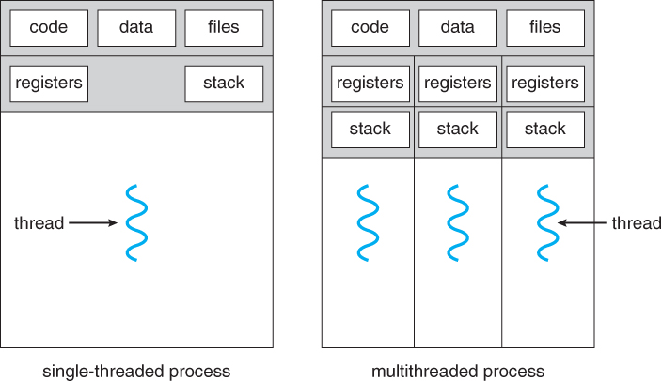

Slide 5
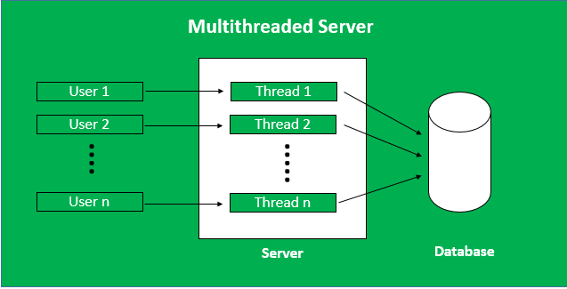

Slide 6





Program FEATURES
Read
Write
Access
Sync
GUI

Slide 7
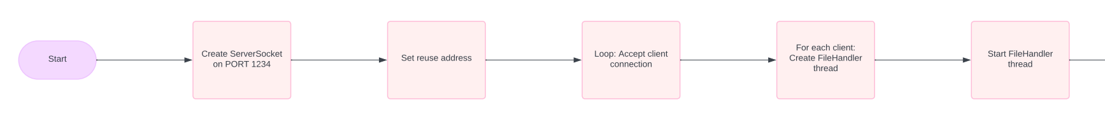
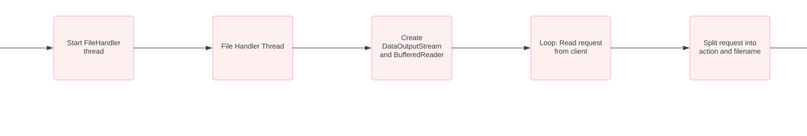
FLowCHARt

Slide 8
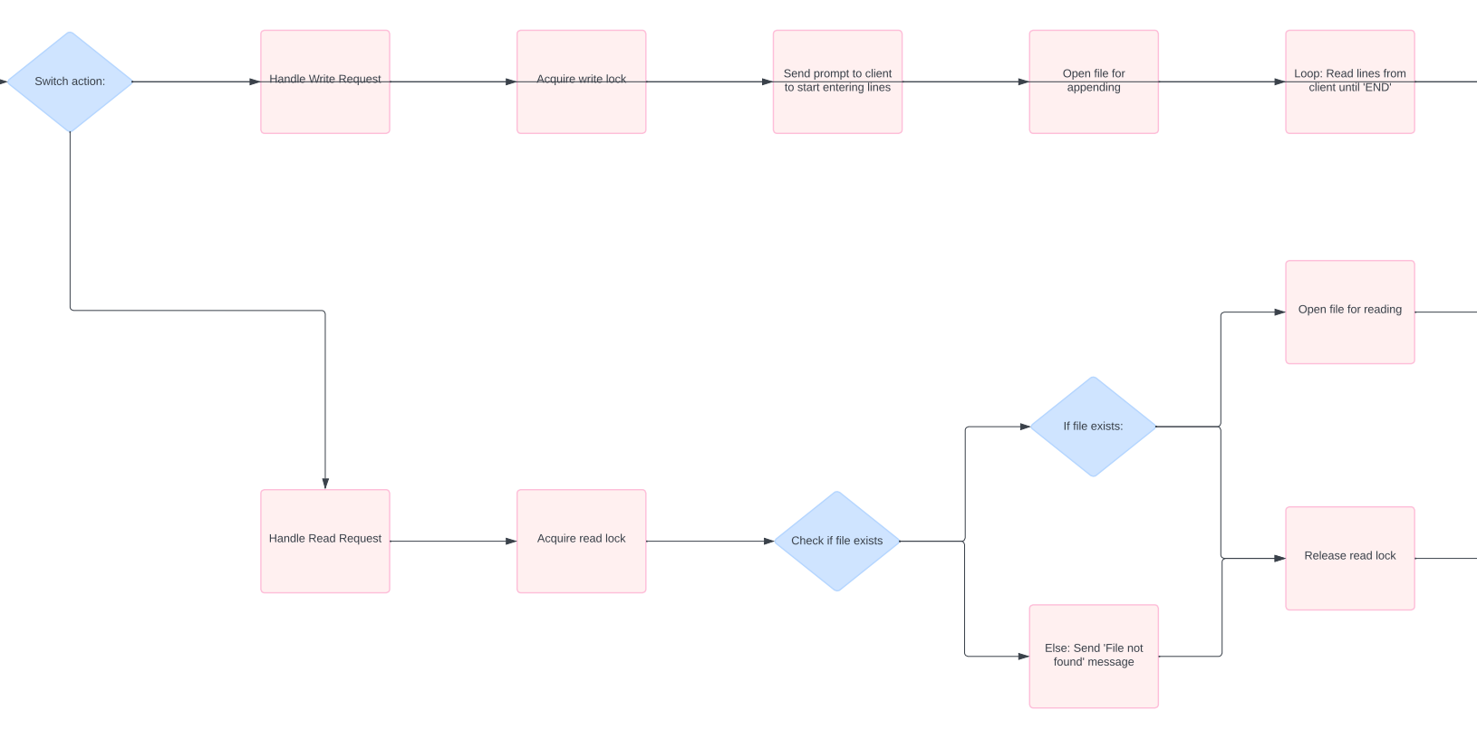

Slide 9
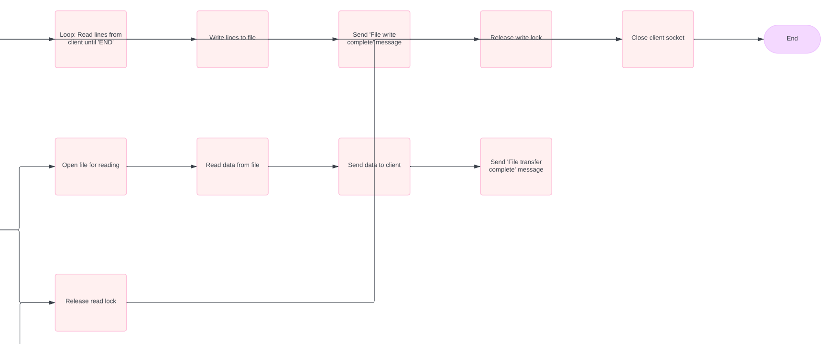

Slide 10
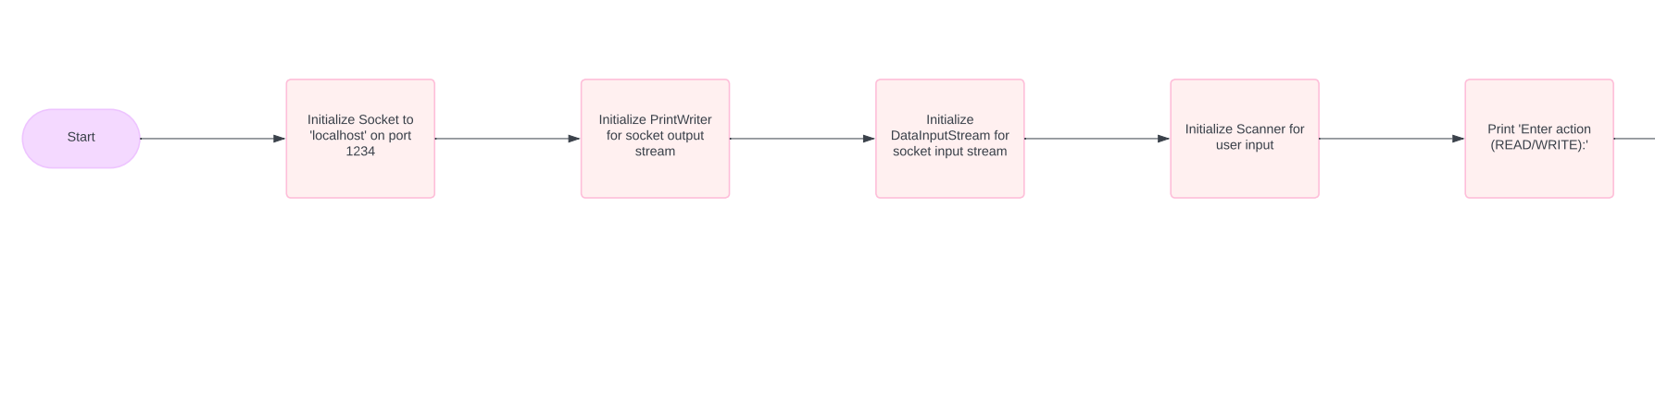
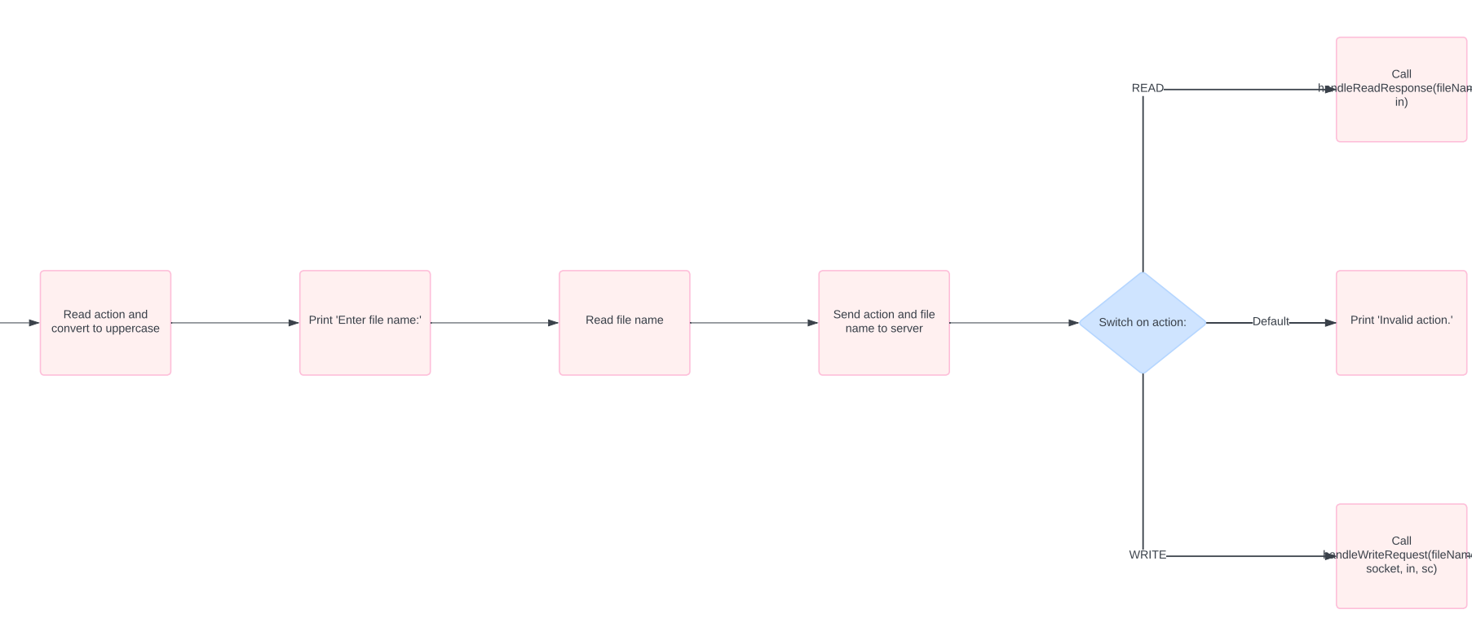

Slide 11
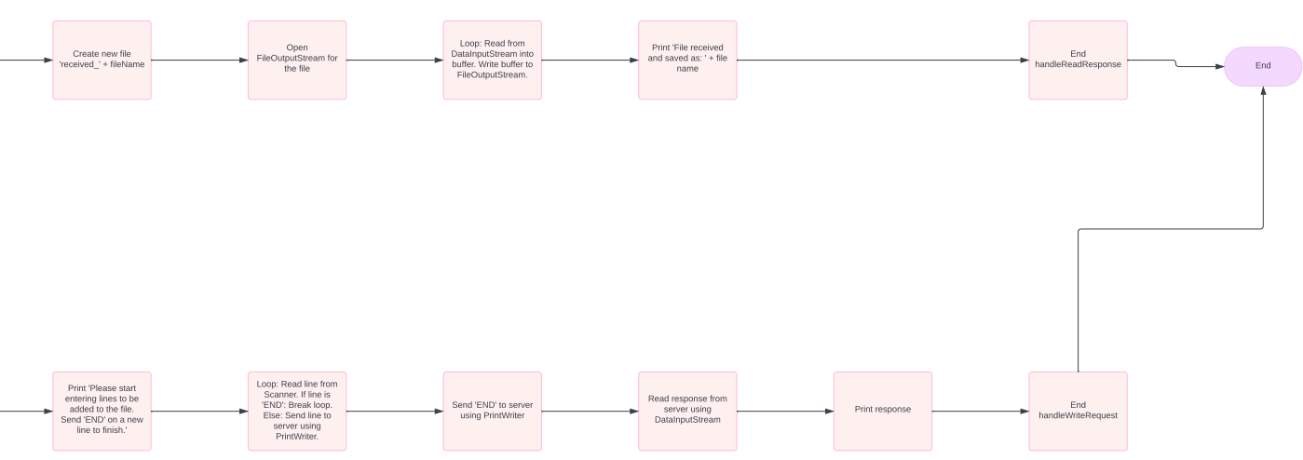

Slide 13
CODE Review
Server

Slide 14
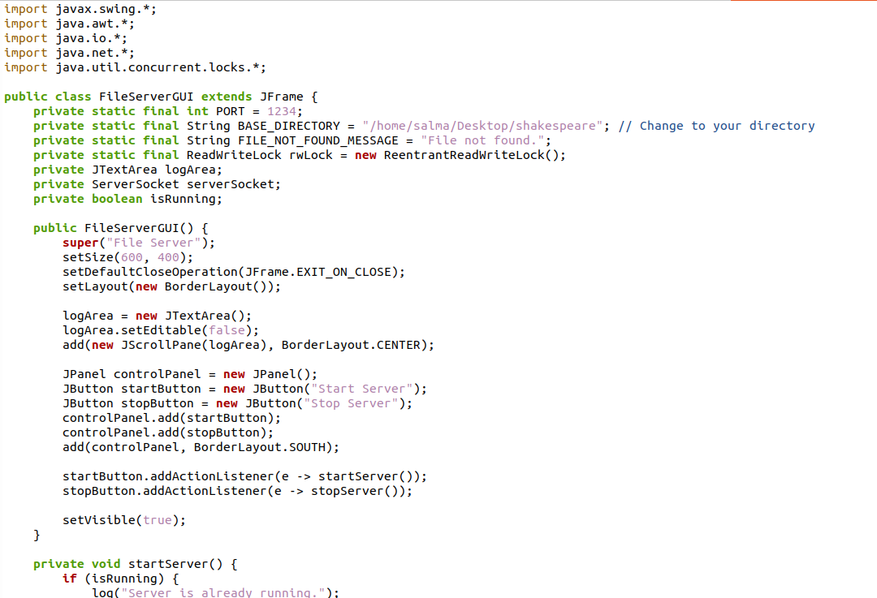

Slide 15
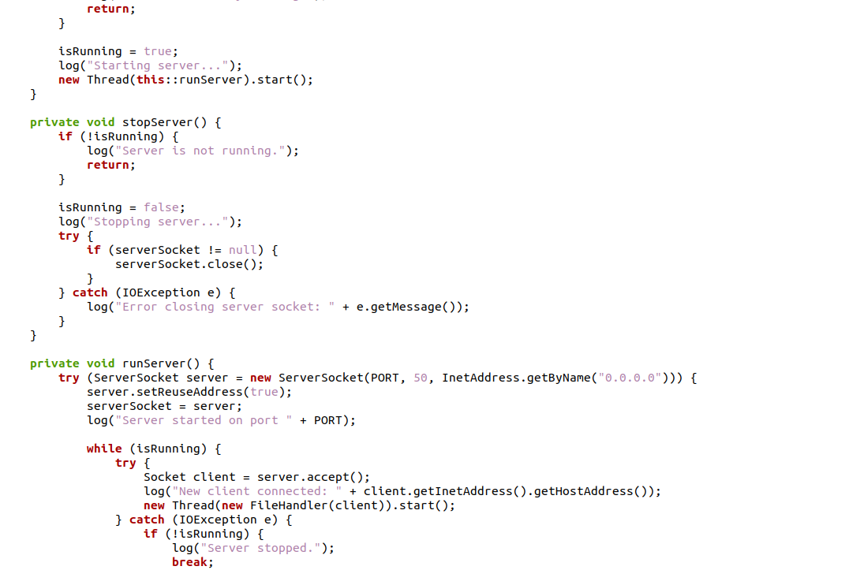

Slide 16
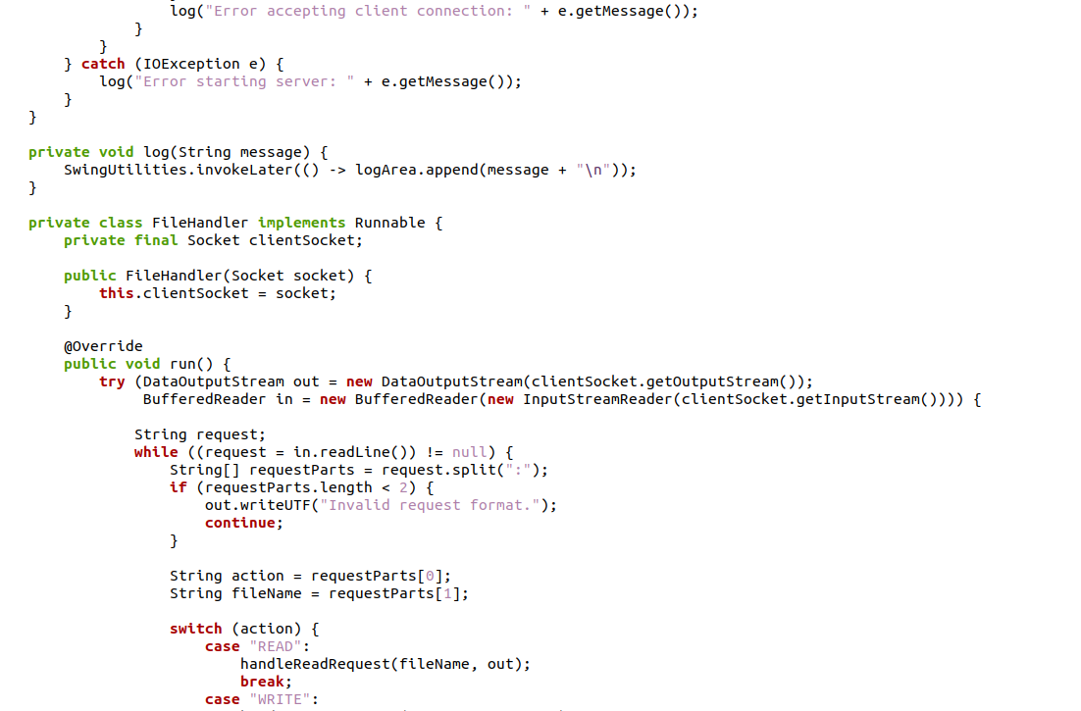

Slide 17
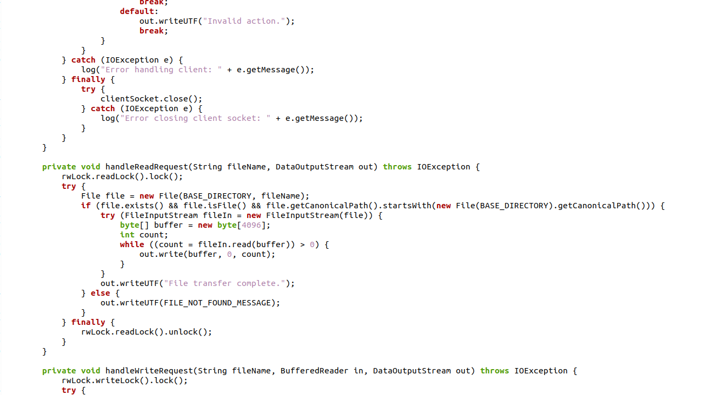

Slide 18
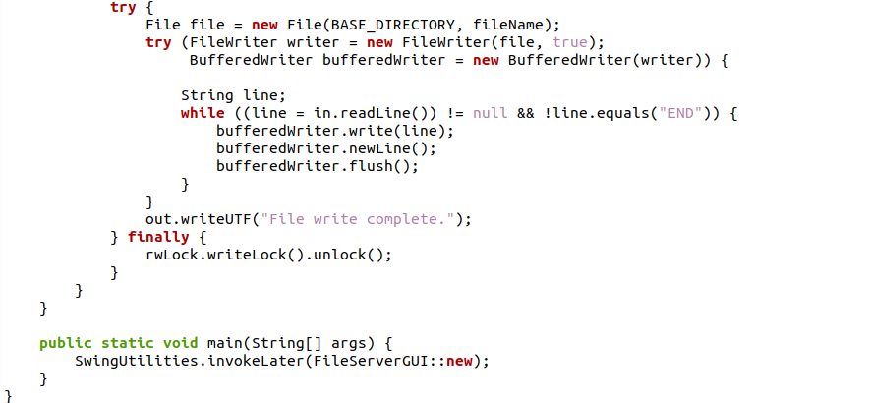

Slide 19
CODE Review
Client

Slide 20
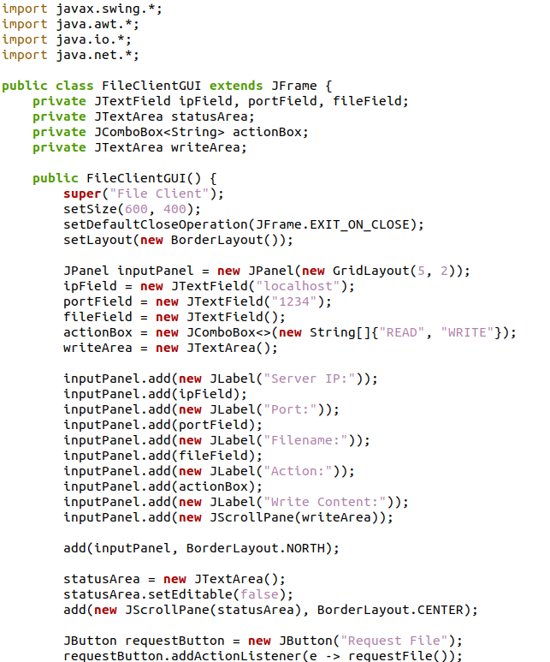
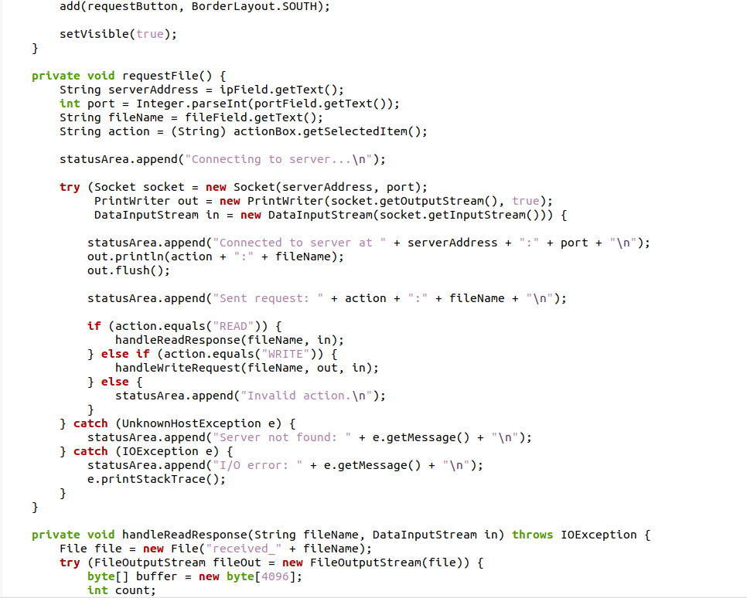

Slide 21
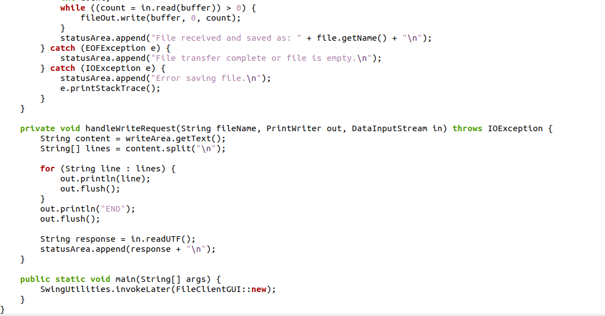

Slide 22
Program output

Slide 23
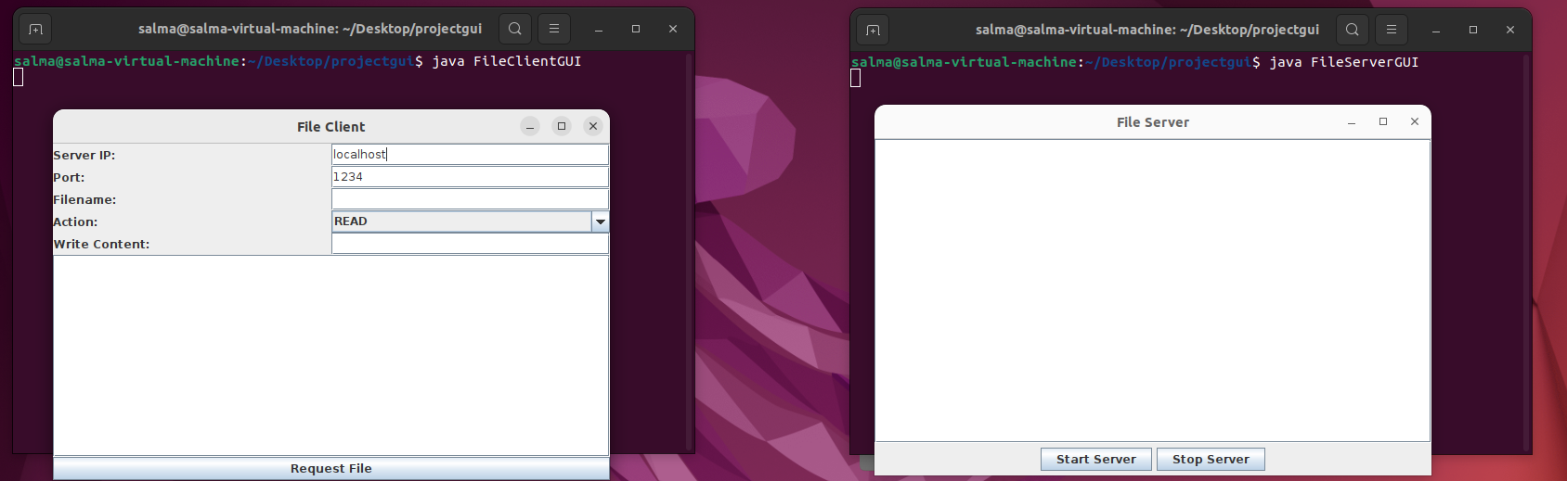

Slide 24
Life is really simple, but we insist on making it complicated.

Slide 25
THANK YOU ☺

