Slide 1

Identifying the Subjectivity of Articles in Sports Media: A Classification Problem Salma Khalfallah

Slide 2
Road Map
Introduction
Data Introduction/Exploration
K-Nearest Neighbors
Decision Trees
Random Forests
Naïve Bayes
Conclusion

Slide 3
Introduction

Slide 4
Introduction
Analysis Goal: Test/Analyze the success of various machine learning models in classifying various sports articles as objective or subjective based on its attributes
Dataset: “Sports articles for objectivity analysis”
1000 rows, 62 columns

Slide 5
Data Clean-up and Exploration
Split testing and training data on random state 45 for consistency
Removed unnecessary attributes (text ID, URL)
A dataset imbalance exists (there are more objective than subjective articles in the dataset)
Influences our results, recall metric is significant in evaluation to pinpoint whether model can pinpoint true subjective articles despite fewer instances to train on

Slide 6
K-Nearest Neighbors

Slide 7
K-Nearest Neighbors
Non-parametric supervised machine learning algorithm classifying new points based on its approximate distance to other points
Value of k, number of other points to compare to, is key in analysis
Very simple model to work with, no initial model learning is required
Slow classification
Problems related to Euclidean distance:
Misleading features
Attribute magnitude (normalization)

Slide 8
Model Fitting and Normalization
Initial fitting metrics:
Train accuracy: 0.86
Test accuracy: 0.82
Precision score: 0.78
Recall score: 0.72
F1: 0.75
Normalized fitting metrics:
Train accuracy: 0.85
Test accuracy: 0.0.83
Precision score: 0.85
Recall score: 0.667
F1: 0.747

Slide 9
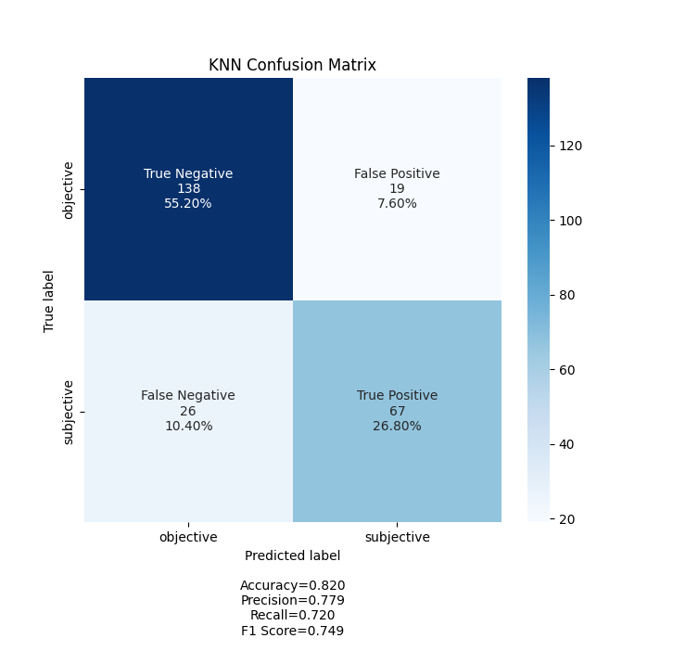
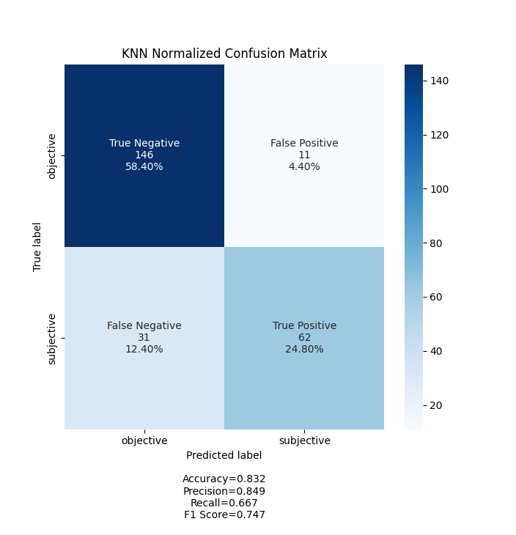
K-Nearest Neighbors Confusion Matrices

Slide 10
Decision Trees/Random Forests

Slide 11
Decision Trees Random Forests
Tree structure based on basic probability information gain
Hyper-parameter tuning: maximum depth of tree (potential overfitting)
High variance due to unstable model nature
Random forests introduced to stabilize decision trees
Decreases variance by averaging out a specific number of decision trees
Hyper-parameter tuning: number of decision tree estimators

Slide 12
Model Fitting
Decision tree fitting metrics:
Train accuracy: 0.0.85
Test accuracy: 0.78
Precision score: 0.760
Recall score: 0.613
F1: 0.679
Random forest fitting metrics:
Train accuracy: 1
Test accuracy: 0.86
Precision score: 0.86
Recall score: 0.742
F1: 0.798

Slide 13
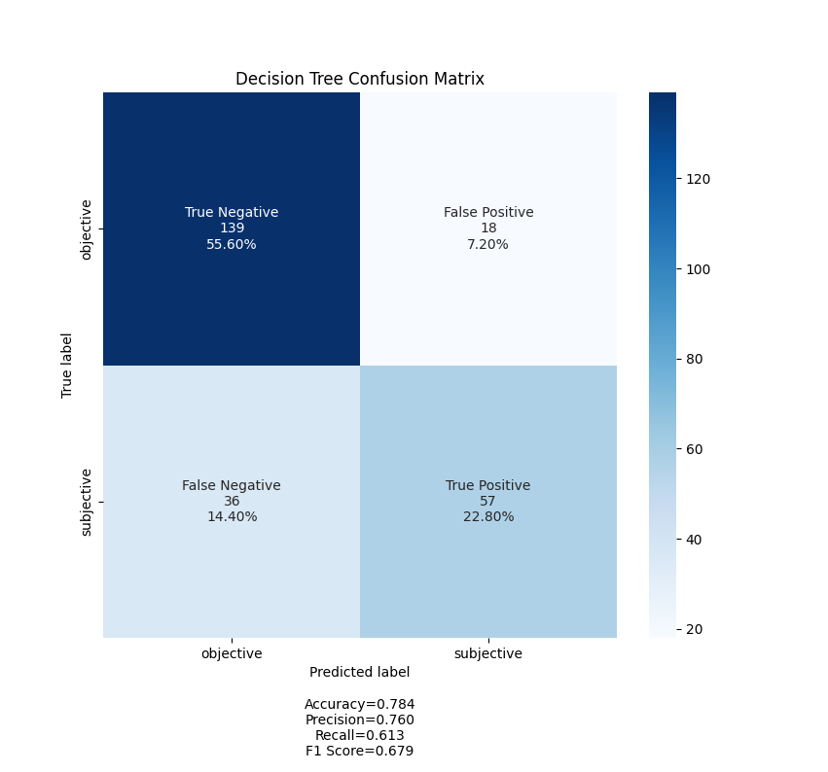
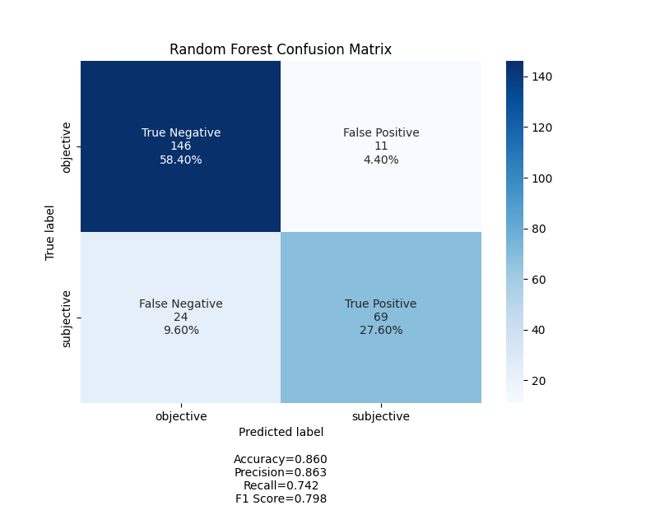
Decision Tree/Random Forest Confusion Matrices

Slide 14
Naïve Bayes

Slide 15
Naïve Bayes
Probabilistic classification algorithm based on Bayesian probability methods
Makes conditional independence assumption for attributes given class
Classifies points based on “naïve” probability computations
Simple, fast yet effective model
Works efficiently even when conditional independence assumption fails
Must introduce smoothing techniques when introduced to new variables in testing

Slide 16
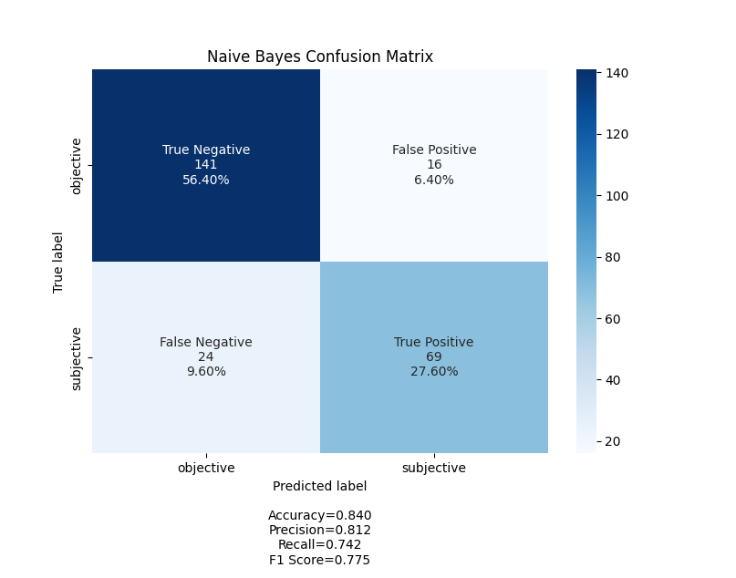
Naïve Bayes Confusion Matrix and Model Fit
Naïve Bayes metrics:
Train accuracy: 0.83
Test accuracy: 0.84
Precision score: 0.812
Recall score: 0.742
F1: 0.775

Slide 17
Conclusion

Slide 18
Conclusion
Most effective models: Random Forest, Naïve Bayes
What worked: hyper-parameter tuning, working with language-based attributes
What didn’t work: Tackling imbalanced model
Future work:
Tackling the same problem with a balanced data set
Introducing other machine learning methods such as Neural Networks

Slide 19
Thank You

