Slide 1
A Comprehensive Evaluation of Sampling Techniques in Addressing Class Imbalance Across Diverse Datasets
456
Authors: Md. Salman Mohosheu¹ [presenting]
MD. Abdullah al Noman¹
Asif Newaz¹
Al-Amin¹
Dr. Taskeed Jabid²
¹ Department of Electrical and Electronic Engineering, Islamic University of Technology (IUT), Boardbazar, Gazipur-1704, Bangladesh.
² Department of Computer Science & Engineering, East West University, Dhaka, Bangladesh.

Slide 2
Outline
Motivation
Introduction
Methodology
Result and Analysis
Conclusion and future scopes
Email: salmanmohosheu@iut-dhaka.edu

Slide 3

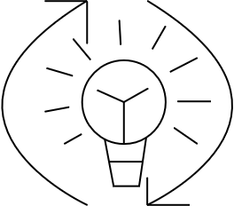


IMBALANCE CASE SCENARIO
CREDIT CARD FRAUD DETECTION
EQUIPMENT FAILURE PREDICTION
MEDICAL DIAGNOSIS
ANOMALY DETECTION IN NETWORK SECURITY
Email: salmanmohosheu@iut-dhaka.edu

Slide 4

CREDIT CARD FRAUD DETECTION
MEDICAL DIAGNOSIS
1M normal case
Less than 1K Fraud case
Benign Patient
Malignant Patient
Email: salmanmohosheu@iut-dhaka.edu

Slide 5

Imbalanced data
The Problem
Different number of samples in different classes
Bias in Model Training
Poor Generalization
Increased False Positives and False Negatives
Misclassification Costs
Low sensitivity score
5
Email: salmanmohosheu@iut-dhaka.edu

Slide 6
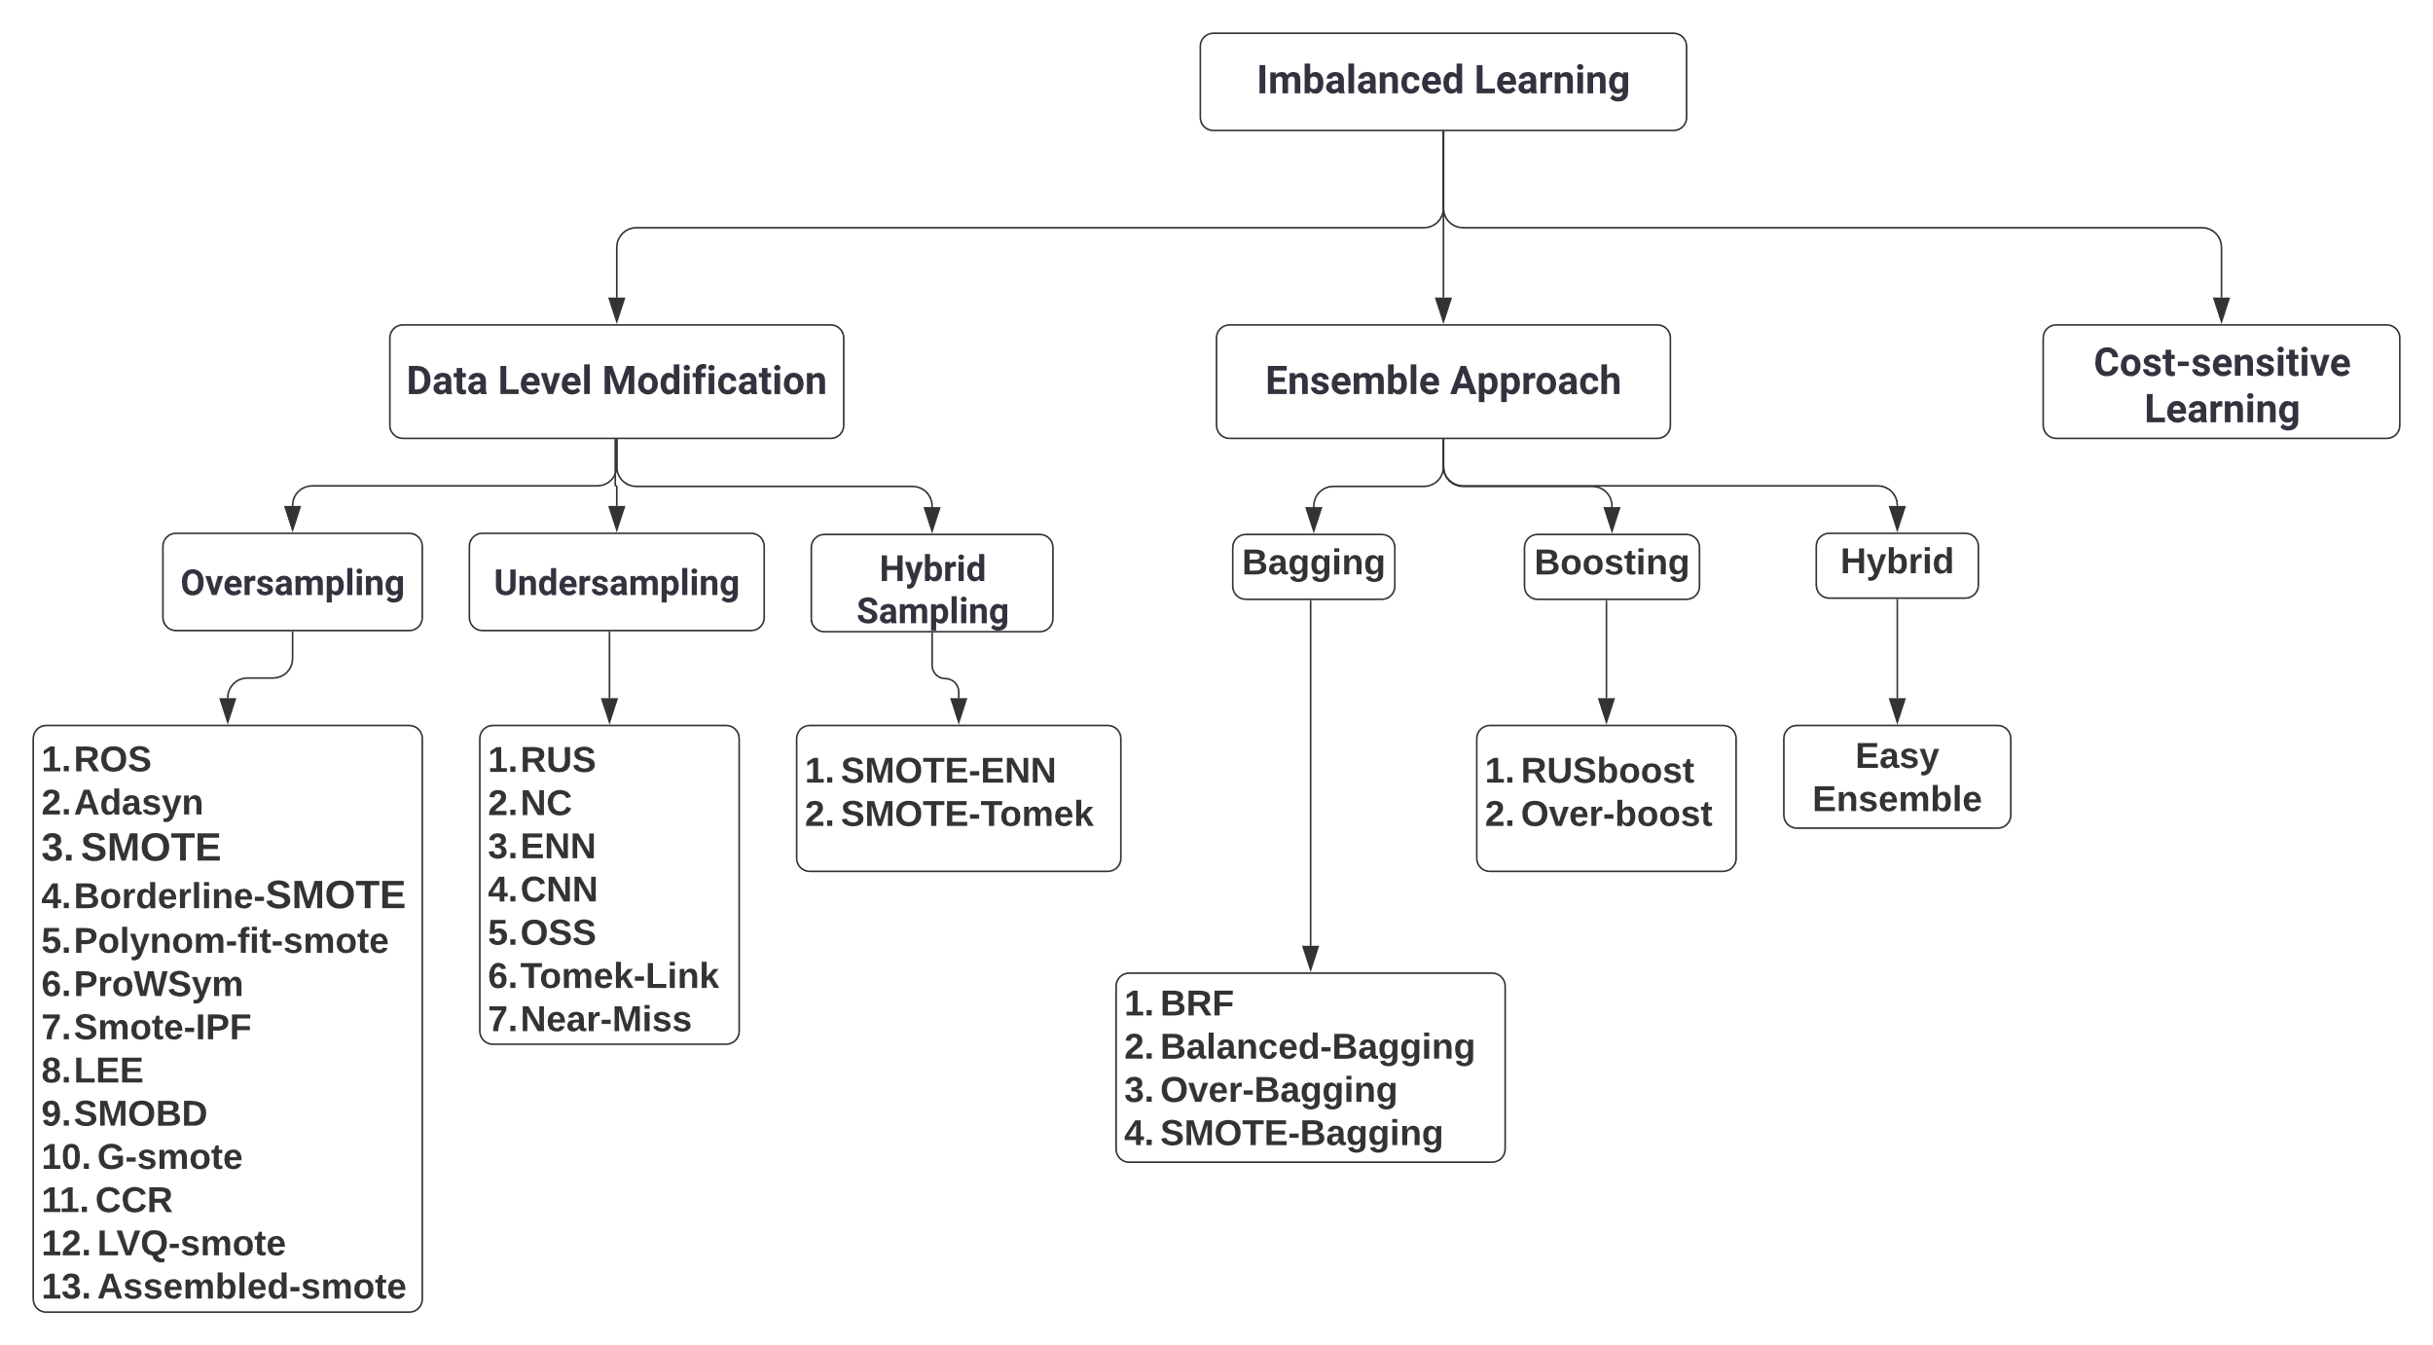
Email: salmanmohosheu@iut-dhaka.edu

Slide 7
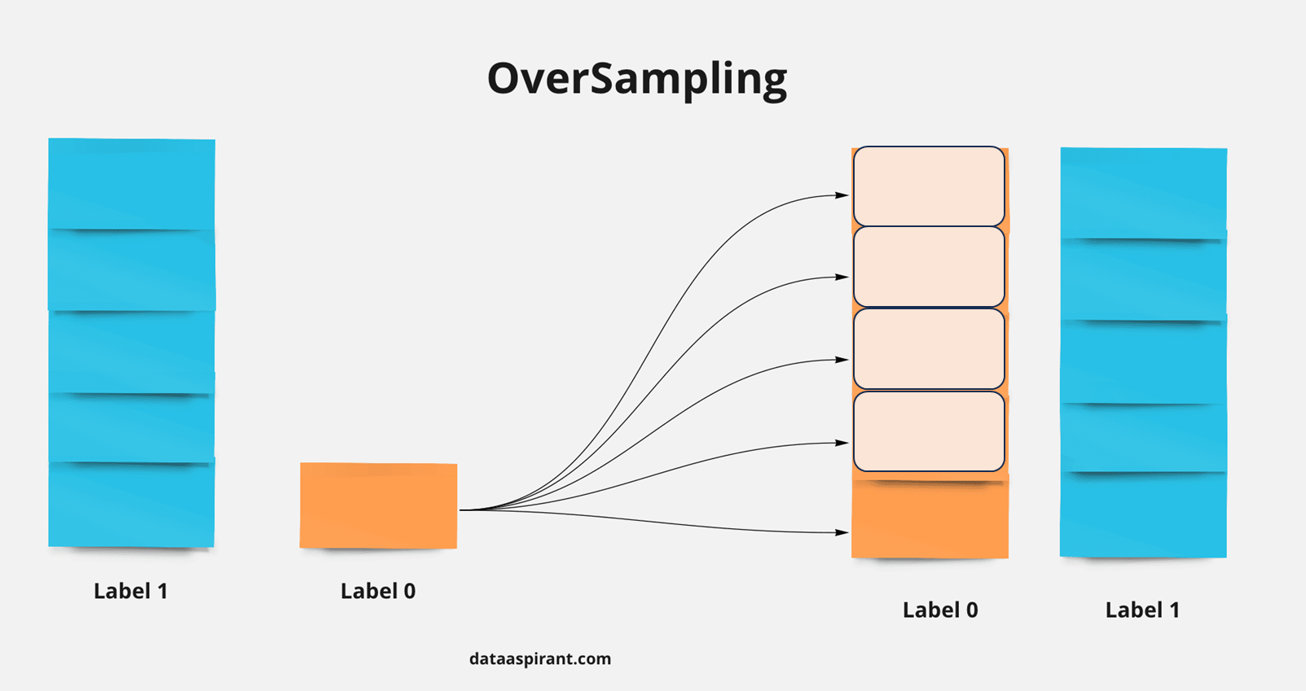
Oversampling
Oversampling:
Increase minority class samples.
Increasing samples by generating new samples or replicating the existing ones.
Transform imbalanced dataset into a balanced one.
Do not try to reduce overlapping.
Different types of oversampling:
SMOTE, ROS, ADASYN, G SMOTE, ROSE, NEATER
7
Email: salmanmohosheu@iut-dhaka.edu

Slide 8
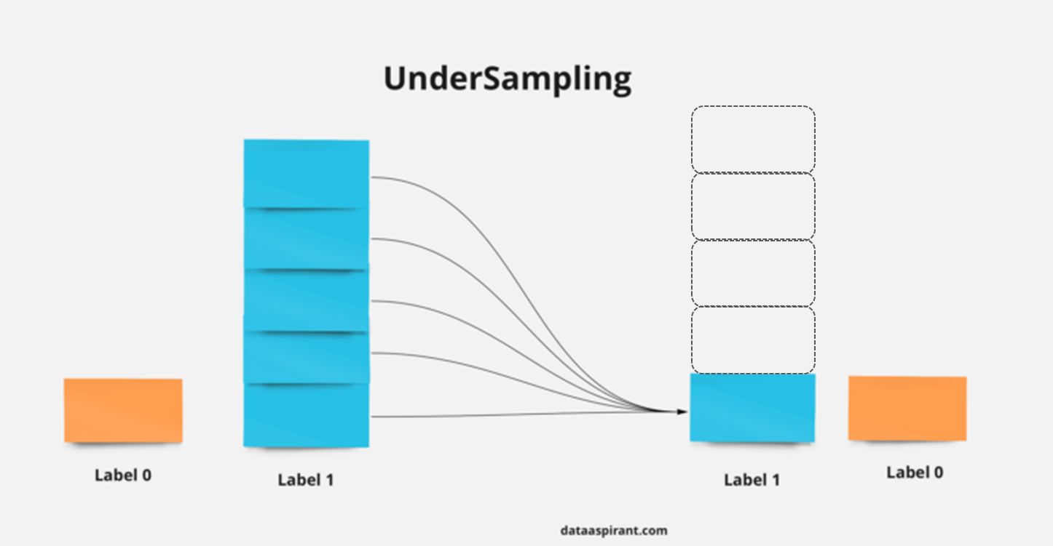
Under sampling
Under sampling:
Decrease the number of samples of the majority class.
Reduce overlapping as well as class imbalance
Different types of Under sampling:
RUS
Tomek Link
Near Miss
ENN
CNN
IHT
Email: salmanmohosheu@iut-dhaka.edu

Slide 9
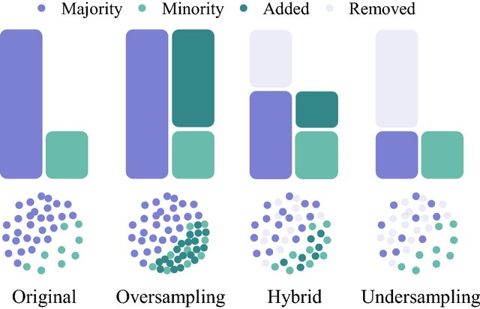
Hybrid Sampling
[1]
Different types of Hybrid Sampling:
SMOTE-TOMEK
SMOTE-ENN
Random Balance
Email: salmanmohosheu@iut-dhaka.edu

Slide 10
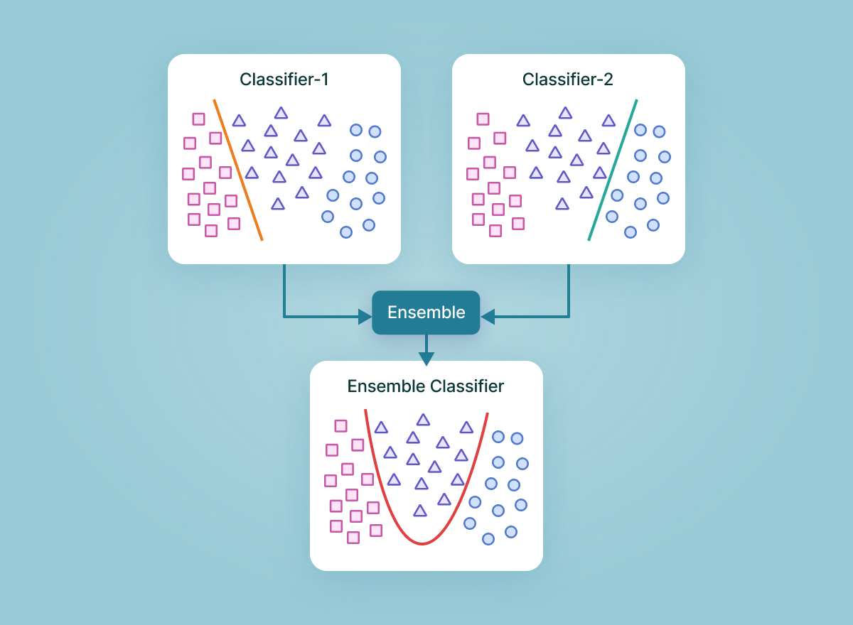
Ensemble Algorithm
[2]
Ensemble Algorithm:
Use many weak learners to get better performance.
Different types of ensemble algorithms:
Balanced Random Forest(BRF)
Easy ensemble
RUSBoost
Balanced Bagging
SMOTE-Bagging
Email: salmanmohosheu@iut-dhaka.edu

Slide 11
Performance Metrics:
Seven different metrics were calculated during experimentation-
Composite metrics are more suitable for evaluating the performance of imbalanced data. Therefore, we considered the MCC to compare the performance among different techniques.
MCC
ROC
G-MEAN
SENSITIVITY
SPECIFICITY
PRECISION
ACCURACY
Email: salmanmohosheu@iut-dhaka.edu

Slide 12
Dataset Description :
Total 84 different
imbalanced datasets
The average performance of 84 datasets is taken while comparing
RF and SVM are taken as the base learning classifier
In total 30 benchmarked sampling techniques were analyzed.
Datasets
Sources including the KEEL & UCI repositories.
All the datasets are binary classification data with different degrees of imbalance ratio. The class imbalance ratio of the datasets utilized in this study varies from 1.8 to 129.
Email: salmanmohosheu@iut-dhaka.edu

Slide 13
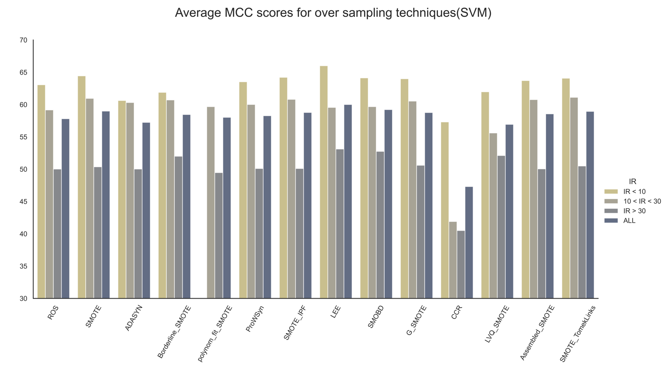
Result analysis: Oversampling
SMOTE and its variants demonstrated similar performance.
LEE, LVQ-SMOTE, Polynom-fit-SMOTE are the best performing oversampling techniques.
Decline in performance is noticeable as the imbalanced ratio increases.
Email: salmanmohosheu@iut-dhaka.edu

Slide 14
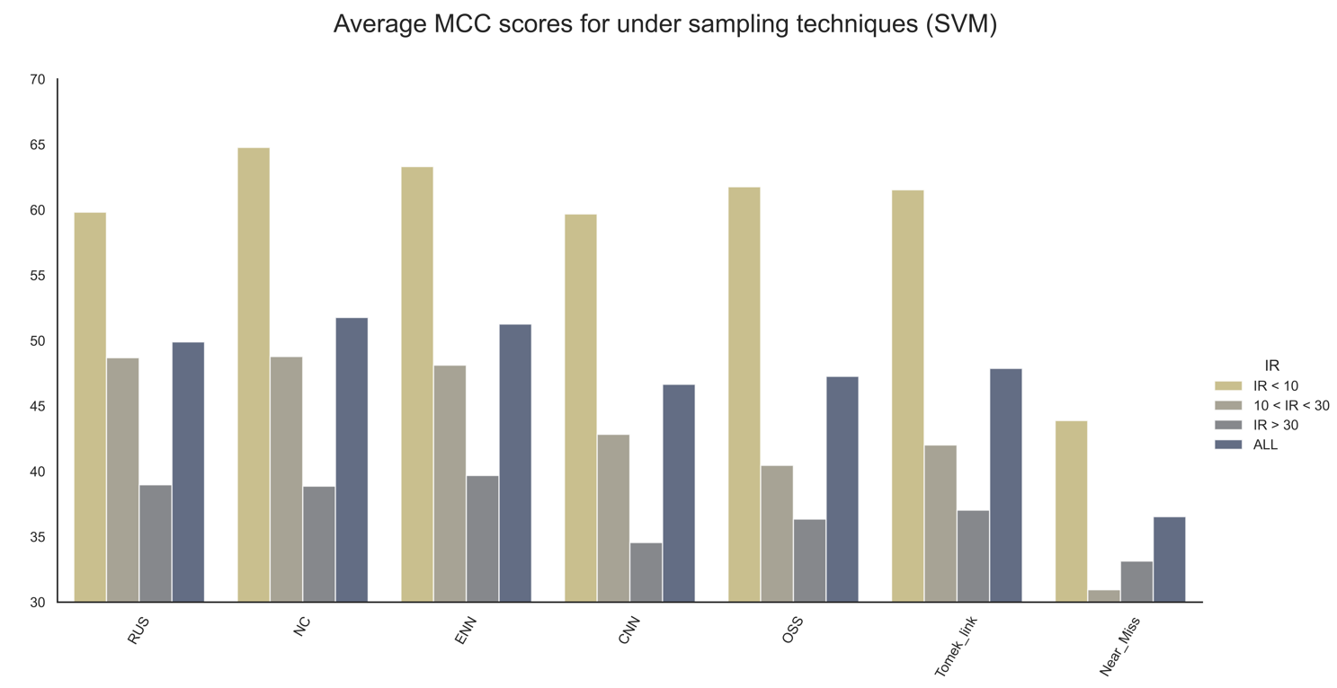
Result analysis: Undersampling
Undersampling techniques work well in lower imbalanced scenarios.
They exhibit major decline in performance as the imbalanced ratio increases.
Neighborhood Cleaning Rule performed the best among the undersampling techniques.
Email: salmanmohosheu@iut-dhaka.edu

Slide 15
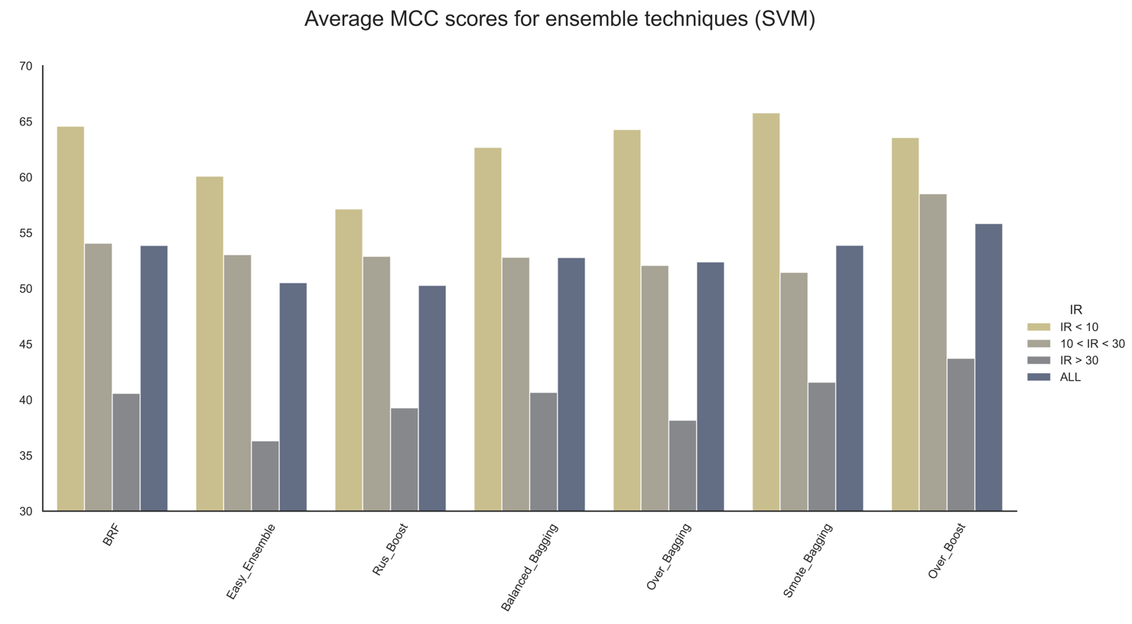
Result analysis: Ensemble
Poorer performance compared to other oversampling or undersampling approaches.
Over-boost performed the best.
Performance drops drastically as IR increases.
Email: salmanmohosheu@iut-dhaka.edu

Slide 16
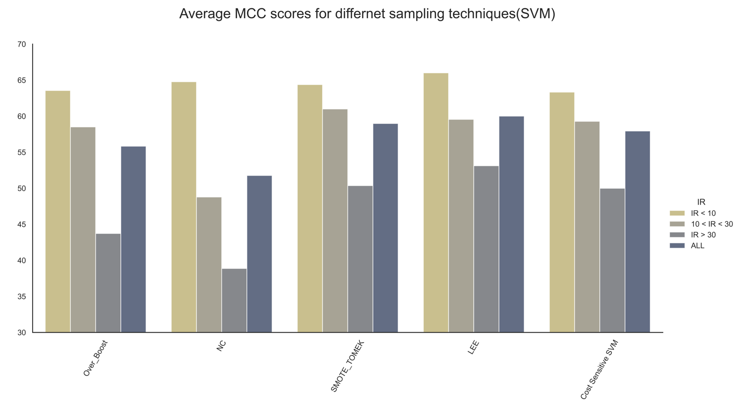
Result analysis:
Oversampling techniques performs better than the other approaches.
Hybridization between oversampling and undersampling provides comparable performance.
Undersampling and ensemble techniques work best in low-imbalanced data. Should be avoided in larger imbalances.
Email: salmanmohosheu@iut-dhaka.edu

Slide 17
Discussion:
Performance of the sampling techniques depend on how they address different factors that complicate the learning task. This includes –
Class overlapping
Imbalance ratio
Rarity of samples
Presence of noisy samples
Undersampling techniques such as NC, ENN focuses on reducing overlapping, but they do not balance the class distribution. When IR is low, they provide comparable performance. However, in large IR, even after sampling, the data remains quite skewed, resulting in poor performance.
Undersampling techniques such as RUS focuses on balancing the distribution without considering overlapping. In higher imbalances, significant loss of information, resulting in poor performance.
Email: salmanmohosheu@iut-dhaka.edu

Slide 18
Discussion:
Oversampling techniques increases the presence of rare samples in the region, improving the performance.
Especially in highly imbalanced scenarios, they have no alternatives.
Hypothesis - performance can be enhanced by reducing noisy instances that are generated in the process and reducing overlapping.
Hybridization between OS and US can simultaneously reduce overlapping and IR while increasing minority-class samples (unexplored - further investigation is suggested).
Cost-sensitive learning can be a good alternative in large datasets because of its simplicity and lower time-complexity.
Email: salmanmohosheu@iut-dhaka.edu

Slide 19
Future works:
In future, we would like to extend our work to multiclass analysis.
Address some other issues in imbalance learning.
Adress local density of minority-class samples
The multi-minority case in multiclass imbalanced datasets.
Reference:
https://link.springer.com/article/10.1007/s10115-022-01772-8/figures/1
https://www.v7labs.com/blog/ensemble-learning
Email: salmanmohosheu@iut-dhaka.edu

Slide 20
Thank you
Any Question?
Contact: salmanmohosheu@iut-dhaka.edu,
eee.asifnewaz@iut-dhaka.edu
Email: salmanmohosheu@iut-dhaka.edu

