Slide 1


2023 IEEE 8th International Conference on Recent Advances and Innovations in Engineering (ICRAIE)
ROC based performance evaluation of machine learning classifiers for multiclass imbalanced intrusion detection dataset.
Paper ID: 1570944500
Presenter: Md. Salman Mohosheu
Organized by,
Department of Electrical and Electronic Engineering,
Islamic University of Technology (IUT)
Boardbazar , Gazipur-1704,
Bangladesh.
UNIVERSITI TEKNOLOGI MARA

Slide 2


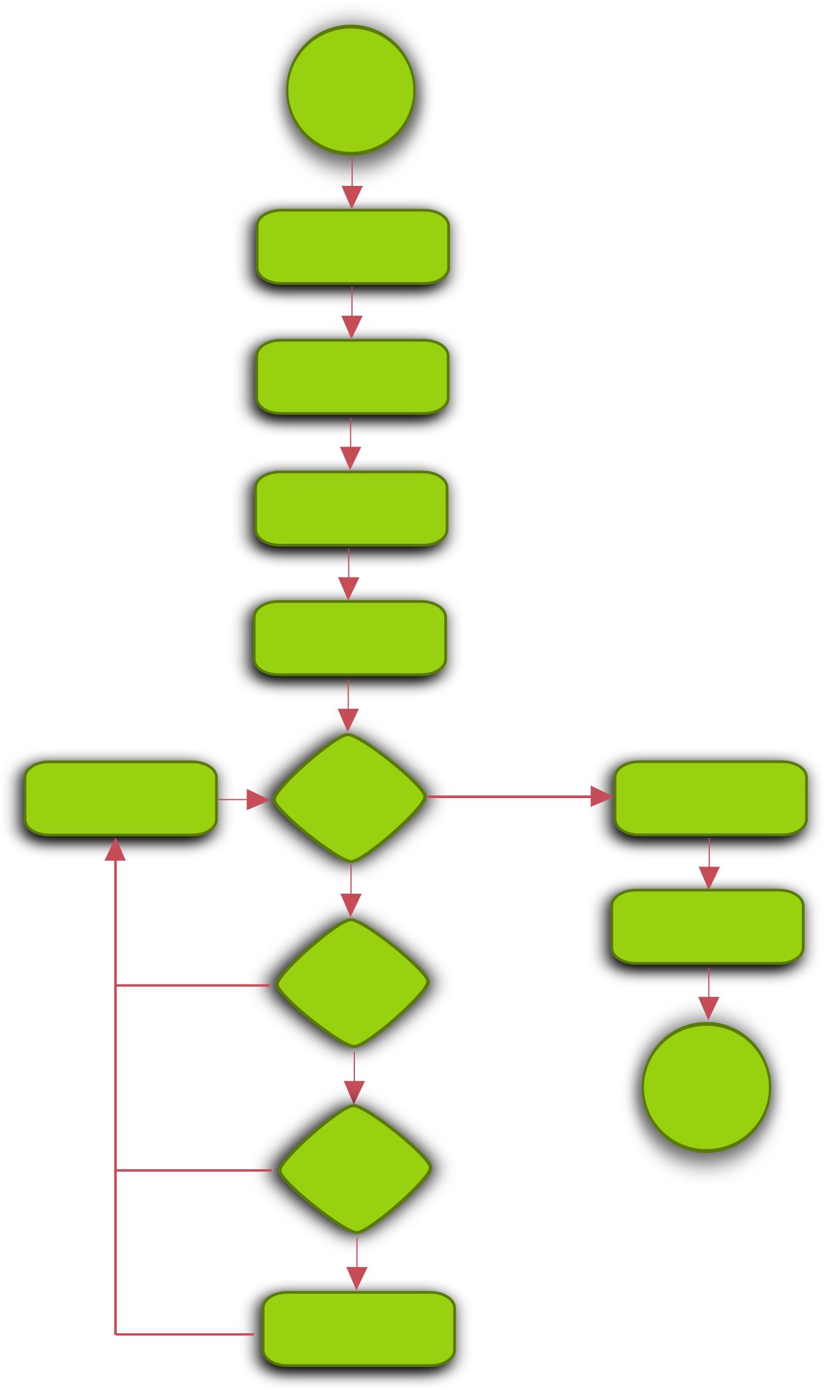


Content :
Motivation
Introduction
Methodology
Result
Conclusion and Future Scopes

Slide 3
Motivation :
Internet and Wireless Communication Growth Over the past decade, there has been a significant increase in internet and wireless communication usage, leading to heightened security concerns
Rapid Expansion of Internet Usage and Data Production Global internet statistics from 2000 to 2019 reveal a remarkable 111.4% expansion in internet usage
Challenges in Data Security Safeguarding it from hostile infiltrations, attacks, and exploitation of network vulnerabilities
Role of Intrusion Detection Systems (IDS) and Machine Learning Motivated by the need to enhance cybersecurity infrastructure, the integration of machine learning

Slide 4
Motivation :
Brief overview of the contemporary era of information technology :
Importance of network security in the digital landscape
Signature-based Detection
(Pre-2000s)
Machine Learning and AI-based Detection (Present)
Data Protection
Data Integrity
Network security
UEBA , Zero Trust Architecture etc.
The need to distinguish between harmful and non-malicious traffic
Firewalls
Network Traffic
Malicious
Non-malicious

Slide 5
Introduction:
Employing machine learning algorithms in intrusion detection system
Validation of accuracy and false alarm rate (FAR) as evaluation metrics
Handling class imbalance in intrusion detection dataset
Selecting appropriate evaluation matrices
Compare the performance of machine learning classifiers
Challenges and Mitigations in Machine Learning for Intrusion Detection

Slide 6
Methodology :
Dataset Description :
Dataset
UNSW-NB15 Dataset
Curated by Cyber Range Lab of UNSW Canberra
257,673 number of instances
training set 175,341 records
testing set is 82,332 records
49 independent features

Slide 7
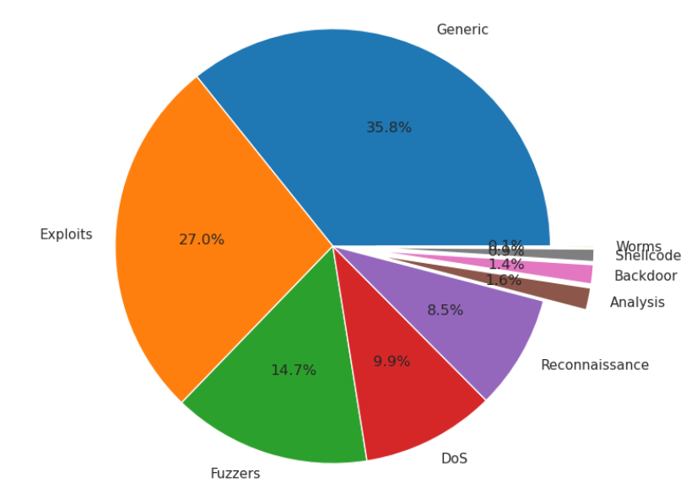
Methodology :
Dataset Description :
Dataset
UNSW-NB15 Dataset
Multiclass dataset
Generic 58871
Exploits 44525
Fuzzers 24246
DoS 16353
Reconnaissance 13987
Analysis 2677
Backdoor 2329
Shellcode 1511
Worms 174

Slide 8
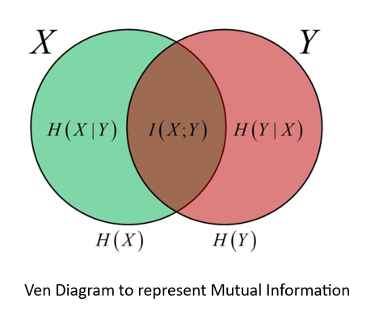
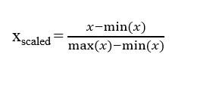
Methodology :
Data Preprocessing:
Unnecessary columns were removed
Nominal columns were label encoded
Mutual Information was implemented as Feature Selection method
Data Scaling by minmaxscaler [0,1]

Slide 9
Methodology :
Work-flow
Label Encoding
Data
Feature Selection
Min-Max Scaling
Train-Test Split
Model Training
Hyperparameter optimization 5cv
Train
Result
Test

Slide 10
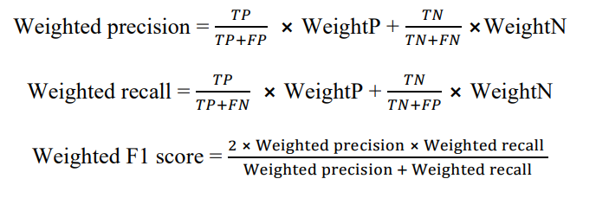
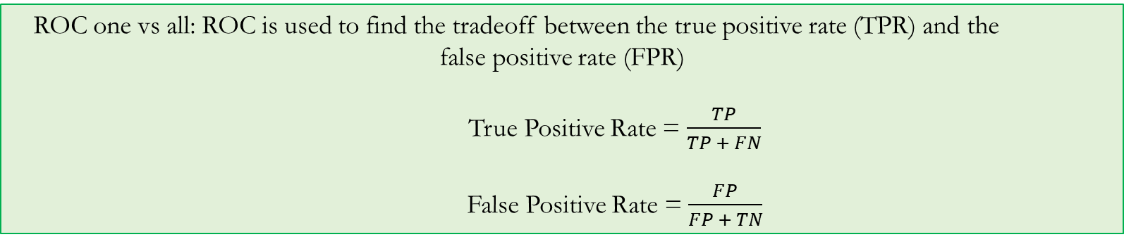


Result :
Evaluation Matrices :
Accuracy : $\frac{TP}{TP +TN}$
False Alarm Rate : $\frac{FP}{FP +TN}$
ROC one vs all: ROC is used to find the tradeoff between the true positive rate (TPR) and the false positive rate (FPR)
True Positive Rate = $\frac{TP}{TP + FN}$
False Positive Rate = $\frac{FP}{FP + TN}$
Weighted Average F1-score:

Slide 11
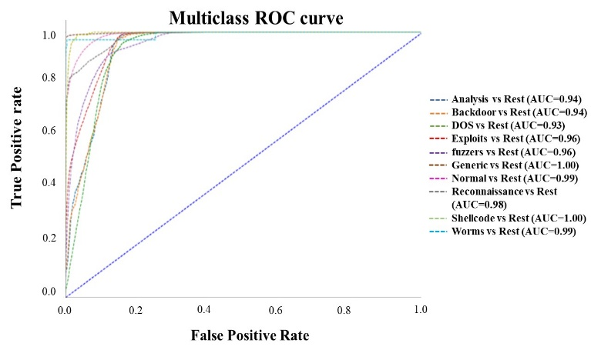
Result :
The XGBoost classifier demonstrated the best performance in terms of the multiclass ROC-AUC score of 0.9695
The Random Forest and Decision Tree models had similar scores of 0.9618 and 0.9569
The K-nearest neighbors (KNN) method exhibited the lowest performance score of 0.8376

Slide 12
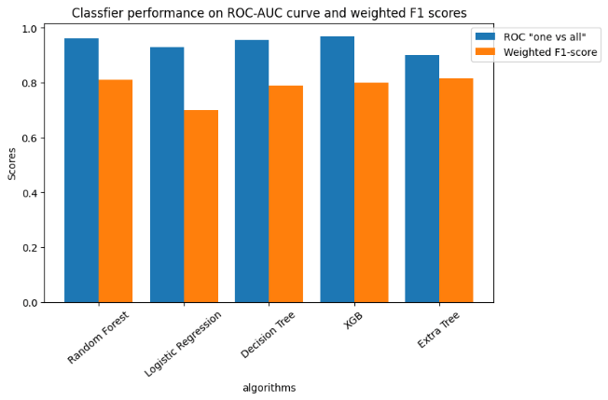
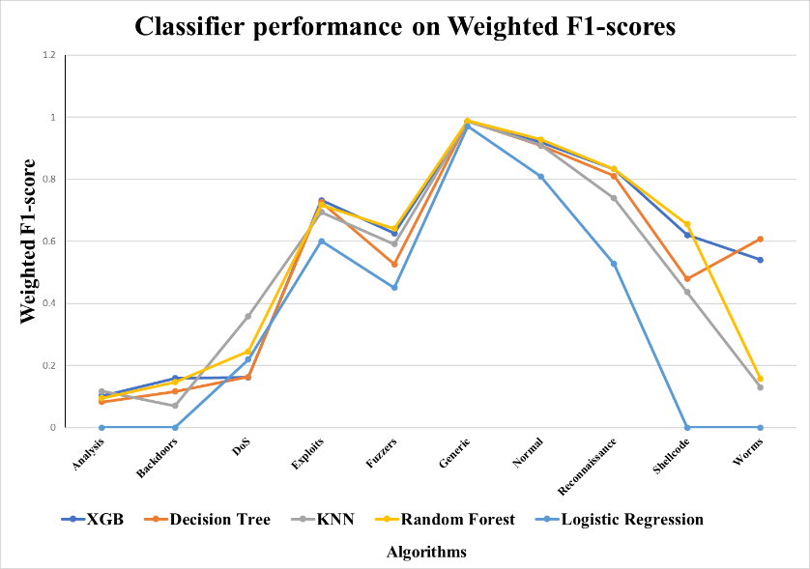
Result :
The Random Forest algorithm obtained the highest F1 score of 0.81.
The XGBoost model exhibited comparable performance, with an F1 score of 0.80

Slide 13
Conclusion and Future works :
ROC ovr and weighted F1 score are the most appropriate evaluation metrices for this kind of dataset
XGBoost showed the best performance for UNSW NB-15 dataset
All sorts of malicious attacks can be stopped while accepting 30% of FPR
Deep neural networks can be implemented for building IDS
Advanced feature selection techniques for dimension reduction

Slide 14
Thank you
Any Question?
Contact: salmanmohosheu@iut-dhaka.edu,
abrarshams@iut-dhaka.edu

