Slide 1


35th Conference of the Open Innovations Association FRUCT
https://fruct.org/conferences/35/call-for-participation/
iBRF: Improved Balanced Random Forest Classifier
Authors: Asif Newaz¹ Md. Salman Mohosheu¹ [presenting]
MD. Abdullah al Noman¹
Dr. Taskeed Jabid²
Organized by,
¹ Islamic University of Technology (IUT), Boardbazar,
Gazipur-1704, Bangladesh.
² East West University, Dhaka, Bangladesh
Notes:
Add all authors names also

Slide 2
Content :
Introduction
Methodology
Result
Conclusion and Future Work
Notes:
Remove related works

Slide 3
Introduction :
They are trained to minimize the overall number of misclassifications
Imbalanced data presents -
Hurdle in classification
tasks
The learning algorithms get biased towards the majority
class due to their accuracy-oriented design.
They perform well in predicting the majority class instances
They fail to correctly identify the instances belonging to the minority class as they are quite
underrepresented.
Most real-world datasets
Necessary steps must be taken to address the class imbalance issue to develop a reliable prediction framework.
The data can
be severely skewed.

Slide 4
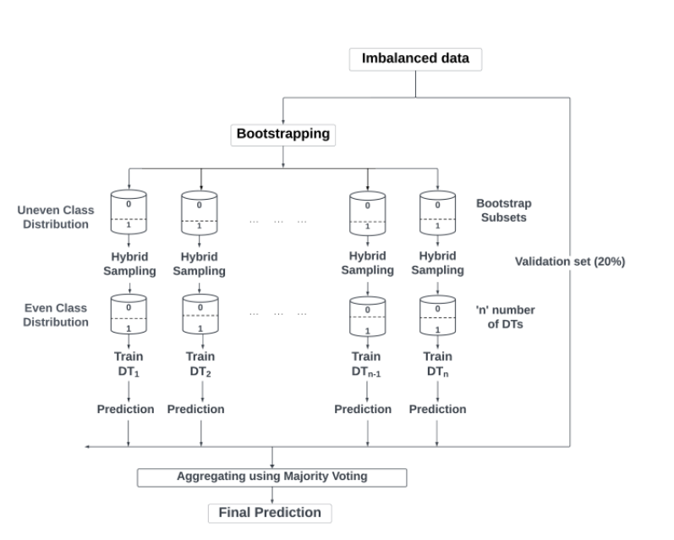
Proposed Framework:
Step-1
Data -split
The data is first split into training and validation folds
using a 5-fold stratified cross-validation strategy.

Slide 5
Proposed Framework:
Step-2
Bootstrap Subsets
’n’ number of bootstrap subsets is then generated from the
training data including all minority class samples. The remaining
portion is filled with instances from the majority class through sampling with replacement

Slide 6
Proposed Framework:
Step-3
NC algorithm to Bootstrap Subsets
The NC algorithm is applied to each bootstrap subset
separately
This reduces the overlapping between the two classes as well as the resultant resampled subsets have comparatively lower IR (different in different subsets) than the original data as some samples are removed in the process (depending on the data, usually around 10-20% of samples are eliminated).

Slide 7
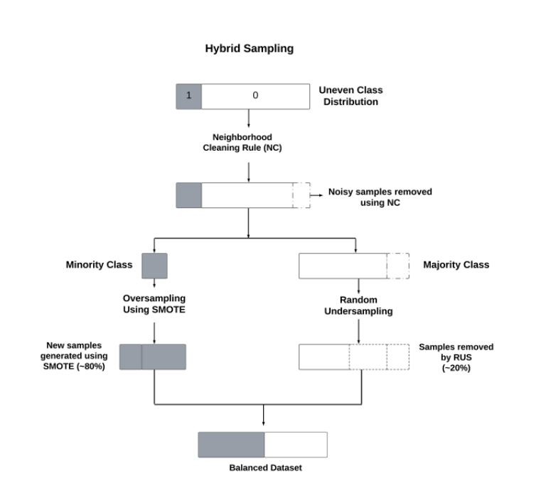
Proposed Framework:
Step-4
RUS
RUS approach is applied to eliminate some majority-class Samples.
The number of samples removed by the NC rule is
usually limited. Consequently, a large number of minority class samples will need to be generated by the SMOTE approach to balance the class distribution. To avoid that, the RUS approach
is applied to randomly eliminate around 20% majority-class samples from the data to lower the IR.

Slide 8
Proposed Framework:
Step-5
SMOTE
The SMOTE algorithm is then used to produce new minority class samples to balance each bootstrap subset.

Slide 9
Proposed Framework:
Step-6
Balanced Class Distribution
Each bootstrap subset passes through steps 3, 4, and 5, producing a balanced class distribution.

Slide 10
Proposed Framework:
Step-7
DTs are trained
Next, DTs are trained on these bootstrap subsets. The training and aggregation process follows the RF architecture of the scikit-learn library.

Slide 11
Proposed Framework:
Step-8
Prediction
The final prediction is made by the ensemble model on the validation set. The process is repeated for the other folds and the average of the prediction performance is calculated and reported here.

Slide 12
Performance Metrics:
Eight different metrics were calculated during experimentation-
Composite metrics are more suitable in evaluating the performance on imbalanced data. Therefore, we considered the MCC, ROC-AUC, G-mean, and F1-score to compare the performance among different techniques.
MCC
ROC
F1-SCORE
G-MEAN
SENSITIVITY
SPECIFICITY
PRECISION
ACCURACY

Slide 13
Dataset Description :
Total 44 different
imbalanced datasets
The average performance of 44 datasets is taken while comparing
RF and SVM are taken as the base learning classifier
The proposed approach is compared with 14 benchmarked sampling techniques
Datasets
Sources including the KEEL & UCI repositories.
All the datasets are binary classification
data with different degrees of imbalance ratio.

Slide 14
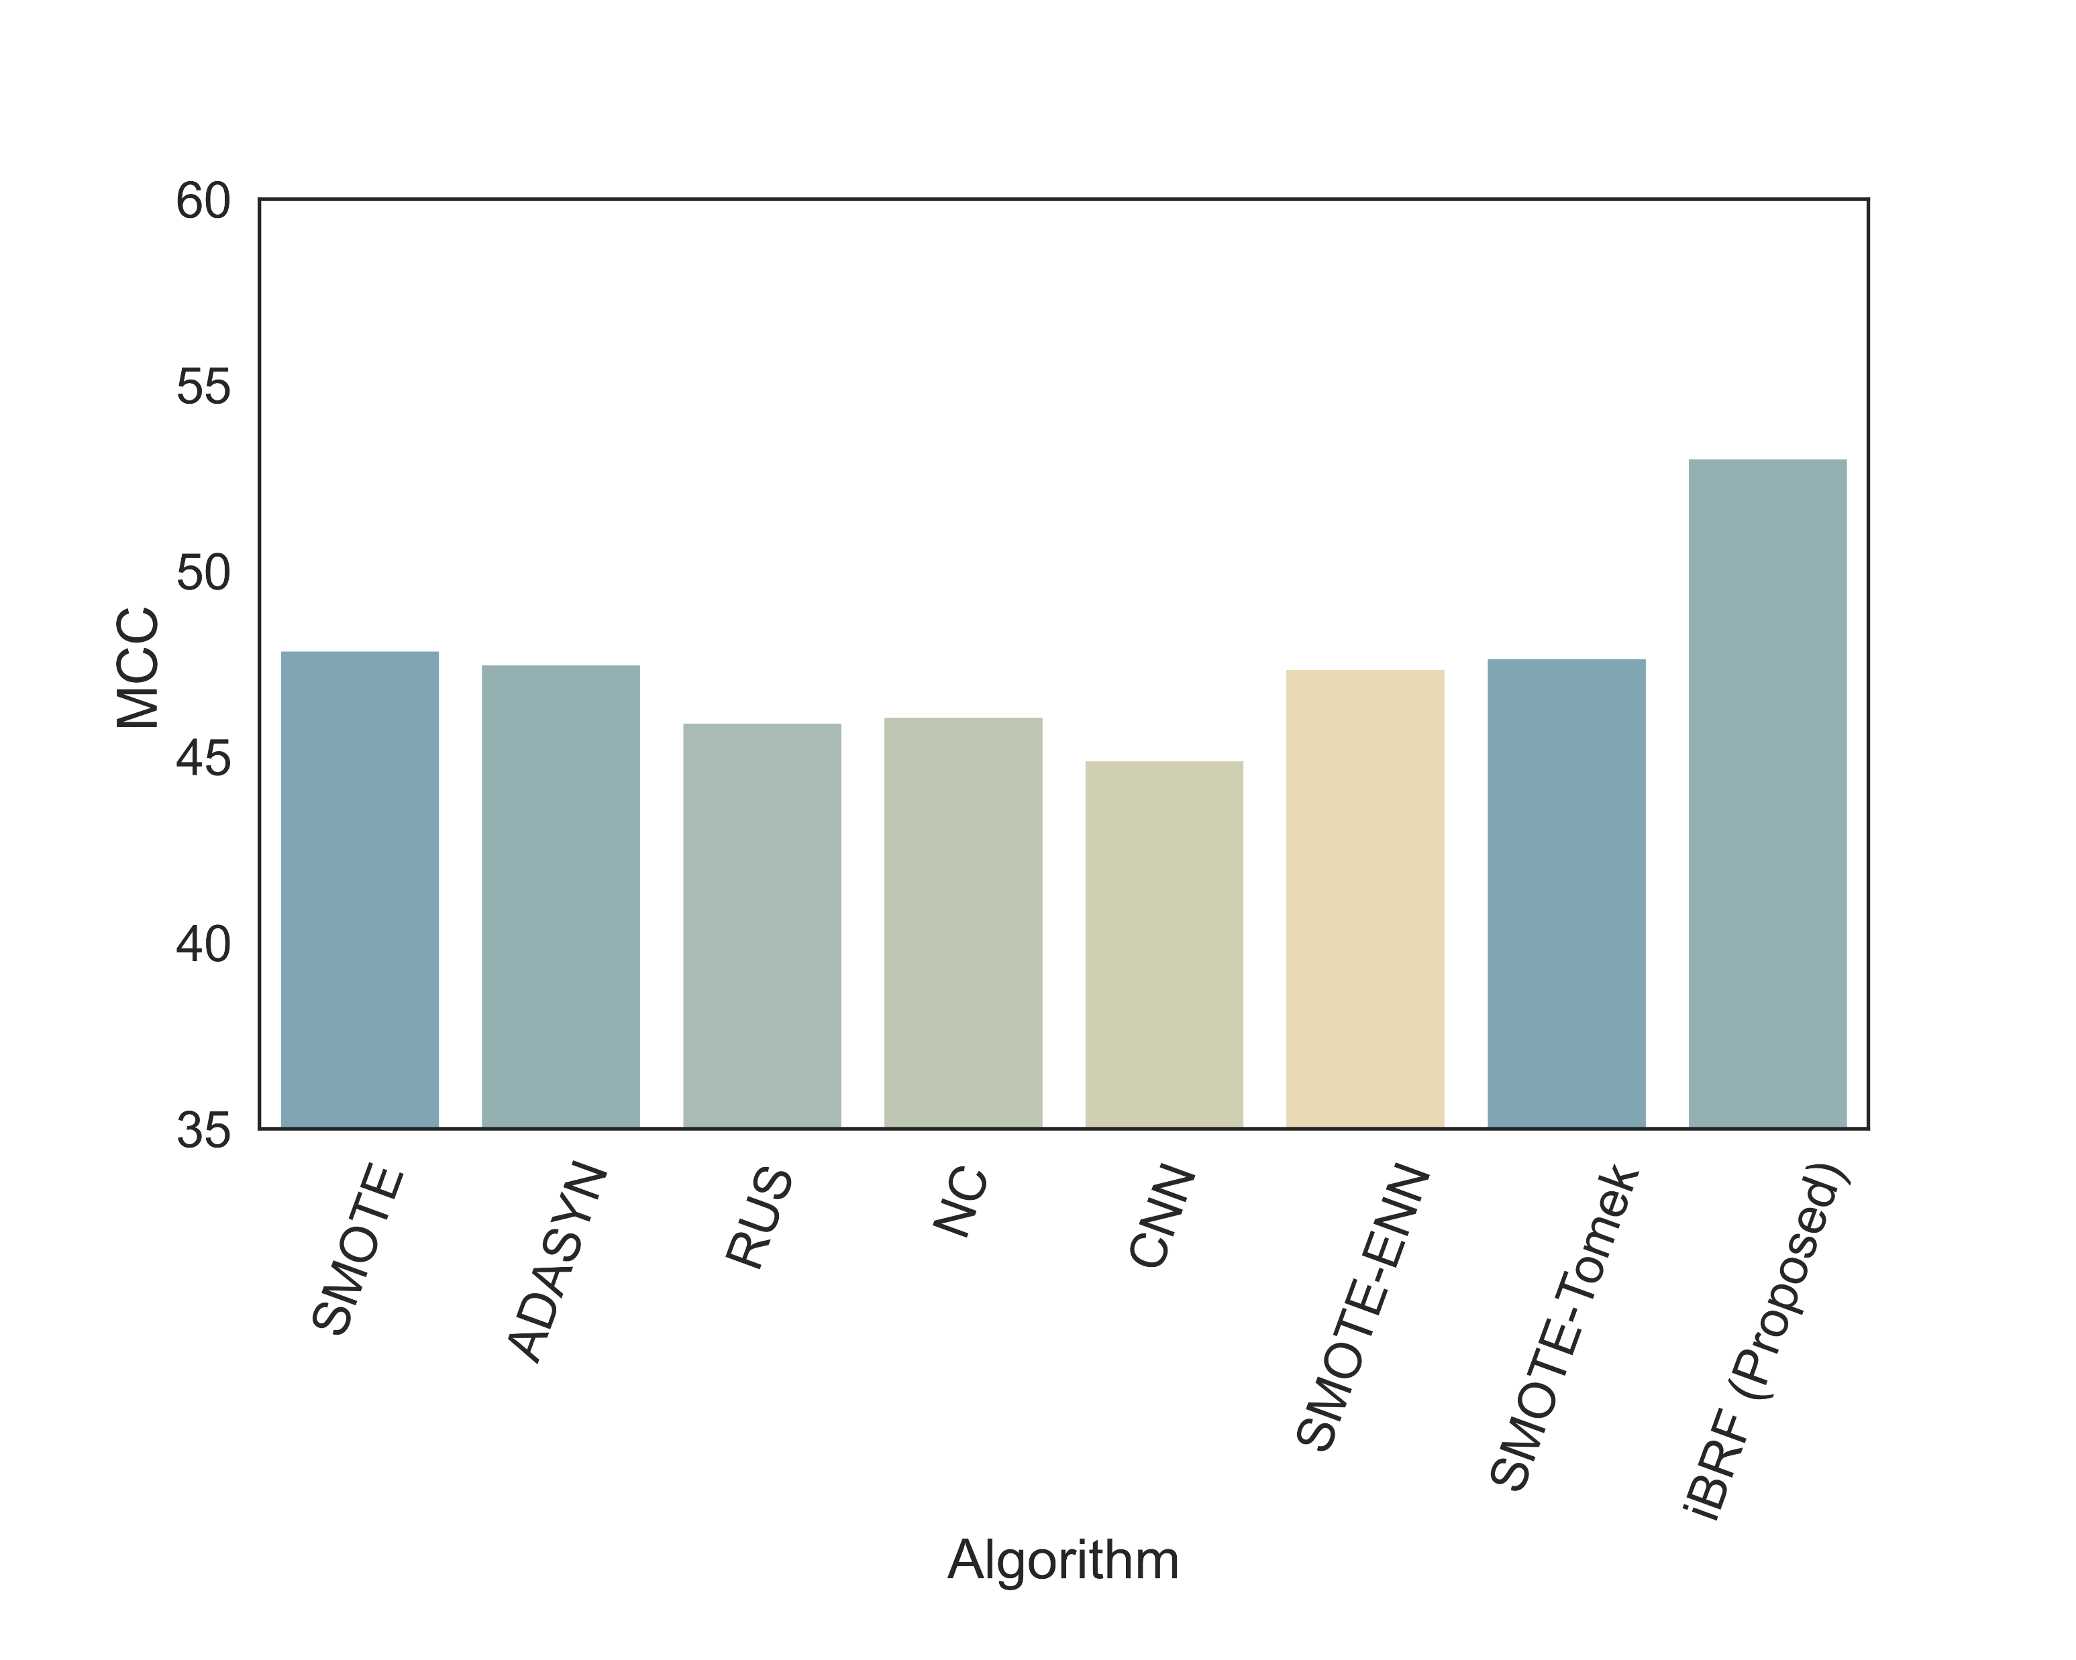
Result :
The proposed solution achieved the highest MCC score of 53.04%
SMOTE, RUS, and NC performed poorer than the proposed solution when used independently.
iBRF also outperformed other hybrid sampling techniques such as SMOTE-ENN and TOMEK-LINK

Slide 15
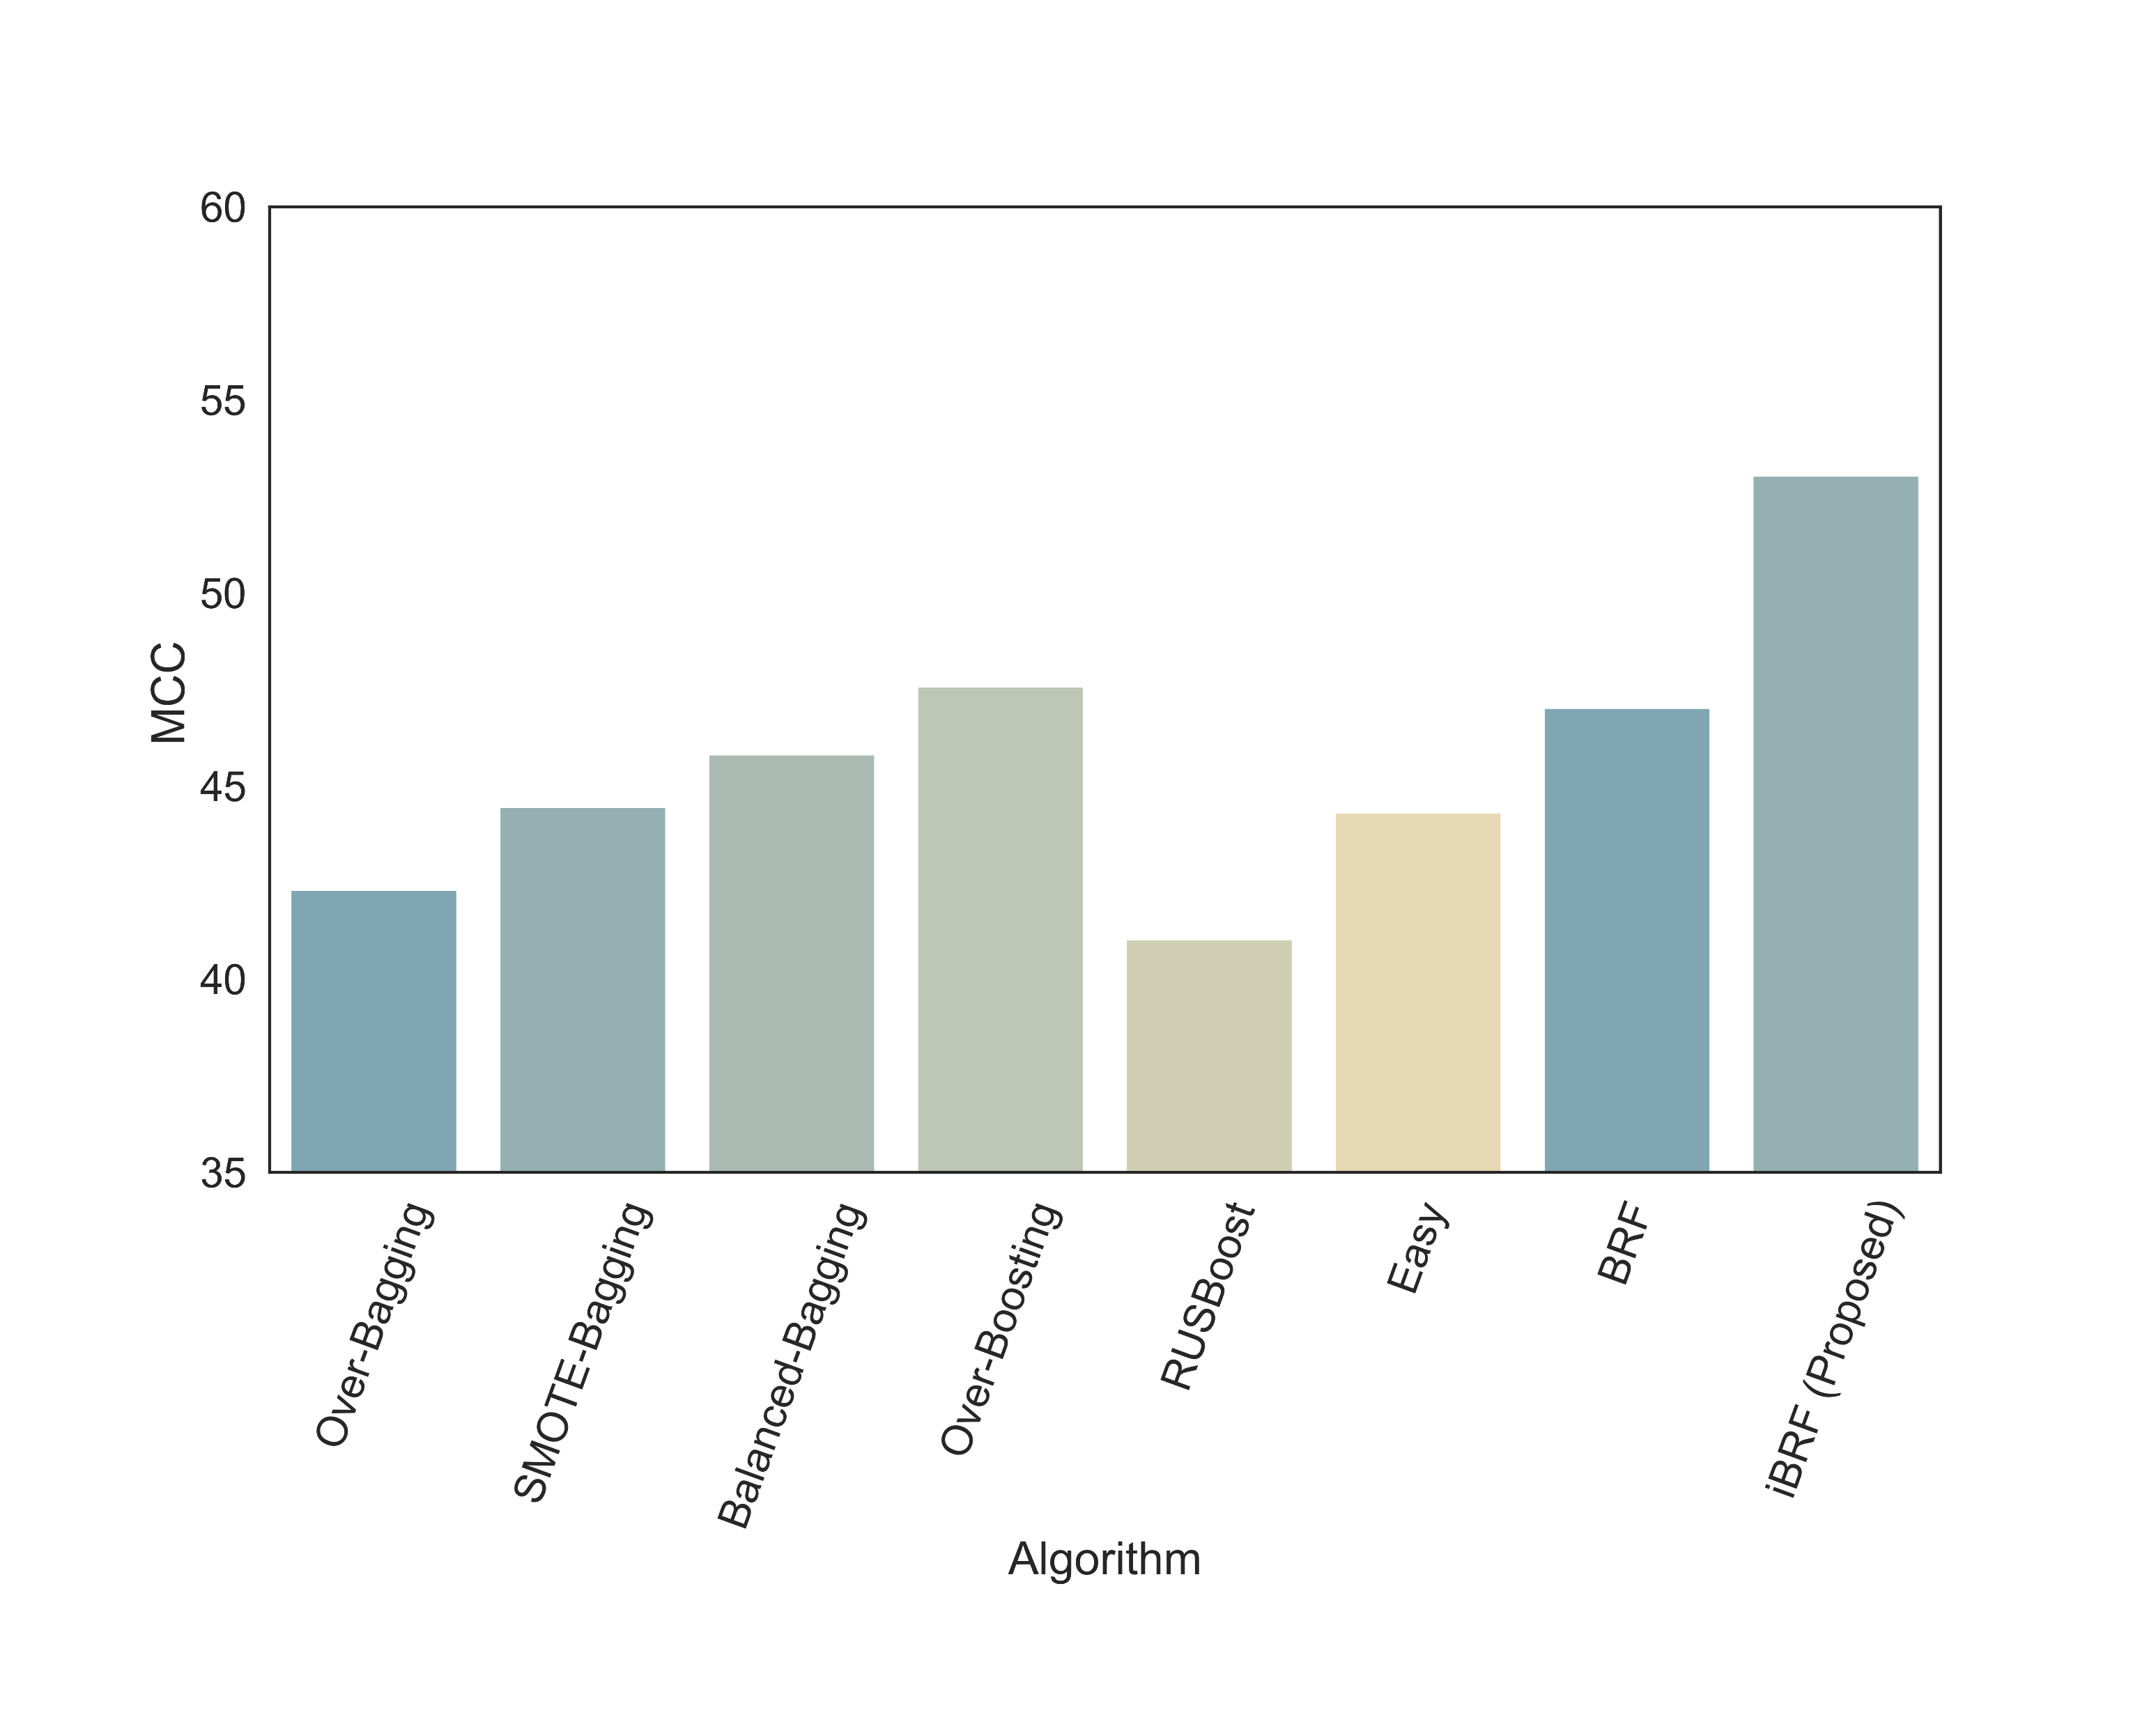
Result :
The proposed solution also outperformed popular ensemble techniques
iBRF achieved a 6% increase in MCC scores than the original BRF classifier

Slide 16
Result :
The proposed approach also outperformed other popular ensemble techniques in terms of G-MEAN, ROC, F1-Score
iBRF achieved a ROC-AUC score of 82.26% while SMOTE and NC scored 74.22% and 72% respectively.
iBRF also achieved significant improvement in F1-Score. It achieved almost 6% improvement over the original BRF.
In terms of G-MEAN, iBRF also showed the highest of 79.92% which outperformed all other techniques.

Slide 17
Result :
TABLE: Performance Measures Obtained From Different Approaches ( In Percentage )
Methods | MCC | G-MEAN | ROC | Sensitivity | Specificity | Precision | Accuracy | F1-Score
NO SAMPLING | 44.047 | 51.476 | 69.416 | 41.688 | 97.144 | 58.864 | 92.891 | 45.247
SMOTE | 47.869 | 64.136 | 74.225 | 54.580 | 93.870 | 53.198 | 91.276 | 51.656
ADASYN | 47.496 | 63.394 | 73.758 | 53.948 | 93.567 | 51.841 | 90.948 | 50.390
RUS | 45.937 | 78.625 | 80.514 | 81.843 | 79.185 | 41.580 | 79.456 | 48.569
NC | 46.094 | 57.956 | 72.548 | 51.535 | 93.562 | 55.065 | 91.732 | 49.615
CNN | 44.920 | 61.155 | 73.192 | 54.668 | 91.715 | 50.574 | 90.105 | 49.104
SMOTE-ENN | 47.381 | 71.001 | 76.860 | 64.274 | 89.445 | 49.836 | 88.439 | 52.486
SMOTE-TOMEK | 47.672 | 63.214 | 73.728 | 53.742 | 93.714 | 52.790 | 91.018 | 50.520
OVER-BAGGING | 42.325 | 51.665 | 69.128 | 41.887 | 96.370 | 54.982 | 92.117 | 44.593
SMOTE-BAGGING | 44.463 | 56.839 | 71.123 | 46.885 | 95.361 | 53.819 | 91.757 | 47.720
BALANCED-BAGGING | 45.823 | 75.662 | 78.169 | 71.092 | 85.245 | 44.184 | 83.909 | 49.237
OVER-BOOSTING | 47.590 | 69.911 | 76.193 | 62.021 | 90.366 | 49.660 | 88.606 | 51.650
RUSBOOST | 41.037 | 68.597 | 74.313 | 62.245 | 86.382 | 43.113 | 84.640 | 46.212
EASY ENSEMBLE | 44.325 | 78.674 | 80.425 | 82.604 | 78.246 | 39.554 | 78.687 | 47.105
BRF | 47.031 | 79.244 | 81.044 | 81.776 | 80.312 | 42.065 | 80.514 | 49.095
iBRF (proposed) | 53.042 | 79.923 | 82.260 | 78.931 | 85.589 | 48.709 | 85.880 | 55.002

Slide 18
Discussion :
Hybridizing among SMOTE, RUS, and NC provided the model with better generalization
Hybrid sampling establishes a balance between oversampling and undersampling techniques.
The proposed approach eliminates noisy, borderline, and overlapped majority samples. It also increases the presence of minority samples in boundary and overlapped regions.
iBRF provided the highest scores in terms of MCC, G-MEAN, ROC, and F1-score compared to 14 other state-of-the-art sampling methods.
iBRF can overcome the overfitting issue of SMOTE, it also reduces the information loss.

Slide 19
Conclusion and future works :
Careful hybridization can provide better data sampling than the existing ones
The proposed approach ‘iBRF’ provides a substantial improvement over other contemporary sampling techniques
In the future, we would like to incorporate the hybrid sampling technique with the boosting framework
We would further test its performance on multiclass imbalanced scenarios
Repository for supplementary files: https://github.com/newaz-aa/iBRF

Slide 20
Thank you
Any Question?
Contact: eee.asifnewaz@iut-dhaka.edu, salmanmohosheu@iut-dhaka.edu

