Slide 1
Program ‘Til It Hertz
Jahiro Otzoy
Felipe Corona
Brian Vu
Mauricio Lomeli
Salman Shah

Slide 2
Introduction
Hotel Management System – Its purpose and
A Software to manage Hotel inventory and customer reservations
Language used: C++

Slide 3
Primary Functions
Handle Reservations
Manage Rooms
Manage Room types
Provide Reports for analysis
Programming approach - agile

Slide 4
Software Organization
Database
Back End
User Interface

Slide 5
Front-End
Creating the GUI
Coding the GUI
Connecting the GUI to the back-end

Slide 6
Back-end
Stages of development
Creating the classes
Integrating the database with the back-end
Integrating the back-end with the GUI

Slide 7
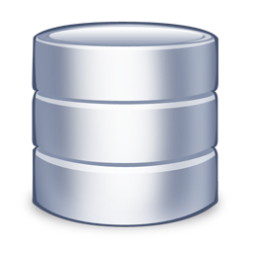
Database
Why is it necessary?
What does it need to do?
What tools to use?
How is it implemented?
How is it integrated?

Slide 8
Database
Why is it necessary?
Accessibility
Access persistent information in system
Reliability
Maintain data over a period of time
Scalability
Handle sets of growing data and large amounts of data
Notes:
Accessibility: To be able to quickly access persistent information in the system
Need to make sure that the system is able to access all the information that is stored.
Reliability: To be able to maintain data over a period of time
Need to make sure that all the data will remain stable over a long period of use.
If the hotel system crashes, the system could easily recover from the database
Scalability: To be able to handle large growing sets of data
Hotel databases are always growing as more reservations are made and rooms are added
Need to be able to handle this

Slide 9
Database
What does it need to do?
Easily read and write data
Integrate all aspects of the software
Store important information consistently and reliably
Prevent users from inputting inconsistent or duplicate data

Slide 10


Database
What tools to use?
SQLite Database Library
Used to implement and integrate the
database
Uses SQL database language
SQLite Expert Database Manager
Used to view the database via GUI
Used to test and easily modify
information in the database

Slide 11
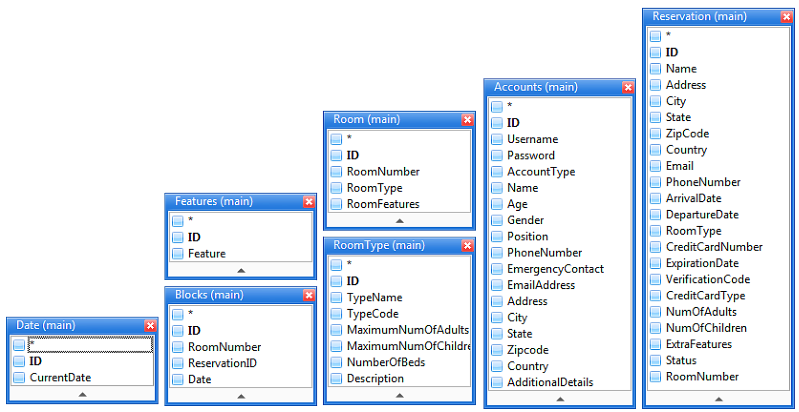
Database
How is it implemented?
Creating tables to organize information
Accounts
Reservations
Rooms
Room Types
Discount
Block
Date

Slide 12
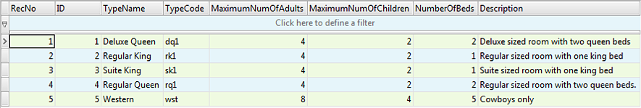
Database
How is it implemented?
Tables are organized into rows and columns
Rows have proper indexes
Columns have correct data types
Room Type Table

Slide 13
Database
How does it integrate with the system?
Database object
Communicates directly to the database via queries
System startup integration
At startup, information is retrieved from database and populated into HMS
System runtime integration
Changes in HMS are immediately saved into database
Notes:
Create a database object that queries the database directly
Using specific functions, may create tables, add, update, or delete entries
Startup integration: At startup, the HMS queries all the tables to retrieve all persistent information from the database and populated them into dynamic memory
Runtime integration: HMS will send updated information immediately to the database once information is added, modified, or deleted from the system

Slide 14
The End

