Slide 1
Addiction
When a person looses control over time, place and quantity upon some abusing habit and his life is derived by the craving of some for that habits, the person is said to be addicted

Slide 2
Drug Addiction
“When a drug abuser looses control over time, place and quantity of drug, he is defined as an drug addict”

Slide 3
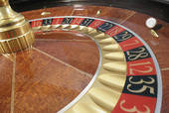
Non-Chemical Addiction:
Sex
Shopping
Eating
Gambling
Power
Money
Fame
Chatting

Slide 4
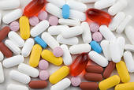
Chemical Addiction
Heroin
Opium
Chars
Sleeping pills
Alcohol
Medicines

Slide 5
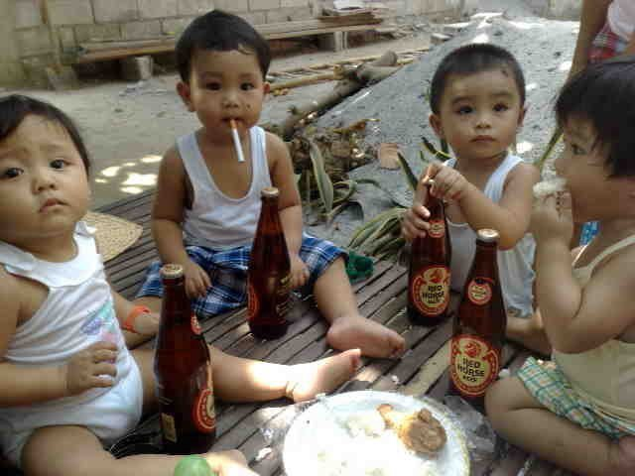
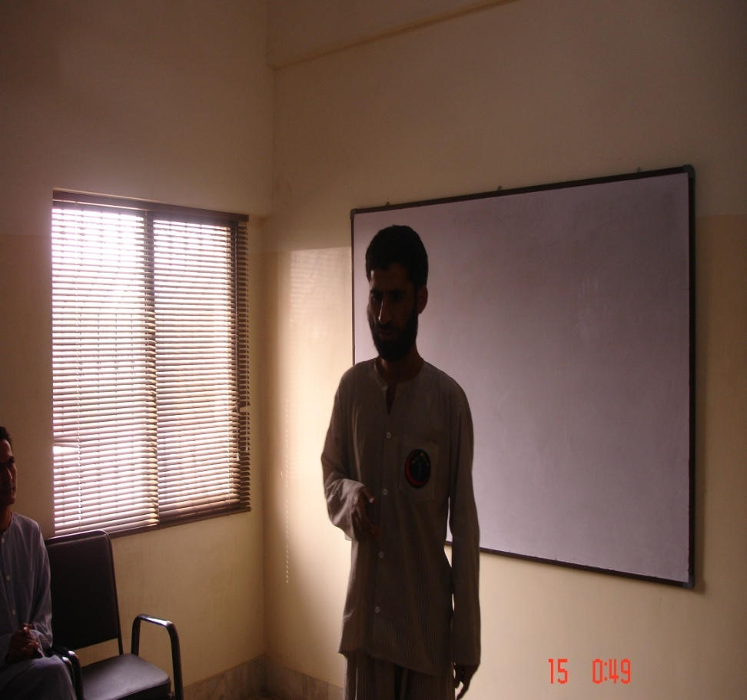
1-Genetic Cause
Modeling
when the father uses drugs, his behavior is predisposed to his next generation and there is vulnerability in his son to be addict whenever a stressful condition comes in his life. 15% chance that son of an addict will become an addict

Slide 6

2- Environmental Cause
Company
Friends
Family
Favorers
Availability

Slide 7
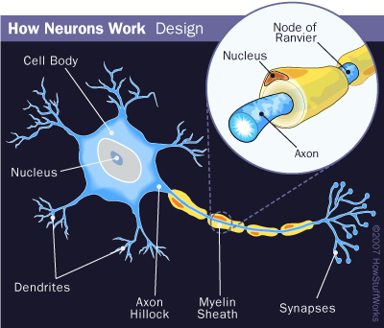
3- Physiological Cause
Psychiatric illness
Biochemical factors
Operation
Accident

Slide 8

4-Psychological /Personality cause
Personality Traits
Antisocial character traits
Curiosity
Revenge
Emotional conflicts
Jealousy
Weak ego coping
Low confidence level
Inferiority complex

Slide 9

cont-
Poor relationships with Family
Feelings of insecurity
Looses hope
Addiction is a Family Illness.
Isolation
Neglect of core values
Family ties and shame
Disregard societal rule

Slide 10
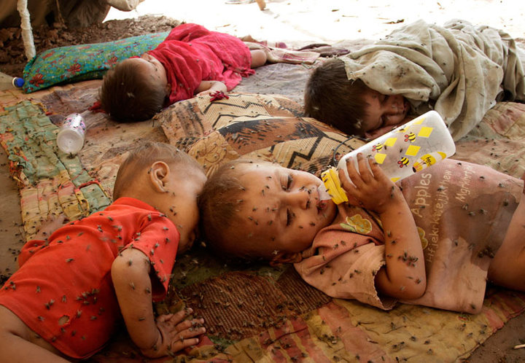
Cont-
Poor Hygiene
Fear and Self Pity
Ridiculous and injustice behavior
Grandiose attitude
Emotional effects
Exaggeration of feelings
Loss of self-esteem

Slide 11
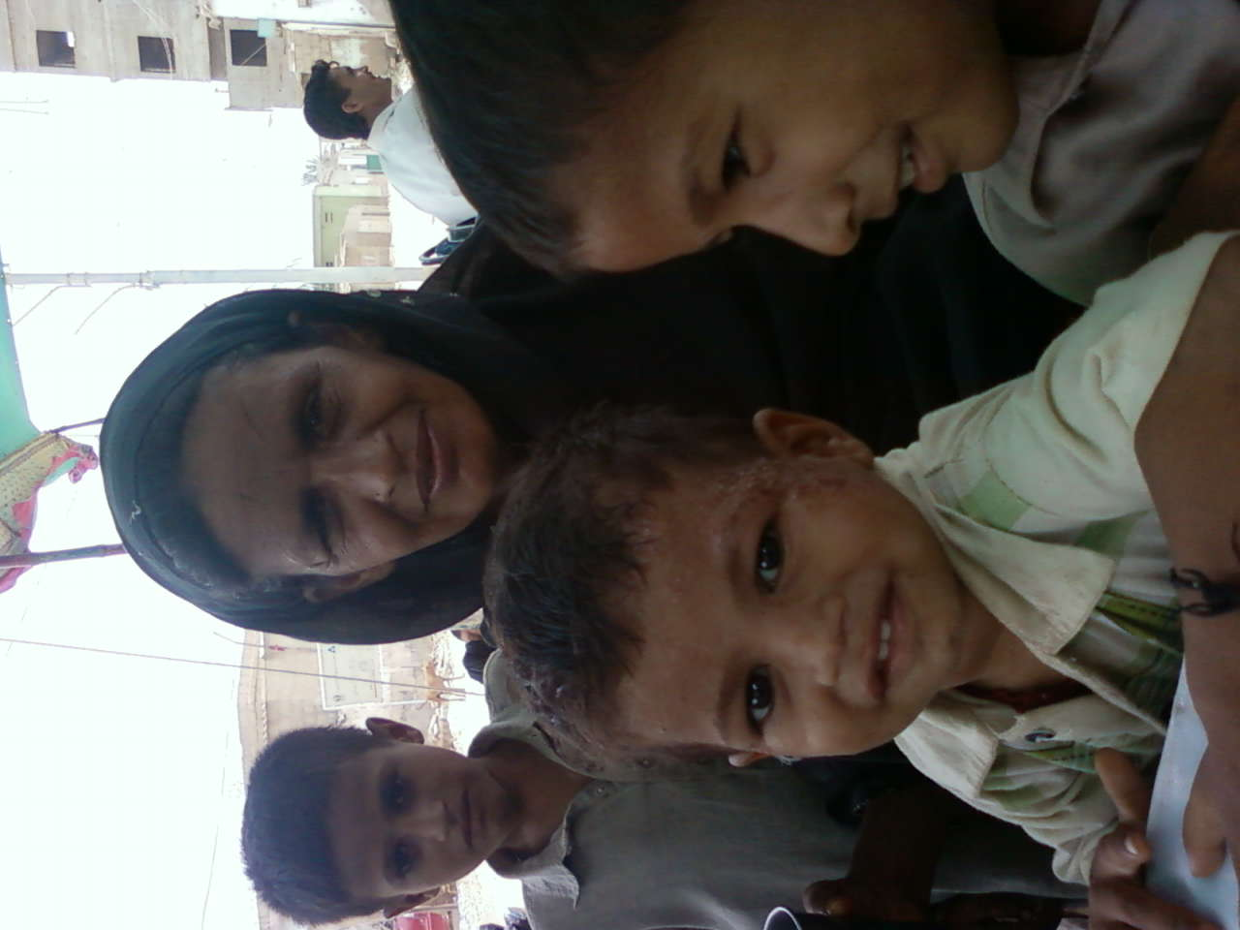
5-Social cause
One member sick role
Family conflicts
Status symbol
Divorce
Separation
Death
Anger
Resentments
Unemployment

Slide 12
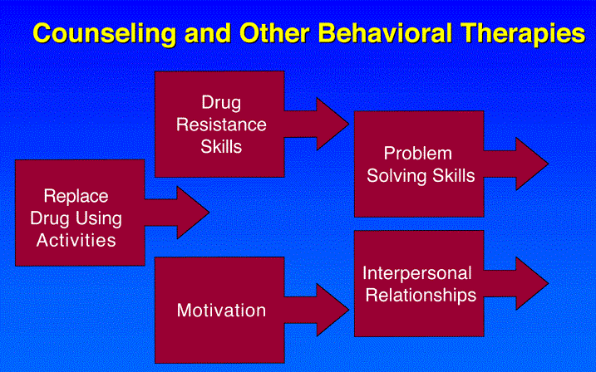
All the effects can be minimized.

Slide 13
Prevention of Addiction
1-Motivation
2-Interpersonal relations
3-Problem solving skills
4-Addiction resistance skills
5-Replace activities with

Slide 14
1-Motivate people for change
Motivate people for change involves increasing their awareness of their need to change and helping them to start moving through the stages of change.
Start “where the person is”
Positive approaches are more effective than confrontation .

Slide 15
Motivation

Slide 16
1-Motivate people for change
Pre-contemplation is stage of awareness about, habits, attitudes and its harm effects. Contemplation is stage unable to decide whether or not to change. Determination is stage of decision making that how to change. Action is stage of need help it is process of change. Maintain is stage of maintain change.
Relapse is not failure its part of again stand up

Slide 17
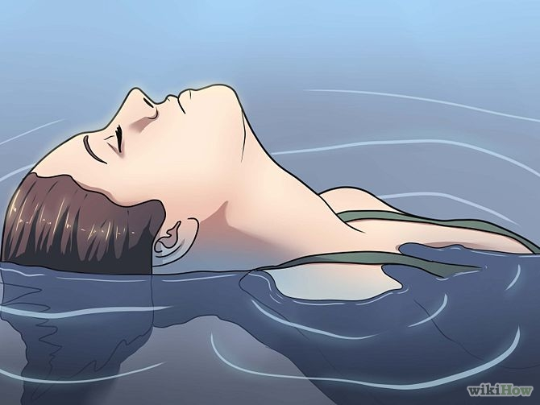
Pre-contemplation is stage of awareness

Slide 18

Contemplation is stage unable to decide

Slide 19

Determination is stage of decision making

Slide 20

Maintain

Slide 21
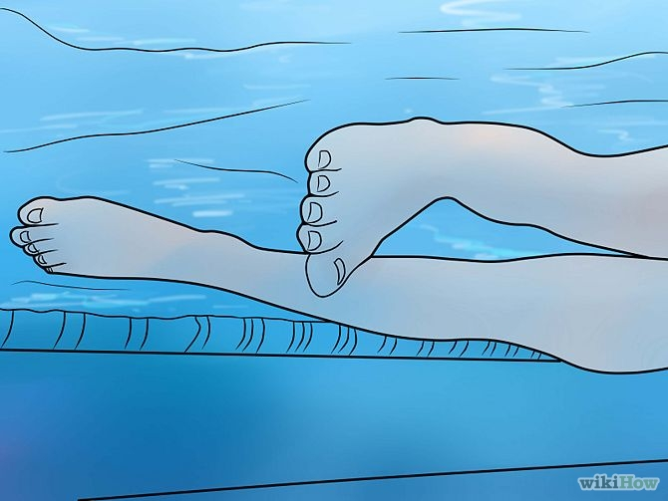
Relapse

Slide 22
2-Interpersonal relations
The right interpersonal relationships can greatly improve the chances of a successful recovery. By being around people who support recovery the individual will benefit from the social support functions of such a group. There can be many challenges to be faced during early recovery, but by having supportive interpersonal relationships it means that these challenges do not have to be faced alone. Such support can come from:
Counselors
Peers in recovery
Family
Friends and work colleagues who support
Online communities that promote sobriety

Slide 23
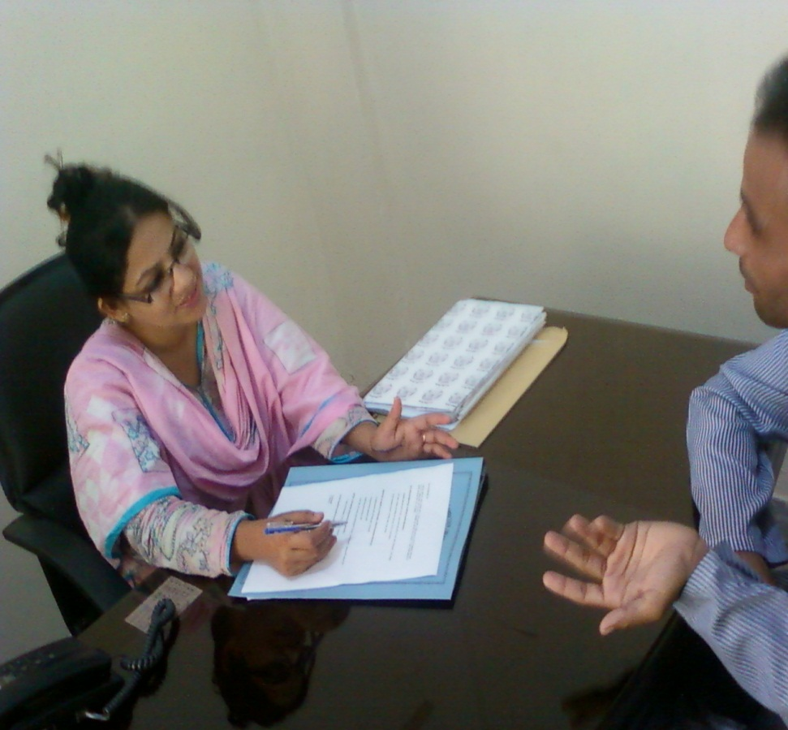
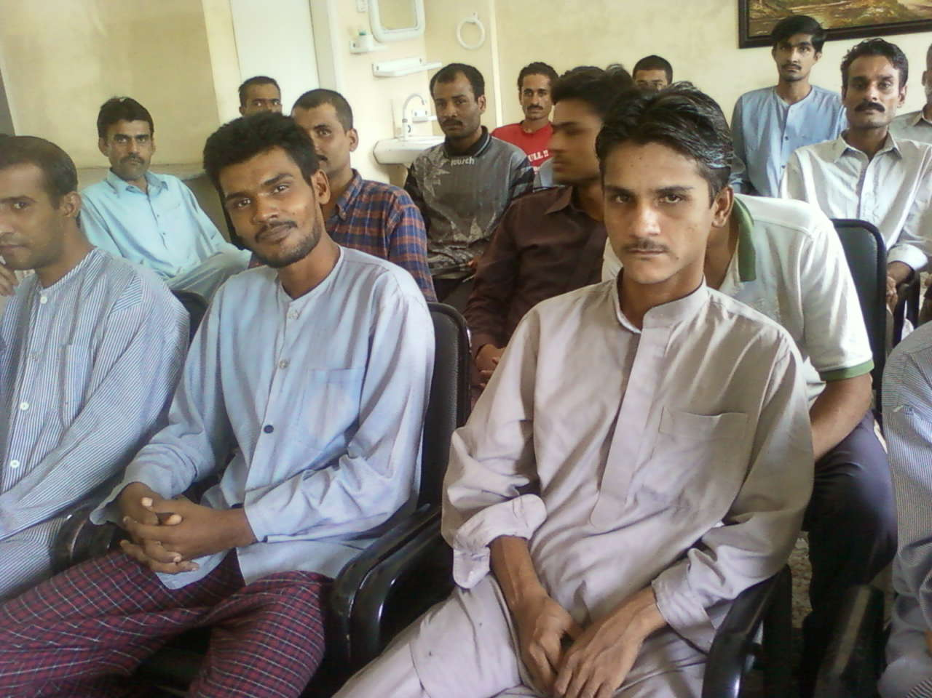
Support can come from

Slide 24
3-Problem solving skills
(1) Problem recognition — determining that a problem exists; (2) Problem Identification — gathering information, being as concrete as possible, checking the accuracy of the information, and defining the exact nature of the problem as well as possible; (3) Considering various approaches — sometimes called “brainstorming,” this involves generating a number of alternatives without regard to how good or bad they are;: (4) Selecting the most promising approach — considering the likely outcomes of the various alternatives and their feasibility, and choosing the approach that maximizes positive consequences while minimizing negative consequences; and (5) Assessing the effectiveness of the selected approach — implementing the chosen alternative and evaluating its results.

Slide 25
4-Addiction resistance skills
Specific coping strategies for relieving stress skills for effectively resisting both peer & media pressures to smoke, drink, use drugs or some other unhealthy activities are effective.
Refusal skill training simply say,,,, NO
Social skills training
Communication skills training
Coping skills with life stressors
Skills for increasing self-control
Skills for increasing self-esteem

Slide 26
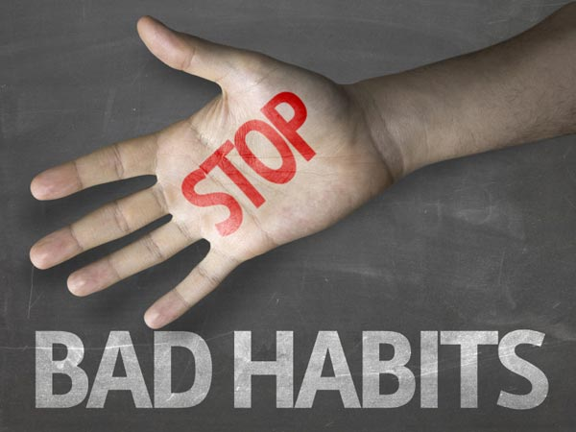
Simply say,,,, NO

Slide 27
5-Replace activities with addictive habits
We all have a mix of good and bad habits. Bad habits cause untold suffering. Good habits serve us in the cause of our liberation. To understand how we got where we are and how to change direction, we need to understand the formation and transformation of habits. The seeker will need to release the energy captured by bad habits and transfer this power to liberating good habits.

Slide 28
Conti,,,,,
1.Engage in constructive activities related to health, work, relationships, recreation, or hobbies.
2.Avoide every thing that associate with bad habits as a single thought or visual image can stimulate craving prevent these thoughts from becoming action.
3.Affirmations and will that mind has the key that can unlock the door of a bad habit, We need to choose our thoughts carefully.

Slide 29
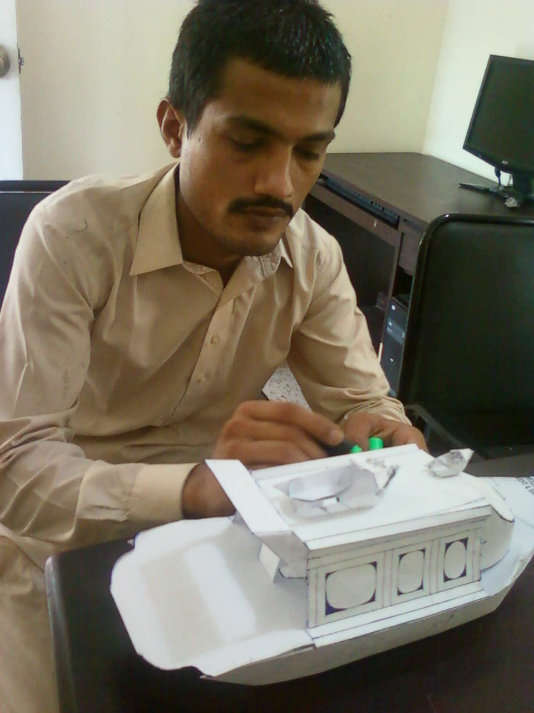
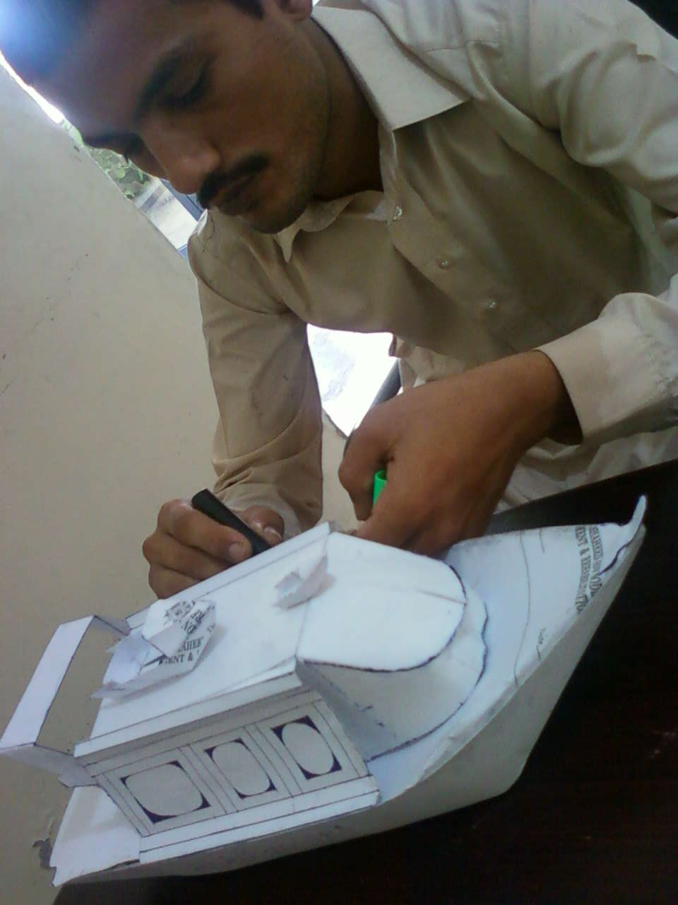
Engage in constructive activities

Slide 30
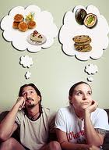

image can stimulate craving

Slide 31
Conti,,,,,
4.Support people who support our spiritual goals friends and family associated with our bad habits often try to pull us back. When we move forward, they take it personally.
5.Change your environment Removing reminders and temptations from your home break relations with people who enable your condition. and workplace can make the break easier
6.Review your past attempts at quitting. Note what worked, what didn't and what might have led to falling back into old habits. Then, make appropriate changes.

Slide 32


Change your environment

Slide 33
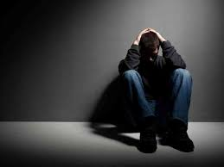
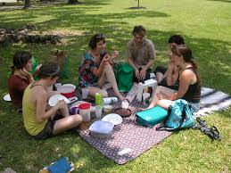
Review your past attempts

