Slide 1
Attitudes
How Attitudes develops and change

Slide 2
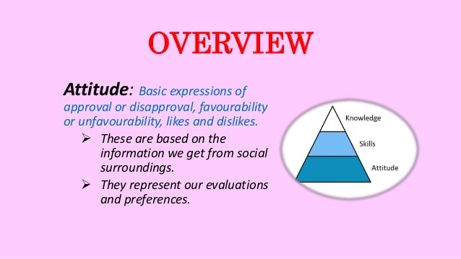
Attitudes

Slide 3
Definition of attitude
Favorable of unfavorable reaction to issue, idea, object, a specific behavior or entire social group is called attitude.
some attitude quite stable and resistant to change but some are unstable, unclear, or uncertain.

Slide 4

How Attitudes develop or format

Slide 5
1- Attitude format by association learning
Classical conditioning , it is very important implication in attitude formation. in this process unconditional and conditional stimuli involve to produce positive responses. this process not only affect the consumer preferences but also social attitude .attitude develops or format by associating product with attractive stimuli benefits or qualities.

Slide 6
2- Instrumental learning(reward for right)
Reward and punishment also format or develop our attitudes. we may be aware that different groups we belong to will reward or punish us for expressing support for the particular attitude positions.
Like ,,,,,,, Religion , political issues, social views.

Slide 7
3- Attitude develop by Observational learning (exposure)
Individual acquire attitudes or behaviors simply by observing others , most of us are doing as we watch television. We have tendency to compare our self that tend to social compression, and conclude that our ideas and attitudes are correct ,people adjust their attitudes so as to hold view closer to those of others who they value of identify with their reference group.

Slide 8
4- Attitude develop by Culture influences
Dominate culture have great influence to shaping attitude of others culture holders. different Nations are adopting the attitude of dominating culture group. therefore belief in detachment exist in tandem with materialism , collectivism, individualism, and humanism with power orientations.

Slide 9

Dominate culture

Slide 10

Nations are adopting the attitude

Slide 11
Attitudes and Behaviors
Other influences
Expressed Attitude (subjective)
Attitude
Behavior (subjective)
Other influences

Slide 12
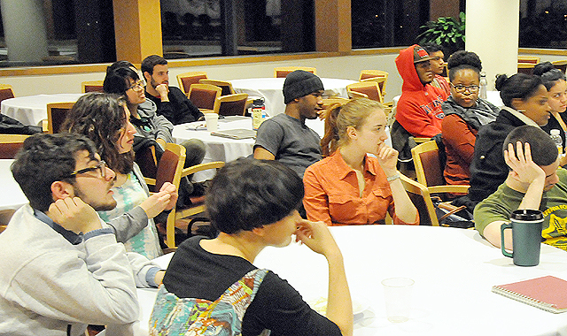
Attitudes and Behaviors

Slide 13
Attitude - Behavior Correspondence
Attitude could be measure through observing Behavior and Behavior could be predict thought measuring Attitudes,
like ,,,,,,,,,,,,,,,,,,,,,,,,,,,,,,, health related practice.
both corresponding , ,, benefits related to attitude and jogging related to behavior.
both is subjective .
Attitude
Behavior

Slide 14
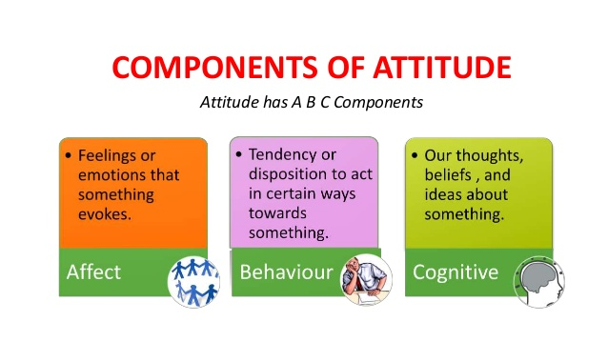

Slide 15
Attitudes = blend of values and beliefs=Attitudes An attitude that is resistance to change =prejudice A component of a prejudicial attitude =stereotyping simply defines a stereotype as ‘a shared conception of peoples.

Slide 16
How are attitudes formed?
Who influences what think
(cognitive), feel (affective) and as a
result the may affect the way you
behave (behavioral)?

Slide 17
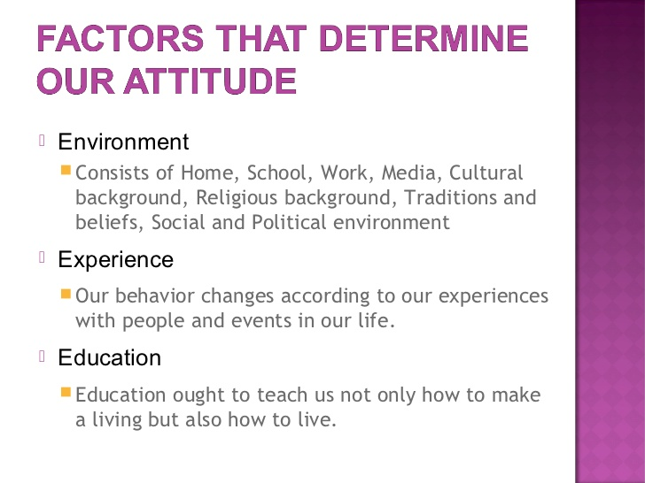

Slide 18
Attitude Based
based on beliefs
based on feelings
based on behavior

Slide 19
Attitude based on Beliefs
First Attitudes can be based on beliefs. Just information we have about a product so we might hold an attitude toward a car because we believe it gets high gas mileage and has a good repair history.

Slide 20
Attitude based on feelings
Attitudes can also be based on feelings or emotional, that's the second component. A lot of attitudes toward other people are based on these emotional reactions so we may not know very much about a person but have a very strong emotional response to that person.

Slide 21
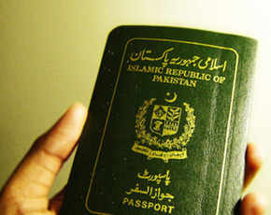
Attitude based on feelings

Slide 22
Attitude based on behavior
Attitudes are largely developed through experience. Identify and describe factors that form attitude.
If attitude is based on false information and is unfair, then it becomes prejudice.

Slide 23
How Attitude change
While attitudes can have a powerful effect on behavior, they are not set in stone. The same influences that lead to attitude formation can also create attitude change.

Slide 24
Learning Theory of Attitude Change:
Classical conditioning, operant conditioning and observational learning can be used to bring about attitude change. Classical conditioning can be used to create positive emotional reactions to an object, person or event by associating positive feelings with the target object. Operant conditioning can be used to strengthen desirable attitudes and weaken undesirable ones. People can also change their attitudes after observing the behavior of others.

Slide 25
Elaboration Likelihood Theory of Attitude Change:
This theory of persuasion suggests that people can alter their attitudes in two ways. First, they can be motivated to listen and think about the message, thus leading to an attitude shift. Or, they might be influenced by characteristics of the speaker, leading to a temporary or surface shift in attitude. Messages that are thought-provoking and that appeal to logic are more likely to lead to permanent changes in attitudes.

Slide 26
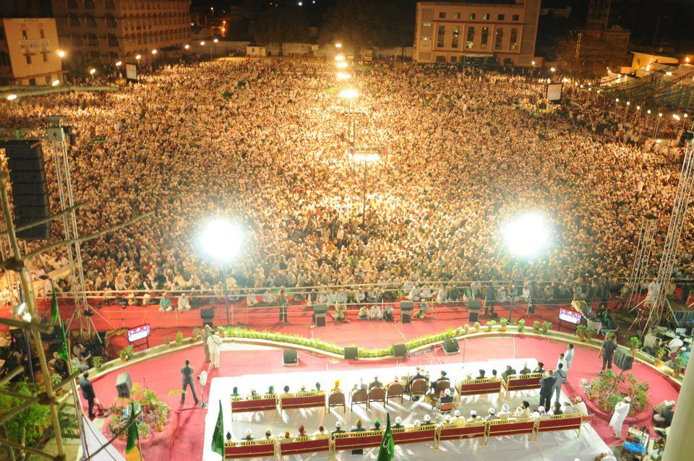
motivated to listen and think about the message

Slide 27
influenced by characteristics of the speaker,
The coach / teacher (person who is persuading) is perceived as:
Expert (perceived as having high status or credibility)
Trustworthy

Slide 28
the message /information given:
is clear, relevant, believable, concise
makes sense, is accurate, unambiguous (not having more than one meaning, certain)
is appropriately balanced between:
emotion and logic, pros and cons.

Slide 29
Dissonance Theory of Attitude Change:
As mentioned earlier, people can also change their attitudes when they have conflicting beliefs about a topic. In order to reduce the tension created by these incompatible beliefs, people often shift their attitudes.

Slide 30
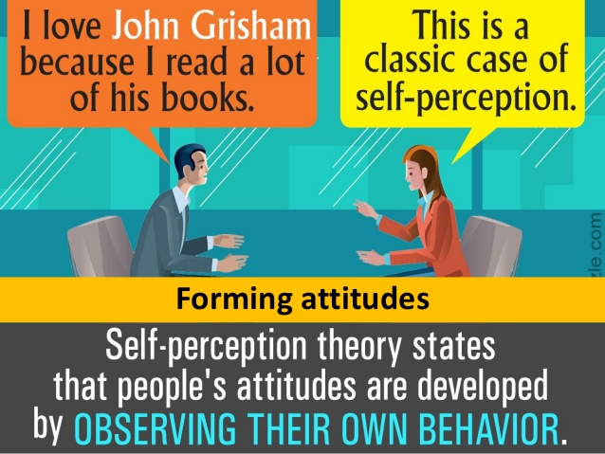

Slide 31
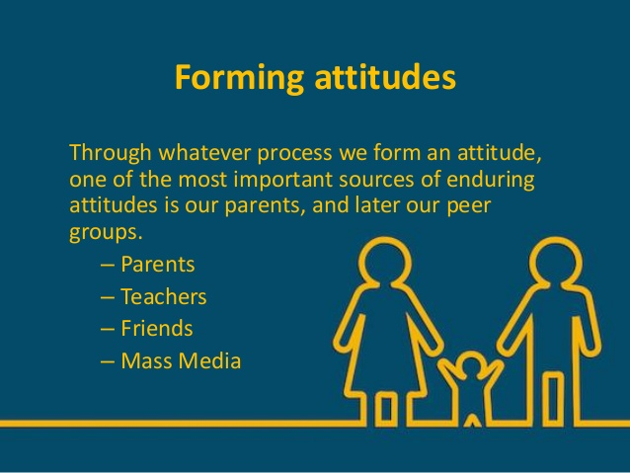

Slide 32


Slide 33
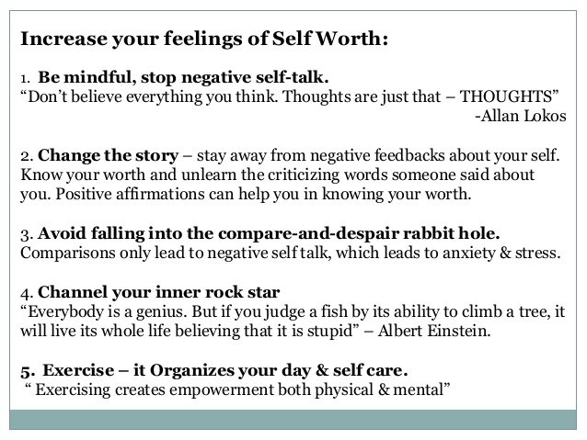

Slide 34
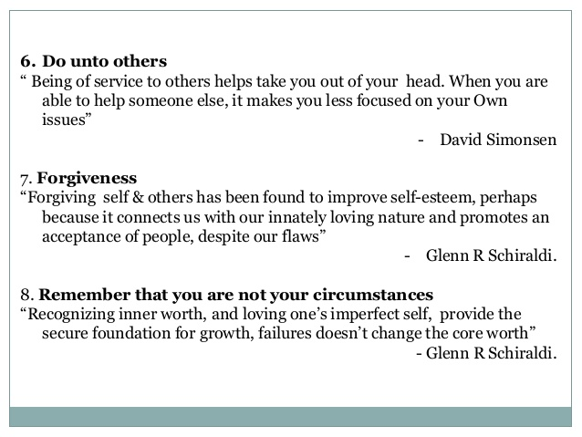

Slide 35
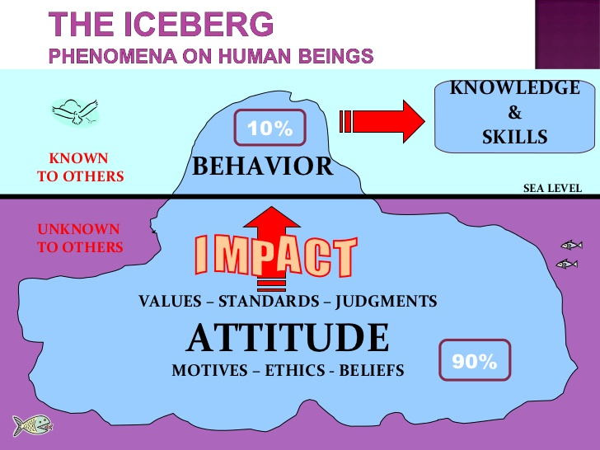

Slide 36


