Slide 1
Software Construction & Development
Week 11
Abeeha Sattar

Slide 2
More on MVC

Slide 3
MVC Pattern
Model: This component stores the application data. It has no knowledge about the interface. The model is responsible for handling the domain logic(real-world business rules) and communication with the database and network layers.
View: It is the UI(User Interface) layer that holds components that are visible on the screen. Moreover, it provides the visualization of the data stored in the Model and offers interaction to the user.
Controller: This component establishes the relationship between the View and the Model. It contains the core application logic and gets informed of the user’s behavior and updates the Model as per the need.

Slide 4
Advantages of MVC
MVC pattern increases the code testability and makes it easier to implement new features as it highly supports the separation of concerns.
Unit testing of Model and Controller is possible.
Functionalities of the View can be checked through UI tests if the View respect the single responsibility principle(update controller and display data from the model without implementing domain logic)

Slide 5
Disadvantages of MVC
Code layers depend on each other even if MVC is applied correctly.
No parameter to handle UI logic i.e., how to display the data.

Slide 6
MVP Pattern
Model: Layer for storing data. It is responsible for handling the domain logic(real-world business rules) and communication with the database and network layers.
View: UI(User Interface) layer. It provides the visualization of the data and keep a track of the user’s action in order to notify the Presenter.
Presenter: Fetch the data from the model and applies the UI logic to decide what to display. It manages the state of the View and takes actions according to the user’s input notification from the View.

Slide 7
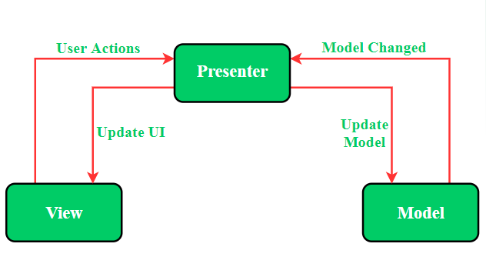
MVP Pattern

Slide 8
Advantages of MVP
Easy code maintenance and testing as the application’s model, view, and presenter layer are separated.

Slide 9
Disadvantages of MVP
If the developer does not follow the single responsibility principle to break the code then the Presenter layer tends to expand to a huge all-knowing class.

Slide 10
MVVM Pattern
Model: This layer is responsible for the abstraction of the data sources. Model and ViewModel work together to get and save the data.
View: The purpose of this layer is to inform the ViewModel about the user’s action. This layer observes the ViewModel and does not contain any kind of application logic.
ViewModel: It is responsible for exposing methods, commands, and other properties that help to maintain the state of the view, manipulate the model as the result of actions on the view, and trigger events in the view itself.
View has a reference to View-Model but View-Model has no information about the View.

Slide 11
MVVM pattern supports two-way data binding between View and View-Model.
Generally, the View-Model utilizes the observer pattern to inform changes in the View-Model to the Model.

Slide 12
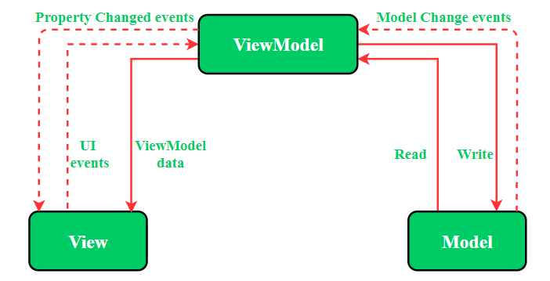
MVVM Pattern

Slide 13
Advantages of MVVP
Enhance the reusability of code.
All modules are independent which improves the testability of each layer.
Makes project files maintainable and easy to make changes.

Slide 14
Disadvantages of MVVP
This design pattern is not ideal for small projects.
If the data binding logic is too complex, the application debug will be a little harder.

Slide 15
Key Differences Between MVC and MVP Design Pattern
MVC(Model View Controller) | MVP(Model View Presenter
One of the oldest software architecture | Developed as the second iteration of software architecture which is advance from MVC.
UI(View) and data-access mechanism(Model) are tightly coupled. | The View is loosely coupled to the Model.
Controller and View layer falls in the same activity/fragment | Communication between View-Presenter and Presenter-Model happens via an interface.

Slide 16
Key Differences Between MVC and MVP Design Pattern (continued)
User inputs are handled by Controller which instructs the model for further operations. | User inputs are handled by View which instructs the presenter to call appropriate functions.
The many-to-one relationship exists between Controller and View as one Controller can select different View based upon required operations. | The one-to-one relationship exists between Presenter and View as one Presenter class manages one View at a time.
The Controller is the overall in charge as it creates the appropriate View and interacts with the Model according to the user’s request. | The View is the overall in charge in this schema as View call methods of Presenter which further directs Model.
Limited support to Unit Testing | Unit Testing is highly supported.

Slide 17
Differences b/w MVC & MVP
MVC | MVP
The controller acts as a bridge between view and model layers and hence provides the user interface to the application. | The presenter is used to show the output to the user with the interface. The view is more or less connected only with the model.
The coupling in MVC is between the Controller and View to handle the business logic and hence to present the result. | There is a tight coupling between view and presenter, and a change in view affects the presenter’s user interface.
Only one user interface is used, which is most basic as this is the primary architecture evolved into designing the application. | Since the user interface is used more, there are a large number of interfaces that make the architecture heavy.
Business logic and any other logics are present only in the model layer where the data is present. | Business logic and UI are separate, and hence testing is done easily on the layers as separate and also as integration testing.
Debugging is done with the help of ASP.NET, and it takes some time to complete the compilation of the codes. | Debugging is easy for MVP applications, and it will not take much time to do the compiling using the architecture.

Slide 18
Differences b/w MVC & MVP(continued)
The layers are separated in a proper divided manner, and the controller connects both the other layers of the architecture. | The layers are separated and hence the fragments and activity classes are ensured to work in their manner.
New releases are done easily in MVC architecture and the version release of ASP.NET. It helps the architecture be updated. | New releases cannot be done easily in the MVP architecture, and maintenance and availability cannot always be ensured in the architecture.
Unit testing is done in MVC as the layers are properly separated from one another. | The logic and application lie in the business logic that is present in the Model layer. Core testing cannot be done in this case.
GUI is controlled in the controller layer, and this helps to do the testing in the layering section alone. | UI and automation create troubles in the testing phase, and it is better to do their testing before going with core logic testing.
It shows only one view and cannot accommodate complex views in the application. This will disrupt the architecture. | View to the presenter is mapped as one to one interaction. Different views have different views on the application.
Data is retrieved from the model layer, and updating those data is done only in the controller layer. Due to the division, other layers are not involved in any of the activities. | Data is retrieved from the model layer, and updates to the data are done in both the presenter layer and view layer.

Slide 19
Differences b/w MVP & MVVM
MVP | MVVM
Observables are not needed in MVP as a presenter layer is in the architecture to display the developers’ user interface. | Observables are needed for each User Interface component due to the absence of the Presenter.
There is a tight coupling between view and presenter, and a change in view affects the presenter’s user interface. | The view and view model are not tightly coupled, and this helps the layers to work independently in each layer and to do the unit testing.
Since the user interface is used more, many interfaces make the architecture heavy. | There is no user interface, and hence fewer interfaces are used. The architecture is light when compared with MVP.
Business logic and UI are separate, and hence testing is done easily on the layers as separate and as integration testing. | Business logic and UI is not separate, which makes testing difficult. Only unit testing can be done in that case.
Debugging is easy for MVP applications, and it will not take much time to do the compiling using the architecture. | Debugging is not easy in MVVM due to the complex layering patterns and the architectural style.

Slide 20
Differences b/w MVP & MVVM (continued)
The layers are separated, and hence the fragments and activity classes are ensured to work in their own manner. | The layers are not separated, and hence the classes are not ensured to produce the expected output from the user.
New releases cannot be done easily in the MVP architecture, and maintenance and availability cannot always be ensured in the architecture. | New releases can be done easily in the architecture, and the maintenance of the layers are really appreciable.
The logic and application lie in the business logic that is present in the Model layer. Core testing cannot be done in this case. | The logic and application lie in the MVVM architecture code, which helps to do the testing at the core level.
UI and automation create troubles in the testing phase, and it is better to do their testing before going with core logic testing. | User Interface does not enter into the phase of these layers, and this helps to do the maintenance part by itself to the code.
Various methods are available in the architecture as the interface covers only a small part of interactions. | Different methods are not available as there are no interfaces to fragment the interactions of the architecture.
MVP architecture does not go well with the android applications or software and has activities as fragments in each stage of the life cycle. | MVVM architecture goes well with android applications and updates the software with the new patches in the system. This helps the software to be up-to-date.

Slide 21

Fin.

