Slide 1
Software Construction & Development
Week 13
Abeeha Sattar

Slide 2
Software Testing
https://www.guru99.com/software-testing.html

Slide 3
What is Software Testing?
Software Testing is a method to check whether the actual software product matches expected requirements and to ensure that software product is defect free.
You identify the:
Correctness
Completeness
Quality
..of a developed software.

Slide 4
What does it entail?
A set of activities which help us find errors in the software.

Slide 5
Why do we test any software?
Software Testing is Important because if there are any bugs or errors in the software, it can be identified early and can be solved before delivery of the software product.
Properly tested software product ensures
Reliability,
Security, and
High performance
… which further results in time saving, cost effectiveness and customer satisfaction.

Slide 6
Why do we test any software?
Testing is important because software bugs could be expensive or even dangerous. Software bugs can potentially cause monetary and human loss, and history is full of such examples.
Some of Amazon’s third-party retailers saw their product price is reduced to 1p due to a software glitch. They were left with heavy losses.
In 2015 fighter plane F-35 fell victim to a software bug, making it unable to detect targets correctly.
China Airlines Airbus A300 crashed due to a software bug on April 26, 1994, killing 264 innocents live
In April of 1999, a software bug caused the failure of a $1.2 billion military satellite launch, the costliest accident in history

Slide 7
Benefits of Software Testing
Cost-Effective: It is one of the important advantages of software testing. Testing any IT project on time helps you to save your money for the long term. In case if the bugs caught in the earlier stage of software testing, it costs less to fix.
Security: It is the most vulnerable and sensitive benefit of software testing. People are looking for trusted products. It helps in removing risks and problems earlier.
Product quality: It is an essential requirement of any software product. Testing ensures a quality product is delivered to customers.
Customer Satisfaction: The main aim of any product is to give satisfaction to their customers. UI/UX Testing ensures the best user experience.

Slide 8
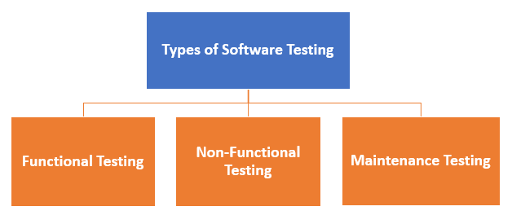
Types of Software Testing

Slide 9
Functional Testing
Unit Testing
Integration Testing
Smoke
UAT ( User Acceptance Testing)
Localization
Globalization
Interoperability

Slide 10
Non-functional Testing
Performance
Endurance
Load
Volume
Scalability
Usability

Slide 11
Maintenance Testing
Regression
Maintenance

Slide 12
Unit Testing
This software testing basic approach is followed by the programmer to test the unit of the program. It helps developers to know whether the individual unit of the code is working properly or not.

Slide 13
Unit Testing
A type of software testing where individual units or components of a software are tested.
Unit Testing is done during the development (coding phase) of an application by the developers.
Unit Tests isolate a section of code and verify its correctness.
A unit may be an individual function, method, procedure, module, or object.

Slide 14
Why do Unit Testing?
If proper unit testing is done in early development, then it saves time and money in the end.
Software developers sometimes try saving time doing minimal unit testing, but
inappropriate unit testing leads to high cost defect fixing during System Testing, Integration Testing and even Beta Testing after application is built.

Slide 15
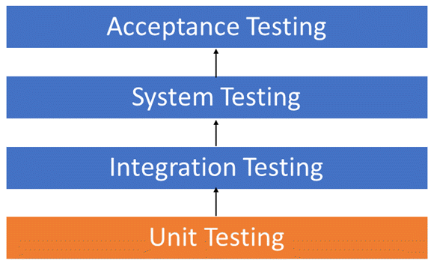

Slide 16
Reasons to Unit Test
Unit tests help to fix bugs early in the development cycle and save costs.
It helps the developers to understand the testing code base and enables them to make changes quickly
Good unit tests serve as project documentation
Unit tests help with code re-use. Migrate both your code and your tests to your new project. Tweak the code until the tests run again.

Slide 17
Code Coverage in Unit Testing
It helps define the degree to which you code has been tested. It has different types:
Statement Coverage
Decision Coverage
Branch Coverage
Condition Coverage
Finite State Machine Coverage
[https://www.guru99.com/code-coverage.html]

Slide 18
Statement Coverage
Statement Coverage is a white box testing technique in which all the executable statements in the source code are executed at least once.
If we look at the source code, there will be a wide variety of elements like operators, functions, looping, exceptional handlers, etc.
The goal of Statement coverage is to cover all the possible path’s, line, and statement in the code.

Slide 19
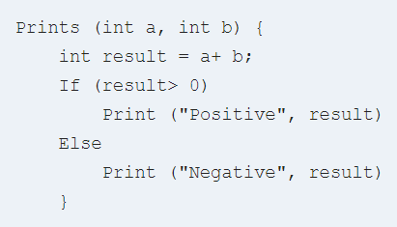
Example Code

Slide 20

Decision Coverage
Decision Coverage is a white box testing technique which reports the true or false outcomes of each boolean expression of the source code. The goal of decision coverage testing is to cover and validate all the accessible source code by checking and ensuring that each branch of every possible decision point is executed at least once.

Slide 21
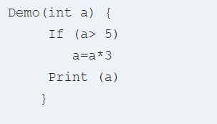
Example Code

Slide 22

Branch Coverage
Branch Coverage is a white box testing method in which every outcome from a code module(statement or loop) is tested.
The purpose of branch coverage is to ensure that each decision condition from every branch is executed at least once.
It helps to measure fractions of independent code segments and to find out sections having no branches.
100% branch coverage usually means 100% statement coverage. Why?

Slide 23
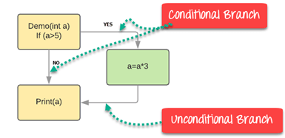
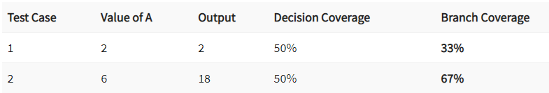
Branch Coverage

Slide 24
Example
printSum(int a, int b) {
int result = a+b;
if (result >0)
System.out.printlbn("red");
else if (result < 0)
System.out.printlbn("blue");
System.out.println(“green");
}

Slide 25
Condition Coverage
Condition Coverage or expression coverage is a testing method used to test and evaluate the variables or sub-expressions in the conditional statement.
The goal of condition coverage is to check individual outcomes for each logical condition.
Condition coverage offers better sensitivity to the control flow than decision coverage. In this coverage, expressions with logical operands are only considered.

Slide 26
Example
myFunction(float x, float y) {
if (x != 0 || y > 0)
y = y / x;
else
x = x + y;
System.out.println("X = " + x);
System.out.println("Y = " + y);
}

Slide 27
How to test Conditional Coverage?
Possible outcomes:
T || T = T
F || F = F
T || F = T
F || T = T
Example Input
x = 0, y = 4
x = 1, y = 0

Slide 28
Finite State Machine Coverage
Finite state machine coverage is certainly the most complex type of code coverage method. This is because it works on the behavior of the design. In this coverage method, you need to look for how many time-specific states are visited, transited.

Slide 29
Unit Testing Best Practices
Unit Test cases should be independent.
Test only one code at a time.
Follow clear and consistent naming conventions for your unit tests.
In case of a change in code in any module, ensure there is a corresponding unit Test Case for the module, and the module passes the tests before changing the implementation.
Bugs identified during unit testing must be fixed before proceeding to the next phase in SDLC.
Adopt a “test as you code” approach. The more code you write without testing, the more paths you have to check for errors.

Slide 30
JUnit
[https://www.guru99.com/junit-test-framework.html]

Slide 31
Testing with JUnit
You can follow the steps here to set up your JUnit with Eclipse, for your project:
[https://www.guru99.com/download-installation-junit.html]

Slide 32
About JUnit
JUnit is the most popular unit Testing framework in Java.
It is explicitly recommended for Unit Testing.

Slide 33
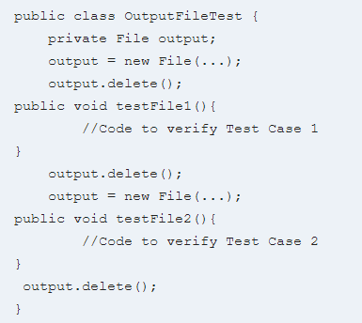
Badly Written Test Code
Notes:
Few issues here
The code is not readable
The code is not easy to maintain.
When the test suite is complex the code could contain logical issues.

Slide 34
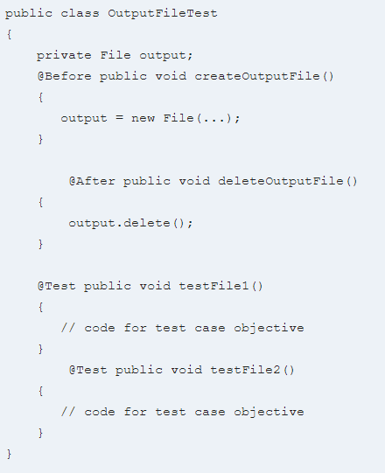
Test Fixture
Notes:
The code far more readable and maintainable. The above code structure is a Test fixture.

Slide 35
Test Fixture
A test fixture is a context where a JUnit Test Case runs. Typically, test fixtures include:
Objects or resources that are available for any test case.
Activities required that makes these objects/resources available.
These activities are
allocation (setup)
de-allocation (teardown).

Slide 36
Setup and Teardown
Usually, there are some repeated tasks that must be done prior to each test case.
Example: create a database connection.
Likewise, at the end of each test case, there may be some repeated tasks.
Example: to clean up once test execution is over.
JUnit provides annotations that help in setup and teardown. It ensures that resources are released, and the test system is in a ready state for next test case.

Slide 37
@Before Annotation
@Before annotation in JUnit is used on a method containing Java code to run before each test case. i.e it runs before each test execution.

Slide 38
@After annotation
@After annotation is used on a method containing java code to run after each test case. These methods will run even if any exceptions are thrown in the test case or in the case of assertion failures.

Slide 39
@Before & @After Annotations
It is allowed to have any number of annotations listed above.
All the methods annotated with @Before in JUnit will run before each test case, but they may run in any order.
You can inherit @Before and @After methods from a super class, Execution is as follows: It is a standard execution process in JUnit.

Slide 40
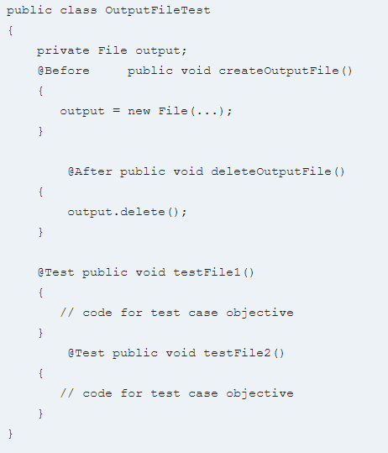
Proper Class with a Test Fixture
Notes:
createOutputFile()
testFile1()
deleteOutputFile()
createOutputFile()
testFile2()
deleteOutputFile()

Slide 41

Once Only Setup
@BeforeClass
It is possible to run a method only once for the entire test class before any of the tests are executed, and prior to any @Before method(s).
“Once only setup” are useful for starting servers, opening communications, etc. It’s time-consuming to close and re-open resources for each test.

Slide 42

Once Only Teardown
@AfterClass
Similar to once only setup , a once-only cleanup method is also available. It runs after all test case methods and @After annotations have been executed.
It is useful for stopping servers, closing communication links, etc.

Slide 43
JUnitCore
JUnitCore class is used to execute the test cases.
A method called runClasses provided by org.junit.runner.JUnitCore, is used to run one or several test classes.
Return type of this method is the Result object (org.junit.runner.Result), which is used to access information about the tests.

Slide 44
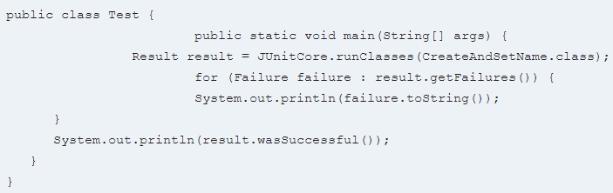
Code Example

Slide 45
First JUnit Test

Slide 46
MyFirstClassTest.java
import static org.JUnit.Assert.*;
import org.JUnit.Test;
public class MyFirstClassTest {
@Test
public void myFirstMethod(){
String str= "JUnit is working fine";
assertEquals("JUnit is working fine",str);
}
}

Slide 47
TestRunner.java
import org.JUnit.runner.JUnitCore;
import org.JUnit.runner.Result;
import org.JUnit.runner.notification.Failure;
public class TestRunner {
public static void main(String[] args) {
Result result = JUnitCore.runClasses(MyFirstClassTest.class);
for (Failure failure : result.getFailures()) {
System.out.println(failure.toString());
}
System.out.println("Result=="+result.wasSuccessful());
}
}

Slide 48
Other Annotations
@Ignores
This annotation can be used if you want to ignore some statements during test execution for e.g. disabling some test cases during test execution.
@Test(timeout=500)
This annotation can be used if you want to set some timeout during test execution for e.g. if you are working under some SLA (Service level agreement), and tests need to be completed within some specified time.
@Test(expected=IllegalArgumentException.class)
This annotation can be used if you want to handle some exception during test execution. For, e.g., if you want to check whether a particular method is throwing specified exception or not.

Slide 49
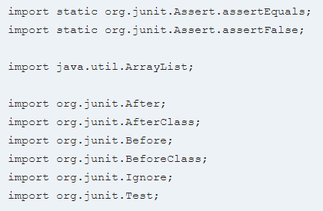
Example with all Annotations
Some imports:

Slide 50
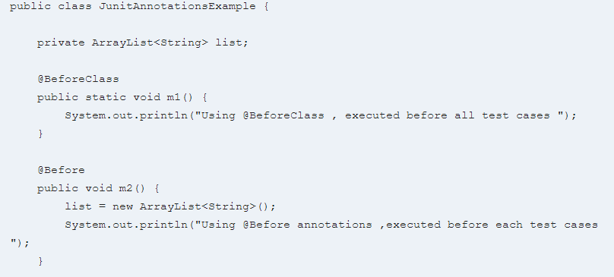
JunitAnnotationsExample.java
Part 1:

Slide 51
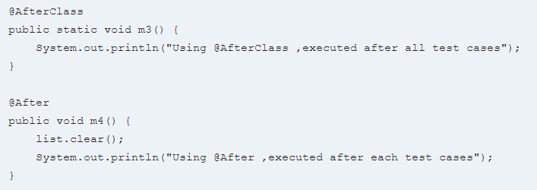
JunitAnnotationsExample.java
Part 2:

Slide 52
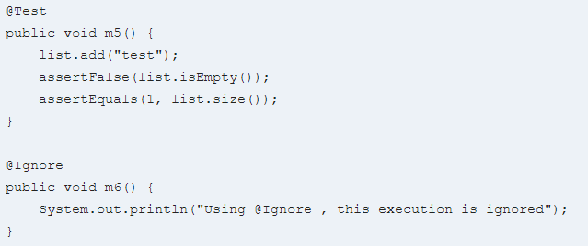
JunitAnnotationsExample.java
Part 3:
Notes:
list.isEmpty() will return false.
assertFalse(list.isEmpty()) must return true.
As a result, the test case will pass.
list.size() must return int value as “1” .
So assertEquals(1, list.size()) must return true.
As a result, the test case will pass.

Slide 53
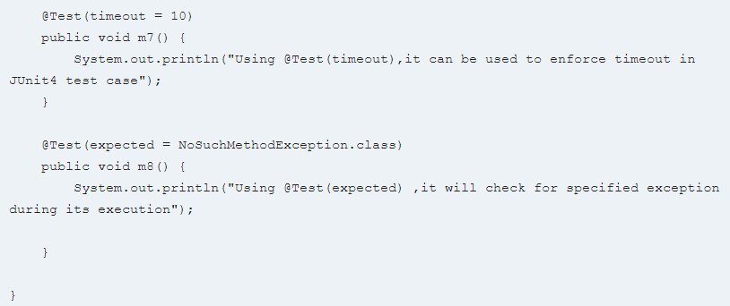
JunitAnnotationsExample.java
Part 4:

Slide 54
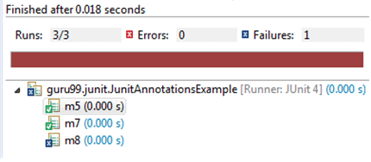
Result:

Slide 55
JUnit Assert Class
This class provides a bunch of assertion methods useful in writing a test case. If all assert statements are passed, test results are successful. If any assert statement fails, test results are failed.

Slide 56
JUnit Assert Class
S.No | Method | Description
1. | void assertEquals(boolean expected, boolean actual) | It checks whether two values are equals similar to equals method of Object class
2. | void assertFalse(boolean condition) | functionality is to check that a condition is false.
3. | void assertNotNull(Object object) | “assertNotNull” functionality is to check that an object is not null.
4. | void assertNull(Object object) | “assertNull” functionality is to check that an object is null.
5. | void assertTrue(boolean condition) | “assertTrue” functionality is to check that a condition is true.
6. | void fail() | If you want to throw any assertion error, you have fail() that always results in a fail verdict.
7. | void assertSame([String message] | “assertSame” functionality is to check that the two objects refer to the same object.
8. | void assertNotSame([String message] | “assertNotSame” functionality is to check that the two objects do not refer to the same object.

Slide 57
Other Classes (explore by yourselves)
JUnit TestCase Class
To run multiple test, TestCase class is available in org.junit.TestCase packages. @Test annotation tells JUnit that this public void method (Test Case here) to which it is attached can be run as a test case.
JUnit TestResult Class
When you execute a test, it returns a result (in the form of TestResult object). This TestResult object can be used to analyze the resultant object. This test result can be either failure or successful.
JUnit TestSuite Class
If you want to execute multiple tests in a specified order, it can be done by combining all the tests in one place. This place is called as the test suites.

Slide 58
Fin.

