Slide 1
Cohesion and Coupling
CS 4311
Frank Tsui, Orland Karam, and Barbara Bernal, Essential of Software Engineering, 3rd edition, Jones & Bartett Learning. Section 8.3.
Hans van Vliet, Software Engineering, Principles and Practice, 3rd edition, John Wiley & Sons, 2008. (Section 12.1)

Slide 2
Outline
Cohesion
Coupling

Slide 3
Characteristics of Good Design
Component independence
  High cohesion
  Low coupling
Exception identification and handling
Fault prevention and fault tolerance
Design for change
M1
M2
M3

Slide 4
Cohesion
Definition
  The degree to which all elements of a component are directed towards a single task.
  The degree to which all elements directed towards a task are contained in a single component.
  The degree to which all responsibilities of a single class are related.
Internal glue with which component is constructed
All elements of component are directed toward and essential for performing the same task.

Slide 5
Type of Cohesion
High Cohesion
Functional
Sequential
Communicational
Procedural
Temporal
Logical
Coincidental
Low

Slide 6
Coincidental Cohesion
Functional
Sequential
Communicational
Procedural
Temporal
Logical
Coincidental
Def: Parts of the component are unrelated (unrelated functions, processes, or data)
Parts of the component are only related by their location in source code.
Elements needed to achieve some functionality are scattered throughout the system.
Accidental
Worst form

Slide 7
Example
Print next line
Reverse string of characters in second argument
Add 7 to 5th argument
Convert 4th argument to float

Slide 8
Logical Cohesion
Functional
Sequential
Communicational
Procedural
Temporal
Logical
Coincidental
Def: Elements of component are related logically and not functionally.
Several logically related elements are in the same component and one of the elements is selected by the client component.

Slide 9
Example
A component reads inputs from tape, disk, and network.
All the code for these functions are in the same component.
Operations are related, but the functions are significantly different.
Improvement?

Slide 10
Temporal Cohesion
Functional
Sequential
Communicational
Procedural
Temporal
Logical
Coincidental
Def: Elements are related by timing involved
Elements are grouped by when they are processed.
Example: An exception handler that
  Closes all open files
  Creates an error log
  Notifies user
  Lots of different activities occur, all at same time

Slide 11
Example
A system initialization routine: this routine contains all of the code for initializing all of the parts of the system. Lots of different activities occur, all at init time.
Improvement?

Slide 12
Procedural Cohesion
Functional
Sequential
Communicational
Procedural
Temporal
Logical
Coincidental
Def: Elements of a component are related only to ensure a particular order of execution.
Actions are still weakly connected and unlikely to be reusable.
Example:
  ...
  Write output record
  Read new input record
  Pad input with spaces
  Return new record
  ...

Slide 13
Communicational Cohesion
Functional
Sequential
Communicational
Procedural
Temporal
Logical
Coincidental
Def: Functions performed on the same data or to produce the same data.
Examples:
  Update record in data base and send it to the printer
    Update a record on a database
    Print the record
  Fetch unrelated data at the same time.
    To minimize disk access

Slide 14
Sequential Cohesion
Functional
Sequential
Communicational
Procedural
Temporal
Logical
Coincidental
Def: The output of one part is the input to another.
Data flows between parts (different from procedural cohesion)
Occurs naturally in functional programming languages
Good situation

Slide 15
Functional Cohesion
Functional
Sequential
Communicational
Procedural
Temporal
Logical
Coincidental
Def: Every essential element to a single computation is contained in the component.
Every element in the component is essential to the computation.
Ideal situation
What is a functionally cohesive component?
  One that not only performs the task for which it was designed but
  it performs only that function and nothing else.

Slide 16
Examples of Cohesion
Function A
Function A
Function A’
Function A’’
Time t₀
Time t₀ + X
Time t₀ + 2X
Function
B
Function
C
logic
Function
D
Function
E
Coincidental
Parts unrelated
Logical
Similar functions
Temporal
Related by time
Function A
Function B
Function C
Procedural
Related by order of functions

Slide 17
Examples of Cohesion (Cont.)
Function A
Function B
Function C
Function A
Function B
Function C
Communicational
Access same data
Sequential
Output of one is input to another
Function A part 1
Function A part 2
Function A part 3
Functional
Sequential with complete, related functions

Slide 18
Exercise: Cohesion for Each Module?
Compute average daily temperatures at various sites
Initialize sums and open files
Create new temperature record
Store temperature record
Close files and print average temperatures
Read in site, time, and temperature
Store record for specific site
Edit site, time, or temperature field
Functional
Sequential
Communicational
Procedural
Temporal
Logical
Coincidental

Slide 19
Outline
Cohesion
Coupling

Slide 20
Coupling
The degree of dependence such as the amount of interactions among components
No dependencies
Loosely coupled
some dependencies
Highly coupled
many dependencies

Slide 21
Coupling
The degree of dependence such as the amount of interactions among components
How can you tell if two components are coupled?
(In pairs, 2 minutes)

Slide 22
Indications of Coupling
?

Slide 23
Type of Coupling
High Coupling
Content
Common
External
Control
Stamp
Data
Uncoupled
Avoid
Loose
Try to achieve
Low

Slide 24
Content Coupling
Content
Common
External
Control
Stamp
Data
Uncoupled
Def: One component modifies another.
Example:
  Component directly modifies another’s data
  Component modifies another’s code, e.g., jumps (goto) into the middle of a routine
Question
  Language features allowing this?

Slide 25
Example
Part of a program handles lookup for customer.
When customer not found, component adds customer by directly modifying the contents of the data structure containing customer data.
Improvement?

Slide 26
Common Coupling
Content
Common
External
Control
Stamp
Data
Uncoupled
Def: More than one component share data such as global data structures
Usually a poor design choice because
  Lack of clear responsibility for the data
  Reduces readability
  Difficult to determine all the components that affect a data element (reduces maintainability)
  Difficult to reuse components
  Reduces ability to control data accesses

Slide 27
Example
Process control component maintains current data about state of operation. Gets data from multiple sources. Supplies data to multiple sinks. Each source process writes directly to global data store. Each sink process reads directly from global data store.
Improvement?

Slide 28
External Coupling
Content
Common
External
Control
Stamp
Data
Uncoupled
Def: Two components share something externally imposed, e.g.,
  External file
  Device interface
  Protocol
  Data format
Improvement?

Slide 29
Control Coupling
Content
Common
External
Control
Stamp
Data
Uncoupled
Def: Component passes control parameters to coupled components.
May be either good or bad, depending on situation.
  Bad if parameters indicate completely different behavior
  Good if parameters allow factoring and reuse of functionality
Good example: sort that takes a comparison function as an argument.
  The sort function is clearly defined: return a list in sorted order, where sorted is determined by a parameter.

Slide 30
Stamp Coupling
Content
Common
External
Control
Stamp
Data
Uncoupled
Def: Component passes a data structure to another component that does not have access to the entire structure.
Requires second component to know how to manipulate the data structure (e.g., needs to know about implementation).
The second has access to more information that it needs.
May be necessary due to efficiency factors: this is a choice made by insightful designer, not lazy programmer.
Notes:
.

Slide 31
Example
Customer Billing System
The print routine of the customer billing accepts customer data structure as an argument, parses it, and prints the name, address, and billing information.
Improvement?

Slide 32
Improvement --- OO Solution
Use an interface to limit access from clients
Customer
get name get address get billing info get other info …
?
void print (Customer c) { … }

Slide 33
Data Coupling
Content
Common
External
Control
Stamp
Data
Uncoupled
Def: Component passes data (not data structures) to another component.
Every argument is simple argument or data structure in which all elements are used
Good, if it can be achieved.
Example: Customer billing system
  The print routine takes the customer name, address, and billing information as arguments.
CS 4311

Slide 34
Uncoupled
Content
Common
External
Control
Stamp
Data
Uncoupled
Content
Common
Control
Stamp
Data
Uncoupled
Completely uncoupled components are not systems.
Systems are made of interacting components.

Slide 35
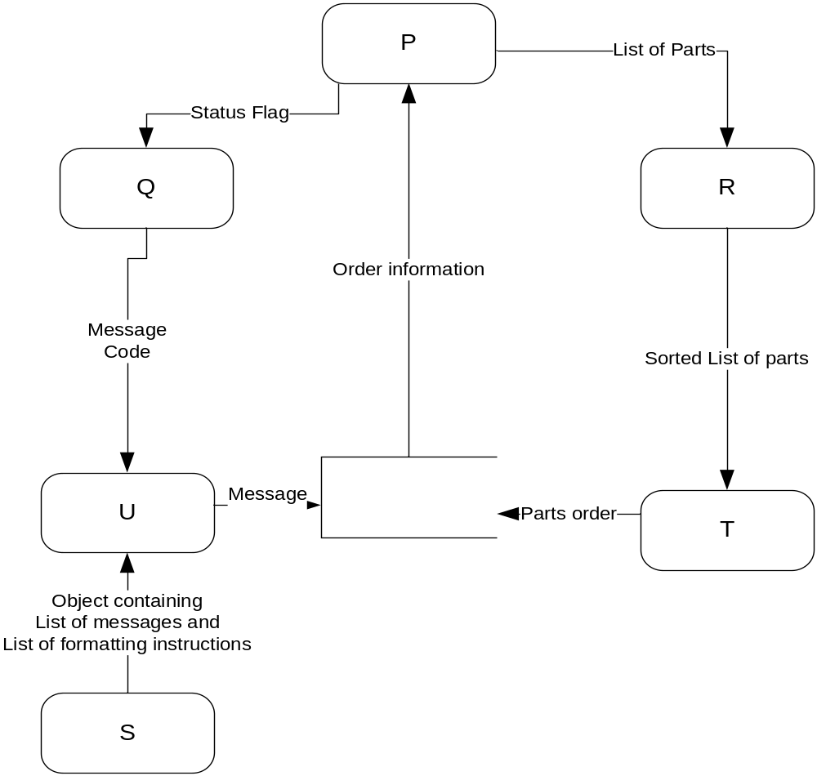
Exercise: Define Coupling between Pairs of Modules
Content
Common
External
Control
Stamp
Data
Uncoupled

Slide 36
Coupling between Pairs of Modules
 | Q | R | S | T | U
P
Q
R
S
T

Slide 37
Consequences of Coupling
Why does coupling matter? What are the costs and benefits of coupling?
(pairs, 3 minutes)

Slide 38
Consequences of Coupling
High coupling
  Components are difficult to understand in isolation
  Changes in component ripple to others
  Components are difficult to reuse
    Need to include all coupled components
    Difficult to understand
Low coupling
  May incur performance cost
  Generally faster to build systems with low coupling

Slide 39
In Class
Groups of 2 or 3:
P1: What is the effect of cohesion on maintenance?
P2: What is the effect of coupling on maintenance?

