Slide 1
Project and Team Management
Professional Practices in IT
Presented to: Miss Sahar Bano

Slide 2
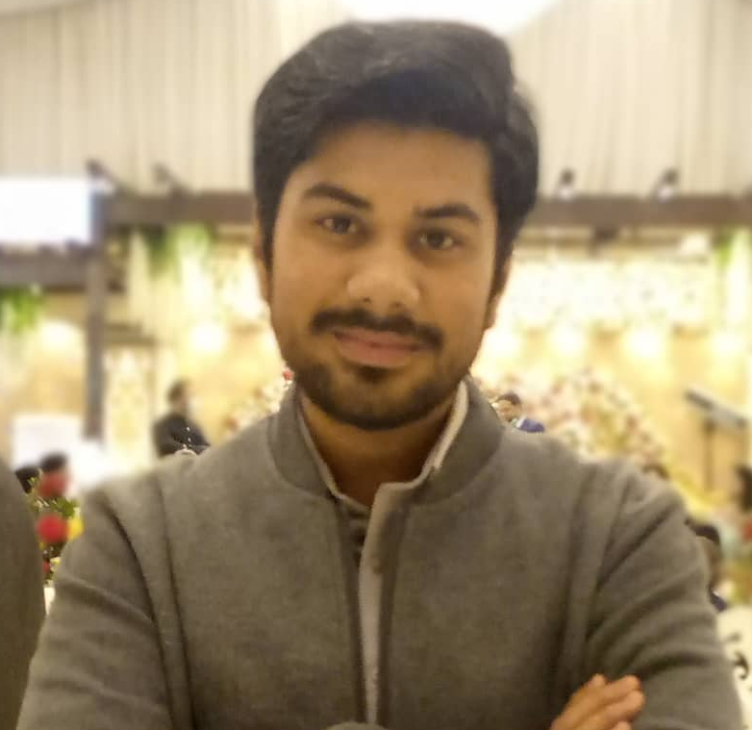
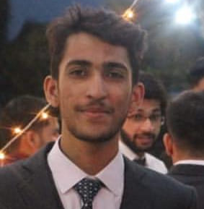
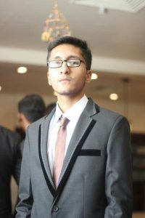
Salman Ahmed Khan 19K-1043 Sadeem Sattar 19K-1102 Abdullah Tilal Khan 19K-1103
Bachelor Of Science Degree
Software Engineering Department – Section A
Batch 2019
National University of Computer and Emerging Sciences, FAST KHI

Slide 3

Codup
Codup is a full-service development agency that develops custom software and web solutions to help businesses accelerate their growth. With more than 100 team members on board, we work with different technologies, platforms, and programming languages to build tailored solutions that solve our client’s business complexities.
https://codup.com/

Slide 4
Interviewed: Ayaz Mehmood (Engineering Manager)
He has 10 years of experience working with Codup, managing large engineering teams, testing teams and handling client issues.

Slide 5
Q. How do you manage your teams?
Create a weekly time slot.
Perform daily scrum meetings with the teams to discuss the updates and the next item action of the project whose deadline is near.
If a team is working smoothly and does not have near deadline, then we perform meetings in the alternate days to discuss the progress.
To manage a team, we need to communicate very frequently and it is very important aspect of the project completion.

Slide 6
Q. How do you manage different deliverables like sometime you have projects and products going in the progress?
Split resources in the different small teams and department.
Whenever a support ticket is generated, the team will check, verify, fixes and perform test runs for release or UAT etc.
For projects, we begin our processes including planning and discuss deliverables with the estimated time and proceed accordingly.
If a resource is working on both, the projects and products, then we resolve this situation by checking the feasibility and criticality of the assigned projects and product and then take decision accordingly.

Slide 7
Q. If there was a resource working on a specific project and it leaves, so how it effect your deliverable timeline and how do you manage it?
Since a resource has all the skills and knowledge that was required to complete the project, however, if it leaves then we have to find out a new resource as quick as possible.
Give the newly appointed resource a complete transition to the undergoing project.
In order to manage our timeline, we do a transparent communication with the client and inform about the resource situation to the client to adjust the project duration.
Discussuions with the client is compulsory in order to remain into the same page.

Slide 8
Q. How do you resolve the disputes within the teams?
As a manager, I need to hear the complete information from both sides in order understand the situation and to resolve it.
If the problem is critical and difficult to resolve, a meeting is held with the team leads to figure out the solution to the dispute.

Slide 9
Q. How do you manage the scope of the project?
If a mistake comes from the team within scope phase, it needs to be managed and resolve the issues.
If their is a time available, so we can extend the internal project delivery time and cover all those issues.
If we don't have enough time then we ask the development team to put more focus on the issues to resolve the scope of the project.

Slide 10
Q. Can you please share your experience of a difficult client that you have faced recently?
Facing difficult clients is a part of the software industry.
Recently, a client we faced who did not have a clear understanding of the project scope and due to that many changes were coming from the client that was deviating from the project scope and its timeline.
The client fired multiple bug tickets before the warranty period which was not allowed to do so before the warranty.
We perform bugs fixing and managing changes and timely inform the client upon the agreed timeline.

Slide 11
Q. How do you prevent discrimination?
The company does not allow to discuss any taboo topics.
If any discrimination happens, we terminate the resource and we cannot compromise with the company’s culture and values.

Slide 12
Q.Are there any specific tools and technique that you use to manage your teams and project?
We use Jira Software Application to manage our tasks, projects and even resources as well.
We also use GitBucket to manage our projects code and it helps in the configuration management of the projects and products.

Slide 13
Recording
https://drive.google.com/file/d/1ean2KVxRvVH0xet-Xlgkp9aO85v0JTWI/view?usp=sharing

Slide 14
Thank YOU!!

