Slide 1
Record Management implementing Confidentiality and Integrity
Information Security (IS)
Presented to: Dr. Fahad Samad

Slide 2

Salman Ahmed Khan 19K-1043
Bachelor Of Science Degree
Software Engineering Department – Section A
Batch 2019
National University of Computer and Emerging Sciences, FAST KHI

Slide 3
Problem Statement
The record management system is a daily activity carried out in various organization including schools, college, universities, companies, factories etc.
Due to large number of user’s details which contains sensitive information, it is difficult to make it in a secure fashion so that no one other then the authorize user of the system should carry out the amendments in the system.
In order to tackle the physical record management system, I developed an automated record management system of the students in a university that ensure the integrity and confidentiality in the system

Slide 4
System Objective
A user details is an essential element that needs to be validated to prevent attack, manipulating and breaching of the data.
To ensure the system works perfectly, I will perform confidentiality and integrity.

Slide 5
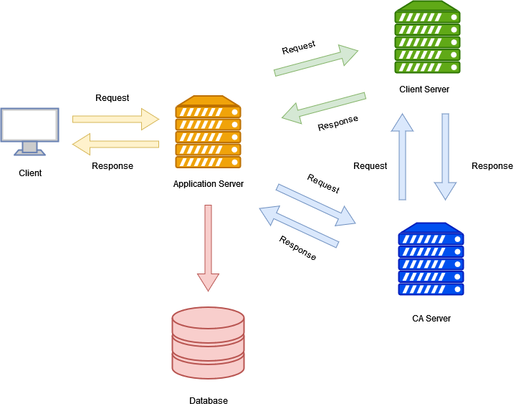
System Architecture
The system consists of three main entities server that include
Client Server
Application Server
CA Server

Slide 6
System Component
The user’s password is hashed with generated salt to make secure password.
The tokenization is done to maintain the user’s session.
The Public and Private keys are created to perform the digital signature.
The Private key is then hashed and mailed to the user to perform certain actions.
A Certificate Authority is used to issue the Digital Certificate to the user. Both the digital certificate and digital signature are used to maintain the integrity in the system.

Slide 7
System Features
Signup
Login
Add Student Details
View Students Details
Edit Student Record

Slide 8
Thank YOU!!

