Slide 1

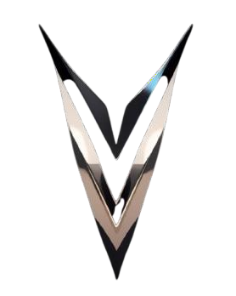
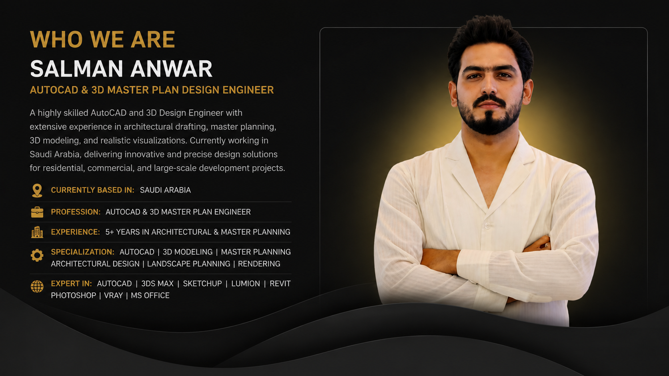

VERSA VISION STUDIO
Creative Production + Marketing Studio
"We Don’t Just Create Content — We Build Impact."

