Slide 1

Case Study:
To predict the ultimate individual claim amounts on historical FNOL Motor Data.
PREPARED BY: SALMAN AHMED
EMAIL : SALMAN.DATASCIENTIST@GMAIL.COM

Slide 2
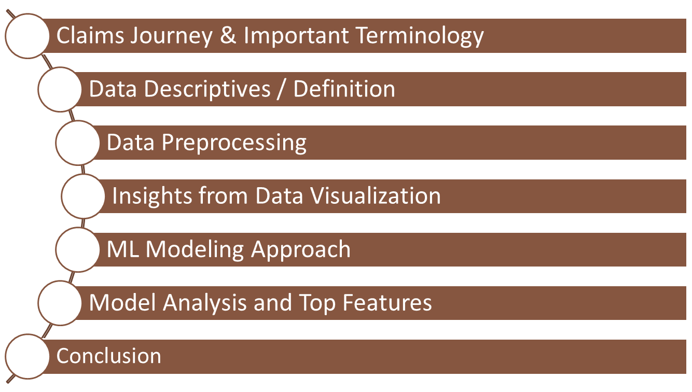
Table of Contents

Slide 3
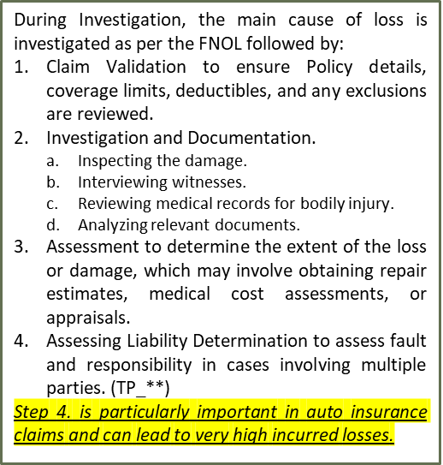
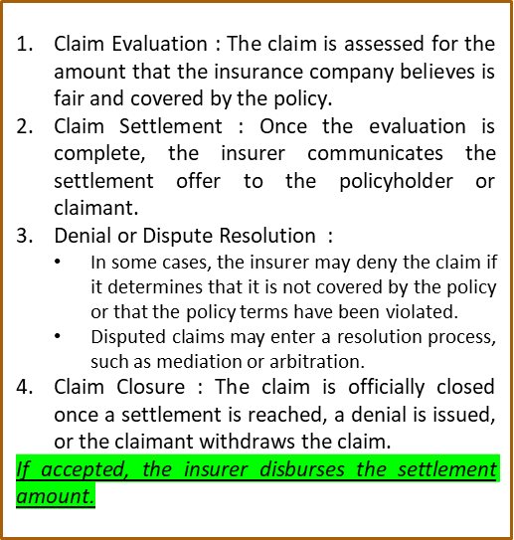
Claims Journey & Important Terminology
During FNOL Report of the Incident, the information captured should include:
Date / Time of Loss.
Location of Incident / Weather Information.
Policy Holder Information.
Motor / Vehicle Damage Details.
Property Damage Details.
Injury Details (in rare case fatality) of Policy holder, Named Driver, Claimant, Third Party or Others.
Photos and Documentation (such as Police Report).
Witness Information.
This information helps in identifying the Policy, assigning a Claims Investigator, the primary cause of Loss and setup Loss Reserves for Potential Loss Payments.

Slide 4
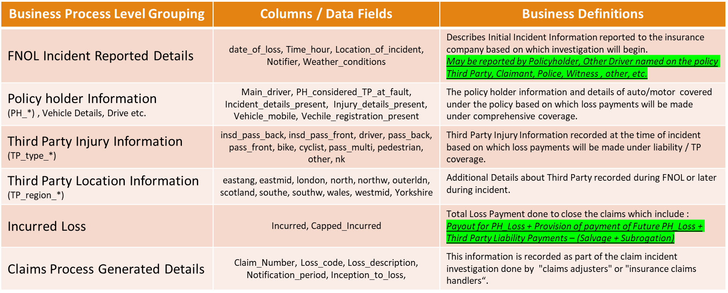
Data Descriptives/Definition
Incurred Loss : In majority of claim settlement scenarios, the total loss payment is a positive non-zero value.
**But in the data, few FNOL records with zero values and negative values can happen in scenarios where no claim amount is reported during the investigation period or the recovery amount from Salvage and Subrogation is higher than the Paid Loss.

Slide 5

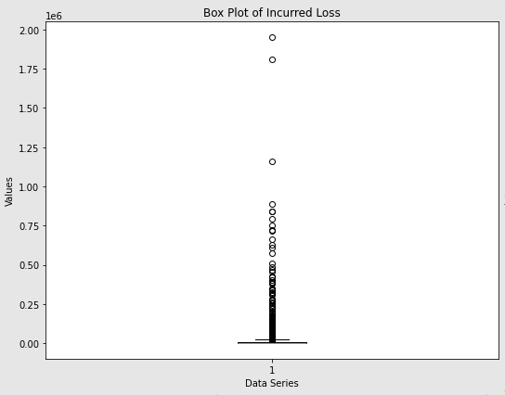

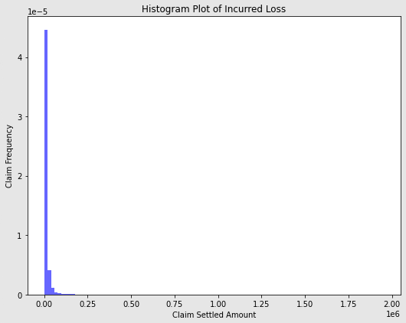
Historical Data Analysis – Incurred Loss
What is observed
Total Historical FNOL Records are 7691 between the periods 2003-April-15 and 2015-June-30 which is 8 years of data.
Identified Columns which have do not provide any predictive value.
1803 FNOL Records have Incurred Loss (Target/ Dependent Variable) as less than equal to zero.
Incurred Loss Data is highly skewed towards right.
What was done as Data Preprocessing
Performed a total of 9 steps in Data Preprocessing Steps :
  Dropped Col’s: 'Claim_Number’, 'Loss_description', 'Loss_code’, 'TP_type_insd_pass_front', 'TP_type_pass_multi’, 'Capped_Incurred'
  Fixed missing values with zeroes in all independent TP_*, variables and converted to numeric columns for calculations
  As the independent variables in the historical data show weak correlation, imputed feature engineering to boost signal which include
    Additional columns to calculate sum total of all TP Regions, TP Injuries, TP Type as three new features.
  To model and predict a stable positive incurred loss amount, filtered out the 1803 (-) FNOL Records in our observed FNOL data.
Next Step for Modelling
As dependent variable is highly skewed towards right and there is weak correlation with independent variables, implemented tree-based regression models like XGBoost Regressor and multiple configurations/flavors available in XGBoost.
Metrics Identified to train and validate the model was Mean Squared Error and Cubic Loss Error.

Slide 6

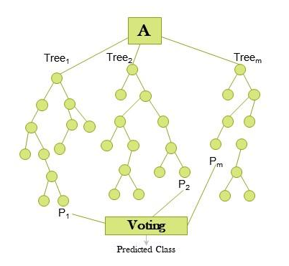

Data Preprocessing
(As a thumb rule) Categorical columns must have the same set of values during both training and testing to maintain consistency and prevent issues for model maintainability.
Feature engineering can help Tree Based models capture complex relationships within the data, include business domain knowledge to improve the predictive power of model.
Since April 2003
~5.9K
(76.5%)
109k
XX
to June 2015
~7.9K
Historic FNOL Data
FNOL Data Filtered
Incurred Loss greater than 0.
Impute missing Data
  List of Columns:
  PH_considered_TP_at_fault
  Main_driver
  Vehicle_mobile
  Weather_conditions
  Location_of_incident
  Notifier
Feature Engineering
  Categorical:
  Time_of_day_cat
  Time_hour_cat
  Quarter_cat
  Month_cat
  Continuous:
  Total_TP_regions_num
  Total_TP_injury_num
  Total_TP_type_num
Train / Test Split
  As target column data is highly skewed, we need to ensure during data split there is equal representation of all the ranges of data.
  Additionally, we will hold-out data between 2014-Oct-01 to 2015-Jun-30 as data which model has never seen.
  To explain this in detail we need to visualize the data.

Slide 7
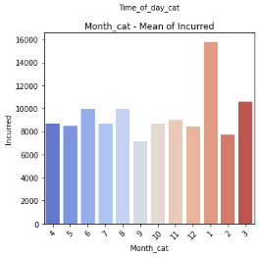
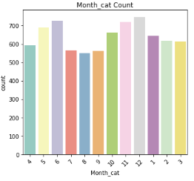
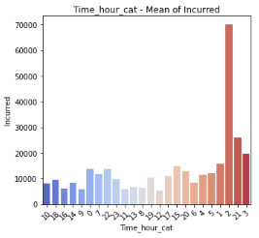
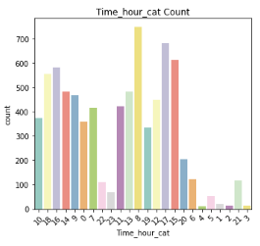
Insights from Data Visualization - 1
Column Value and its observed relation with Incurred Loss
Month of Reported FNOL : From the RHS we can see that month of FNOL reported in the 8 years of data, the count is unform but from LHS we can observe that Mean Incurred Loss is mush higher in the first month of the year.
Time Hour of Reported FNOL: From the RHS we can see that Time of FNOL reported in the 8 years of data, the count is uneven, and highest count of claims are reported in the early part of the, but from LHS we can observe that Mean Incurred Loss is much higher for claims reported in the night-time and very early morning hours.

Slide 8
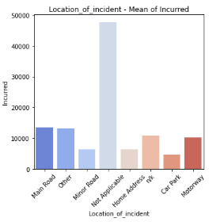
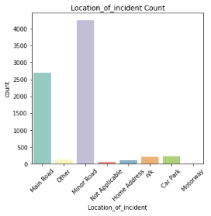
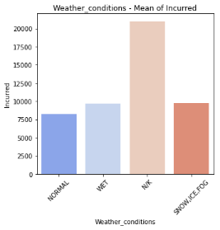
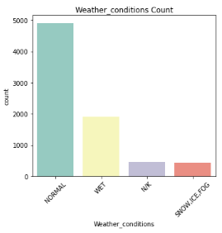
Insights from Data Visualization - 2
Column Value and its observed relation with Incurred Loss
Location of Incident Reported on FNOL : From the RHS we can see that Locations such as Motorway, Car Park , n/l and Home Address reported in the 8 years of data, the count is insignificant but from LHS we can observe that Mean Incurred Loss is significant.
Weather condition Reported on FNOL: From the RHS we can see that Weather Conditions reported in the 8 years of FNOL data, the count is uneven, and highest count of claims are reported for Normal Weather, but from LHS we can observe that Mean Incurred Loss is much higher for claims reported with Weather N/K and Snow_Ice_Fog. The weather variable needs further investigation! A recourse could be taken is to use external weather data service to get the weather information at the FNOL report date and time. Alternate approach is to impute the missing weather information “n/k” using K-Modes Clustering using information of Year, Month, Date and Time of all the historical records. The cluster index will indicate the predicted Weather_conditions for the FNOL.

Slide 9
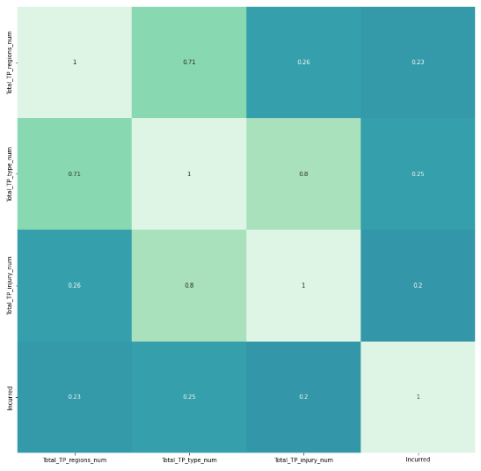
Insights from Data Visualization - 3
The consolidated features
Total_TP_Injury
Total_TP_type
Total_TP_regions
Do not show strong linear relationship with the target variable Incurred Loss, but they have strong correlation with each other.
Because of this correlated independent variables. Strict Linear Model ma not be the right predictor. But Tree Based model can use all the information to create a predictive model.

Slide 10
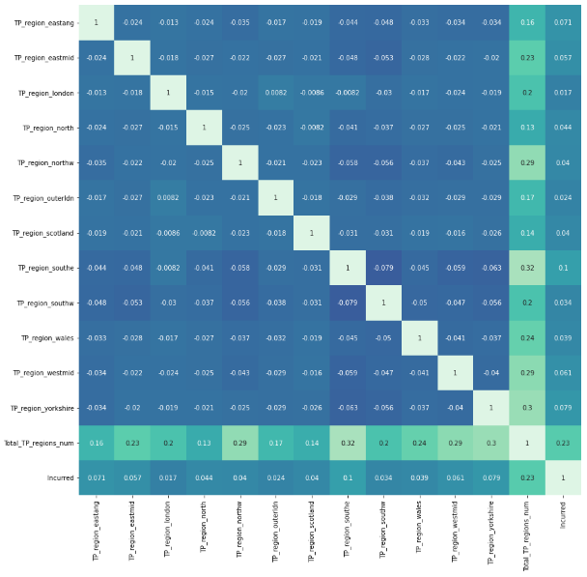
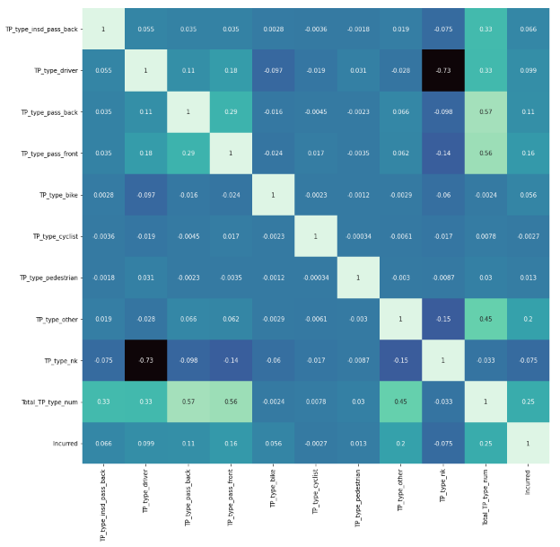
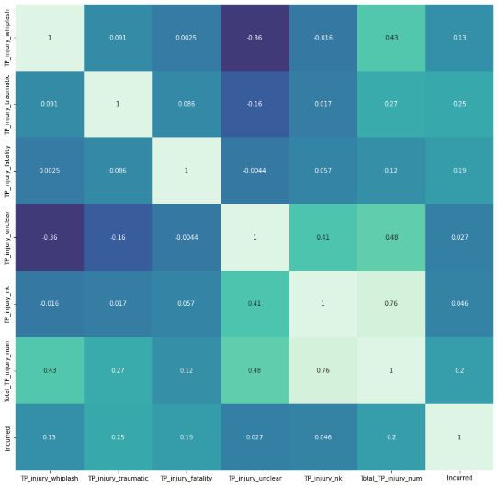
Insights from Data Visualization - 4
The individual correlation of 26 raw numeric features provided in data do not show strong linear relationship with the target variable Incurred Loss, and individually also do not show any strong relationship
Because of the weak predictive power of these variable, a Tree Based model can use the weak signal to generate multiple trees as an ensemble model and boost the signal information to create a better predictive model overall.

Slide 11
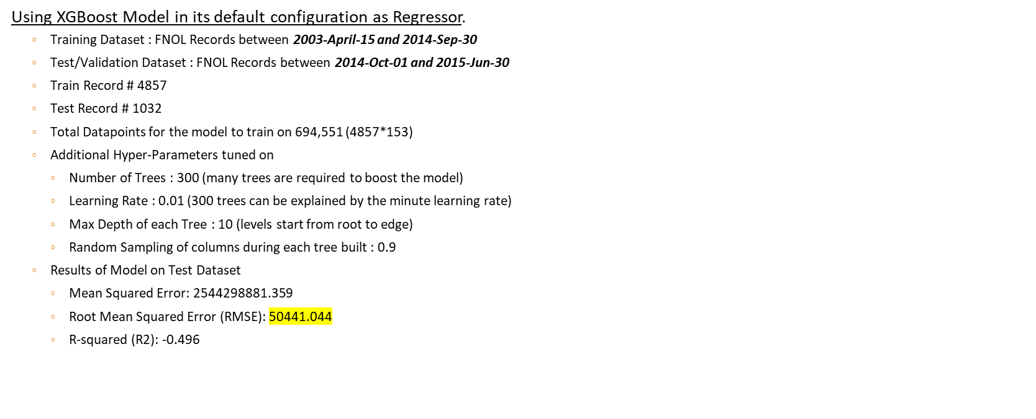
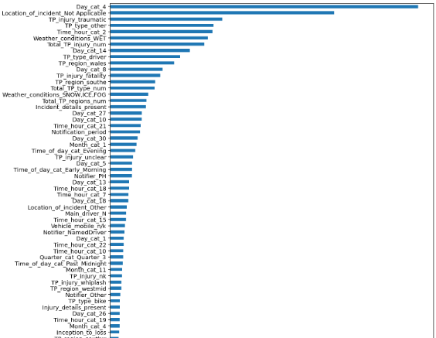
ML Modelling – Approach 1

Slide 12
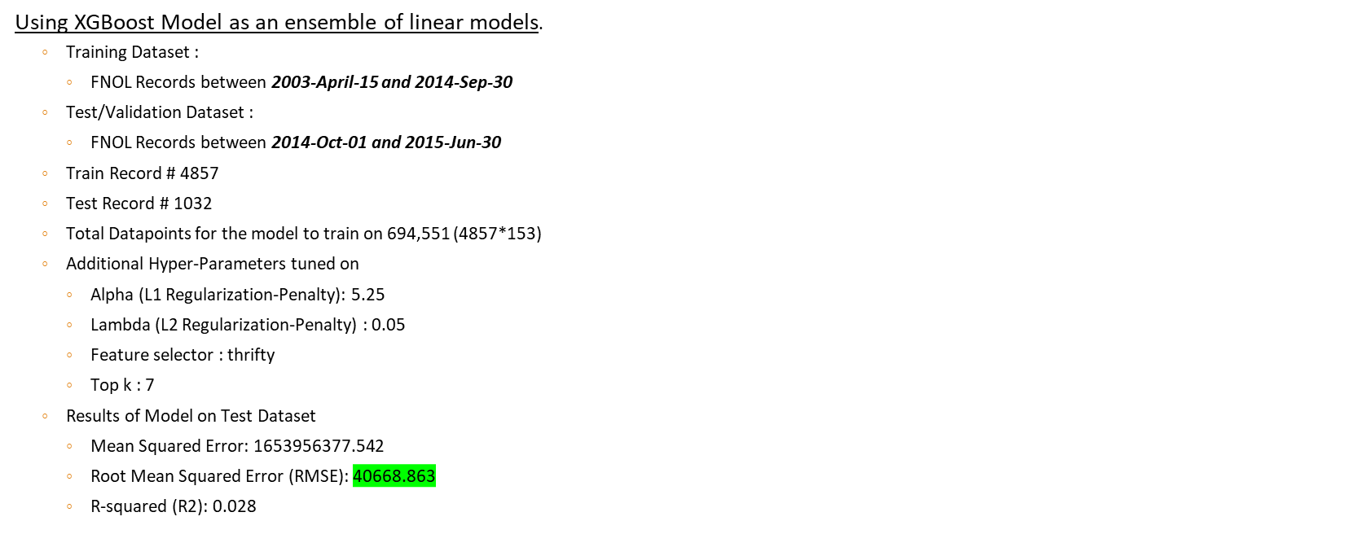
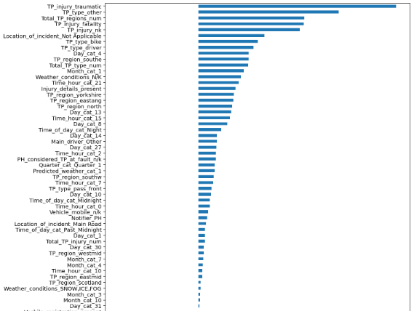
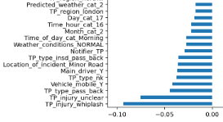
ML Modelling – Approach 2
Positive Coefficients Variables
Negative Coefficients Variables

Slide 13
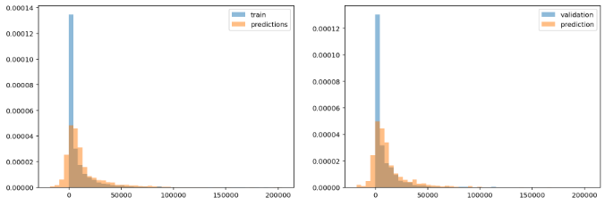
Model Analysis and Top Features
By analysis of both the models and top features, Higher Incurred Loss can be predicted using;
  ML Model Approach 2, as this model has lower error loss metric when predicted on hold-out data between 2014-Oct-01 and 2015-Jun-30
  Third Party Claimants Information that are reported on the claim.
  Third Party has received severe Injuries like trauma or fatality.
  If Third Party claimants belong to multiple regions in the UK.
  Location Details as Not Applicable.
  Injury Details of Policy Holder or First Party on the FNOL.
  4th of Every month (or First Week of Month) has been reported as the dates when Loss events probability is higher.
Based on evaluation metrics and Plotting of Incurred Loss fitting with predicted Loss
The model is unable to capture extreme values of Incurred Loss but it does capture the distribution of Incurred Loss overall.

Slide 14
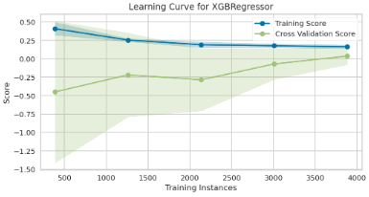
Conclusion
The key takeaways taken from the modelling and its analysis is
Third Party Claimants leads to high incurred loss, if the TP claims trend indicates policy holder is at-fault, it would make Policy Holder as a high-risk profile, and we can use this information to identify and segment other high risk policy holders with active Auto Policies for future claims.
As this model uses Day/Week of Month, Time-Hour of Day and Quarter of the year when predicting higher aggregate incurred loss.
    An alternate use case of the model can be in forecasting staffing requirement for claim adjusters and on-call support.
Location Details as not Applicable can be explored further by segment this Column information into additional sub-categories for learning new patterns.
Few columns like Notifier, Notification period, Inception to loss did not provide any predictive lift to the model, we can remove these columns from the Claims/ FNOL database to maintain a smaller and leaner dataset for Claims/ FNOL reporting.
    Additional Features or Datapoints to capture Witness Statements, other Reports like Police Reports or other Documentation can help in learning new patterns and predict incurred loss with more accuracy.
As only one XGBoost Model was trained as a Global Model, maintaining and retraining this model will not be expensive and can communicate with any other system via API calls with Low Latency and overall efficiency. Data requirements for updating model can be checked by plotting Training Instance and Data size. When a new sample of data contains 3000-4000 FNOL records then we can retrain the parameters of the model.

