Slide 1
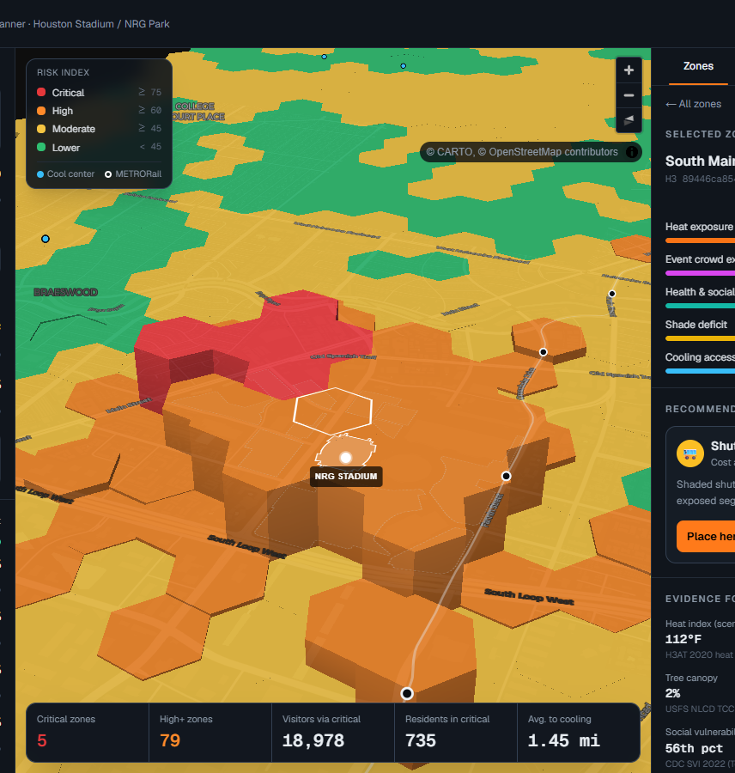

HeatShield 26
Where should Houston invest $1M to protect visitors and residents from extreme heat during its next mega-event?
A geospatial decision-support platform for NRG Park and its visitor corridors
Rice Urban Sustainability Hackathon · Track 3: Public Health & the Built Environment
Notes:
[~20 sec — calm, look at the judges, not the screen]
Hi, I'm Salman. Houston just hosted World Cup matches at NRG Stadium — sixty-eight thousand people in one of the hottest, most humid big cities in the country.
Our question is simple and practical: if Houston had one million dollars to protect people from heat at its next mega-event, where exactly should it spend it?
This is HeatShield 26. It gives a city a real answer — a map, a ranked plan, and the evidence behind every recommendation.

Slide 2
THE PROBLEM
Mega-event crowds meet Houston heat — unevenly
113°F
14°F
68,777
431,348
heat index at 98°F and 50% humidity — NWS “Danger”
measured gap between Houston’s hottest and coolest neighborhoods (H3AT 2024)
capacity of FIFA’s Houston Stadium at NRG Park
street-level heat observations in the Aug 10, 2024 H3AT campaign
The same heat is not the same risk. Danger concentrates where tens of thousands of people wait on asphalt with no shade, far from cooling — often next to neighborhoods that are already the most vulnerable.
Sources: NWS heat index equation; H3AT 2024 campaign results (h3at.org); FIFA stadium capacities.
HeatShield 26 · 2
Notes:
[~30 sec]
Here's the problem. At a normal Houston summer afternoon — ninety-eight degrees, fifty percent humidity — the heat index is a hundred and thirteen. The Weather Service calls that 'Danger'.
But heat isn't evenly distributed. Houston's own H3AT campaign collected over four hundred thousand street-level readings and found a fourteen-degree gap between neighborhoods.
Now drop sixty-eight thousand fans into that. The risk isn't the stadium bowl — it's the parking lots, the rail platforms, the security lines, and the neighborhoods around them.

Slide 3





WHY IT'S HARD TODAY
The data exists. It just lives in five different places.
Heat
Crowds
Health
Shade
Cooling
H3AT heat models (HARC)
METRORail stations, NRG lots
CDC SVI + CDC PLACES
USFS tree canopy
City of Houston cool centers
Planners can see each layer — but nobody can answer “where is it dangerous for this event, and what do we fund first?”
HeatShield 26 · 3
Notes:
[~20 sec]
What's frustrating is that the data already exists. Heat maps from HARC. Transit from METRO. Health data from the CDC. Tree canopy from the Forest Service. Cooling centers from the City.
But they sit in separate silos. A planner can look at any one of them — nobody can answer the question that matters on event day: where is it dangerous, and what do we fund first?

Slide 4




THE SOLUTION
HeatShield 26 turns five silos into one decision
01
02
03
04
Measure
›
Model the crowd
›
Score risk
›
Act
11 open datasets joined onto 1,419 hex cells around NRG, Midtown and Downtown
Attendance routed from rail stations, real lot capacities, rideshare curbs and walk-ups
Transparent 0–100 Heat Event Risk Index for every cell, live as you move sliders
Place cooling, shade, water or shuttles — or let the optimizer spend the budget
No database, no black box: open data in, every assumption visible, runs in the browser.
HeatShield 26 · 4
Notes:
[~25 sec]
HeatShield does four things.
One — it measures: we pulled eleven open datasets and joined them onto about fourteen hundred hexagons, each about a tenth of a square kilometer.
Two — it models the crowd: attendance gets routed from the actual rail stations and the actual NRG parking lots, weighted by their real capacities.
Three — it scores risk for every cell. Four — it helps you act: place interventions yourself or give it a budget.
And it's transparent — no black-box AI deciding where the money goes.

Slide 5
THE MODEL
An explainable Heat Event Risk Index
40%
Heat exposure
Risk tiers
Scenario heat index + H3AT local anomaly
25%
Critical
≥ 75
Event crowd exposure
Modeled person-hours per cell
High
60–74
20%
Health & social vulnerability
Moderate
45–59
CDC SVI + heart disease, COPD, diabetes, CKD
Lower
< 45
10%
Shade deficit
A decision-support composite, not a medical prediction. Weights are adjustable in the app; costs and effect sizes are labeled planning assumptions.
USFS NLCD tree canopy
5%
Cooling access deficit
Distance to nearest City cool center
HeatShield 26 · 5
Notes:
[~25 sec]
Here's the model. It's a weighted index, not a black box. Forty percent heat, twenty-five percent crowd, twenty percent health and social vulnerability, ten percent shade, five percent access to cooling.
Every component is normalized to zero–one hundred, every weight is a slider in the app, and we're explicit that this is decision support — not a medical prediction. Where we make assumptions, like the cost of a cooling hub, we label them as assumptions.

Slide 6
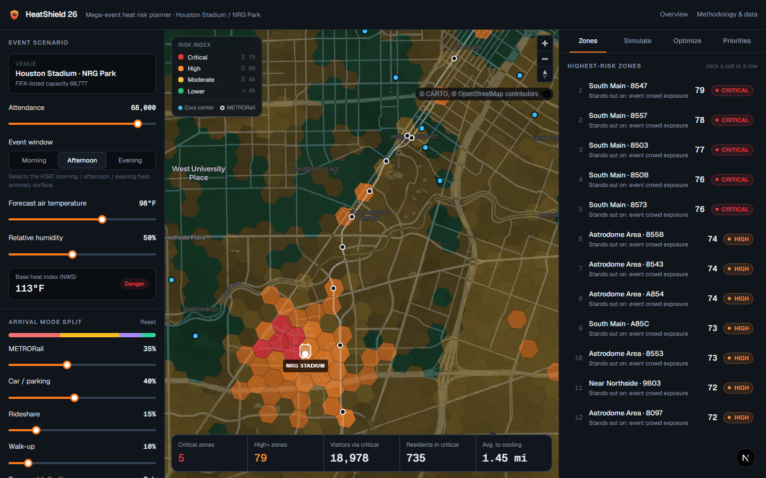
LIVE DEMO · 1
Game day: 68,000 fans, 98°F afternoon
5
critical zones — on NRG Park’s Yellow, Green, Purple & Teal lots at the stadium edge
79
high-or-critical zones, including the Stadium Park/Astrodome and Fannin South rail stations
18,978
Screenshot of the live planner — switch to the app here.
visitors whose modeled route crosses a critical zone
Demo move: drag the temperature to 88°F (risk collapses), back to 98°F; toggle 3D; switch the layer to Crowd and show modeled routes.
HeatShield 26 · 6
Notes:
[SWITCH TO THE LIVE APP — ~45 sec. If Wi-Fi fails, stay on this slide and narrate the screenshot.]
This is the planner. Sixty-eight thousand attendees, ninety-eight degrees, afternoon kickoff.
Red is critical. Notice it isn't the whole city — it's the NRG parking lots right at the stadium edge, where people tailgate on asphalt, and the rail stations where fans queue. Five critical zones, seventy-nine high-risk zones, and almost nineteen thousand visitors whose route crosses a critical zone.
[Drag temperature to 88] Watch — at eighty-eight degrees the critical zones disappear. [Back to 98.] [Click 3D] The height is risk. [Switch layer to Crowd, show routes] And these are the routes we model — rail, parking, rideshare, walk-ups.

Slide 7
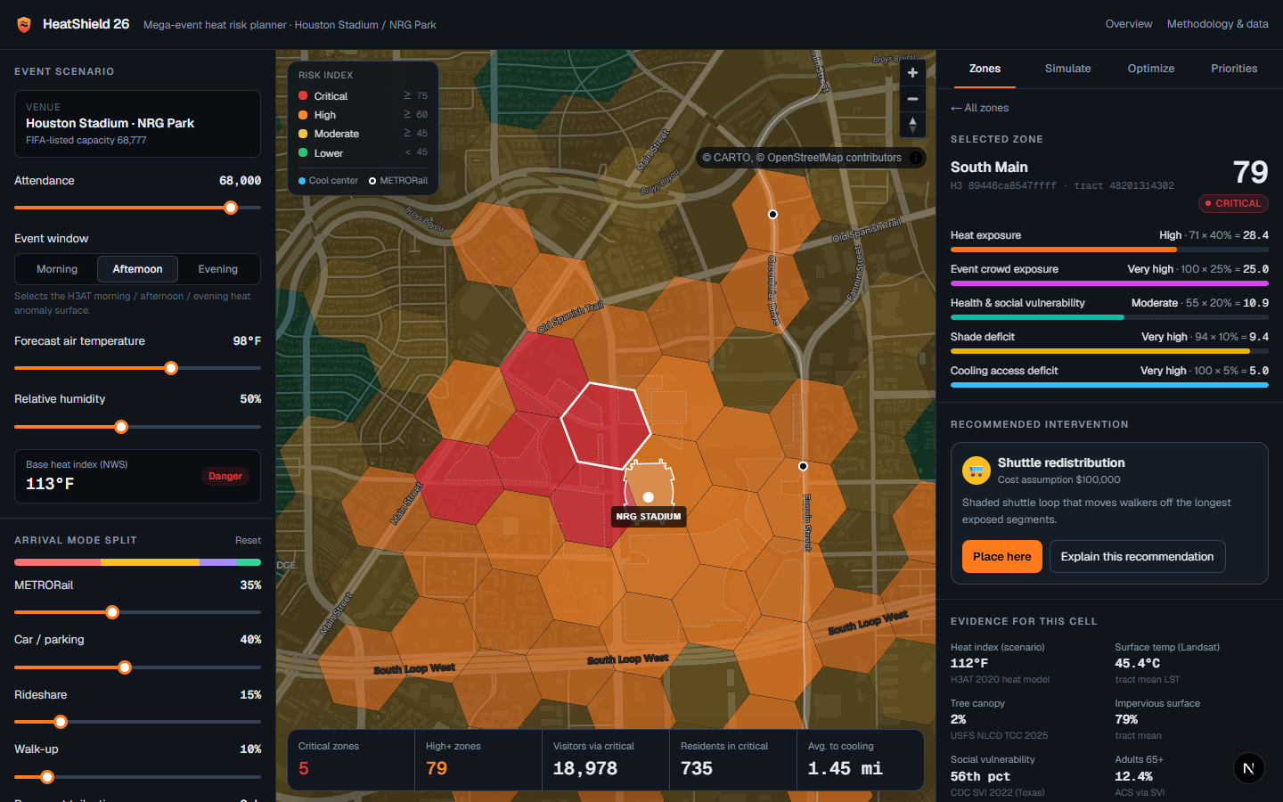
LIVE DEMO · 2
Every score shows its evidence
Crowd exposure 100/100
≈5,400 event person-hours in one cell
Shade deficit 94/100
2% tree canopy, 79% impervious surface
Heat index 112°F
H3AT 2020 heat model for this block
1.28 mi to cooling
Example: South Main cell on NRG Park lots — risk 79, critical
Nearest City cool center: Linkwood
Explain this recommendation: Gemini writes a planner memo from these facts only.
HeatShield 26 · 7
Notes:
[In the app: click the #1 zone — ~30 sec]
Click any zone and HeatShield shows why. This cell scores seventy-nine. Crowd exposure is maxed — about fifty-four hundred person-hours. Two percent tree canopy. A hundred-and-twelve-degree heat index. And the nearest cooling center is more than a mile away.
[Click Explain this recommendation] This is the only place we use AI. Gemini turns these exact numbers into a short memo a planner could paste into a briefing. It's told to use only these facts — the scores themselves are deterministic code.

Slide 8
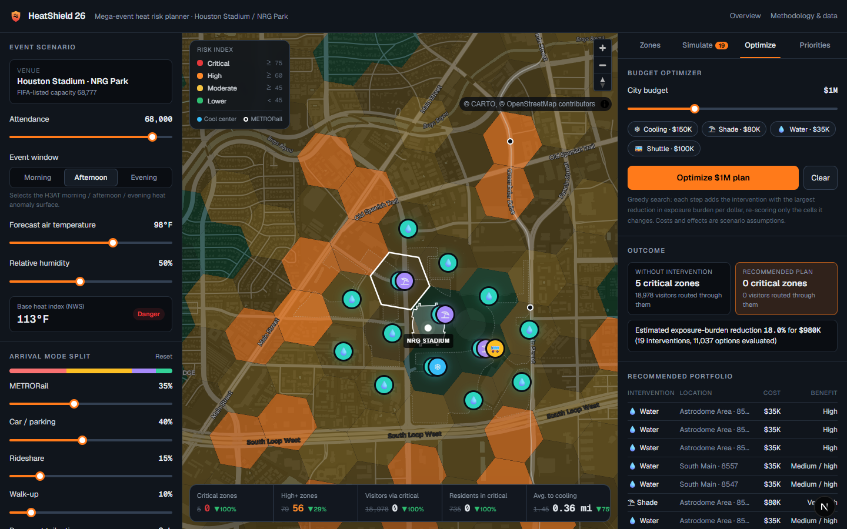
LIVE DEMO · 3
Optimize a $1M plan in one click
5 → 0
critical zones
18,978 → 0
visitors routed through critical zones
−18%
exposure burden for $980K (19 interventions)
Portfolio: water & misting stations, shade over queues, a cooling hub and a shuttle loop. Greedy search, verified against full re-scoring.
Demo move: Optimize tab → “Optimize $1M plan”. Point at the markers appearing on the lots and the KPI strip dropping to zero.
HeatShield 26 · 8
Notes:
[In the app: Optimize tab → Optimize $1M plan — ~40 sec. This is the money moment; pause after clicking.]
Knowing where the problem is isn't enough — cities need to know what to do. So I give it the budget: one million dollars.
[Click] In about a tenth of a second it evaluates over eleven thousand options and builds a portfolio: water and misting stations, shade over the queues, a cooling hub, a shuttle loop.
Critical zones go from five to zero. Visitors routed through critical zones go from nearly nineteen thousand to zero. Total exposure burden drops eighteen percent — for nine hundred eighty thousand dollars.
The costs and effect sizes are planning assumptions, and they're labeled that way — a city would swap in its real procurement numbers.

Slide 9



DATA ANALYTICS
We let the data correct us
Two heat campaigns disagree
Gap-filling earns its place
H3AT 2020 vs 2024 afternoon surfaces correlate at r = −0.19 on 360 shared cells — so we don’t blend them. 2020 is primary; 2024 fills only its gaps.
Interpolation is used only where spatial hold-out cross-validation beats a median fill (morning RMSE 1.99°F vs 2.72°F).
Caught a silent coverage gap
Verified, fast, reproducible
LiDAR canopy only covers focus areas (Hermann Park read 0%). Scoring switched to full-coverage USFS canopy; LiDAR stays as evidence.
Optimizer burden matches a full re-score exactly (0.0000% difference). 3 ms per full evaluation. One command rebuilds the dataset.
HeatShield 26 · 9
Notes:
[~30 sec — this slide wins the data analytics points; slow down]
We didn't just stack layers. We tested them — and the data corrected us more than once.
Houston ran heat campaigns in 2020 and 2024. Where they overlap, their afternoon maps actually disagree — the correlation is negative. So instead of averaging two inconsistent maps, we use one primary source and document why.
We only interpolate heat into gaps where cross-validation proves it beats a flat guess. We caught that the high-resolution LiDAR canopy only covers certain neighborhoods — it said Hermann Park had no trees — and switched to a consistent national dataset.
And the optimizer's math is verified against a full re-scoring to four decimal places.

Slide 10


IMPACT & LEGACY
FIFA is the stress test. Every future event is the use case.
Impact
Feasible now
Reusable
Protects visitors and the vulnerable neighborhoods around them
Targets money where people, heat and vulnerability overlap
Uses only open data Houston already publishes
Actions a city can buy: tents, shade, water, shuttles
Runs in a browser; no database to maintain
Texans games and the Rodeo at NRG Park
Marathons, festivals, heat emergencies
Cooling hubs become neighborhood resilience hubs
Swap the venue, attendance and arrival assumptions — the same pipeline plans the next event.
HeatShield 26 · 10
Notes:
[~25 sec]
Why does this matter beyond the World Cup? The tournament is over — but NRG Park hosts the Rodeo and Texans games every year, and Houston's heat season gets longer.
It's feasible today: it only uses data Houston already publishes, it recommends things a city can actually buy, and it runs in a browser. And every cooling hub placed for one event becomes a resilience hub for the neighborhood next door.

Slide 11
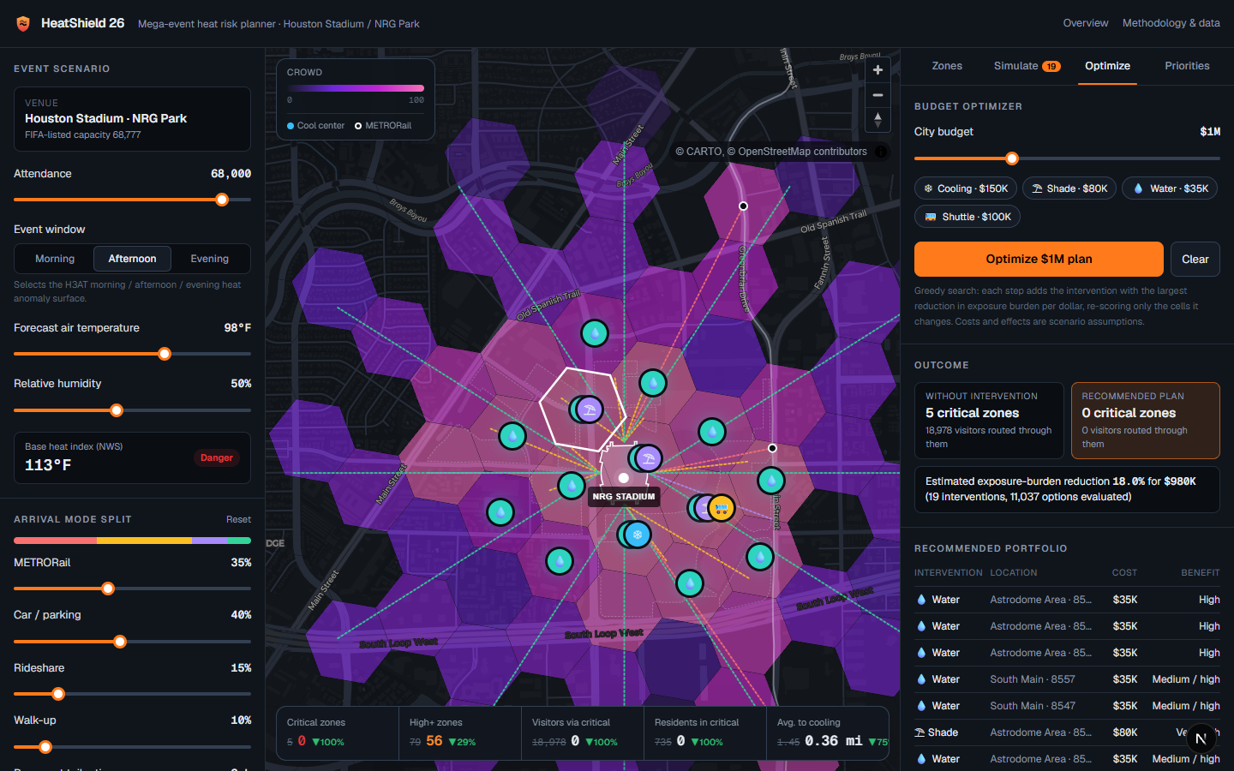


HOW IT'S BUILT
Built for the hackathon, end to end
Data pipeline
Node · ArcGIS REST & ImageServer sampling · CDC Socrata · OSM · H3 hex grid
Scoring engine
TypeScript model + greedy optimizer, 100% client-side (~3 ms / ~100 ms)
Planner UI
Next.js 16 · MapLibre GL (2D/3D) · Recharts · Tailwind
AI explanations
Crowd layer with modeled arrival routes
Gemini (flash-latest with fallbacks) + deterministic template fallback
github.com/salman-khan03/heatshield26
HeatShield 26 · 11
Notes:
[~15 sec — skip if short on time]
Quickly on the build: a Node pipeline pulls the live government map services and samples the heat and canopy rasters onto a hex grid. The model and optimizer are TypeScript that runs entirely in the browser — that's why every slider is instant. The front end is Next.js and MapLibre. Everything is open source on GitHub.

Slide 12
Where should Houston invest $1M?
Now there’s an answer — with a map, a plan, and the evidence behind it.
HeatShield 26 becomes Houston’s planning layer for every stadium event, festival, marathon and heat emergency.
Thank you · github.com/salman-khan03/heatshield26
Notes:
[~15 sec — slow, then stop talking]
So: where should Houston invest a million dollars to protect people from heat at its next mega-event?
Now there's an answer — a map, a plan, and the evidence behind every dollar. FIFA was the case study. HeatShield is built for every event Houston hosts next.
Thank you — I'd love your questions.

Slide 13

BACKUP · Q&A
What we don’t claim
Crowd flows are modeled, not counted
No public FIFA pedestrian data exists; all routing assumptions are sliders and documented.
Intervention costs & effects are placeholders
Built for comparison; a city should replace them with procurement and EMS data.
Health data describes residents, not fans
Visitor vulnerability (age, hydration, travel) isn’t observed.
Heat surfaces are single campaign days
Anomalies are applied to a forecast you choose, not a weather model.
Routes are straight lines
Adequate inside NRG Park’s open lots; coarse outside it.
HeatShield 26 · 13
Notes:
[Only show if asked about accuracy or assumptions]
We're upfront about limits. The crowd flows are modeled because no public FIFA pedestrian counts exist — so every assumption is a visible slider. Costs are placeholders for comparison. The CDC data describes residents, not visiting fans. And the heat surfaces come from single measurement days, which we apply to a forecast the planner chooses.

