Slide 1
MINOR PROJECT (ES-451) | SECOND DEFENSE
AarogyaSathi
AI-Driven Public Health Chatbot for Disease Awareness
Salman Mohammad Khan (00520815723)
Dhairya Summi (00420815723)
Sidharth Singh (01820815723)
Under the supervision of Mr. Aditya Sam Koshy, Assistant Professor, CSE
Bhagwan Parshuram Institute of Technology, Delhi | November 2026
Notes:
Good morning. We are presenting AarogyaSathi, an AI-driven public health chatbot for disease awareness, built for Smart India Hackathon problem statement SIH25049. It is deployed on Oracle Cloud and reachable on the web and on WhatsApp through a Meta test number. It is an awareness tool: it does not diagnose or prescribe.

Slide 2
PROBLEM
Why this problem matters
1
2
3
Myths spread fast
Language and access gaps
Unclear urgency
Home remedies and myths spread in forwarded messages, with no quick way to check them.
Official health guidance is mostly in formal English or Hindi, hard to use in regional languages.
People struggle to tell routine symptoms from emergencies, and care is delayed or skipped.
The brief: Smart India Hackathon SIH25049 (Government of Odisha) asks for an AI-driven chatbot that gives verified preventive-health information, symptom awareness, vaccination schedules, outbreak alerts and health-claim verification over WhatsApp and SMS.
AarogyaSathi | Minor Project ES-451 | BPIT, CSE-DS
2
Notes:
Health information reaches people mainly through forwarded messages. Good guidance exists from WHO and MoHFW, but it is often in formal English, and people cannot easily check whether a claim is true or whether a symptom is urgent. SIH25049 from the Government of Odisha asks for an AI chatbot for disease awareness; that is the brief we answered.

Slide 3
WHAT WE SET OUT TO DO
Objectives and scope
1
Answer disease, prevention and vaccination questions from a curated knowledge base
Scope boundaries
2
Understand queries across languages, with English and Hindi strongest
Awareness only. No diagnosis, no dosage or prescriptions.
Grounded answers. Sources and a disclaimer on every reply.
Prototype. Demonstrated on the web and a WhatsApp test number, not a public service.
3
Check forwarded health claims and return a verdict with an explanation
4
Escalate emergency phrases to 108 / 112 without waiting for a model
5
Reach people on the web and on WhatsApp, with simple outbreak signals by pincode
AarogyaSathi | Minor Project ES-451 | BPIT, CSE-DS
3
Notes:
We set five objectives. The important boundary is on the right: AarogyaSathi gives awareness information with sources and disclaimers. It does not diagnose, prescribe, or replace a doctor, and we state that on every answer.

Slide 4
FEATURES
What AarogyaSathi does
14
13
64
12
Disease profiles
Vaccine entries
Myth records
Language codes
Symptoms, prevention, when to see a doctor, with sources
Immunisation schedule lookups by age and pregnancy
Fact-check verdicts: Verified, Myth, Partly true, Unverifiable
Detected and welcomed; English and Hindi strongest
1
108
7d
2
Symptom flow
Emergency path
Outbreak signals
Channels
Asks one clarifying question before suggesting conditions
Red-flag phrases go straight to 108 / 112 advice
Pincode symptom counts vs a 7-day baseline
Web chat and WhatsApp (approved test number)
AarogyaSathi | Minor Project ES-451 | BPIT, CSE-DS
4
Notes:
Eight capabilities. The numbers in the circles are real counts from our knowledge base: 14 disease profiles, 13 vaccine entries, 64 myth records, and 12 language codes detected. We are careful here: language detection covers twelve codes, but answer quality is strongest in English and Hindi.

Slide 5
ARCHITECTURE
How one message is handled
Incoming message
Web or WhatsApp
1 Emergency check
Red-flag phrases to 108 / 112
2 Fact-check trigger
'fact check:' prefix or myth match
3 Fast-path rules
TF-IDF intent + entity matching
4 Semantic retrieval
LaBSE embeddings + lexical overlap
5 Answer generation
Qwen3-1.7B via Ollama, or template
6 Reply
Sources and disclaimer attached
Steps 1 to 3 are deterministic
The language model never rewrites the emergency or fact-check results.
Each message is checked for safety first; the language model is used only when the rules cannot answer.
AarogyaSathi | Minor Project ES-451 | BPIT, CSE-DS
5
Notes:
Every message passes the same ordered pipeline. First three gates are deterministic: an emergency check, a fact-check trigger, and fast-path rules that combine a TF-IDF intent classifier with entity matching. If none resolves it, LaBSE multilingual embeddings retrieve the right records from the knowledge base, and the local Qwen3 1.7B model writes a short answer using only that context. If the model is unavailable we fall back to templates. The emergency and fact-check results are never rewritten by the model.

Slide 6
IMPLEMENTATION
Technology and deployment
Backend
Python 3.12, FastAPI, Uvicorn
Oracle Cloud VM (Arm, 2 OCPU, 12 GiB)
NLP and ML
scikit-learn (TF-IDF + logistic regression), PyTorch, Transformers
FastAPI app + router
LaBSE + intent model
Retrieval
LaBSE multilingual sentence embeddings
Ollama: Qwen3-1.7B
SQLite + JSON knowledge base
Answer model
Qwen3-1.7B served locally by Ollama
Storage
SQLite for counts, JSON knowledge base, in-memory sessions
Cloudflare HTTPS tunnel
Meta WhatsApp Cloud API
Channels
Web chat UI, Meta WhatsApp Cloud API
Deployed files verified identical to the local project by hash comparison.
AarogyaSathi | Minor Project ES-451 | BPIT, CSE-DS
6
Notes:
The whole system runs on one Oracle Cloud Arm virtual machine with 2 OCPUs and 12 GiB RAM. FastAPI serves the web UI and the API. LaBSE and Qwen3 1.7B run locally, and SQLite stores only anonymous counts. A Cloudflare tunnel gives Meta an HTTPS address for the WhatsApp webhook. We verified that the deployed files match our local code by comparing hashes.

Slide 7
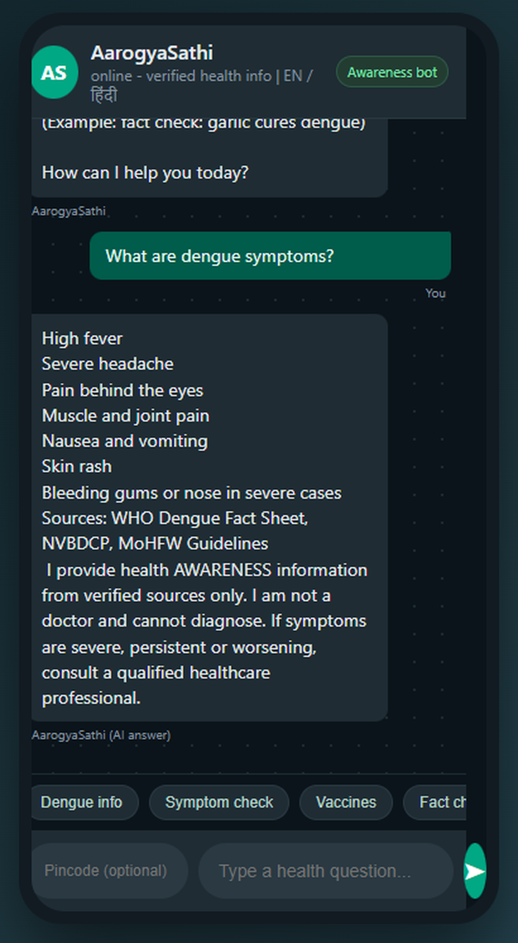
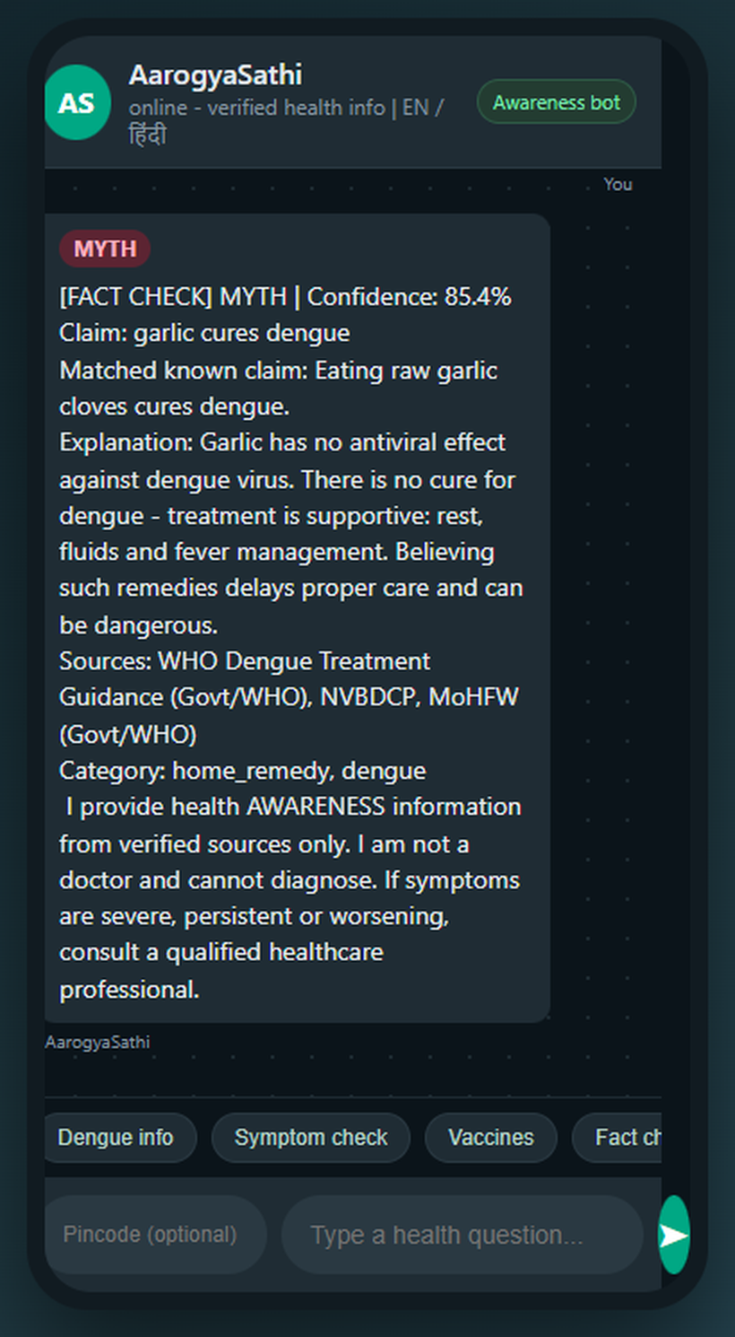
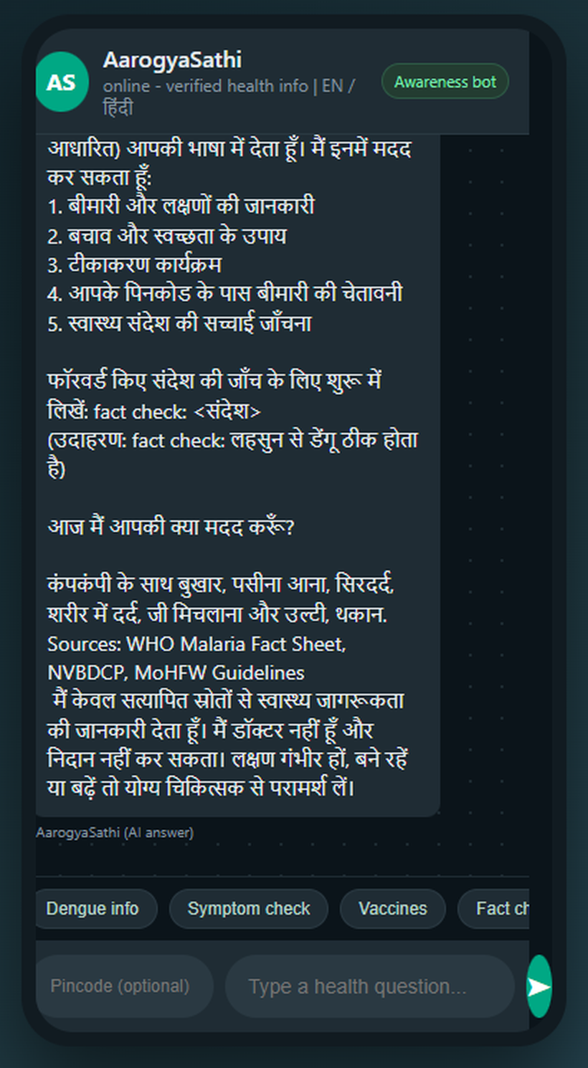
DEMO
Live on the web: three real responses
What to notice
Every answer names its sources
A disclaimer says it is not a doctor
Verdict labels: Verified, Myth, Partly true, Unverifiable
Confidence is a heuristic score, not a probability
Disease information
Claim check
Hindi answer
Symptoms, sources and a disclaimer
MYTH verdict with explanation
Language detected as Hindi
AarogyaSathi | Minor Project ES-451 | BPIT, CSE-DS
7
Notes:
These are captures from the web interface running on our Oracle server. Left: a disease question about dengue returns symptoms, sources and the disclaimer. Middle: a forwarded claim, 'garlic cures dengue', is checked and returns a MYTH verdict with an explanation; the percentage shown is a heuristic score, not a calibrated probability. Right: a Hindi malaria question is answered in Hindi. If time allows, we will run one of these live.

Slide 8
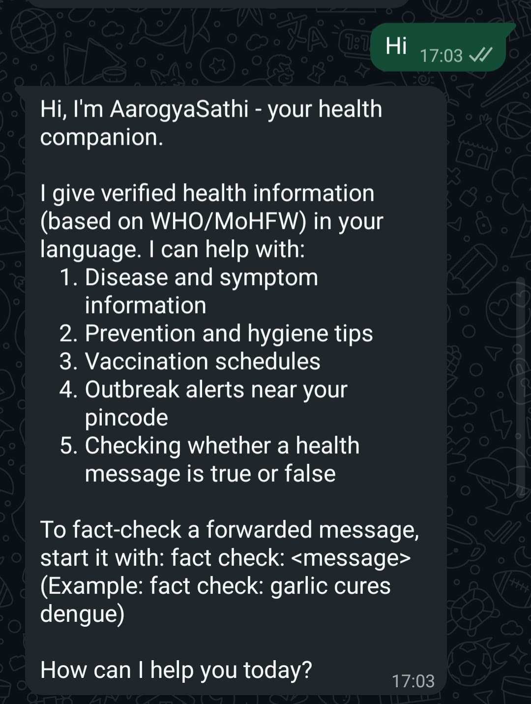
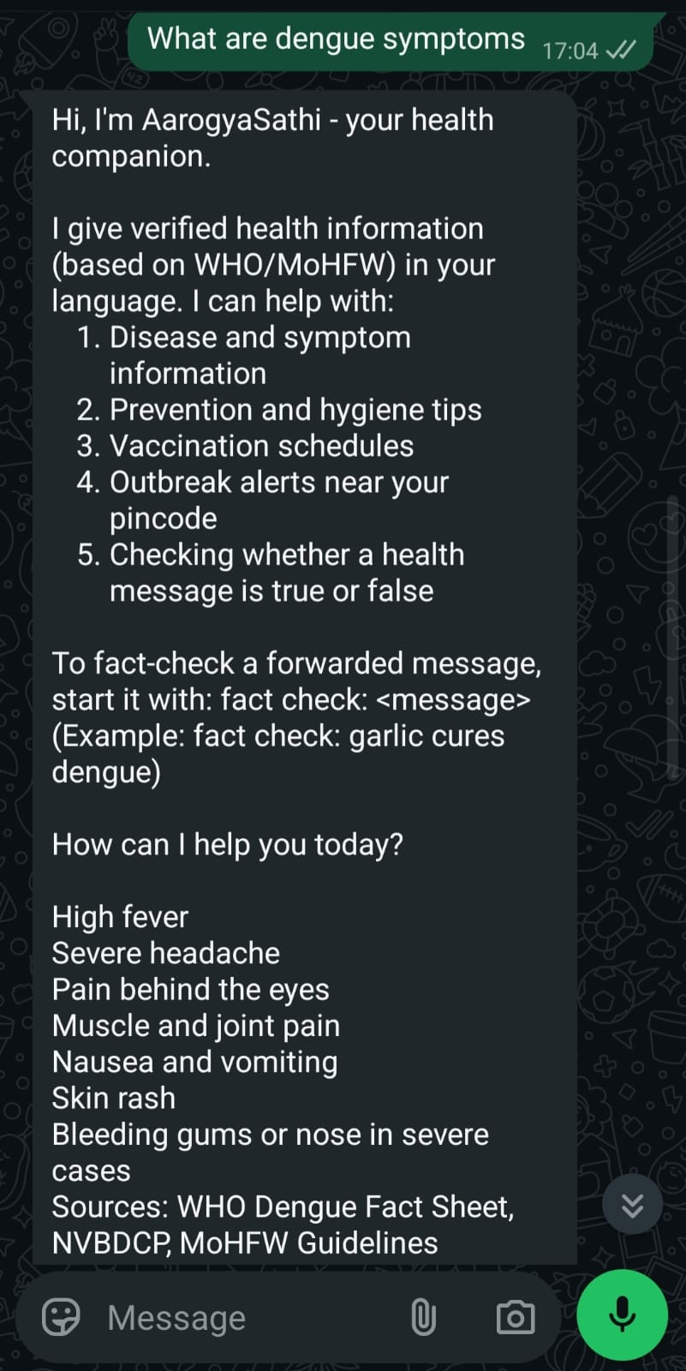
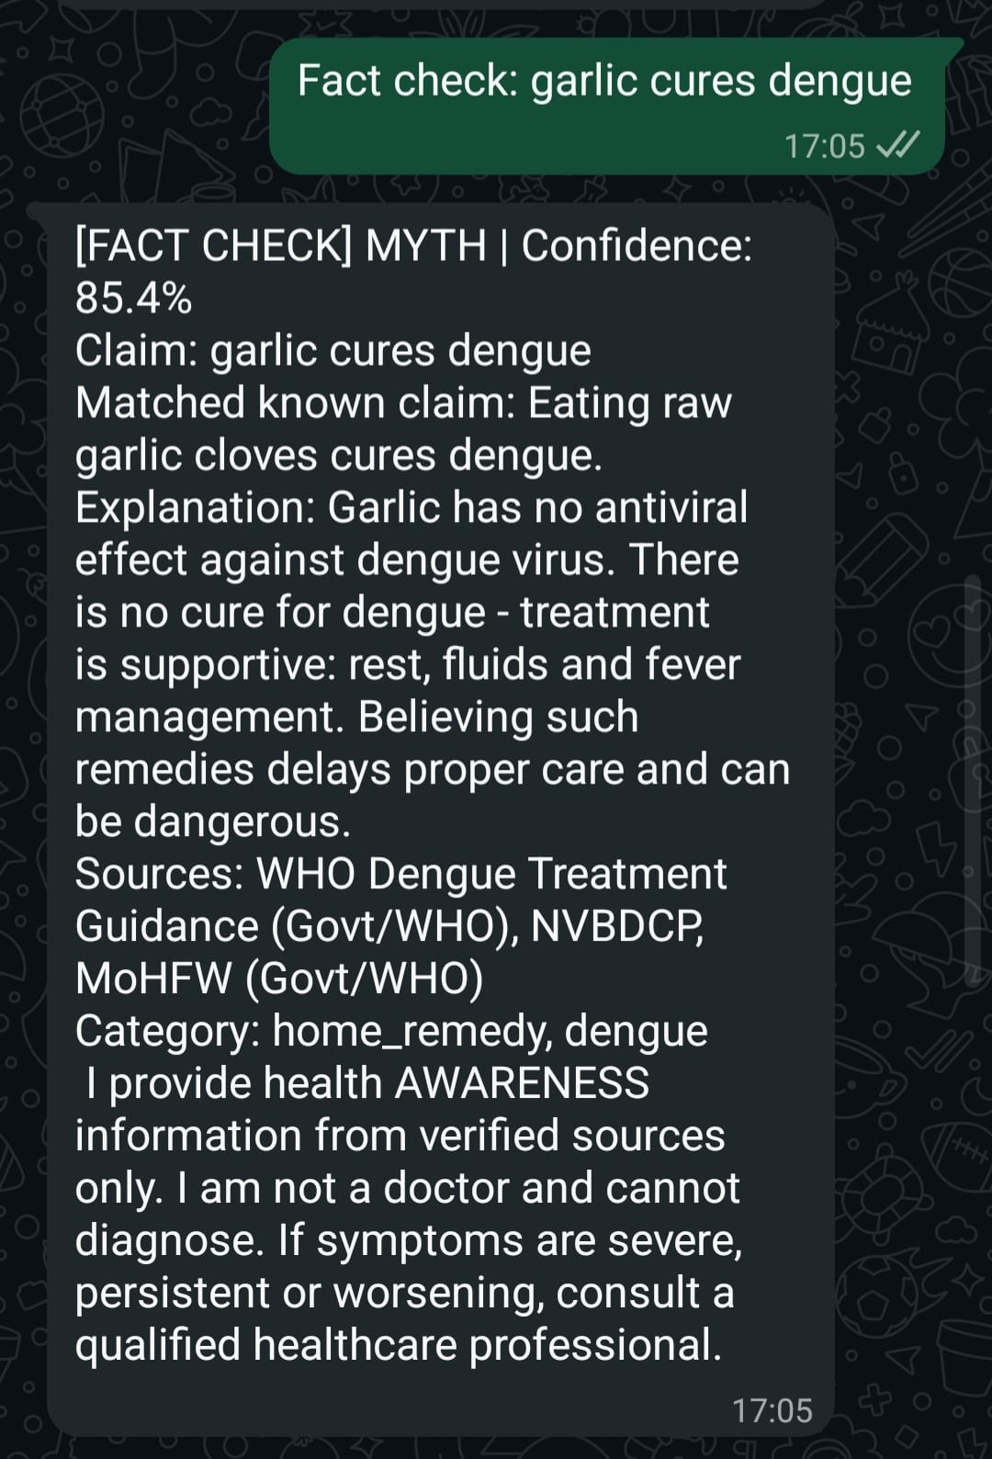
INTEGRATION
WhatsApp channel
Phone
Approved test recipient
Meta Cloud API
Delivers the webhook
Cloudflare tunnel
HTTPS to the VM
AarogyaSathi
Verify, ack, process, reply
1
Signed webhooks HMAC-SHA256 check; unsigned requests get HTTP 403
2
Fast acknowledgement 200 returned first; reply sent from a background task
3
Evidence 3 messages from an approved phone answered; 0 sending errors in the logs
4
Scope Runs on a Meta test number, available to approved test recipients
1. hi
2. What are dengue symptoms?
3. Fact check: garlic cures dengue
AarogyaSathi | Minor Project ES-451 | BPIT, CSE-DS
8
Notes:
The WhatsApp channel uses Meta's Cloud API on a test number. Meta sends each message to our webhook; we check the HMAC signature, acknowledge with 200 straight away, and process in the background. On 31 October three test messages from an approved phone were answered, and the server logs showed no sending errors. Be clear: this is a restricted test number, so only registered recipients can use it; it is not a public production bot.

Slide 9
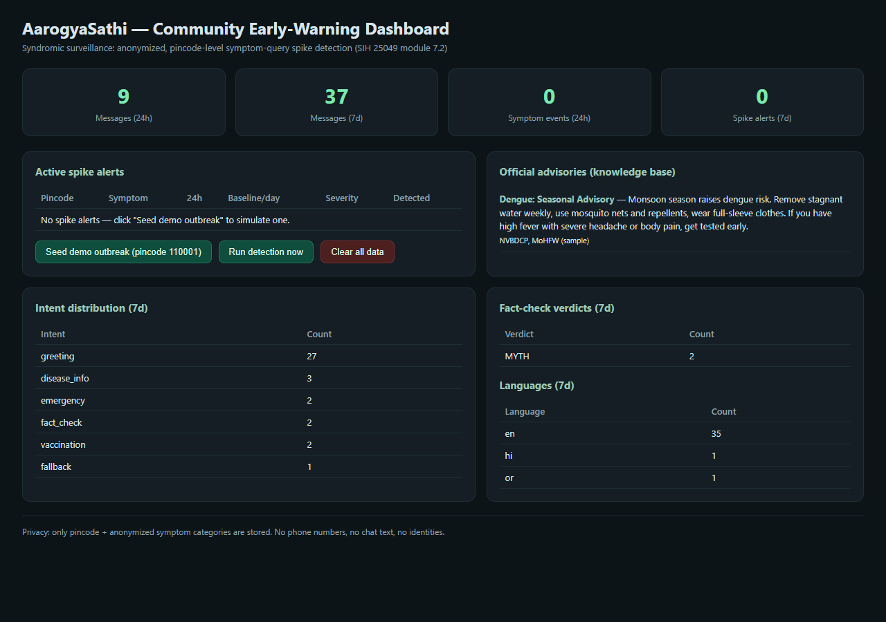
SURVEILLANCE
Early-warning signals by pincode
Alert rule
count in last 24 h >= 6
and >= 3 x the 7-day baseline
(or baseline below 1)
How the dashboard works
Symptom reports are counted per 6-digit pincode and symptom.
Each count is compared with a rolling 7-day baseline.
Spikes appear on the admin dashboard next to curated health advisories.
Admin dashboard (/admin), populated with demonstration data
AarogyaSathi | Minor Project ES-451 | BPIT, CSE-DS
9
Notes:
Users can optionally add a pincode. The system counts symptom reports per pincode and compares the last 24 hours with a seven-day baseline. An alert is raised when the count is at least six and at least three times the baseline. The figure on screen is the admin dashboard with demonstration data. Important: these are chatbot counts, not confirmed disease cases, and we do not have a live government data feed.

Slide 10
EVALUATION
Testing and results
42
30/30
15/15
34/34
automated tests passed
intent labels
retrieval top-1
claim verdicts
37 on 26 Oct + 5 channel security tests
TF-IDF + logistic regression
LaBSE + lexical overlap
mean 387 ms per claim
How to read these numbers
Evaluation sets were written by the team: 14 of 30 intent questions also appear in the training data.
Benchmark thresholds differ from production (intent 0.45 vs 0.55; retrieval top-3 / 0.35 vs top-5 / 0.52).
Claim set is imbalanced: 24 MYTH, 4 TRUE, 5 PARTLY TRUE, 1 UNVERIFIABLE.
AarogyaSathi | Minor Project ES-451 | BPIT, CSE-DS
10
Notes:
37 automated tests passed on 26 October, and five WhatsApp security tests added later also passed, so 42 now. On our supplied evaluation sets we got 30 of 30 for intent, 15 of 15 for retrieval and 34 of 34 for claim verdicts. We want to be upfront: these are our own development sets, 14 of the 30 intent questions also appear in the training data, and the benchmark thresholds differ from production. So we treat them as evidence the components work, not as real-world accuracy.

Slide 11
QUALITY ASSURANCE
What whole-conversation testing found
1
2
3
Negation in emergency phrases
Vaccine age mapping
Regional-language gap
'No chest pain, only a mild headache' triggered an emergency reply, with unrelated snakebite advice.
Code maps ages in months to the 9 to 12 month bucket and 1 year to the 5 to 6 year bucket.
An Odia prevention question fell back to a generic answer after 11.4 s.
Why this matters: passing benchmarks did not show these faults. Only whole-conversation testing did.
AarogyaSathi | Minor Project ES-451 | BPIT, CSE-DS
11
Notes:
Live spot checks found three real problems that the benchmarks missed. One: 'I have no chest pain, only a mild headache' triggered an emergency reply, because the red-flag matcher does not understand negation, and that reply also included unrelated snakebite advice. Two: a code defect maps a 2-month-old to the 9 to 12 month vaccine bucket. Three: an Odia question fell back to a generic apology.

Slide 12
RESPONSIBLE ENGINEERING
Privacy, security and deployment limits
+
Built in
i
Deployment scope
Webhook signatures verified with HMAC-SHA256
No message text, names or phone numbers in the database
Sessions held in memory and expire after 30 minutes
Disclaimer and sources on every answer
Demonstration tunnel address
WhatsApp through an approved test number
Not load-tested; no uptime study
Answers not clinically reviewed
AarogyaSathi | Minor Project ES-451 | BPIT, CSE-DS
12
Notes:
On privacy: the database stores only pincode, symptom, intent, language and verdict, not message text, names or phone numbers; conversation state lives in memory and expires after 30 minutes. On security: WhatsApp webhooks are verified with HMAC-SHA256. On limits: the tunnel address is temporary, there is no durable retry queue, and we have not run load tests. These are the gaps between a prototype and a public service.

Slide 13
CONCLUSION
A working, honestly evaluated health-awareness chatbot
1
Built and deployed
FastAPI + LaBSE + Qwen3 on Oracle Cloud, reachable on the web and a WhatsApp test number
2
Safety-first design
Deterministic emergency and fact-check paths, sources and disclaimers on every answer
3
Tested honestly
Component benchmarks plus whole-conversation spot checks, reported openly
Thank you. Questions?
Research paper (6 pages) and final project report (59 pages) available on request
Notes:
To conclude: we built and deployed a working multilingual public-health awareness chatbot with a safety-first routing design, a claim checker, and a WhatsApp channel, and we tested it honestly, including the failures. We are happy to run a live demo and take questions.

