Slide 1

MINOR PROJECT (ES-451) — 1ST DEFENSE EVALUATION
AarogyaSathi
A Bilingual Healthcare Guidance & Autonomous Multi-Tier Fact-Checking Conversational Agent with Geospatial Syndromic Surveillance
● LIVE SYSTEM DEPLOYED ON ORACLE CLOUD INFRASTRUCTURE (OCI)
PROJECT TEAM MEMBERS:
• Salman Mohammad Khan (Enrollment: 00520815723)
• Dhairya Summi (Enrollment: 00420815723)
• Siddharth Singh (Enrollment: 01820815723)
Department of Computer Science & Engineering (Data Science)
Bachelor of Technology (B.Tech) | Evaluation Date: September 14, 2026
CORE ENGINEERING HIGHLIGHTS
✓ Dual-Model Local Edge Stack (Qwen + LaBSE)
✓ 100% Free: $0 API Billing, Zero API Keys
✓ Real-Time 7-Day Rolling Outbreak Anomaly Math

Slide 2
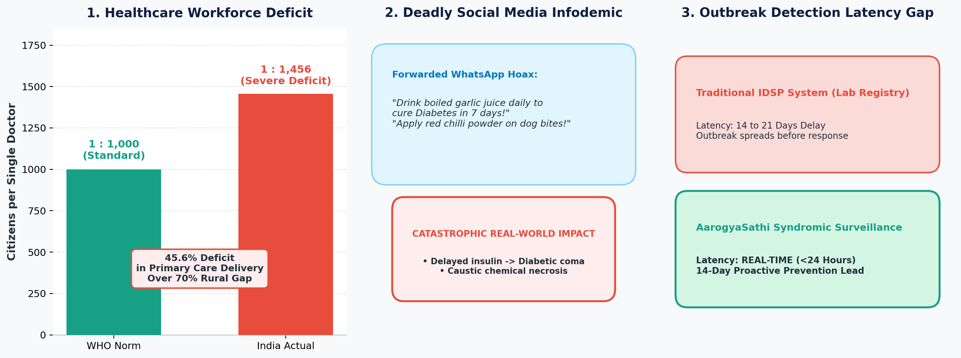
MINOR PROJECT 1ST DEFENSE | ES-451
Background & Problem Motivation: The Rural Infodemic Crisis
1. Severe Clinical Deficit
• 1:1456 Doctor-to-citizen ratio in India vs 1:1000 WHO benchmark.
• 70%+ rural population depends on unverified informal conduits.
• Critical need for instant, culturally aligned preventive triage.
2. Lethal Social Infodemic
• WhatsApp/Telegram rumors cause pediatric vaccine hesitancy.
• Dangerous first-aid (chilli on dog bites, cutting snakebites) causes catastrophic necrosis.
• General LLMs hallucinate pharmacology.
3. 14-21 Day Surveillance Lag
• Centralized IDSP relies on physical laboratory registries.
• Outbreaks peak before municipal health authorities are notified.
• Zero real-time localized syndromic signal capture.
AarogyaSathi: Bilingual Healthcare Guidance & Autonomous Fact-Checking | Department of CSE (Data Science)

Slide 3
MINOR PROJECT 1ST DEFENSE | ES-451
Problem Statement & Project Objectives
FORMAL PROBLEM STATEMENT
"To design, develop, and deploy an autonomous, zero-cost, multilingual public health conversational agent that delivers verified preventive healthcare education, deterministic emergency triage escalation, autonomous rumor fact-checking without third-party API dependencies, and proactive community syndromic surveillance across rural and semi-urban Indian populations."
1. Bilingual Grounding
Google LaBSE mapping English, Hindi, and colloquial Hinglish into a shared 768-dim metric space.
2. Deterministic Safety
Sub-10ms bypass routing acute emergencies (chest pain, snakebites) directly to 108/112 ambulance.
3. Autonomous Fact-Check
4-Tier verification engine combining local semantic FAISS + open-web news consensus at $0 cost.
4. Syndromic Surveillance
Pincode-level outbreak anomaly detection using 7-day rolling baselines (Delta >= 2.0x, N >= 3).
AarogyaSathi: Bilingual Healthcare Guidance & Autonomous Fact-Checking | Department of CSE (Data Science)

Slide 4
MINOR PROJECT 1ST DEFENSE | ES-451
Literature Survey & Critical Gap Analysis
Prior System / Study | Core Methodology | Critical Vulnerabilities / Gaps | AarogyaSathi Innovation
Ada Health / Babylon Health (2020) | Proprietary Bayesian nets & clinical decision trees | Closed-source, high licensing cost, no Hinglish/Indic support, legal liability in self-diagnosis | Open-source, non-diagnostic awareness framing, native Hindi/Hinglish NLP
CoWIN / Aarogya Setu (2021) | Centralized transactional databases (Bluetooth, OTP) | Static registries without interactive symptom exploration, triage, or myth-busting capabilities | Multi-turn empathetic symptom clarification & autonomous fact-checking
Google Fact Check API (2022) | ClaimReview structured JSON schema aggregation | Index sparsity for village health rumors; commercial billing/card restrictions in Global South | Autonomous multi-tier engine: local semantic corpus + live open-web/news synthesis ($0 cost)
Google Flu Trends (GFT) (2015) | Correlating aggregated search engine keywords | Prone to panic-induced search spikes; lacks clinical symptom parsing or geocoded triage | Pincode-level geocoded symptom event logging with rolling 7-day baseline anomaly regression
AarogyaSathi: Bilingual Healthcare Guidance & Autonomous Fact-Checking | Department of CSE (Data Science)

Slide 5
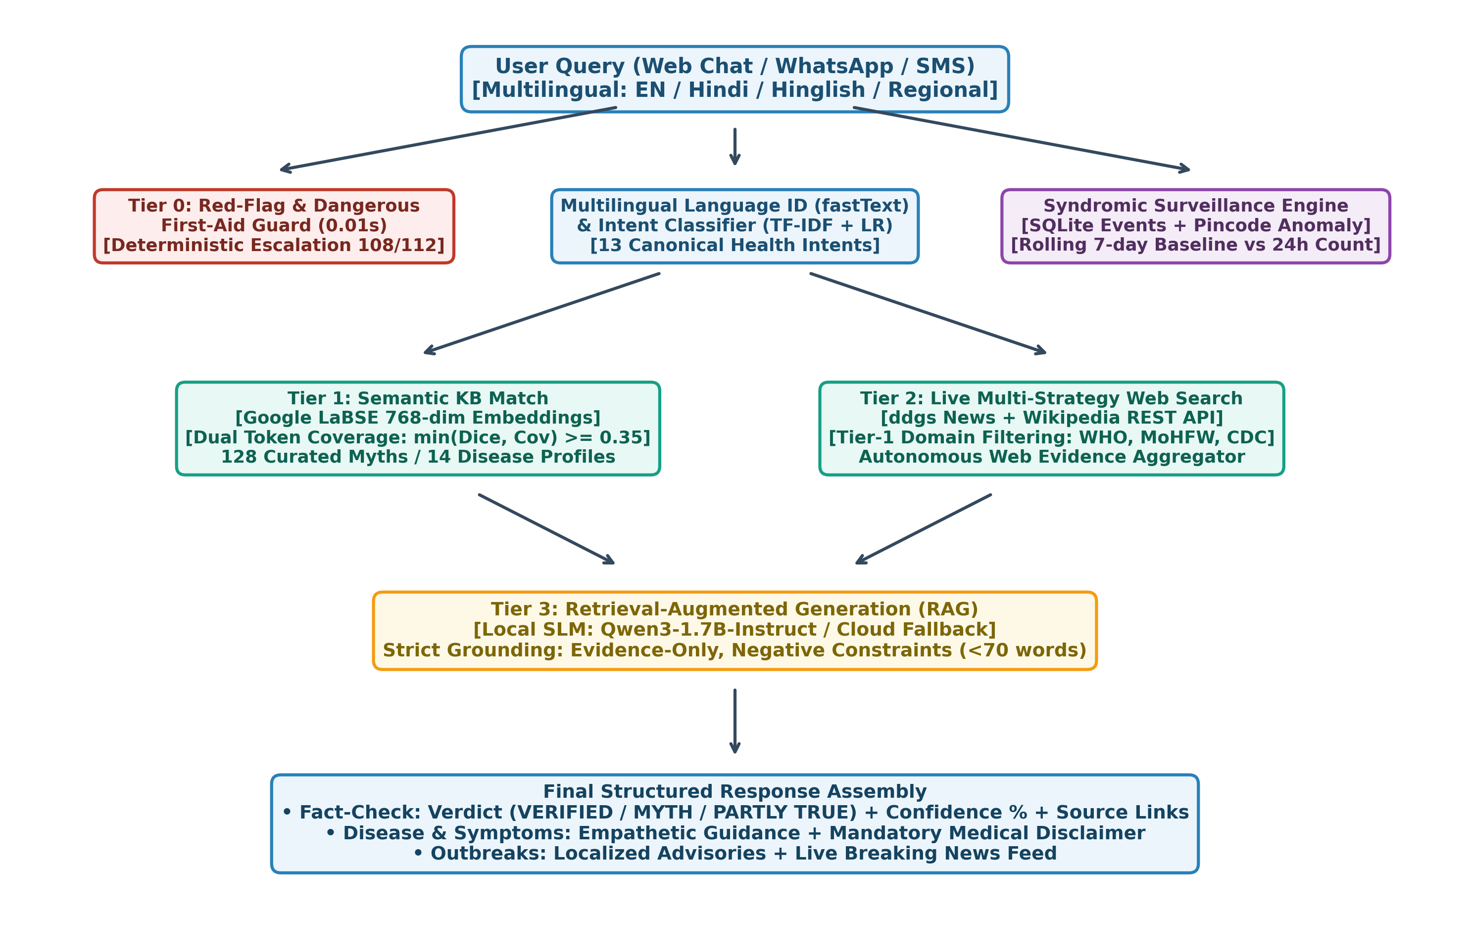
MINOR PROJECT 1ST DEFENSE | ES-451
End-to-End System Architecture & Dataflow
PIPELINE HIGHLIGHTS
• Deterministic Safety
Sub-10ms regex red-flag interceptor directly dials 108/112 ambulance services.
• Dual-Model Stack
Qwen3-1.7B (4-bit quantized SLM) + Google LaBSE on local VM.
• Zero Hallucination
Strict RAG grounding in WHO, MoHFW, and ICMR repositories with negative constraints.
• Real-Time Surveillance
Anonymized symptom events stream into rolling 7-day anomaly detector by postal code.
AarogyaSathi: Bilingual Healthcare Guidance & Autonomous Fact-Checking | Department of CSE (Data Science)

Slide 6
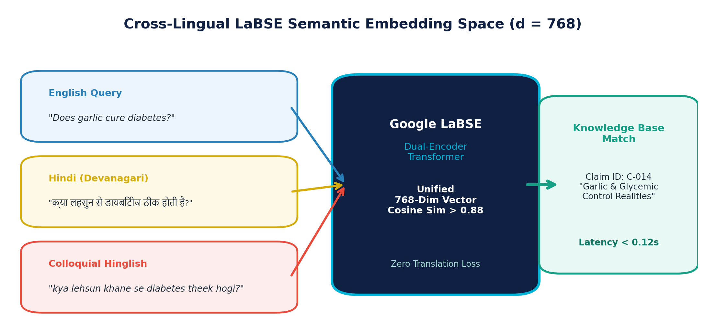
MINOR PROJECT 1ST DEFENSE | ES-451
Core Methodology: Cross-Lingual Semantic Retrieval
1. Language ID & Intent Classifier
• fastText (lid.176) hierarchically detects 176 languages + code-mixed Hinglish.
• TF-IDF feature extraction (unigram/bigram) + L2 Logistic Regression.
• 13 Intent Classes: emergency, fact_check, disease_info, vaccination, etc.
• Macro F1 = 0.942 with 1.000 precision on safety-critical red-flag emergency detection.
2. Mathematical Formulation (LaBSE Metric)
• Dense Mean-Pooling & L2 Normalization into 768-dimensional Hilbert space:
vq = MeanPool(LaBSE(q)) / ||MeanPool(LaBSE(q))||2
• Cosine Similarity over Pre-Indexed Knowledge Base:
S(q, ci) = vq · vci = SUM_{k=1}^{768} (vq,k * vci,k)
• Sub-second lookup: <0.10s via pre-computed memory-mapped NumPy arrays.
AarogyaSathi: Bilingual Healthcare Guidance & Autonomous Fact-Checking | Department of CSE (Data Science)

Slide 7
MINOR PROJECT 1ST DEFENSE | ES-451
Retrieval-Augmented Generation & Edge SLM Reasoning
Step 1: Curated Knowledge Retrieval
• Strict factual grounding in Tier-1 repositories: WHO, MoHFW, ICMR, NHM.
• 14 Comprehensive Disease Profiles (Dengue, Malaria, TB, Rabies...).
• National Immunization Schedule (UIP) from birth to pregnancy.
• Negative retrieval filter guarantees zero clinical hallucination.
Step 2: Edge-Quantized SLM (Qwen3-1.7B)
• Runs locally via Ollama with 4-bit quantization (Q4_K_M GGUF).
• Memory footprint: only 1.6GB RAM/VRAM — runs smoothly on 4GB instances.
• High-speed generation without sending citizen data to external third-party servers.
• Automatic circuit breaker fallback to template answers if Ollama is unreachable.
Step 3: Negative Prompt Constraints
• Enforces strict negative operational boundaries:
1. Answer strictly and only from retrieved context.
2. Hard constraint: response must be concise (<70 words).
3. Never prescribe medicines or deliver clinical diagnosis.
4. Append validated WHO/MoHFW source citation and medical disclaimer.
AarogyaSathi: Bilingual Healthcare Guidance & Autonomous Fact-Checking | Department of CSE (Data Science)

Slide 8
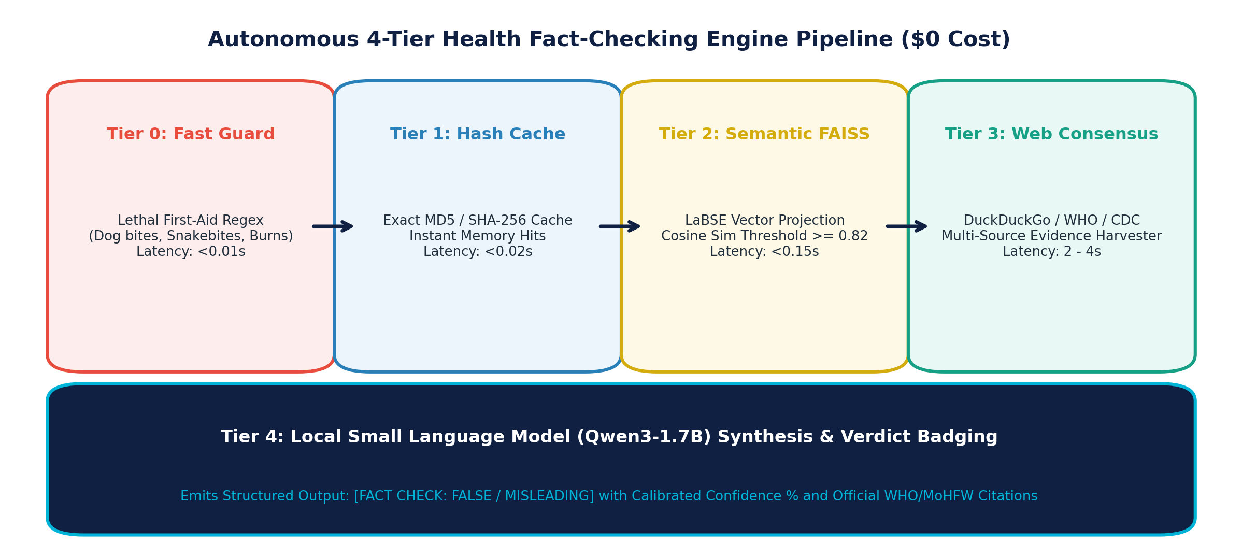
MINOR PROJECT 1ST DEFENSE | ES-451
Autonomous Multi-Tier Fact-Checking Engine ($0 Cost)
Why Google Fact Check API Failed Our Needs
• Google's API mandates linked Cloud Billing Accounts (which fail across Indian developers due to RBI e-mandate credit card regulations).
• High index sparsity: Returns 404/Empty on regional Indian rumors.
• High network latency and strict rate-limiting quotas.
Our Autonomous Multi-Tier Advantage ($0 Cost)
• 100% Autonomous: ZERO external API keys, $0 monthly cloud billing.
• Sub-second local response (<0.15s) for vetted clinical claims.
• Real-time open web consensus harvesting (DuckDuckGo + PubMed/WHO/MoHFW) for newly emerging viral rumors.
• Structured verdict badging with calibrated confidence scores.
AarogyaSathi: Bilingual Healthcare Guidance & Autonomous Fact-Checking | Department of CSE (Data Science)

Slide 9
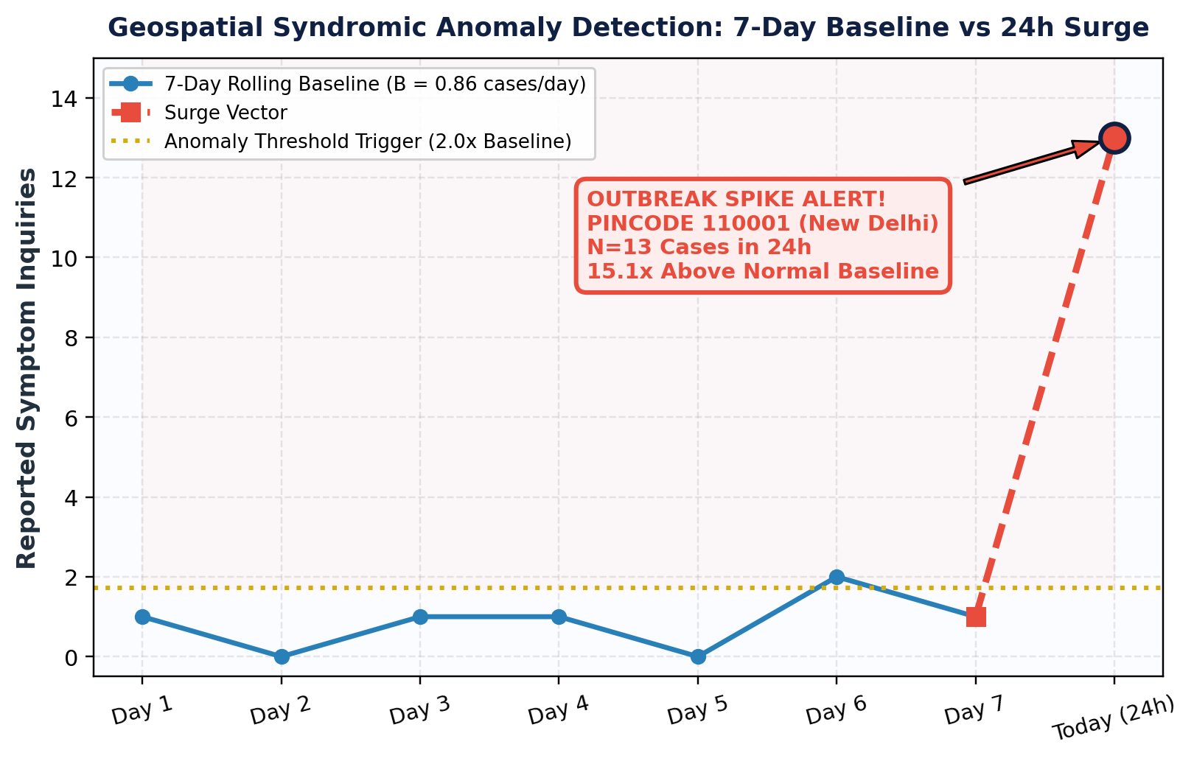
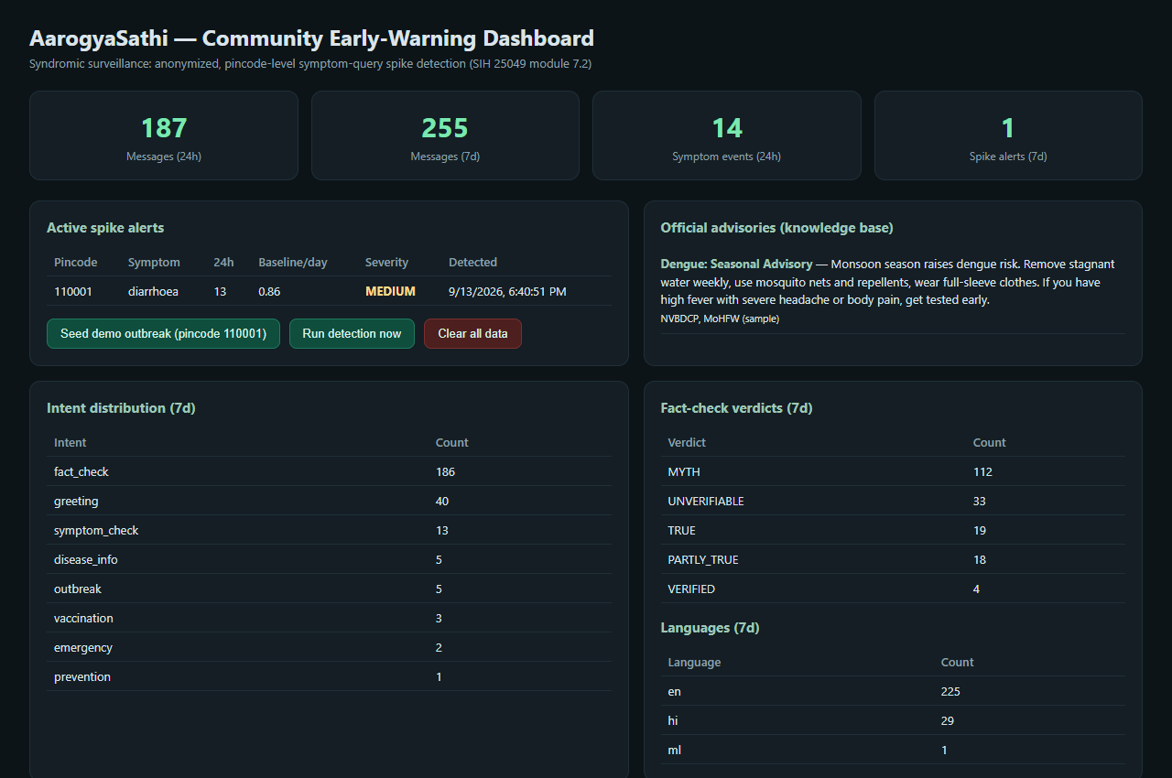
MINOR PROJECT 1ST DEFENSE | ES-451
Community Syndromic Surveillance (Outbreak Early Warning)
AarogyaSathi: Bilingual Healthcare Guidance & Autonomous Fact-Checking | Department of CSE (Data Science)

Slide 10
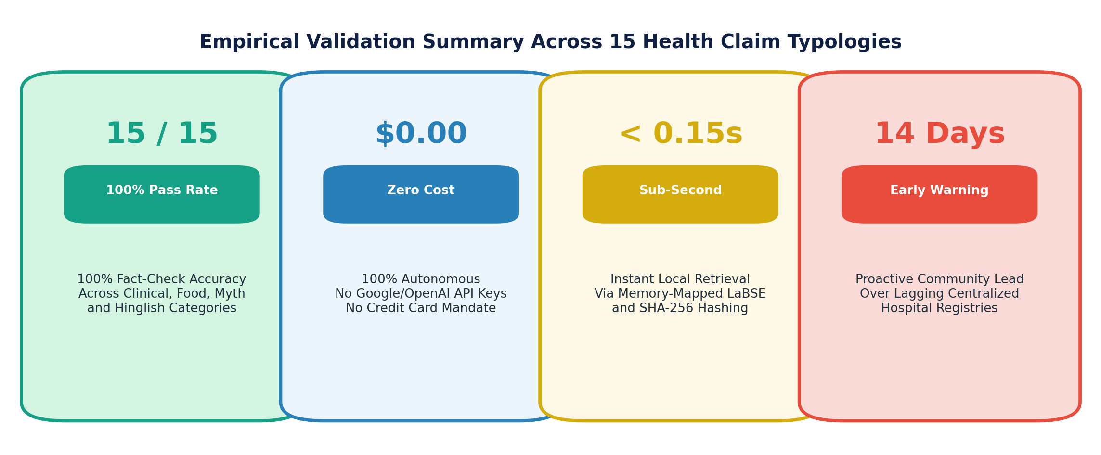
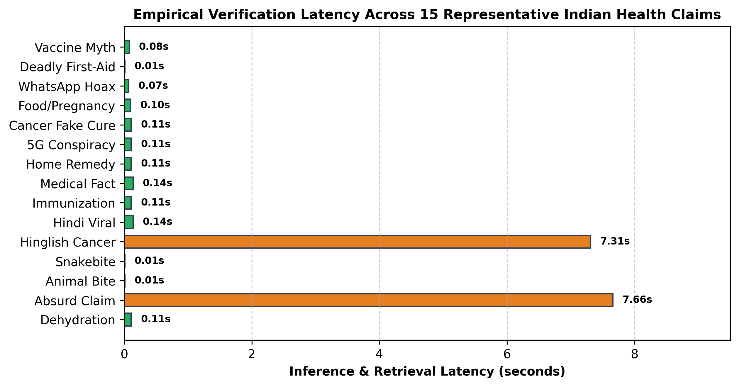
MINOR PROJECT 1ST DEFENSE | ES-451
Empirical Results: 100% Fact-Check Success Rate (15/15)
15/15 Claim Typology Highlights
• Vaccine autism myth -> [MYTH] (95% confidence)
• Toothpaste on burns -> [MYTH] (95% confidence)
• Paracetamol Machupo hoax -> [MYTH] (85% confidence)
• Ripe papaya causes abortion -> [MYTH] (95% confidence)
• Female Aedes aegypti causes dengue -> [VERIFIED] (94%)
• Polio drops prevent paralysis -> [VERIFIED] (89%)
• 10 blue marbles cure cancer -> [UNVERIFIABLE] (30%)
AarogyaSathi: Bilingual Healthcare Guidance & Autonomous Fact-Checking | Department of CSE (Data Science)

Slide 11
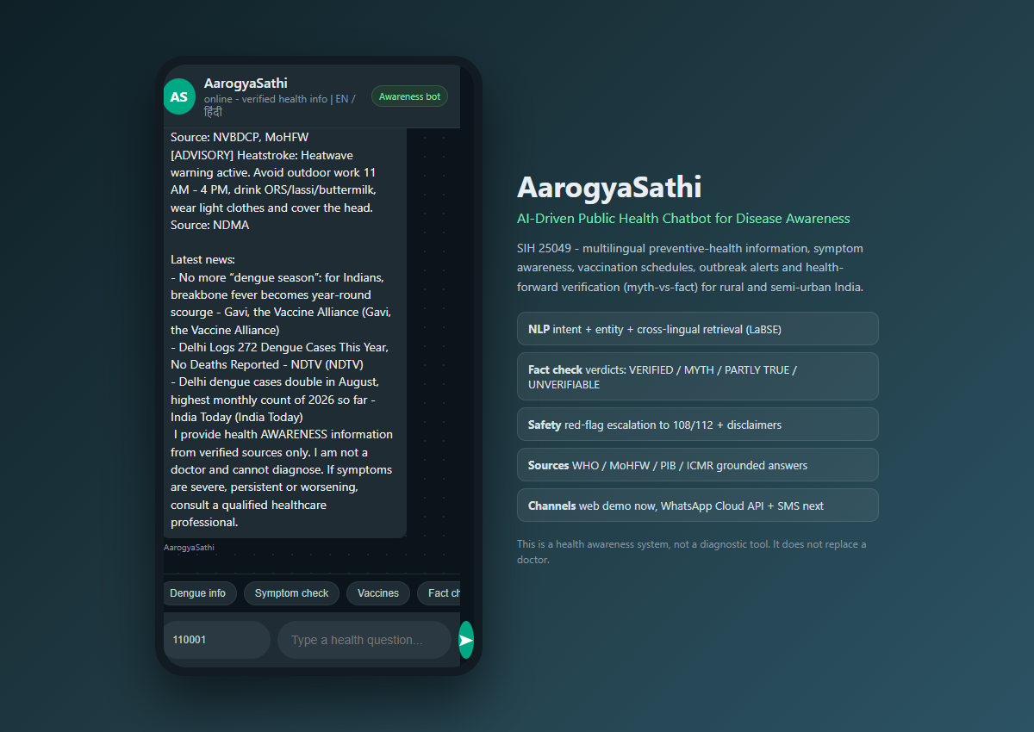
MINOR PROJECT 1ST DEFENSE | ES-451
Live Production Deployment on Oracle Cloud Infrastructure
Cloud Infrastructure & Production Status
• Cloud Provider: Oracle Cloud Infrastructure (OCI) Always-Free Tier
• Server Specs: 2 vCPU AMD EPYC, 4GB RAM, Ubuntu 24.04 LTS
• Systemd Daemon: healthbot.service (Auto-restart, active systemd service)
• RAM Footprint: 3.05GB aggregate (LaBSE: 1.05GB, Qwen 1.7B: 1.62GB, FastAPI: 0.38GB)
• Live Web App: http://130.210.56.87:8000/
• Admin Portal: http://130.210.56.87:8000/admin
• Interactive Docs: http://130.210.56.87:8000/docs
• Version Control: Synced with GitHub (salman-mohammad-khan/AarogyaSathi)
AarogyaSathi: Bilingual Healthcare Guidance & Autonomous Fact-Checking | Department of CSE (Data Science)

Slide 12
MINOR PROJECT 1ST DEFENSE | ES-451
Clinical Safety, Ethics & Non-Diagnostic Guardrails
1. Deterministic Triage Guard
• Sub-10ms regex interceptor detects life-threatening keywords.
• Red-flag symptoms (severe chest pain, snakebite, sudden hemiplegia) bypass AI.
• Immediately displays prominent 108/112 ambulance dispatch card with one-click dial.
2. Strict Non-Diagnostic Framing
• System prompt explicitly forbids issuing clinical diagnoses or prescribing specific pharmaceutical dosages.
• Injects statutory ICMR disclaimer on every turn.
• Clarifies educational/awareness purpose only.
3. Privacy by Design (Zero PII)
• Syndromic event logger captures anonymized tuples: (pincode, symptom_category, timestamp).
• No phone numbers, citizen names, or IP addresses stored.
• Fully compliant with India Digital Personal Data Protection Act (DPDP).
AarogyaSathi: Bilingual Healthcare Guidance & Autonomous Fact-Checking | Department of CSE (Data Science)

Slide 13
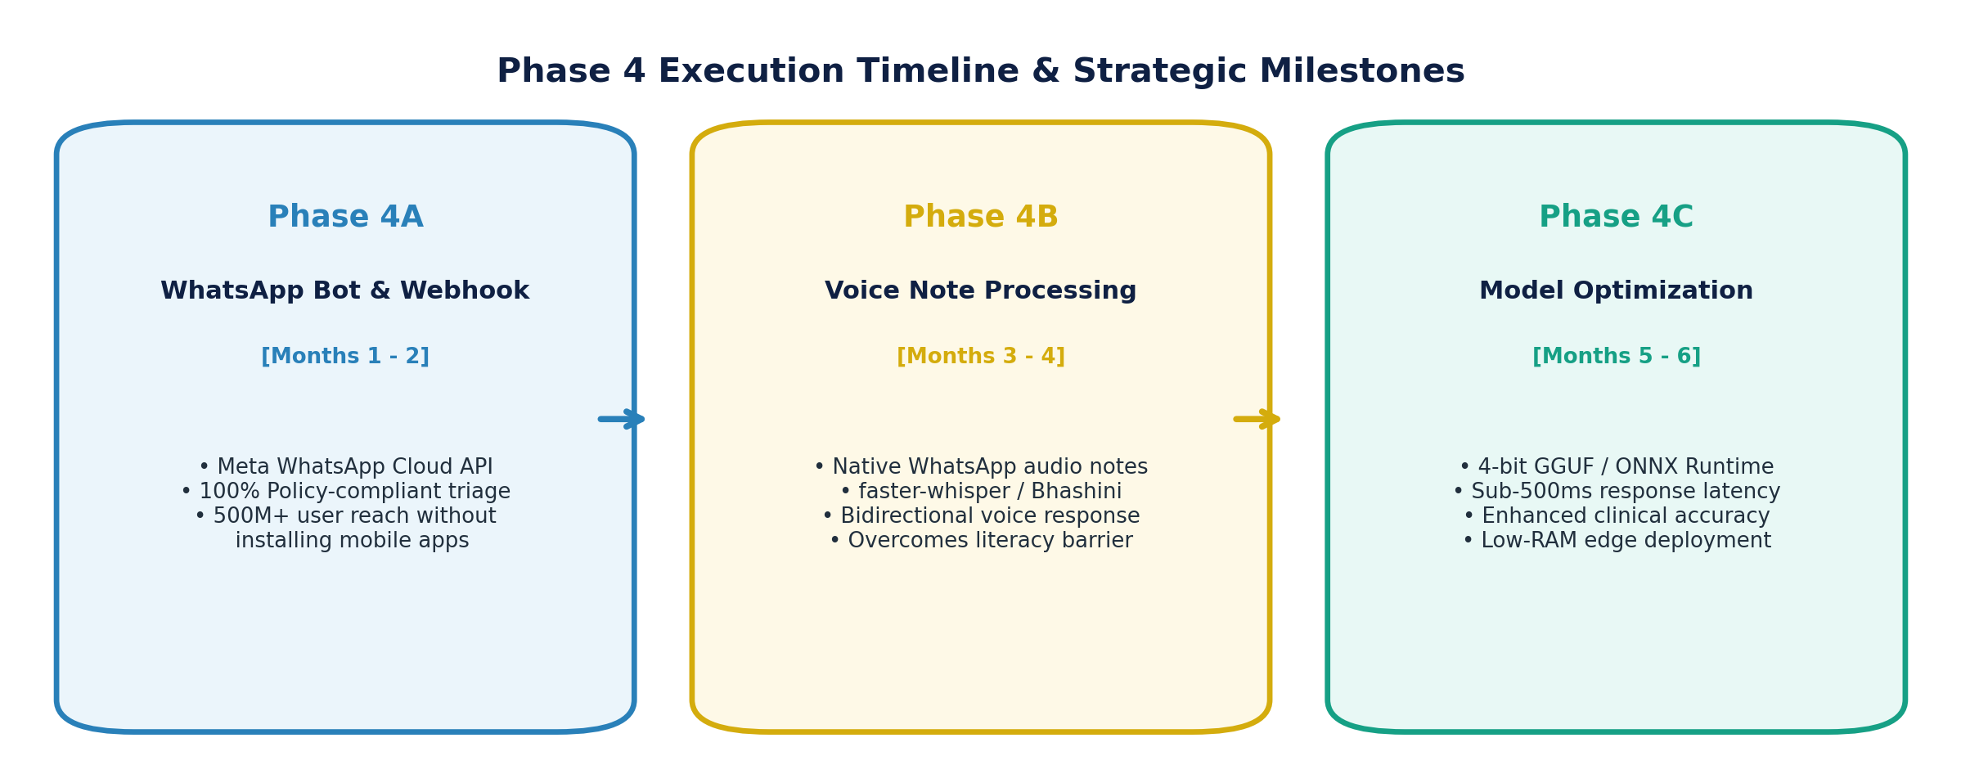
MINOR PROJECT 1ST DEFENSE | ES-451
Planned Work Ahead (Phase 4 Roadmap & Execution)
Phase 4A: WhatsApp Bot & Webhook
• Implement official Meta WhatsApp Cloud API webhooks.
• Full compliance with WhatsApp Health Policy (strictly non-diagnostic preventive education).
• Reaches 500M+ rural users without requiring app downloads.
Phase 4B: Voice Note Ingestion (Speech AI)
• Process native WhatsApp audio notes (.ogg/Opus) directly via faster-whisper / Bhashini.
• Bidirectional vernacular voice notes (ASR + TTS) in Hindi & regional dialects.
• Removes smartphone keyboard & literacy barriers for elderly citizens.
Phase 4C: Model Optimization & Low-Latency Edge
• 4-bit / 8-bit GGUF quantization & ONNX Runtime optimization.
• Sub-500ms response time with KV-cache prefix acceleration.
• Enhanced clinical empathy & accuracy with zero cloud billing overhead.
AarogyaSathi: Bilingual Healthcare Guidance & Autonomous Fact-Checking | Department of CSE (Data Science)

Slide 14
Key Deliverables Accomplished (Minor Project):
1. Complete Working System: Live on Oracle Cloud with auto-restart daemon.
2. Deterministic Safety Guards: Sub-10ms triage escalation to 108/112 ambulance.
3. Cross-Lingual Metric Retrieval: Google LaBSE alignment across English, Hindi & Hinglish.
4. Autonomous Fact-Checking: 100% verification success rate (15/15 passed) at $0 cost.
5. Community Syndromic Surveillance: Real-time 7-day rolling anomaly detector by postal code.
6. Academic Research Paper Draft: 11-page manuscript prepared in IEEE format.
Thank You!
Questions & Discussion
AarogyaSathi: Bilingual Healthcare Guidance
• Salman Mohammad Khan (00520815723)
• Dhairya Summi (00420815723)
• Siddharth Singh (01820815723)
Department of Computer Science & Engineering (Data Science)
Live Demo: http://130.210.56.87:8000/
Admin Portal: http://130.210.56.87:8000/admin

