Slide 1


Slide 2
Types of reviews
Narrative reviews:
Summaries of research that lack explicit descriptions of systematic methods
Systematic reviews:
Use explicit and rigorous methods to identify, critically appraise, and synthesize relevant studies
Meta-analysis: quantitative review using statistical analyses
Meta-ethnography: systematic review of qualitative data

Slide 3
Advantages of Systematic Reviews
You don’t have to be an “expert” to do one!
More objective, less prone to bias and error
Literature search is comprehensive, exhaustive and repeatable
Clear description of the methods used
Explicit criteria for choosing studies
Includes assessment and discussion of quality of primary studies
Readers can replicate or verify the review

Slide 4
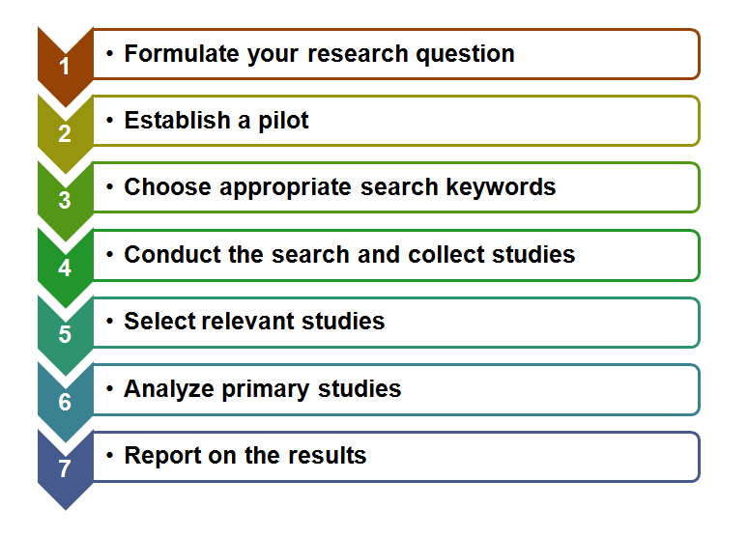
Steps Overview

Slide 5
1. Formulate your research question
Example
What are the existing approaches for user-friendly semantic content authoring?
How to classify the existing approaches for semantic content authoring?
What type of user interfaces are used by each approach?
What are the features supported by the proposed user interfaces?
What type of users are targeted in each approach?
How is the user interface evaluated?

Slide 6
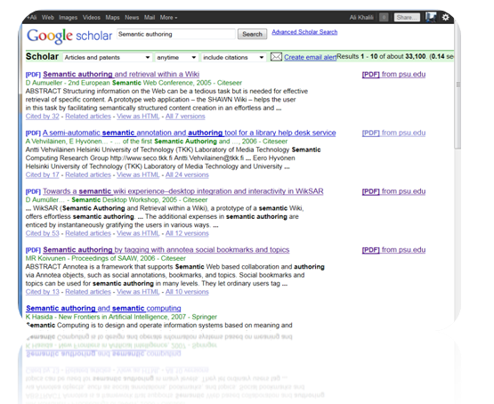
2. Establish a pilot
As an starting point:
Do some pilot searches
Get some relevant studies from an expert in the field

Slide 7
3. Choose appropriate search keywords
Based on pilot studies
Trial and Error
Not too broad (‘scope creep’)
Not too narrow (‘empty net’)
Think of all possibly synonyms
Example
1 AND 2 AND 3
"semantic" OR "linked data" OR "web of data" OR "data web"
"content" OR "web page" OR "document"
"authoring" OR "annotating" OR "annotation" OR "annotate" OR "enrich" OR "edit"

Slide 8
4. Conduct the search and collect studies
Get list of relevant data sources
Commonly used data sources:
ACM Digital Library
IEEE Xplore Digital Library
ScienceDirect
SpringerLink
ISI Web of Sciences
Adapt your query to each data source API
Download citations

Slide 9
5. Select relevant studies
Define your inclusion and exclusion criteria
Example
Include
A study that focuses on semantic content authoring.
A study that either proposes a user interface or a set of user interface features for the purpose of semantic content authoring.
Exclude
A study that does not focus on semantic content authoring but only mentions it for the purpose of data integration.
A study that does not propose any user interface (or user interface feature) for semantic content authoring but only a method, approach or algorithm for semantic annotation.
A study that is not about Web-based content authoring (e.g. It is about semantic authoring in word processors like Latex).
A study that is only about the ontology authoring or ontology annotation (e.g. by using the natural language).
A study that does not discuss textual Web content authoring but image, audio or video annotation.

Slide 10
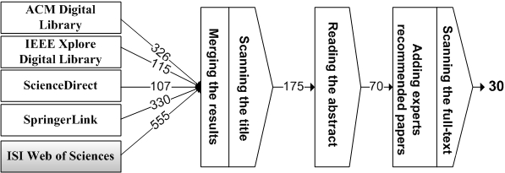
5. Select relevant studies (con.)
Apply your criteria on title, abstract and full-text of studies
Result : List of primary Studies

Slide 11
6. Analyze primary studies
Quantitative Data Analysis Methods
Qualitative Data Analysis Methods
Coding
"filling in": adding codes, reconstructing a coherent scheme as new insights emerge and new ways of looking at the data emerge.
"extension": returning to materials coded earlier and interrogating them in a new way, with a new theme, construct, or relationship.
"bridging": seeing new or previously not understood relationships within units of a given category (that relationship within itself have a name, and it may call for a new configuration of the categories).
"surfacing": identifying new categories.
Analysis Software
Commercial
Atlas.ti
QSR NVIVO
Free
Weft QDA (http://www.pressure.to/qda/)

Slide 12
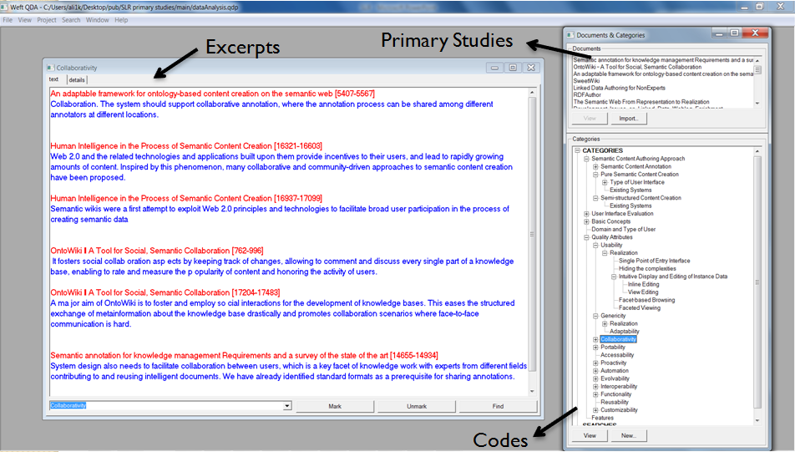
6. Analyze primary studies (con.)

Slide 13

7. Report on the results

Slide 14
Steps Overview

