Slide 1
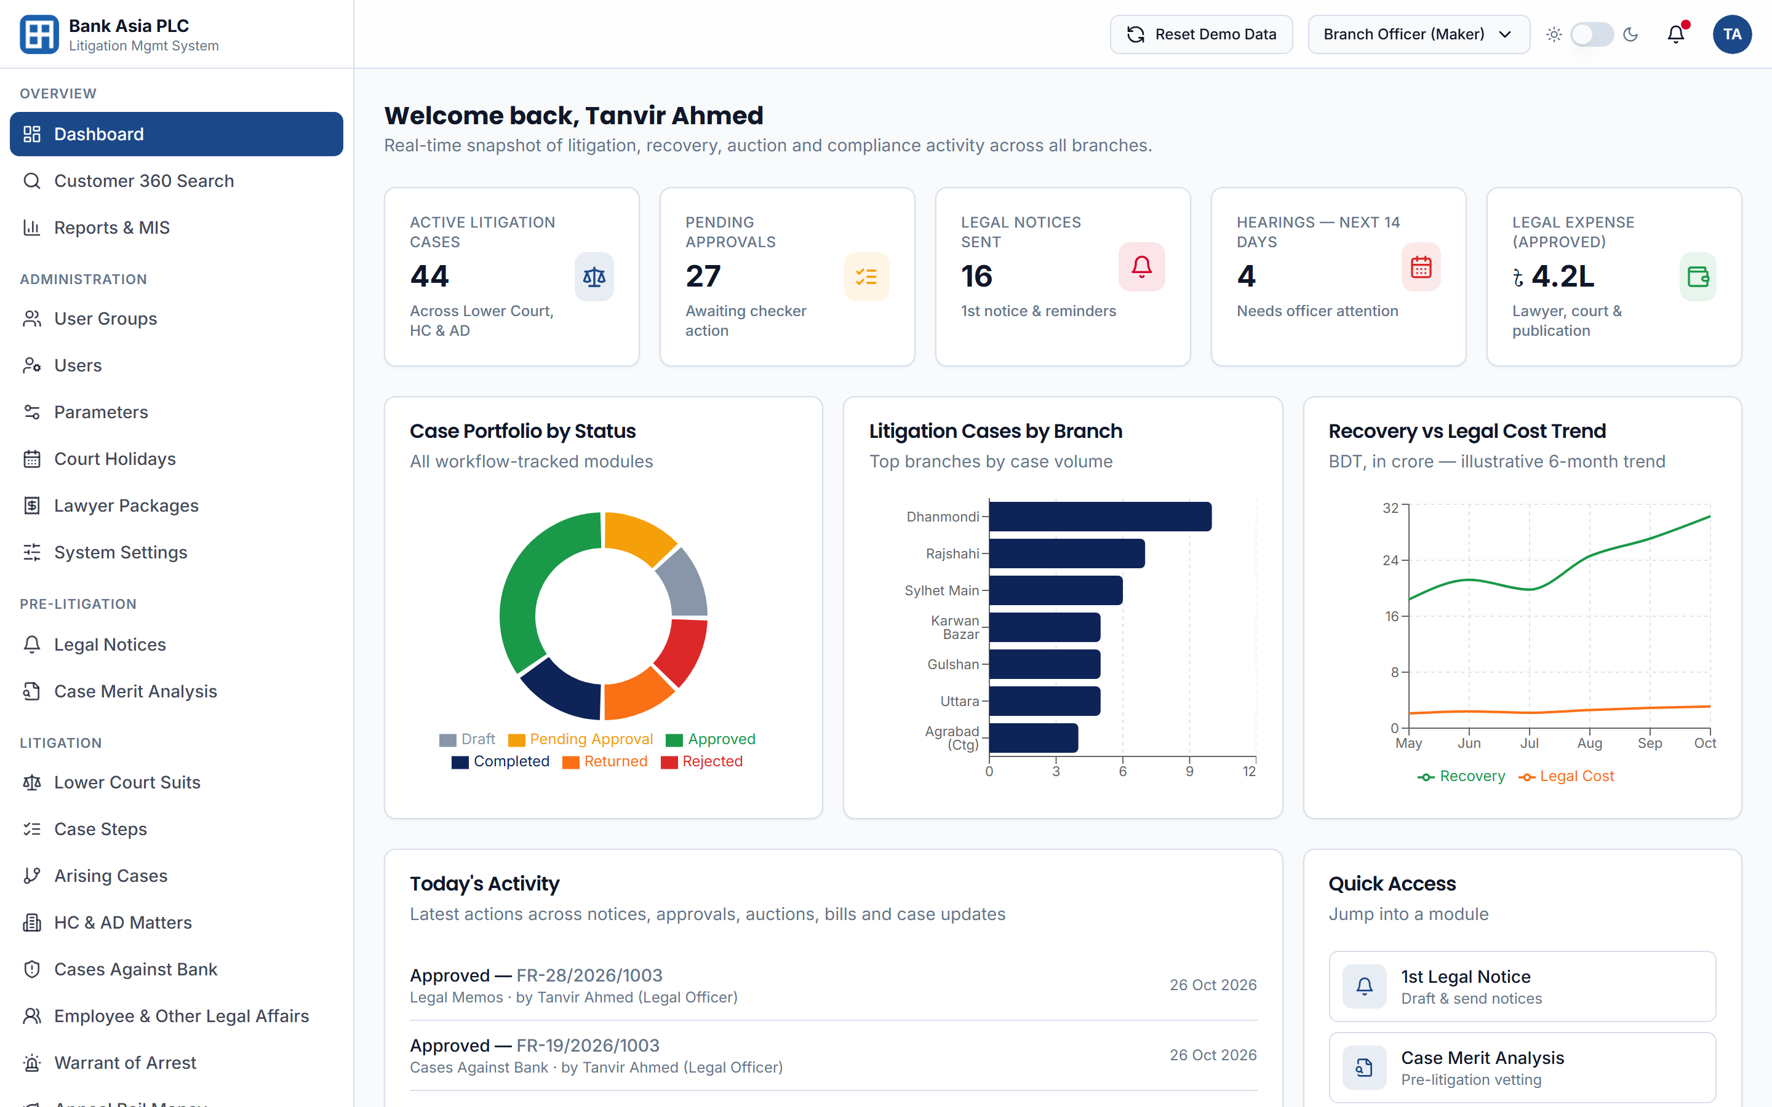
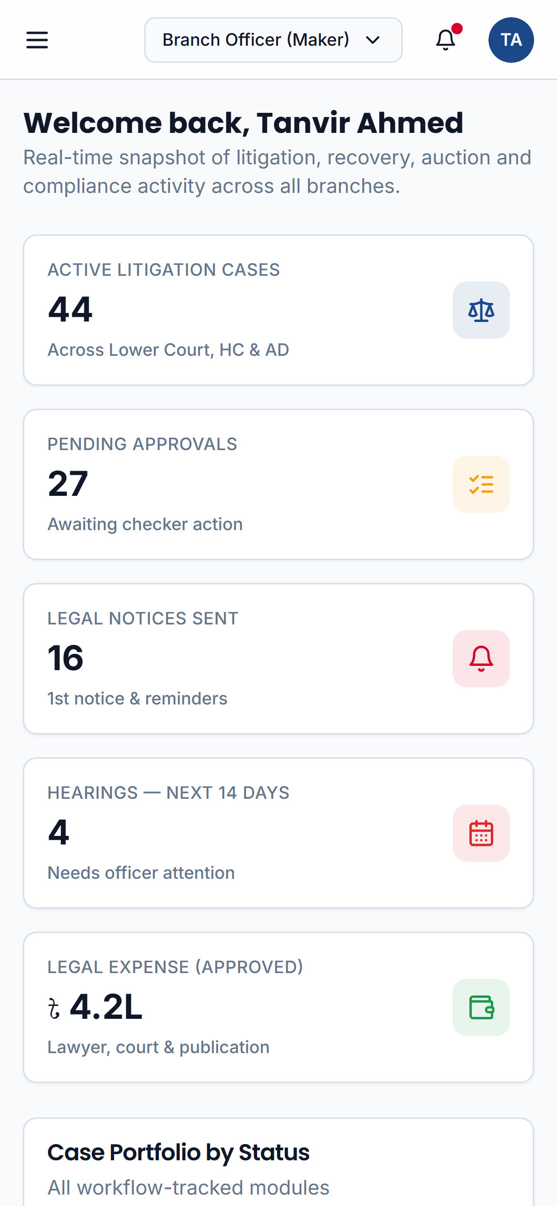
Litigation Management System
lms.skoder.co/dashboard
SOLUTION PRESENTATION · LIVE DEMONSTRATION
One centralized platform for Bank Asia's legal and recovery lifecycle — from first notice to final settlement
27 October 2026
Live system: lms.skoder.co
Notes:
Thank you for the opportunity. Today we present our Litigation Management System for Bank Asia, built directly against the RFP's functional and technical specifications. Everything you will see is a live, working system at lms.skoder.co. It runs on desktop and mobile.

Slide 2
Agenda
What we will cover today
01
02
03
LIVE DEMO
Understanding Your Requirement
Solution & Architecture
Live System Walkthrough
Objectives and challenges from the RFP
Modules, integrations and deployment
Dashboard, workflow and case management
04
05
06
Customer 360° & Reports
Security & Compliance
Implementation & Next Steps
Consolidated view and regulatory MIS
Access control, audit trail and resilience
Delivery phases and support model
Notes:
We start with our understanding of your requirement, then the solution and its architecture. Most of our time is a live walkthrough of the working system. We then cover reporting, security and compliance, and close with our implementation approach.

Slide 3





Understanding Your Requirement
Moving the Legal Division from fragmented, manual tracking to one centralized, insight-driven platform
Today
With the LMS
Challenges in the current process
What the platform delivers
Case tracking spread across branches, files and spreadsheets
One platform with a 360° view of every account and case
Risk of missed hearings, limitation dates and dormant cases
Automated alerts for hearings, limitation, filing and appeals
Limited visibility of exposure and recovery per account
CBS-linked balances, statements and recovery tracking
Notices, opinions, documents and lawyer bills held manually
Central repository with maker–checker approval and audit trail
Heavy manual effort to compile Bangladesh Bank reports
Real-time dashboards and 48 MIS & regulatory reports
Source: Bank Asia RFP v0.3 — Executive Summary (Section 2) and Objectives (Section 3)
Notes:
The RFP describes a legal environment that is fragmented and largely manual. The objectives are clear: centralize, automate deadlines and alerts, integrate with CBS, strengthen governance with maker-checker and audit trails, and deliver real-time MIS. Each outcome on the right maps to an objective in Section 3.

Slide 4
The Solution at a Glance
One integrated platform covering the complete legal and recovery lifecycle
31
48
6
360°
Functional modules
Reports & MIS
Role profiles
Customer & case view
Every RFP Section 8 requirement
Including Bangladesh Bank formats
Maker–checker segregation
Cases, documents and payments
The legal and recovery lifecycle, end to end
Pre-Litigation
Litigation
Auction
Recovery
Settlement
Legal & reminder notices
Case merit analysis
Property vetting
Lower court suits
Case steps & hearings
HC & AD matters
Publication copies
Bidder details
Final auction memo
Account statements
Jari certificates
Bill disbursement
Compromise & solenama
CBS reconciliation
Case closure
Notes:
In one platform: all 31 functional modules from Section 8, 48 reports including Bangladesh Bank formats, six role profiles with maker-checker segregation, and a 360-degree customer view. It covers the full lifecycle the RFP describes, from pre-litigation through settlement.

Slide 5






31 Modules Across Six Domains
Every functional requirement in RFP Section 8 has a working screen in the live system
Administration
Pre-Litigation
Litigation
7 modules
2 modules
8 modules
User Groups
Users
Login & Access
Parameters
Court Holidays
Lawyer Packages
System Settings
1st Legal & Reminder Notice
Case Merit Analysis (CMA)
Lower Court Suits
Case Steps
Arising Cases
HC & AD Matters
Cases vs. Bank
Employee Affairs
Warrant of Arrest
Appeal Bail Money
Includes CBS customer lookup and land/property legal vetting
Recovery & Finance
Insight & Reporting
Collaboration
5 modules
4 modules
5 modules
Auction Management
Account Statements
Jari Statement & Certificate
Bill Processing & Disbursement
Court Fee Return & Adjustment
Real-Time Dashboard
Reports & MIS (48)
Notifications & Alerts
Customer 360° Search
Authorization Requests
Document Repository
Legal Memos & Notices
Legal Opinions
Task Management
Notes:
This is the full coverage map. Every module listed in RFP Section 8, from user groups to task management, has a working screen in the live system. Bidders are scored on A/PA/NA compliance, and we can demonstrate each item live.

Slide 6











Architecture & Integration
A modern N-tier platform, deployed on-premises at Bank Asia's DC and DR and integrated with core systems
USERS
PLATFORM
INTEGRATIONS
Branch Officers (Maker)
Web Application
Core Banking System
Conventional, Islamic & offshore
Responsive Next.js interface · role-aware menus · Bank Asia branding
Branch Managers (Checker)
SMS & Email Gateway
Alerts, reminders & notices
HO Legal Division
Application Services (REST API)
Finance System
Workflow engine
Business rules
Role-based access
Bill payment & reconciliation
Audit trail
Alerts & scheduler
Report engine
EDW / MIS
Management & Audit
Dashboards & regulatory data
Active Directory / SSO
Any modern browser — desktop, tablet or mobile
Single sign-on & user sync
PostgreSQL Database
Cases, financials, documents and audit logs · DC → DR replication
Document Repository
Archival & retrieval
Deployed on-premises at Bank Asia DC & DR · Integrations via REST/SOAP APIs, batch/ETL, message queues and SFTP · The live demo simulates CBS, SMS and email
Notes:
The architecture is N-tier and cloud-ready, but deployed on-premises at your DC and DR as Section 7.8 prefers. The application tier hosts the workflow engine, business rules, role-based access and the audit trail. Integrations with CBS, SMS and email, Finance, EDW and Active Directory use REST/SOAP APIs, batch/ETL, message queues or SFTP. In the demo, CBS and messaging are simulated.

Slide 7
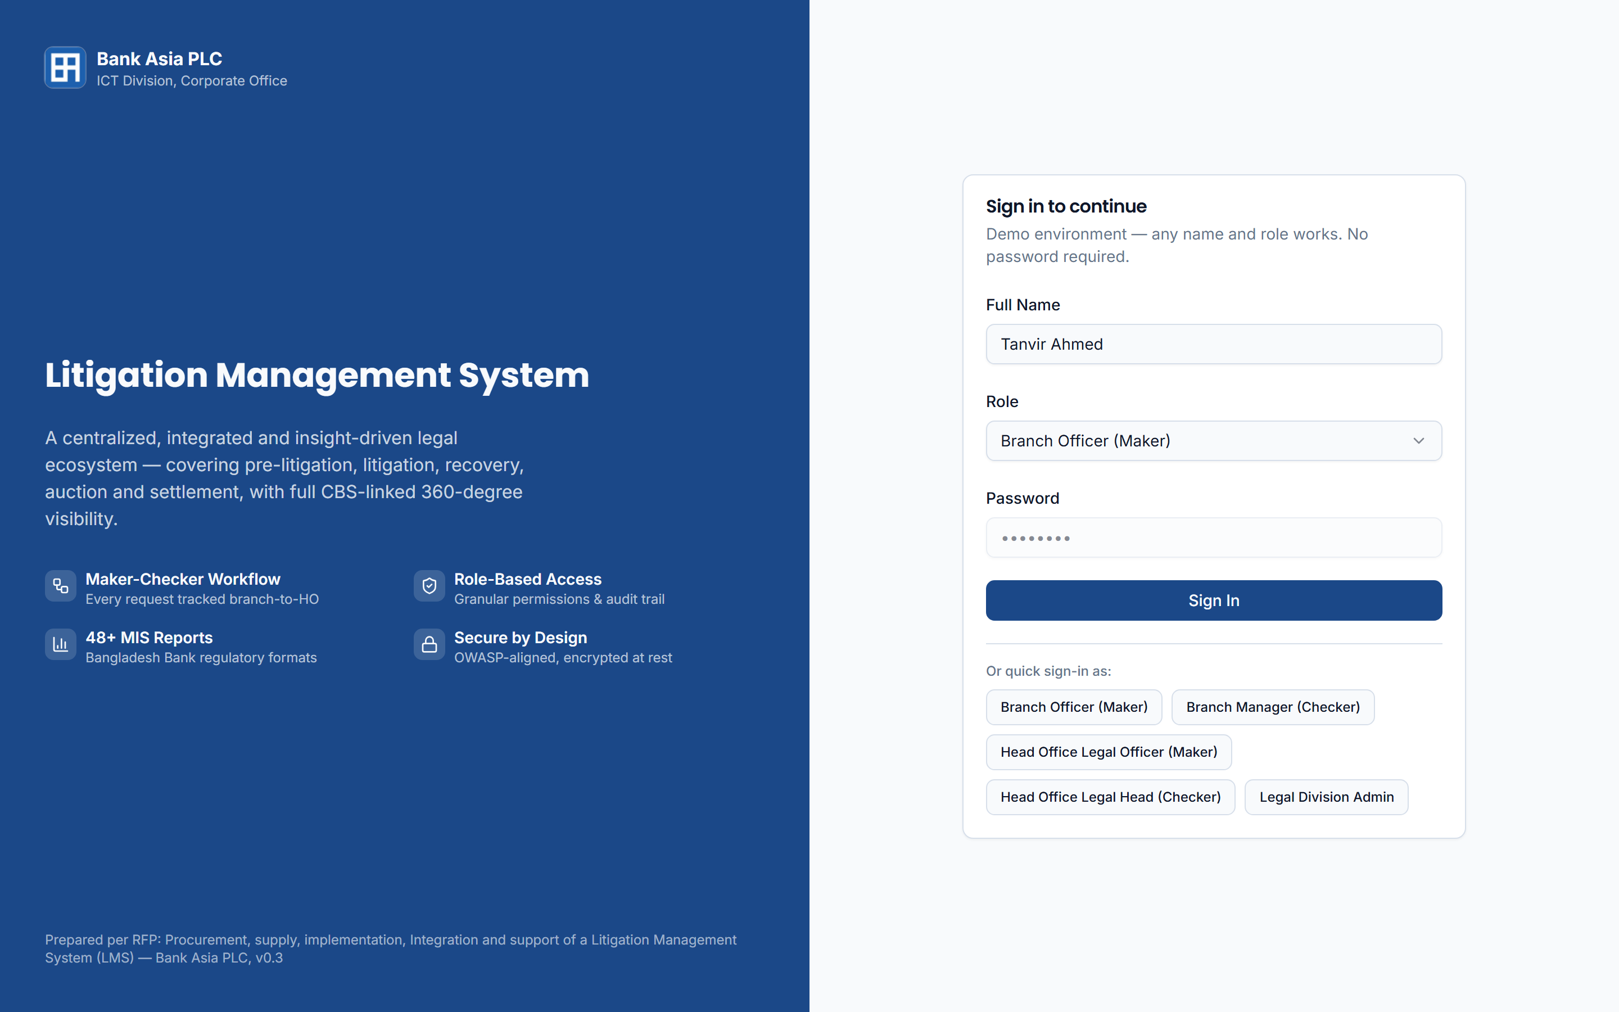


Secure, Role-Based Access
Six role profiles with maker–checker segregation, applied to every screen and action
lms.skoder.co/login
Role profiles
Branch Officer
Maker
Branch Manager
Checker
HO Legal Officer
Maker
HO Legal Head
Checker
Legal Division Admin
Configuration
System Administrator
Security & settings
Access controls
Group-wise menu and action permissions
Password policy, CAPTCHA and 5-attempt lockout
Session timeout and single-workstation login
Live system · the demo uses quick role sign-in to switch between personas
Active Directory / SSO and MFA on mobile
Notes:
Access is role-based. Six profiles separate makers from checkers at branch and Head Office level. In production: the bank's password policy, lockout after five failed attempts, session timeout, single-workstation login, Active Directory or SSO, and MFA for mobile. In the demo we use quick sign-in to switch personas.

Slide 8
Real-Time Legal Dashboard
Branch-to-Head-Office visibility of workload, approvals, hearings and recovery (RFP §8.7)
1
KPI tiles
lms.skoder.co/dashboard
Active cases, pending approvals, notices sent, upcoming hearings and approved legal expense
2
Portfolio by status
1
Draft, pending, approved, returned and rejected at a glance
2
3
4
3
Branch-wise volume
See where litigation is concentrated across branches
4
Recovery vs. legal cost
Six-month trend for management review
5
5
Today's activity
Live feed of actions across every module
Notes:
The dashboard gives the real-time daily view that Section 8.7 asks for: KPI tiles for active cases, pending approvals, notices, upcoming hearings and approved legal expense; the portfolio by workflow status; branch-wise volume; recovery against legal cost; and a live activity feed across all modules.

Slide 9

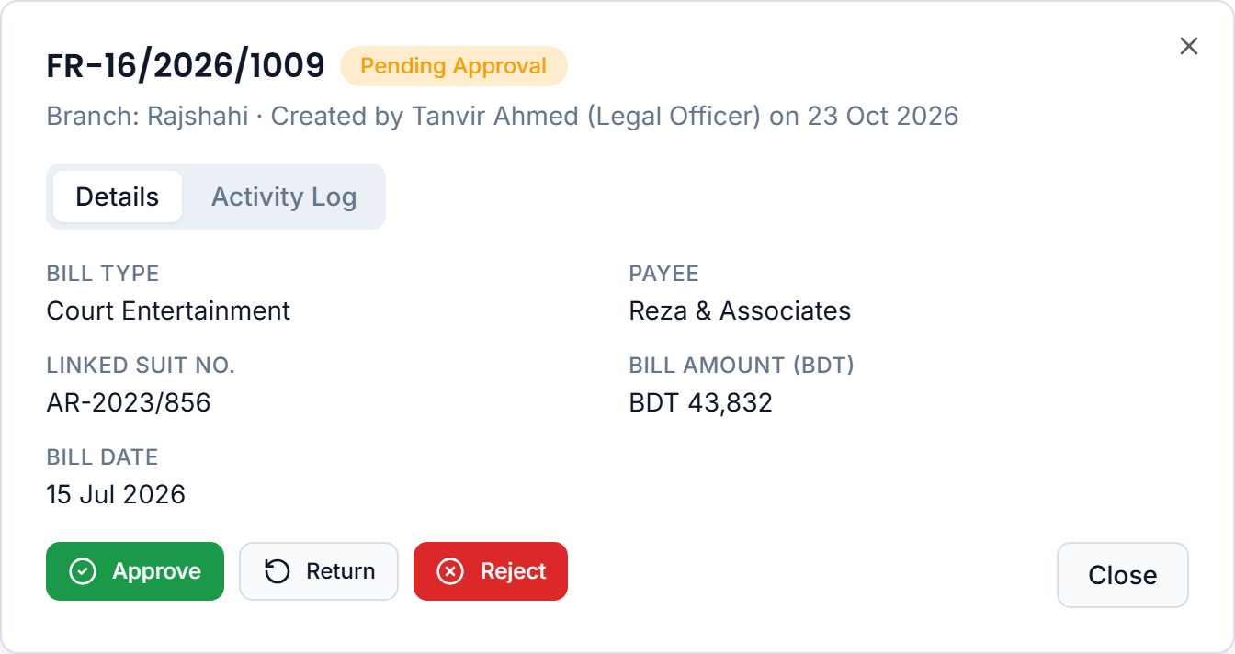

Maker–Checker Workflow
Every request is made at branch level, verified at Head Office and recorded in a complete audit trail
Draft Saved
Pending Approval
Approved
Returned
Rejected
Created at branch
With the checker for review
Moves to the next stage
Back to maker with a reason
Closed with a reason
Checker view in the live system
Controls on every request
Duplicate requests blocked while one is pending
Return or reject always records a reason
Editable only while Draft or Returned
Status and full history available on enquiry
Email & SMS alerts on initiate, reject and complete
Every action stamped with user, role and time
Notes:
Maker-checker is applied consistently. A branch officer creates and submits. A checker at Head Office approves, returns with a reason, or rejects. The system blocks duplicate pending requests, restricts edits to draft or returned items, and logs every action. These are the controls repeated throughout Sections 8.9 to 8.24.

Slide 10
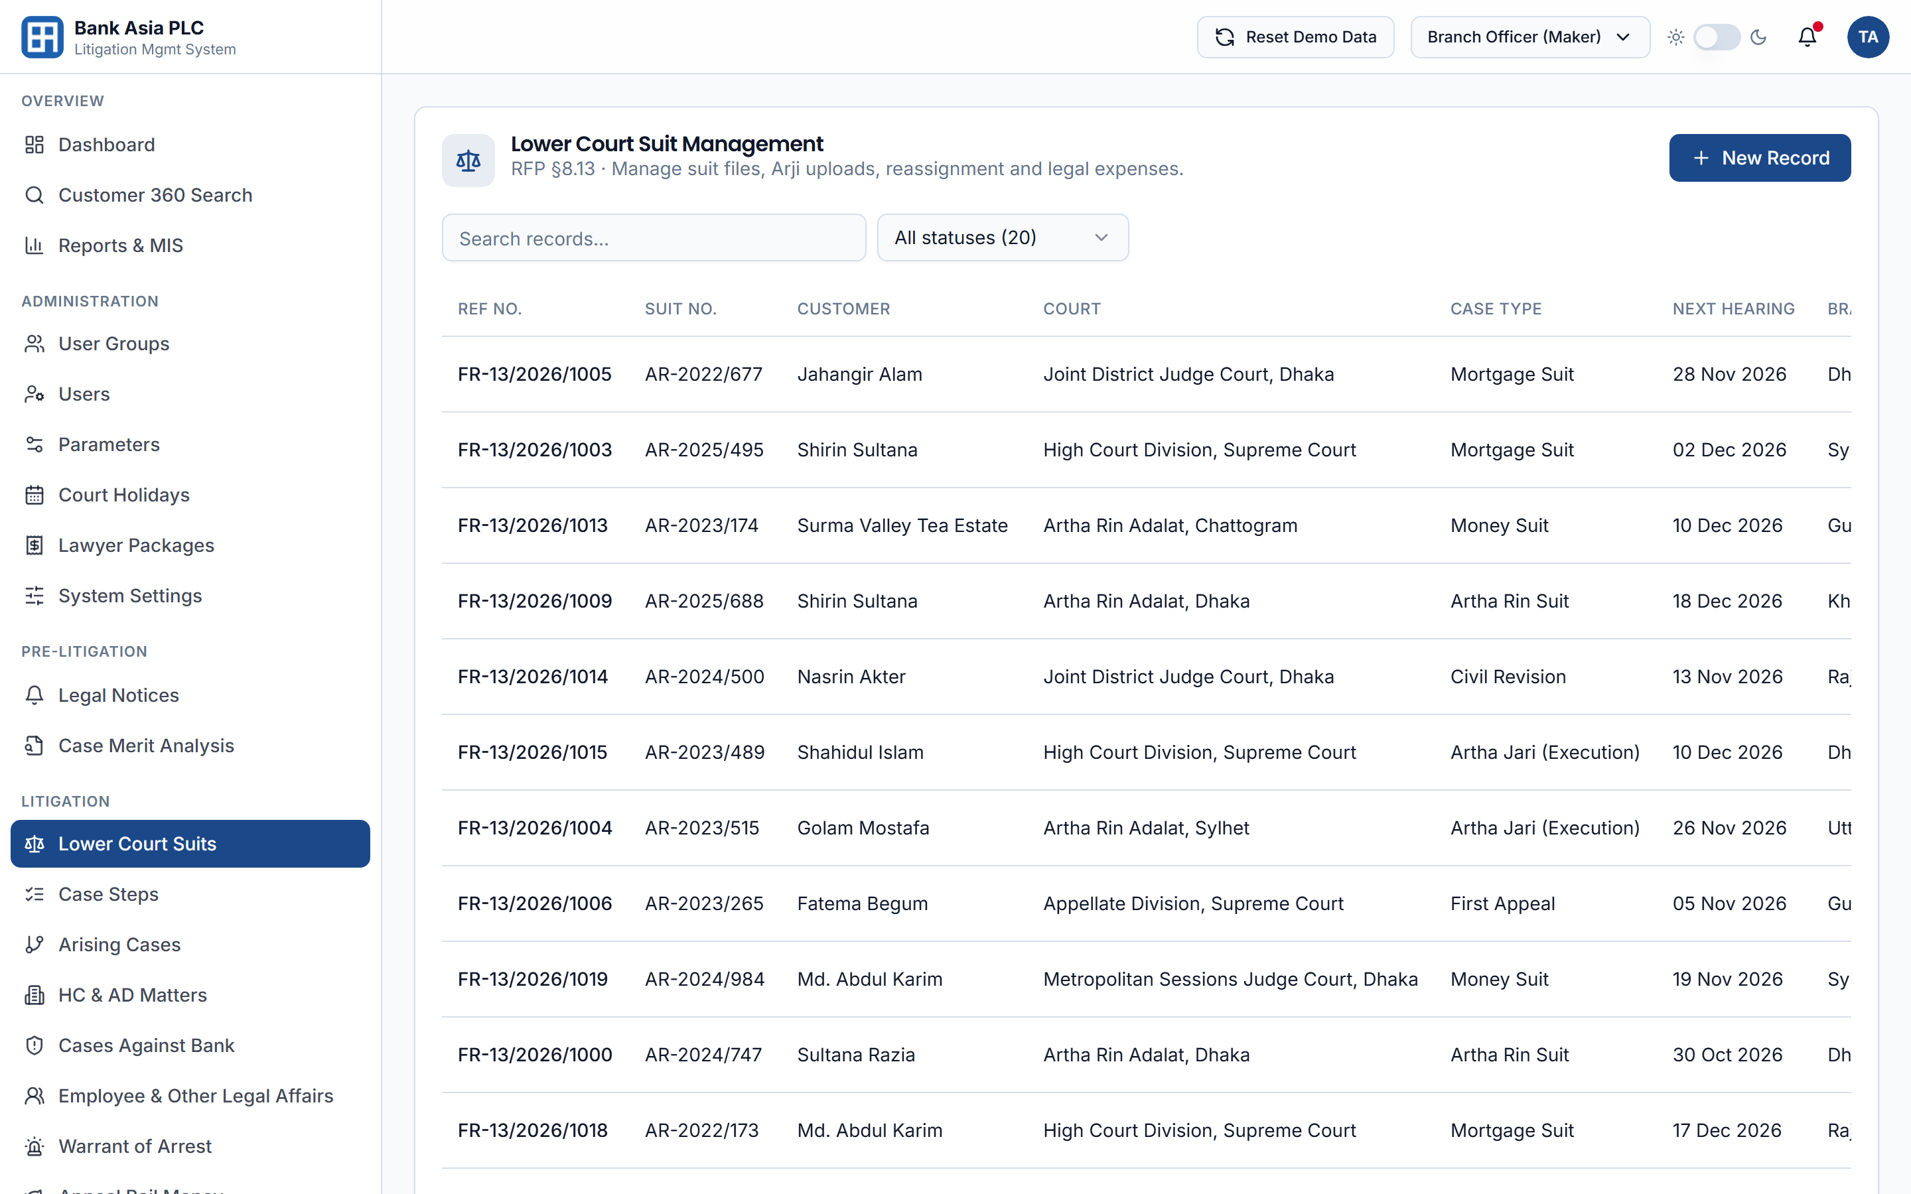





Litigation Case Management
Every suit, step, hearing and cost — linked from the lower court to the Appellate Division
Lower Court Suits
lms.skoder.co/modules/FR-13
Suit files, Arji and summons uploads, reassignment
Day-by-Day Case Steps
Hearing outcomes, next dates and lawyer expenses
Arising Cases
Execution suits and session cases linked to the original
HC & AD Matters
Filed against a lower-court case or independently
Cases Against the Bank
Plus employee-related and other legal affairs
Warrants & Bail Money
Issuance, execution, deposits and withdrawals
Notes:
Litigation management covers lower court suits with document uploads and reassignment, day-by-day case steps with lawyer expenses, arising cases such as execution suits, High Court and Appellate Division matters linked to the original case, cases against the bank, and warrants and bail money.

Slide 11
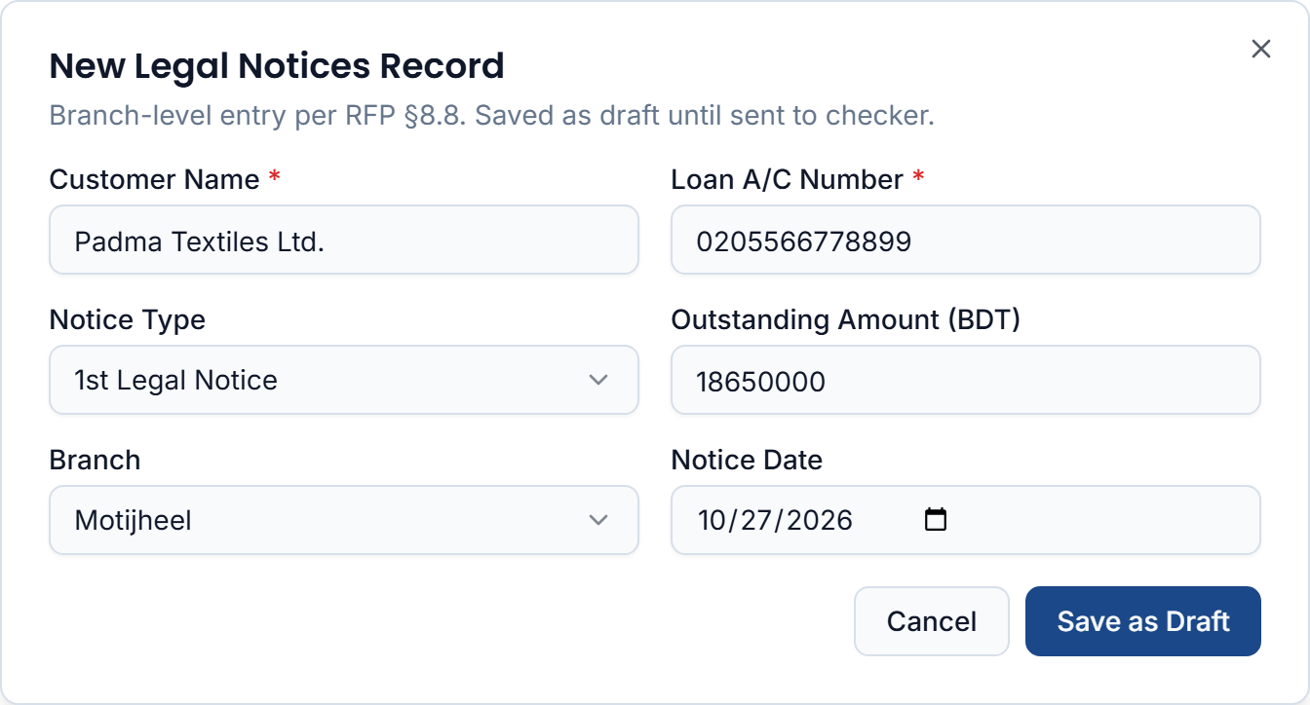
From First Notice to Recovery
Pre-litigation and recovery workflows, connected to Core Banking data at every step
1st Legal Notice — branch entry in the live system
Pre-Litigation
1st legal & reminder notices, CBS customer lookup
Case merit analysis with security documents
Land/property vetting with TAT and escalation
Recovery & Finance
Auctions with statutory publication copies
CBS-based account statements & Jari certificates
Lawyer, court & publication bill disbursement
Court fee return and adjustment
Saved as a draft until a checker verifies it
Notes:
Pre-litigation starts with the 1st legal notice, with customer details pulled from CBS, and case merit analysis with security documents and property vetting. Recovery covers auctions with statutory publication copies under sections 12(3), 33(5) and 33(7), CBS-based statements and Jari certificates, bill disbursement with Finance integration, and court fee adjustments.

Slide 12
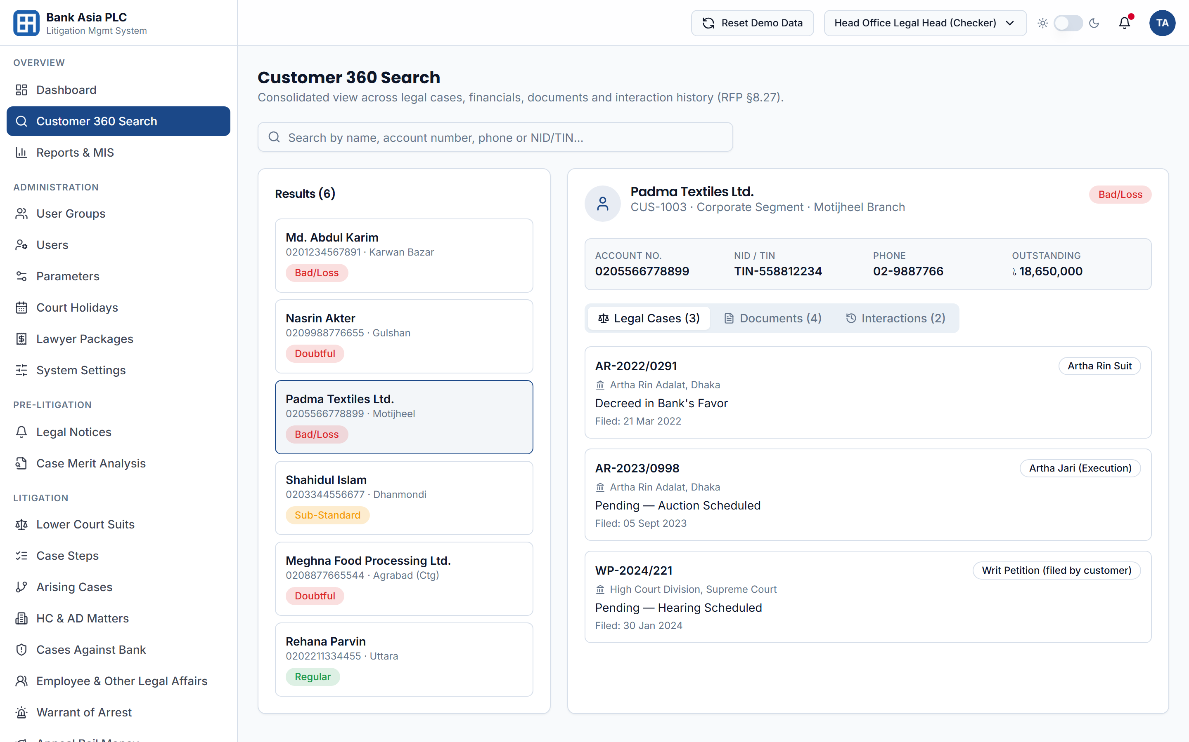



Customer 360° View
Every case, document, payment and interaction for a borrower — on a single screen (RFP §8.27)
lms.skoder.co/customer-360
Search by
Name
Account no.
Phone
NID / TIN
Branch
Case no.
Consolidated view
Profile & loan classification
All legal cases across courts
Document history
Interaction history
Arrest & bail records
Notes:
Customer 360 consolidates everything for a borrower: profile and classification, every case across courts, documents, interactions, and arrest and bail history. Users search by name, account, phone, NID or TIN, branch or case number.

Slide 13
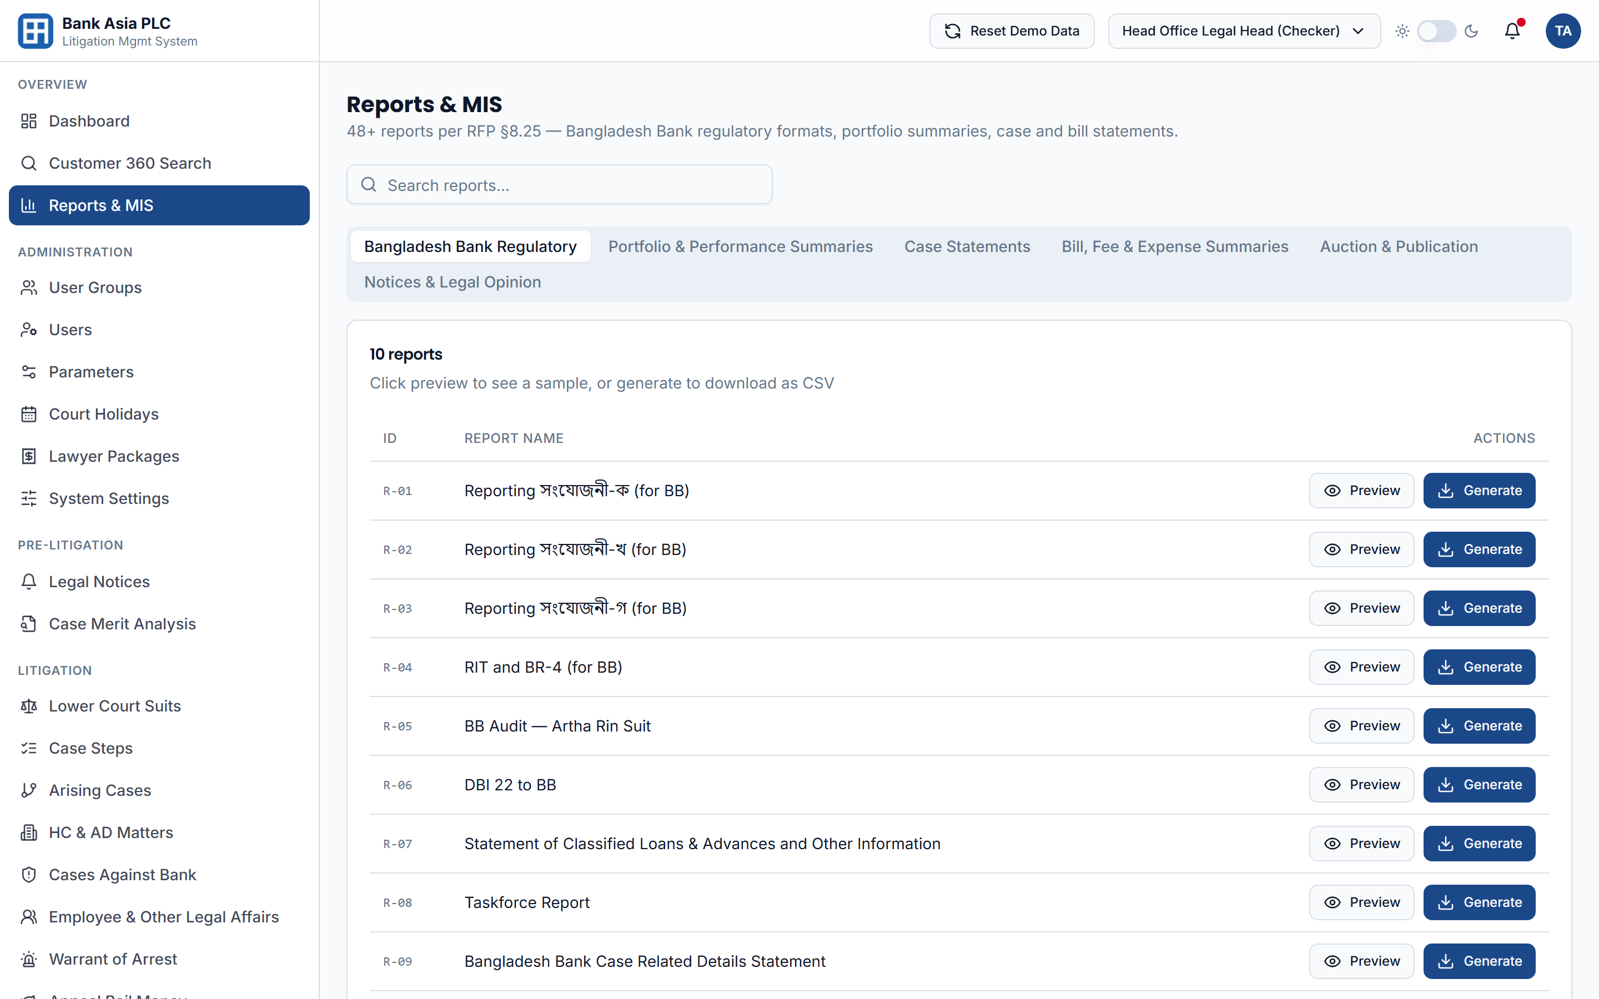
Reports & Regulatory MIS
48 reports across six categories — Bangladesh Bank formats generated on demand, not compiled by hand
48
lms.skoder.co/reports
reports across six categories
Bangladesh Bank formats
সংযোজনী-ক / খ / গ
RIT & BR-4
DBI-22
CRMR
ISS Report
Classified Loans
Risk-Based Audit
BB Audit — Artha Rin Suit
Plus portfolio, segment, officer, lawyer, court, bill and recovery summaries — each previewed on screen and exported on demand
Notes:
Reporting includes the Bangladesh Bank formats — সংযোজনী ক, খ and গ, RIT and BR-4, DBI-22, CRMR, ISS, the classified loans statement and BB audit reports — plus portfolio, lawyer, court and bill summaries. Every report can be previewed on screen and exported on demand.

Slide 14

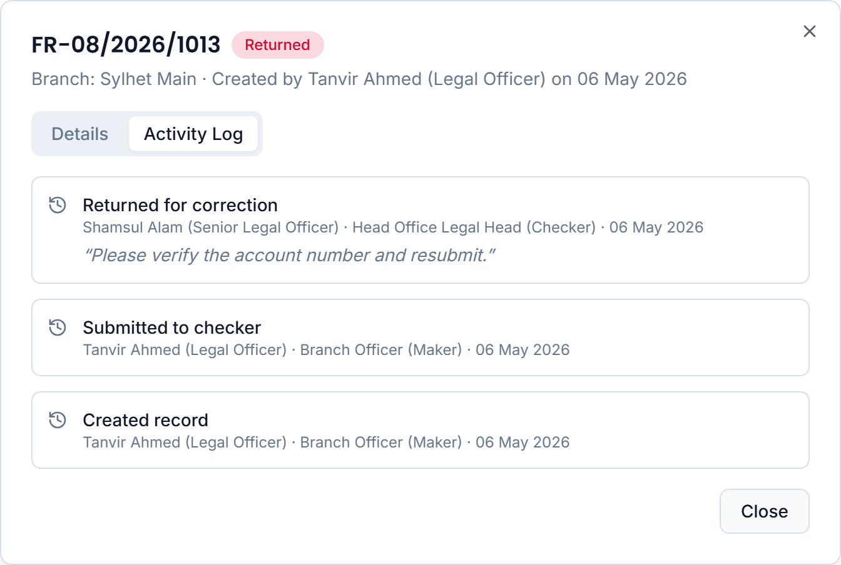



Built for a Regulated Bank
Security, auditability and resilience designed in from day one — aligned with RFP Section 7
Segregation of duties
Maker–checker on every request, with role- and group-wise permissions
Tamper-evident audit trail
Every login, change and approval logged with user, role and time
Data protection
TLS in transit, encryption at rest and OWASP Top 10 controls
Resilience
On-premises DC and DR, module-level redundancy, no data loss on restart
Regulatory alignment
Bangladesh Bank reporting, risk-based audit and 4-hour breach notification
Live system · audit trail of a request returned by the checker, with the reason recorded
Notes:
Security and compliance are designed in: segregation of duties; a tamper-evident audit trail, shown here on a returned request with the checker's reason; encryption in transit and at rest; OWASP Top 10 protection with penetration testing; DC and DR resilience; and regulatory alignment, including the 4-hour breach notification commitment in Section 6.48.

Slide 15

Implementation & Next Steps
A phased delivery with Bank Asia's Legal and ICT teams, followed by long-term support
1
2
3
4
5
Discover & Design
Build & Integrate
Migrate & Test
Train & Go-Live
Support & Evolve
Requirement workshops
Gap analysis
Design sign-off
Configuration
CBS, SMS & email
Finance integration
Legacy data migration
SIT & performance tests
UAT with Legal Division
Technical & user training
SOPs & handover
DC/DR cut-over
3-year warranty + AMC
24/7/365 support
Patches & upgrades
Thank you
LIVE SYSTEM
lms.skoder.co
Questions & discussion
Scan or visit to try any module live
Prepared for Bank Asia PLC — Litigation Management System RFP
Notes:
We propose a five-phase delivery with your Legal and ICT teams, followed by the 3-year warranty and AMC with 24/7/365 support specified in the RFP. Thank you. We are happy to take questions, and the live system is available at lms.skoder.co. Scan the QR code to open it.

