Slide 1
Dog Emotion Classification
Using Meat Learning With three CNN models: Lenet-5, VGG16, and resnet-50

Slide 2
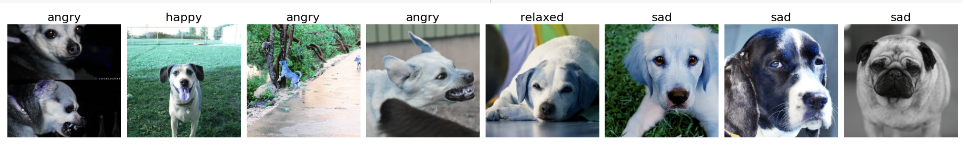
Defining the Problem
Given a dog image, determine whether the dog in the image is happy, sad, angry or relaxed
Example:

Slide 3
Why is this important?
Basis for an app that classifies dogs
Helps humans understand dogs better
Might contribute to research of dog facial expression

Slide 4
New Approach
“But There are several notebooks on Kaggle classifying dogs. How is your code any different?”
Three main differences:
Using different models
Meta learning
Different data augmentation

Slide 5
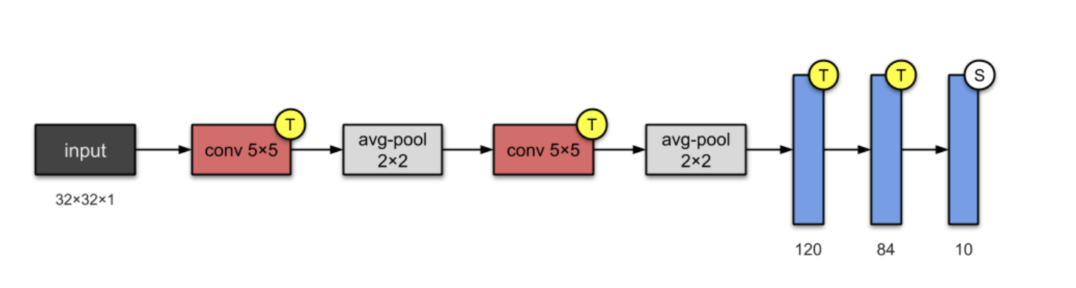
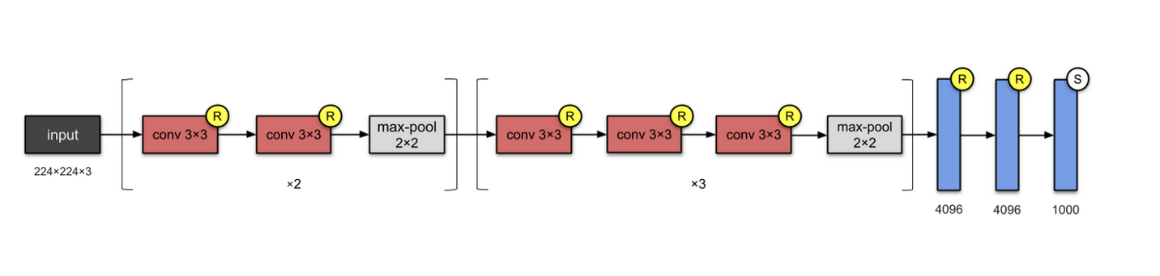
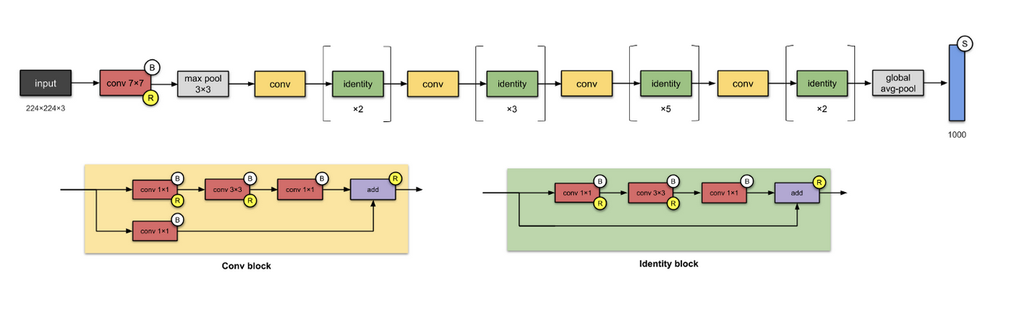
Models
LetNet-5, a simple CNN developed by Yann LeCun in 1998
Pretrained VGG16, developed in 2015
Pretrained ResNet-50, developed in 2016

Slide 6

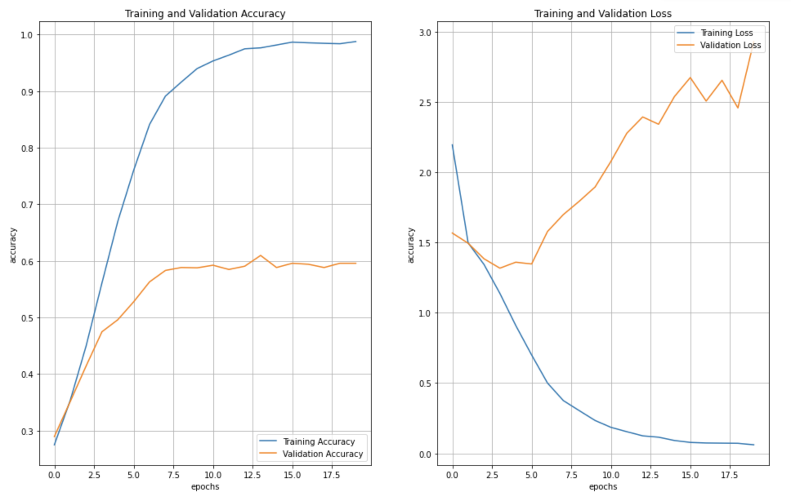
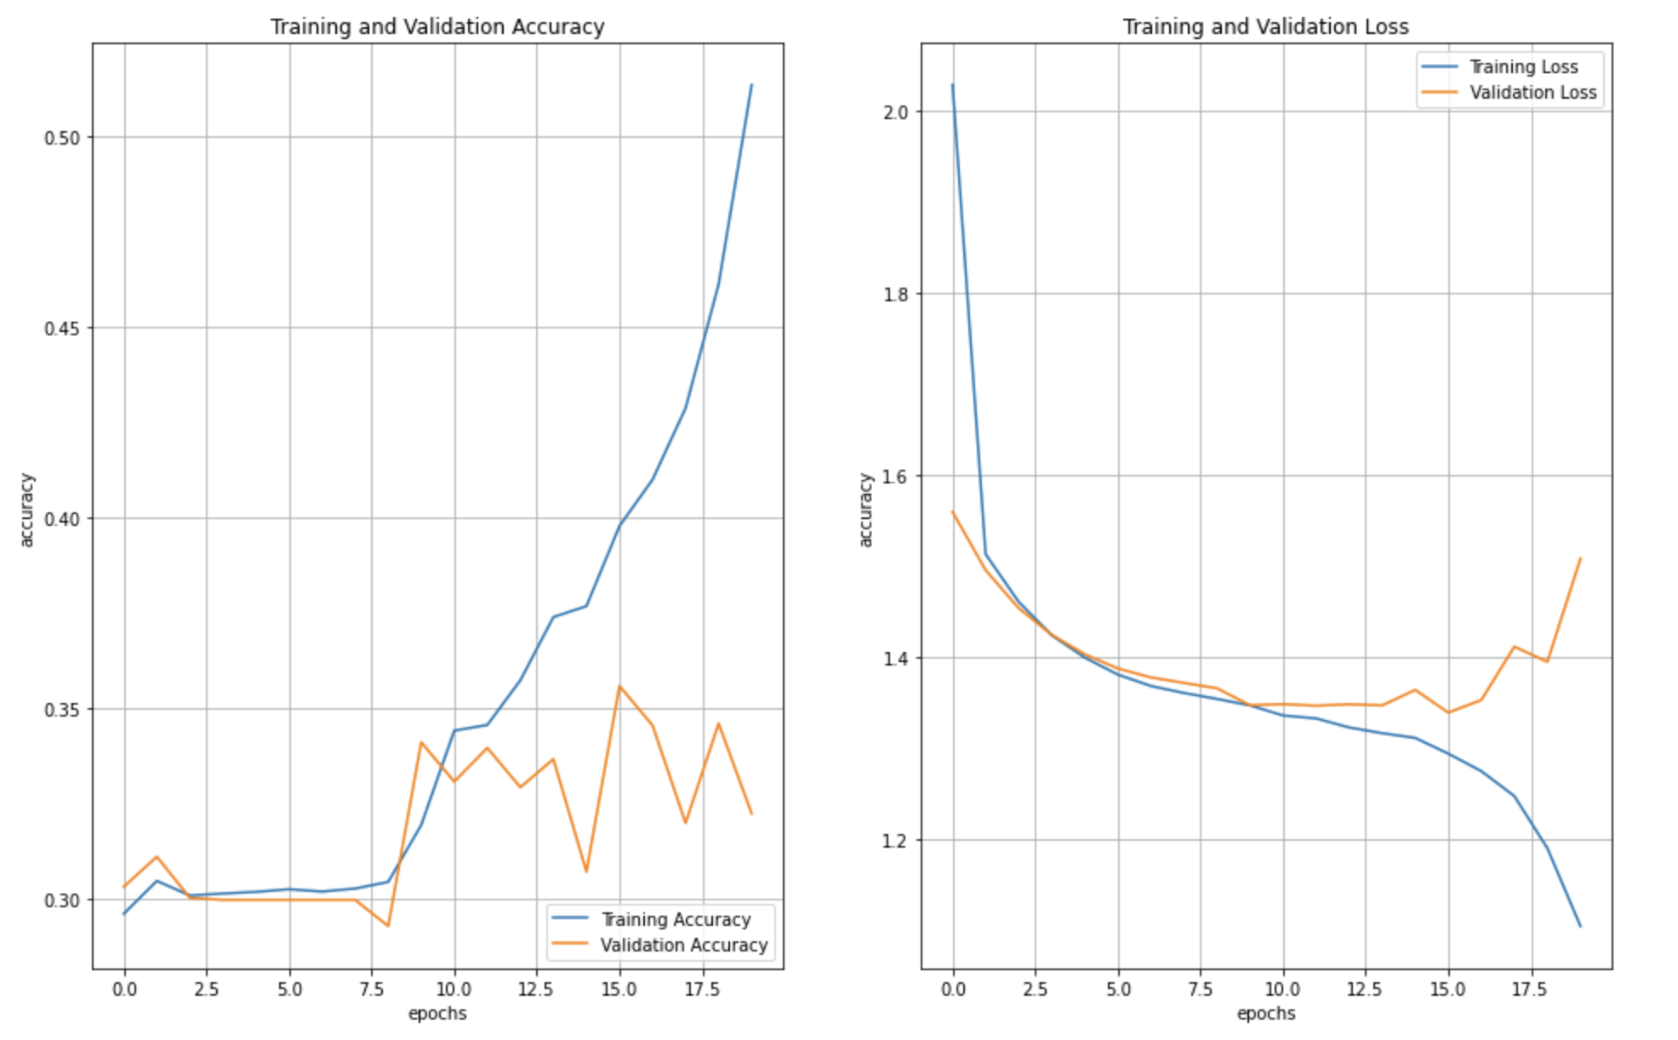
Meta Learning
Mine:
Few Shot Learning
Taking random samples from the data, in contrast to the whole data set
Regular approach:

Slide 7
Results
VGG16 performs worse than the other two models, probably because we are not using its specific augmentation.
LeNet model outperforms Resnet and the open-source model, achieving c.a. 63% accuracy on the test dataset.
Resnet outperforms the open-source models.

Slide 8
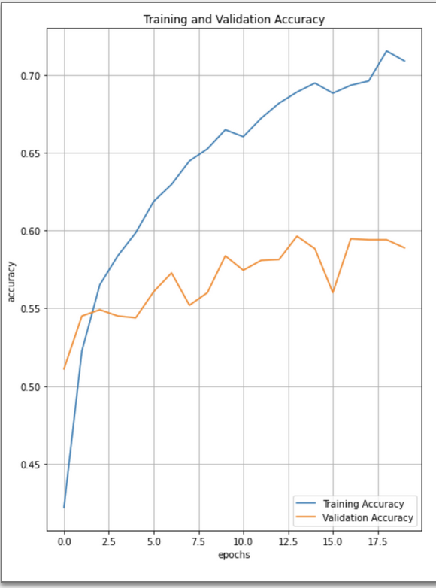
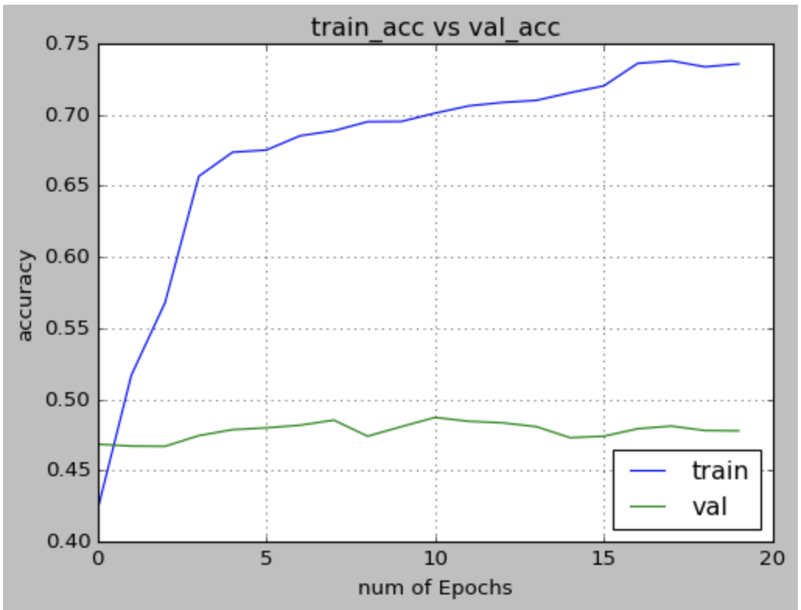
Performance
ResNEt-50:
VGG16 (open source):
Source: https://www.kaggle.com/code/sasakitetsuya/dog-emotion-classify-model-by-mobilenetv2-vgg16

Slide 9
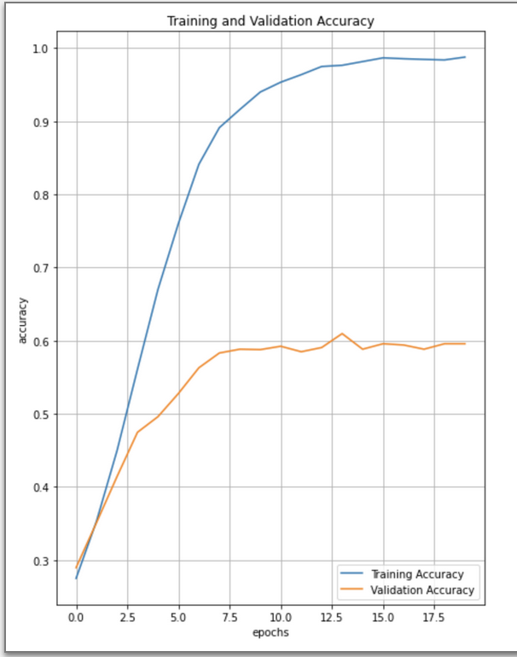
Performance 2
Modified LeNet
VGG16 (open-source):

Slide 10
Conclusion
Meta learning provides us with a better accuracy than simply scanning the whole dataset once
Simple models can outperform complex model can; LeNet in our case outperformed VGG16
Some dataset are too complex to be solved by the conventional deep learning techniques

