Slide 1

Project
on
Website Scraping

Slide 2
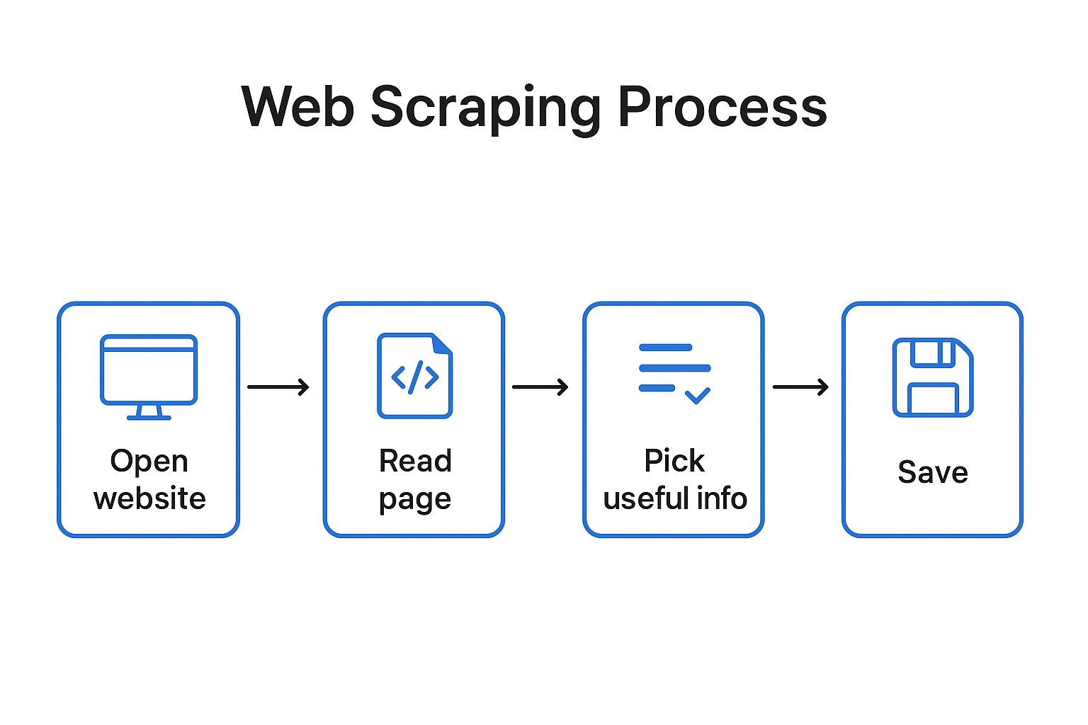
What is Website Scraping ??
Web scraping means collecting information from websites automatically using a program instead of copying by hand.

Slide 3
Introduction:
Hockey is an exciting sport with many statistics that tell interesting stories about teams and players. In this project, we collect data from a hockey webpage to analyze team performances, player stats, and match outcomes. The goal is to understand trends, highlight top performers, and present insights in a clear, visual way. This project combines web scraping and data visualization to make hockey data easy to explore and interpret.
The Shape of Dataset is 582 row and 7 columns

Slide 4
Problem Statement:
This project aims to address this problem by collecting, organizing, and analyzing hockey data from a reliable online source. By transforming raw webpage data into structured datasets and visual insights, the project will make it easier to understand team performances, player achievements, and league trends, thereby supporting better decision-making, fan engagement, and sports analysis.

Slide 5
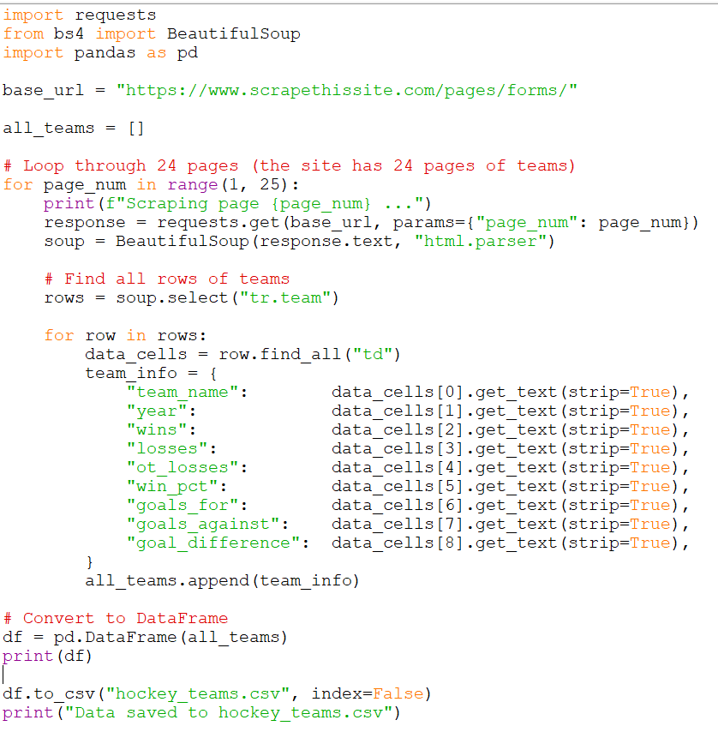
Importing Data From website:

Slide 6
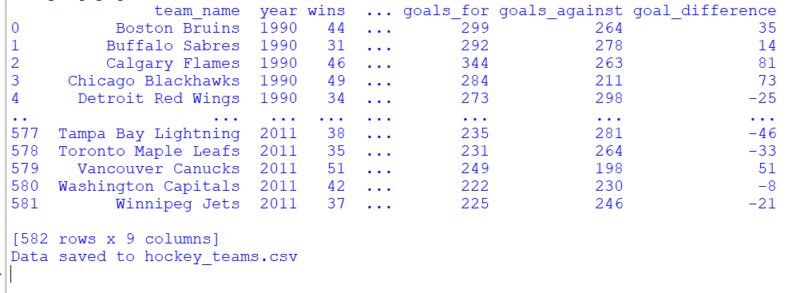
Output of Program:

Slide 7
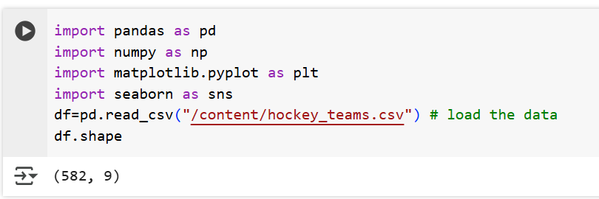
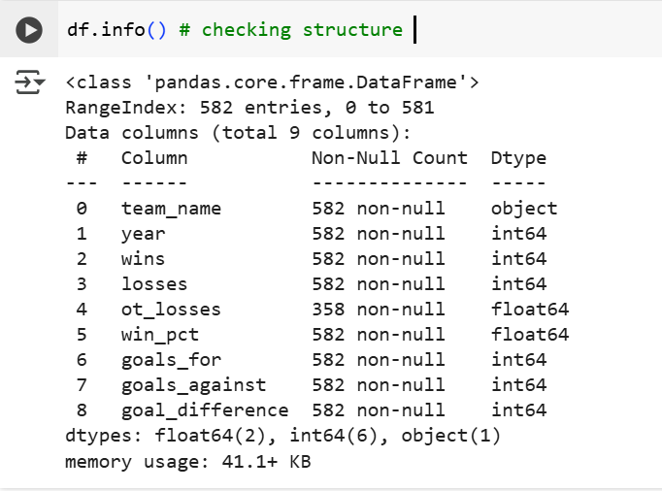
Exploratory Data Analysis:

Slide 8
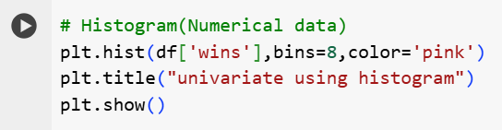
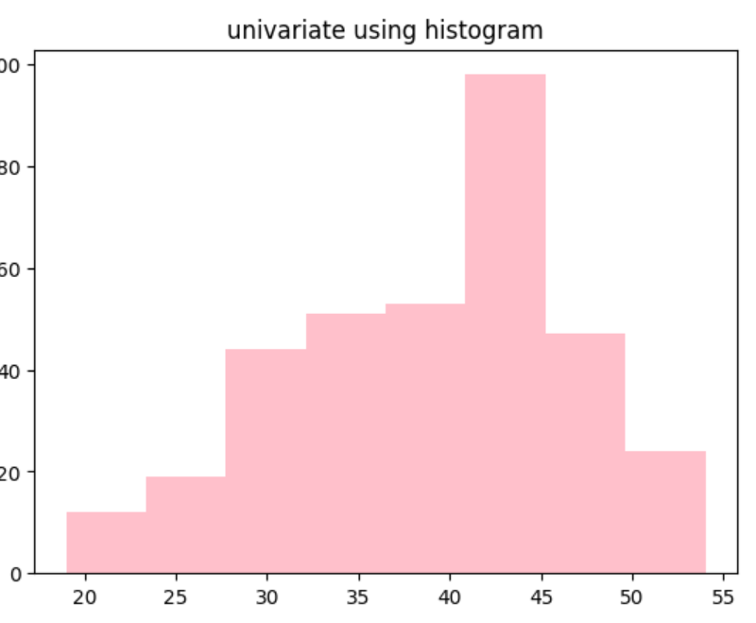
EDA – WINS DISTRIBUTION:

Slide 9
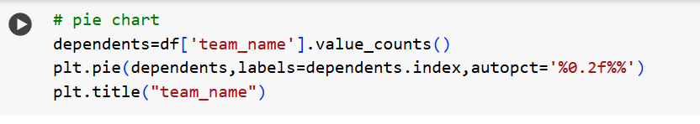
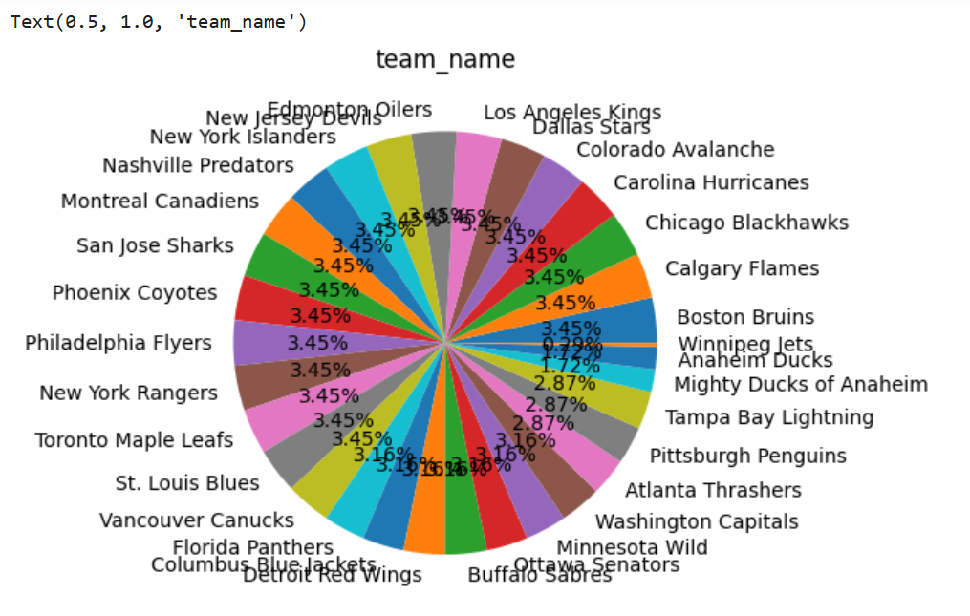
EDA Team-Name DISTRIBUTION:

Slide 10
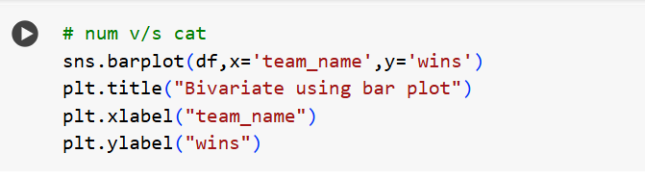
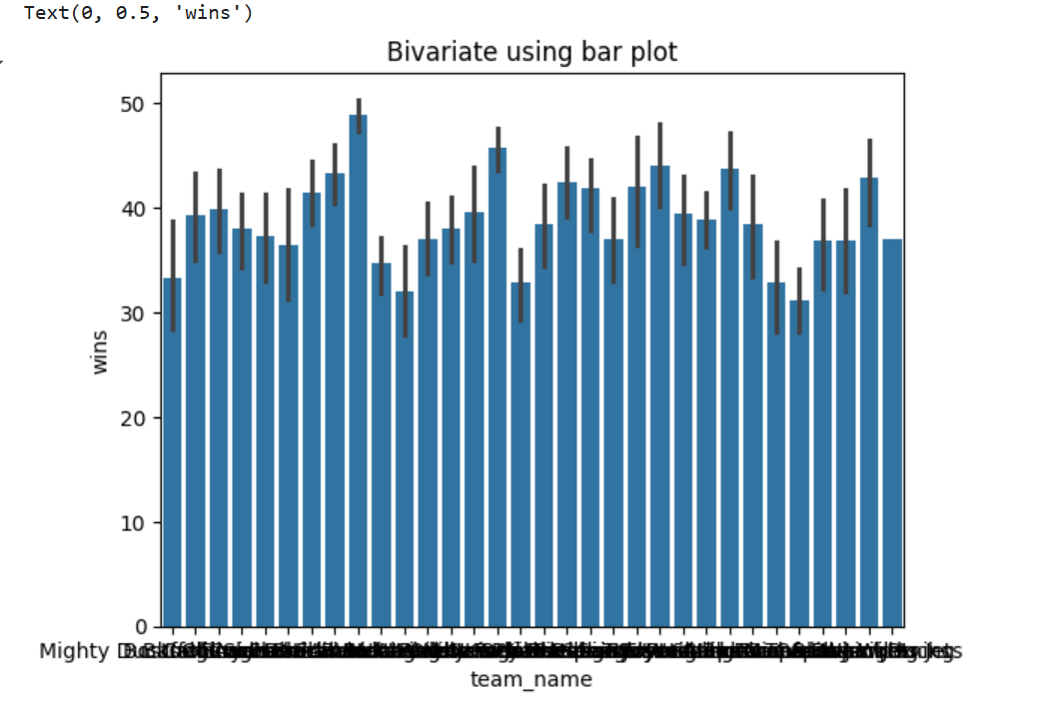
EDA Team-Name and Wins DISTRIBUTION:

Slide 11
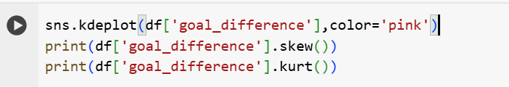
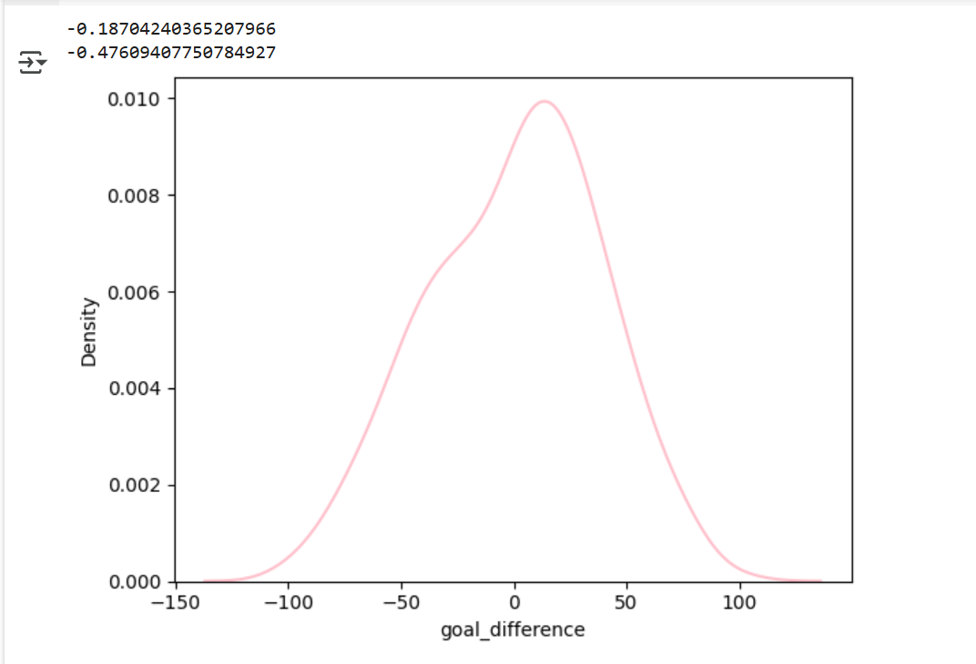
Data Distribution:

Slide 12
Insights:
Detroit Red Wings are the most successful team overall.
Teams with long history (Boston, Pittsburgh, Philadelphia) dominate cumulative wins.
Some franchises (Minnesota North Stars, Hartford Whalers) had short runs and low totals.
Goal differences show most teams hover around even, with only a few consistently positive teams.

Slide 13

THANK YOU

