Slide 1
AUTOMOBILE INSURANCE FRAUD DETECTION

Slide 2
Fraud claims affect not only the companies financial aspect, but also of the innocent people seeking effective claim coverage. Fraud claims are serious financial burden to the company.
Here we predict the claim is genuine or fraud by analyzing and manipulating the data collected. This will help the company to reject the fraud claims and accept only the genuine claim request.

Slide 3
Data Collection
DATA EXPLORE AND VISUALIZATION
DATA PREPROCESSING
MODEL BUILDING
MODEL VALIDATION AND FINALIZE
DEPLOYMENT

Slide 4
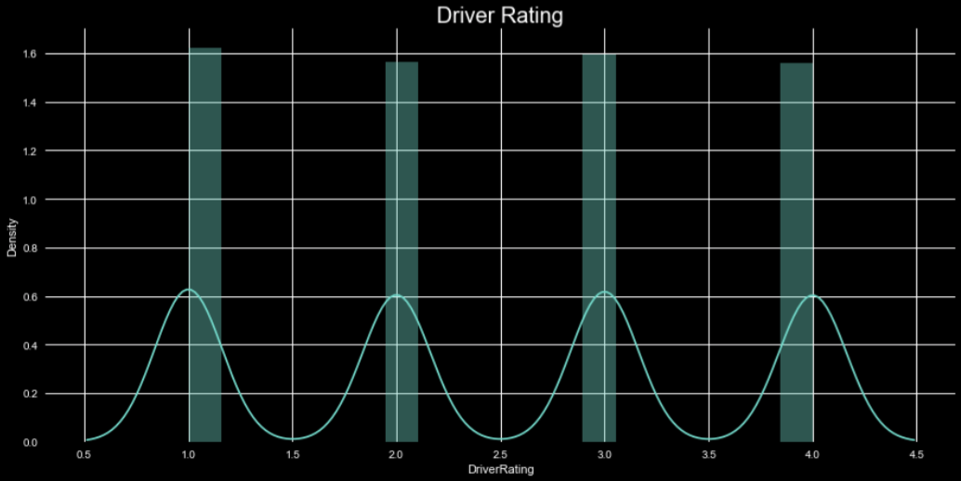
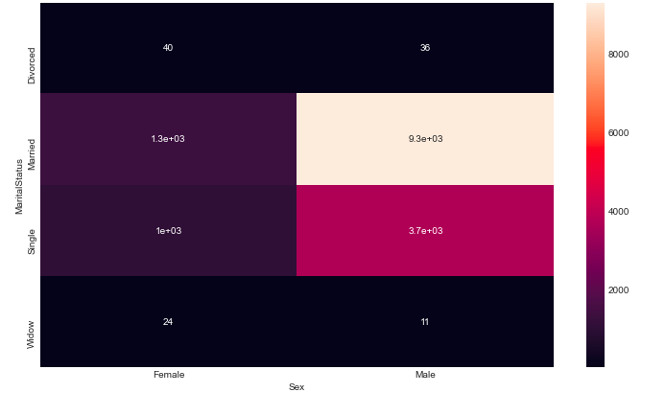
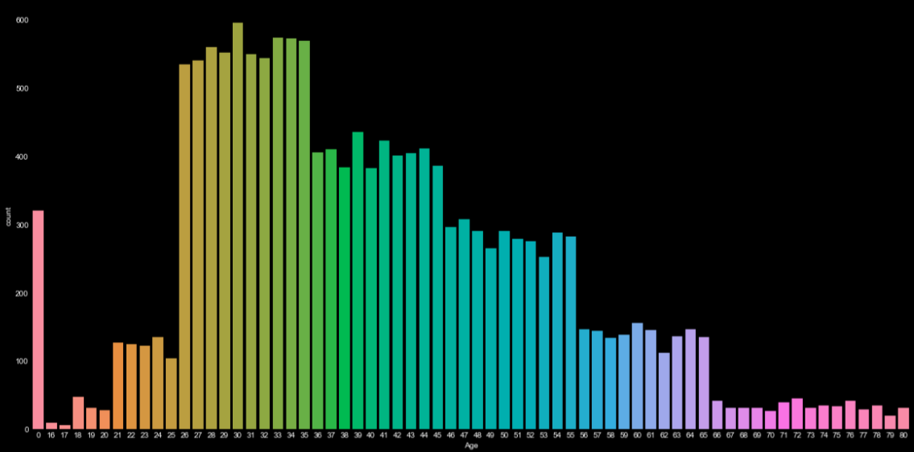

Slide 5
PREPROCESSING
DATA TRANSFORMATION
DATA CLEANING
HANDLING MISSING AND DUPLICATE VALUES
BALANCED THE DATA
DIMENSIONAL REDUCTION

Slide 6
MODEL BUILDING
1.RANDOM FOREST
2.KNN
3.BERNOULI
4.SVM
5.LOGISTIC REGRESSION
6.MULTINOMIAL

Slide 7
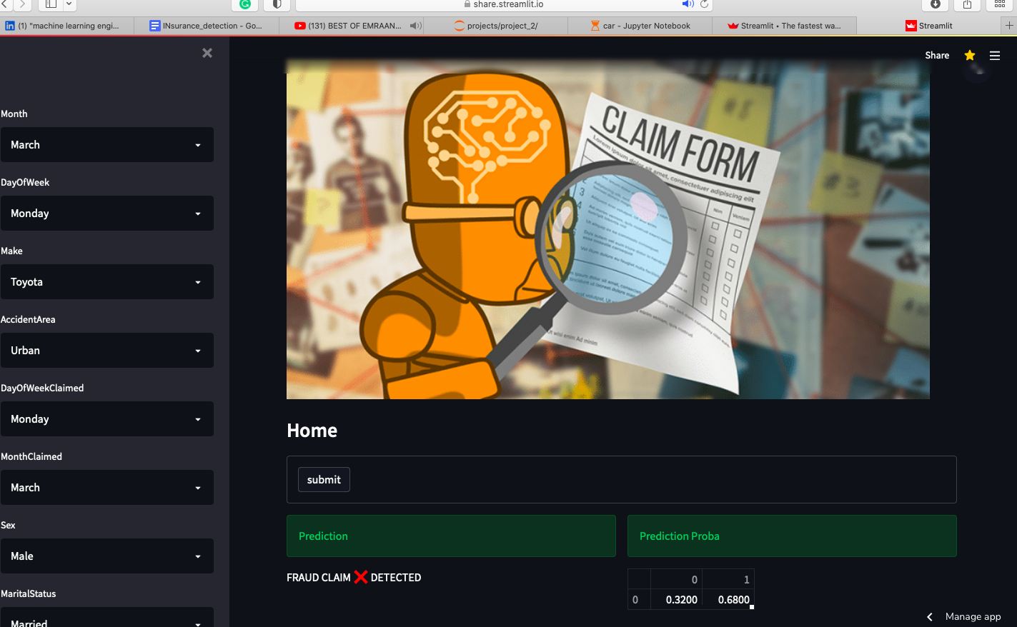
Is the colour of the clear sky and the deep sea. It is located between violet and green on the optical spectrum.
Red
Is the color of blood, and because of this it has historically been associated with sacrifice, danger and courage.

Slide 8
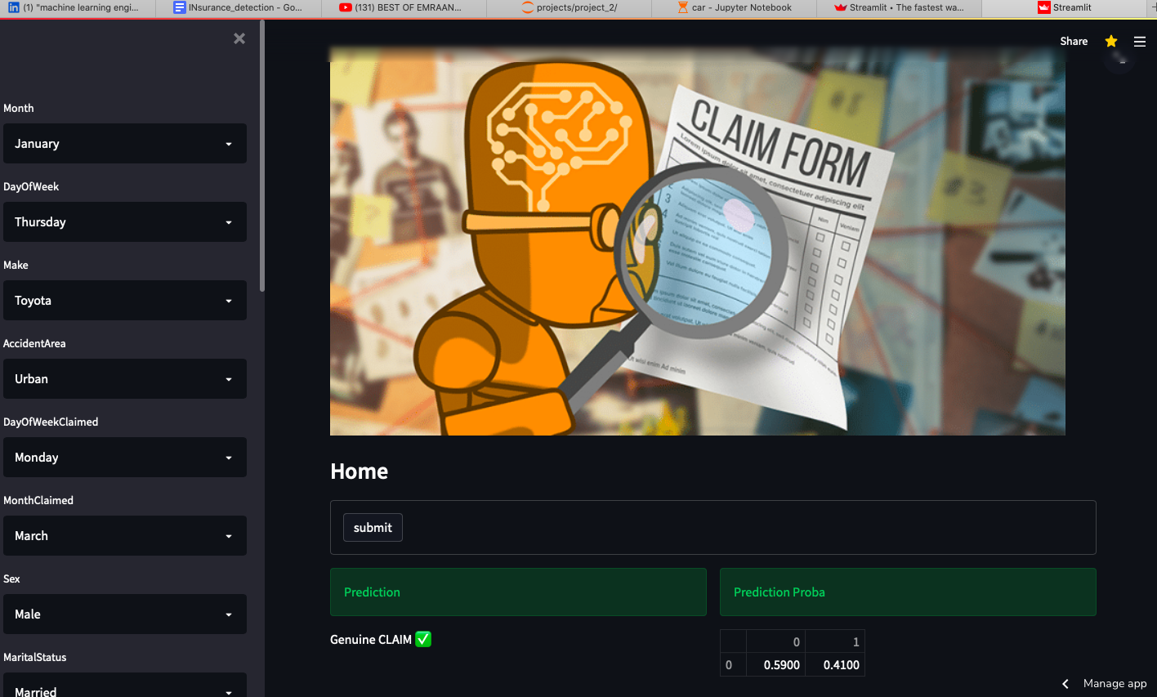

Slide 9
THANK YOU

