Slide 1
A presentation on
Main Memory Database Systems: An Overview
Hector Garcia-Molina, and Kenneth Salem
Presented by:
Group No. 8
22166033 A.K.M. Salman Hosain

Slide 2
Abstract
Main Memory Database Systems (MMDB) resides permanently in main physical memory, whereas conventional database systems (DRDB) resides is disk resident.
Optimizations of the two different types of database systems are different due to their storage location
This paper surveys the major memory residence optimizations and discusses some memory resident systems

Slide 3
Introduction
In DRDB, disk data are cached into memory for access; in MMDB the memory resident data have a backup copy on disk
MMDB have better response times and transaction throughputs
Three questions: Entire database fits in main memory? difference between a MMDB and a DRDB with a very large cache? main memory is nonvolatile and reliable by introducing special purpose hardware?
In this paper brief survey some MMDBs are presented

Slide 4
Impact of Memory Resident Data
Impact of memory resident data on functional components of database management systems are discussed:
Concurrency control
Commit Processing
Access Methods
Data Representation
Query Processing
Recovery
Performance
Application Programming lnterface and Protection

Slide 5
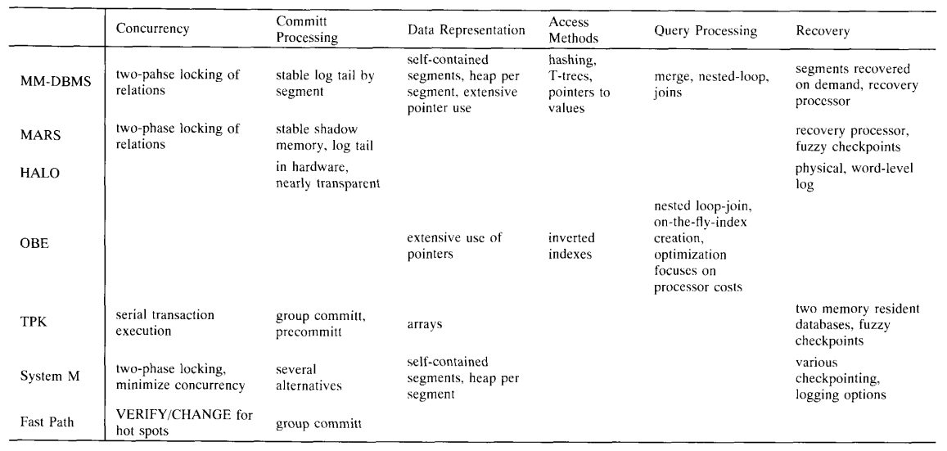
Summary of Main Memory Systems

Slide 6
Conclusion
Data that are referred every 5 minutes or more should be memory resident
Storing memory becomes convenient with the decreasing price of memory
Memory resident database systems will become more common in the future, and hence, the mechanisms and optimizations discussed in this paper will become important

