Slide 1
Lazy loading
SALMAN AHMED G

Slide 2
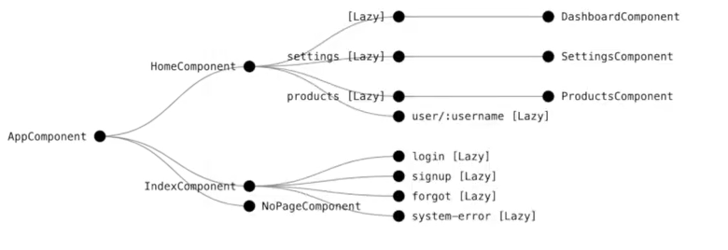
Lazy loading

Slide 3
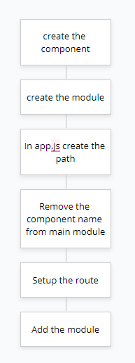
setup

Slide 4
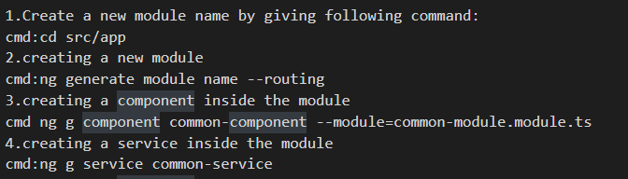
Example steps

Slide 5
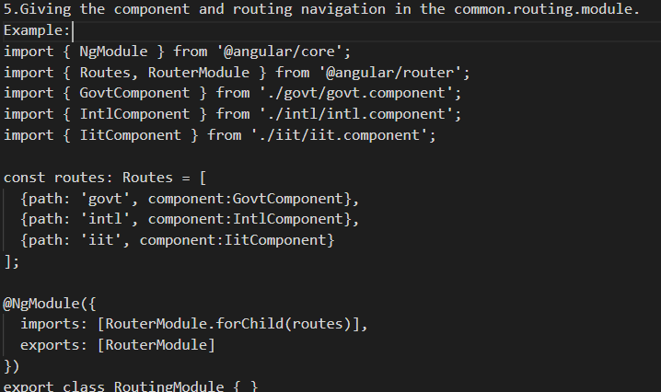
Example steps

Slide 6
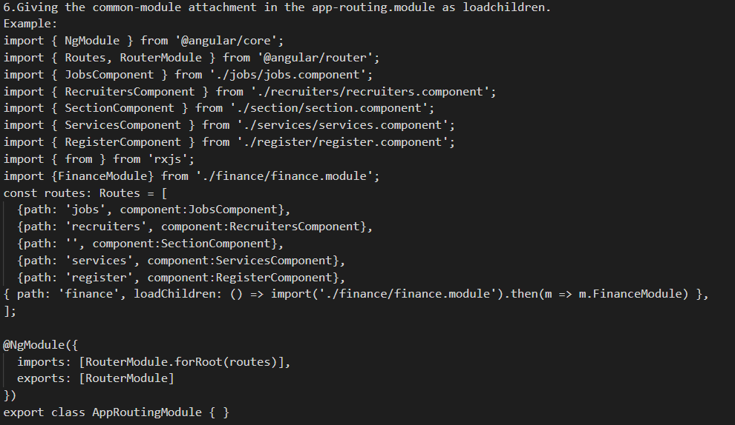
Example steps

Slide 7
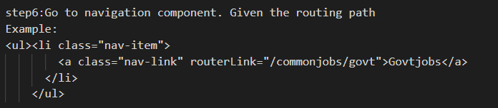
Example steps

