Slide 1


CSS - Training

Slide 2

CSS Properties
Borders
Margins
Padding
Height and Width
Colors
Backgrounds
Fonts
Float
www.credosystemz.com © Copyright 2021 | credosystemz | All Rights Reserved

Slide 3
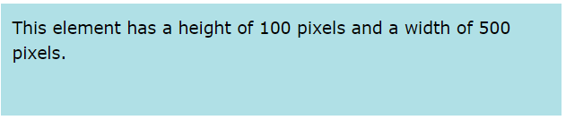
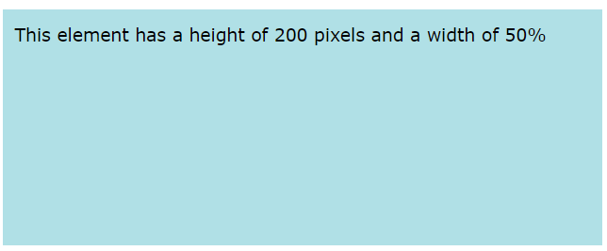
CSS Property – Height & Width
Height and Width - The CSS height and width properties are used to set the height and width of an element.
Individual Sides
div { height: 100px; width: 500px; background-color: powderblue; }
div { height: 200px; width: 50%; background-color: powderblue; }
www.credosystemz.com © Copyright 2021 | credosystemz | All Rights Reserved

Slide 4
CSS Property - Border
Borders - The CSS border properties allow you to specify the style, width, and color of an element's border
Border Style – dotted, dashed, solid, double -
Border Width -
Border Color –
Border Sides
Shorthand Border Property -
Rounded Borders -
p {border-style: solid;}
p {border-width: 5px;}
p {border-color: red;}
p { border-top-style: dotted; border-right-style: solid; border-bottom-style: dotted; border-left-style: solid; }
p {border: 5px solid red;}
p {border-radius: 5px;}
www.credosystemz.com © Copyright 2021 | credosystemz | All Rights Reserved

Slide 5
CSS Property - Padding
Padding - Padding is used to create space around an element's content, inside of any defined borders
Individual Sides
Shorthand Property -
div { padding-top: 50px; padding-right: 30px; padding-bottom: 50px; padding-left: 80px; }
p { padding: 25px 50px 75px 100px; }
div{padding: 25px 50px;}
div {padding: 25px;}
www.credosystemz.com © Copyright 2021 | credosystemz | All Rights Reserved

Slide 6
CSS Property - Margin
Margins - Margins are used to create space around elements, outside of any defined borders
Individual Sides
Shorthand Property -
auto Value - set the margin property to auto to horizontally center the element within its container
p { margin-top: 100px; margin-bottom: 100px; margin-right: 150px; margin-left: 80px; }
p {margin: 25px 50px 75px 100px;}
div { width: 300px; margin: auto; border: 1px solid red; }
www.credosystemz.com © Copyright 2021 | credosystemz | All Rights Reserved

Slide 7
CSS Property - Background
Backgrounds - CSS background properties are used to add background effects for elements.
background-color
Background Image
Background-repeat
Background Shorthand
div { background-color: lightblue; }
div {background-image: url("bgWallppr.jpg"); }
body { background-image: url("img_tree.png"); background-repeat: no-repeat;
Background-size:100px 200px;
Background-size:cover; }
div {background: #ffffff url("img_tree.png") no-repeat;}
www.credosystemz.com © Copyright 2021 | credosystemz | All Rights Reserved

Slide 8
CSS Properties
Colors - Colors are specified using predefined color names, or RGB, HEX, HSL, RGBA, HSLA values.
Text Color
Border Color
Background Color
Color Values - In CSS, colors can also be specified using RGB values, HEX values, HSL values:
<h1 style="color:blue;">Hello World</h1>
<h1 style="border:2px solid Tomato;">Hello World</h1>
<h1 style="background-color:DodgerBlue;">Hello World</h1>
Tomato
rgb(255, 99, 71)
#ff6347
hsl(9, 100%, 64%)
www.credosystemz.com © Copyright 2021 | credosystemz | All Rights Reserved

Slide 9
CSS Property - Fonts
Fonts
font-family
font-style
font-weight
font-size
p {font-family: "Times New Roman", Times, serif; }
p {font-style: italic;}
p {font-weight: bold;}
p {font-size: 14px;}
www.credosystemz.com © Copyright 2021 | credosystemz | All Rights Reserved

Slide 10
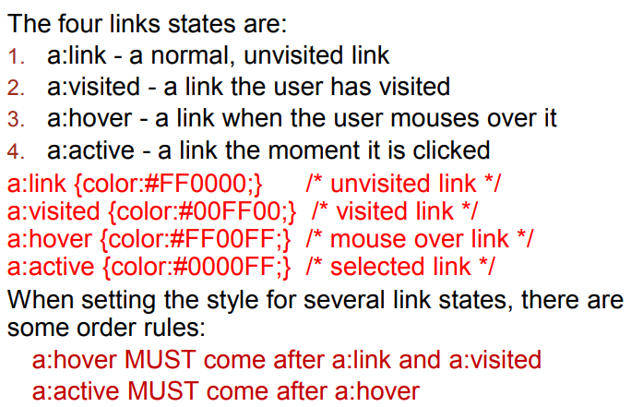
CSS Property – Link Properties
www.credosystemz.com © Copyright 2021 | credosystemz | All Rights Reserved

Slide 11
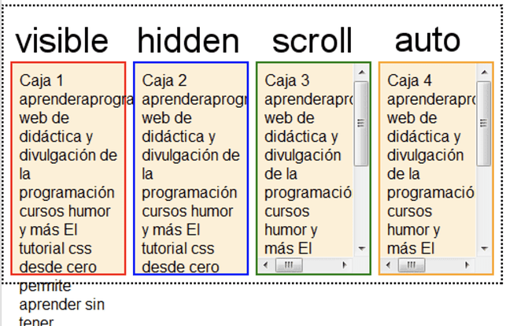
CSS Property - overflow

Slide 12
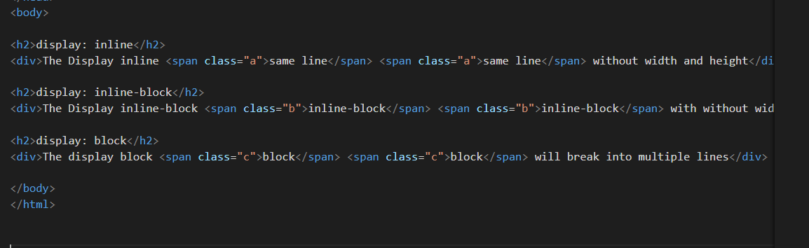
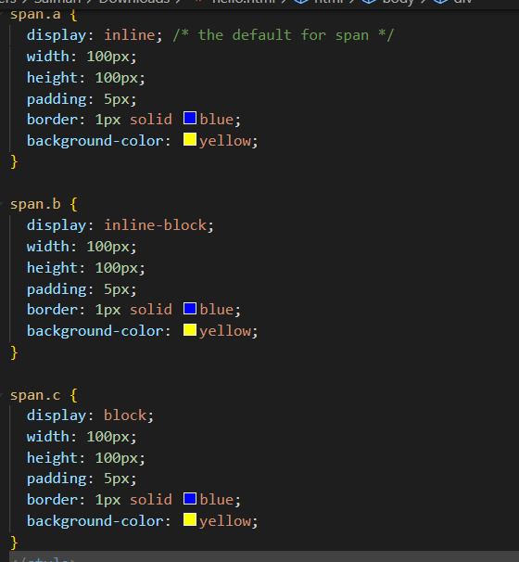
Display:inline,display:inline-block,display:block

Slide 13
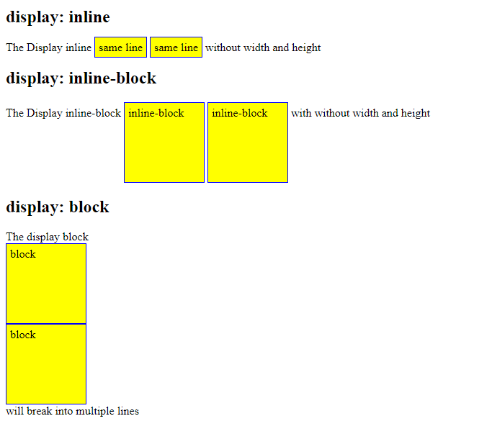
Display:inline,display:inline-block,display:block

Slide 14
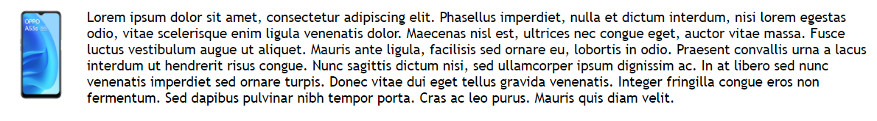
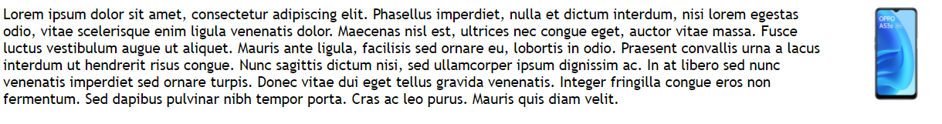
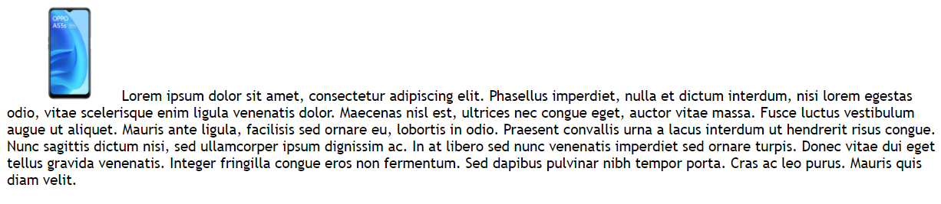

CSS Property - Float
Float - The CSS float property specifies how an element should float.
float: left
float: right
float: none
img {
float: left;
}
img { float: right; }
img { float: none; }
www.credosystemz.com © Copyright 2021 | credosystemz | All Rights Reserved

