Slide 1


CSS - Training

Slide 2


CSS – Navigation using List
Horizontal Navigation bar
ul {
list-style-type: none;
margin: 0;
padding: 0;
background-color: #E7E9EB;
}
li {
float: left;
}
li a {
display: block;
color: black;
text-align: center;
padding: 14px 16px;
text-decoration: none;
}
li a:hover {
background-color: #04AA6D;
}
.active {
background-color: #04AA6D;
}
<ul> <li><a class="active" href=“home.html">Home</a></li> <li><a href=“news.html">News</a></li> <li><a href="contact.html">Contact</a></li> <li><a href="about.html">About</a></li> </ul>
www.credosystemz.com © Copyright 2021 | credosystemz | All Rights Reserved

Slide 3
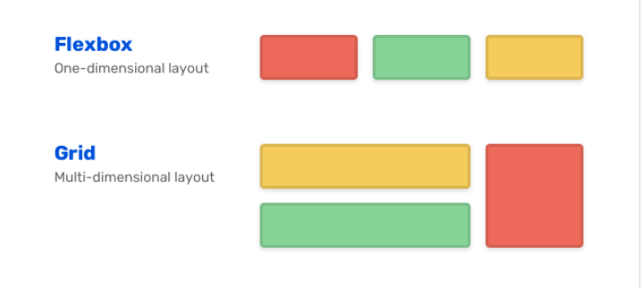
Flex box and grid

Slide 4
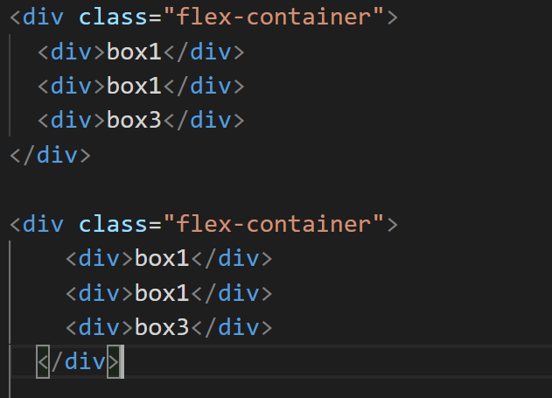
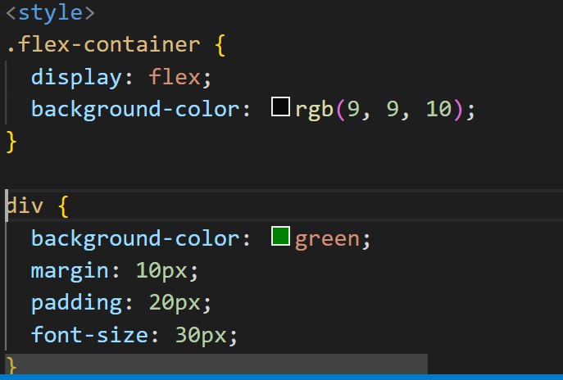
flexbox

Slide 5
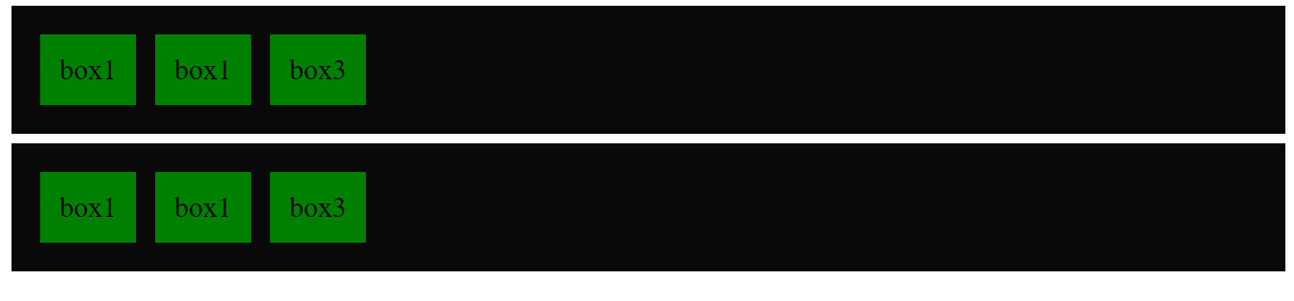
FlexBoX

Slide 6
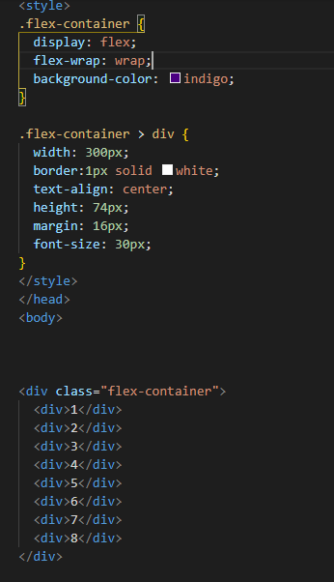
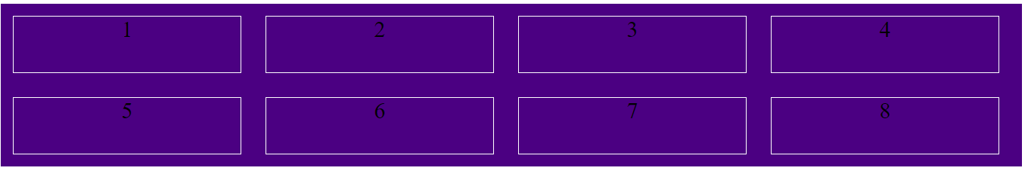
Flexbox

Slide 7
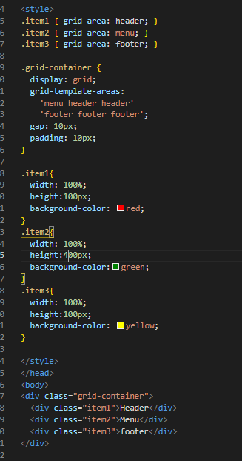
Grid layout 1

Slide 8
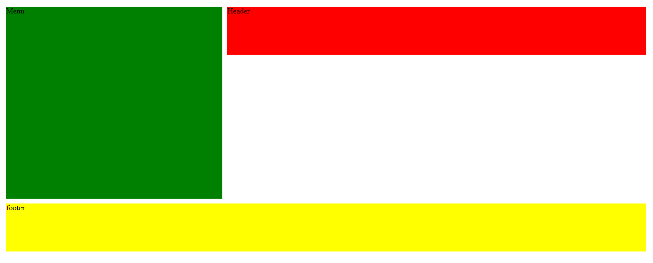
Output

Slide 9
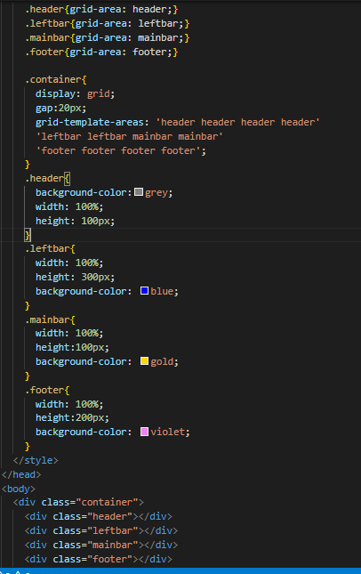
Grid Layout 2

Slide 10

Output

Slide 11
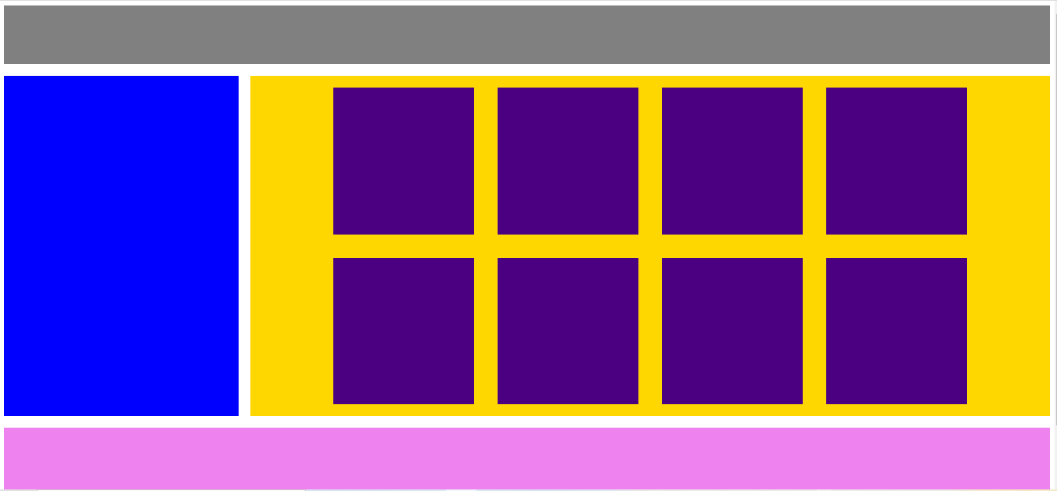
Flex+Grid

