Slide 1


JavaScript - Training

Slide 2

Agenda
Introduction to JavaScript
Why JavaScript?
How to Add JavaScript?
Difference between – HTML/CSS/JS
Understanding DOM
DOM Methods
Events & Functions
Variables & DataTypes
Operators
Conditional Statements
Loops
Arrarys
www.credosystemz.com © Copyright 2021 | credosystemz | All Rights Reserved

Slide 3
What is JavaScript?
JavaScript is a client side scripting language (interpreted programming language)
JavaScript make web pages interactive
Open source and cross-platform
Case sensitive
Most commonly used as a part of web pages
JS was created to make web pages more Dynamic (Change content on a page directly from inside the browser)
Supported by all major browsers and enabled by default
www.credosystemz.com © Copyright 2021 | credosystemz | All Rights Reserved

Slide 4
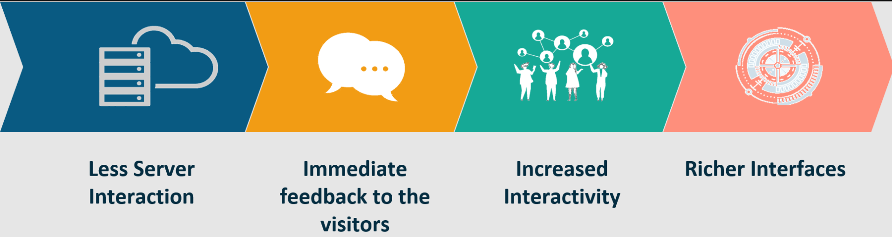
Why JavaScript?
JavaScript adds behavior to web pages
Show or hide more information with the click of a button
Change the color of a button when the mouse hovers over it
Less server interaction
Immediate feedback to the visitors
www.credosystemz.com © Copyright 2021 | credosystemz | All Rights Reserved

Slide 5
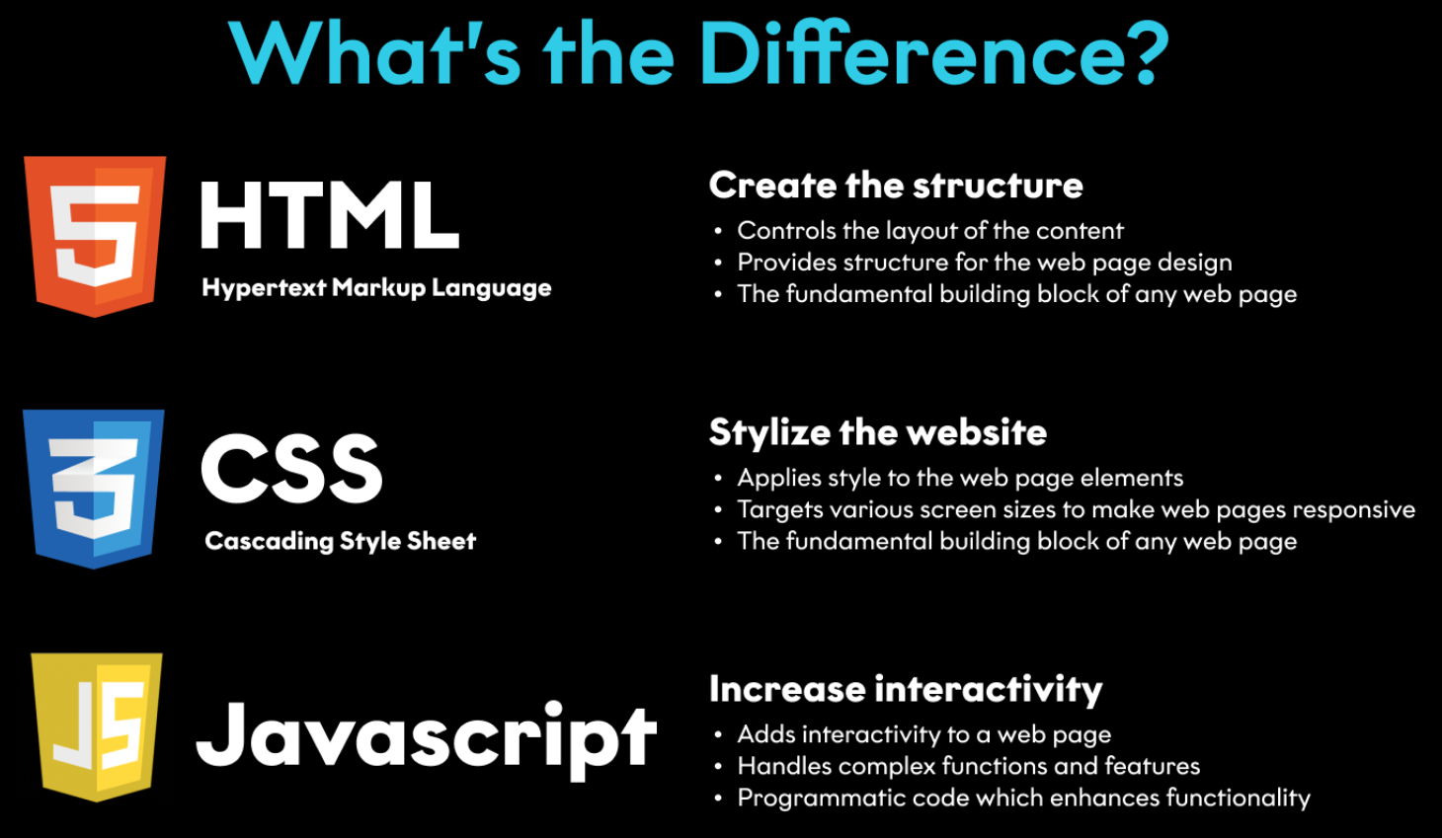
HTML, CSS & JavaScript
www.credosystemz.com © Copyright 2021 | credosystemz | All Rights Reserved

Slide 6
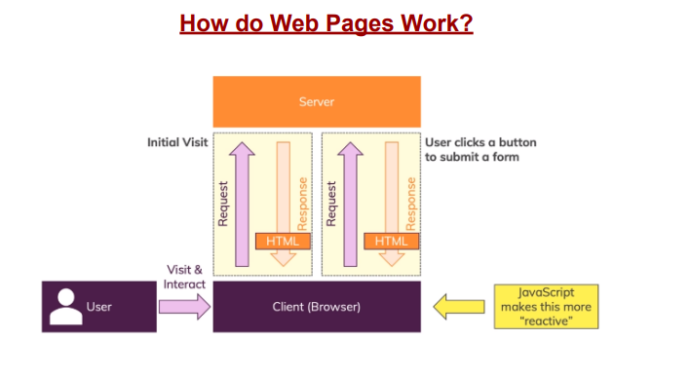

Slide 7
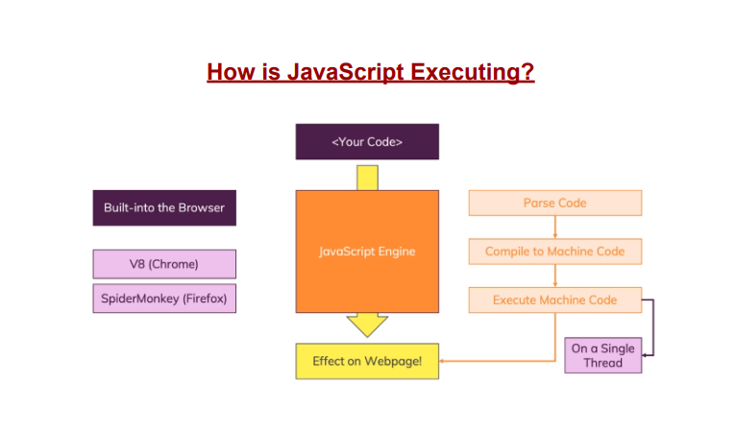

Slide 8
How to Add JavaScript
Internal JS - Internal JavaScript code is code that's placed anywhere within the web page between the HTML tags
External JS
JavaScript code placed in a file separate from the HTML code is called external Javascript.
External JavaScript code is written and used in the same way as internal Javascript.
The file should have the ".js" extension.
<script>
alert("Happy Learning");
</script>
<script src="myScript.js"></script>
www.credosystemz.com © Copyright 2021 | credosystemz | All Rights Reserved

Slide 9
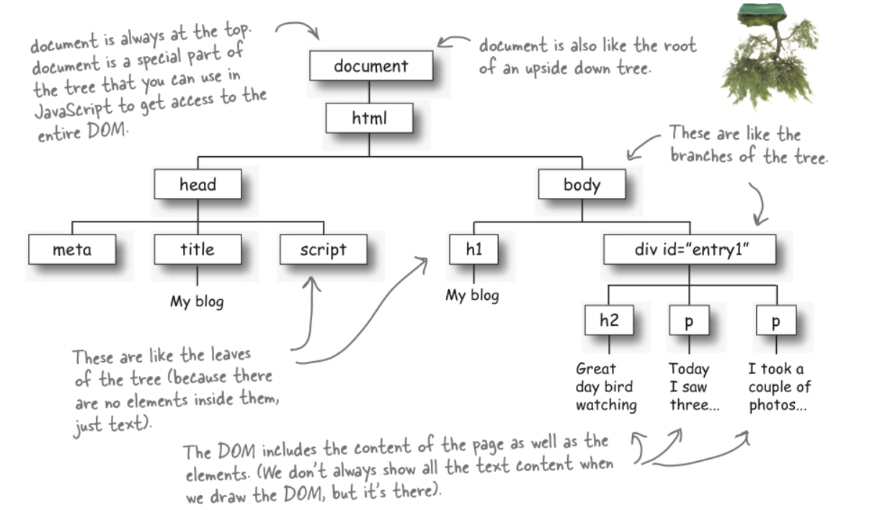
What is DOM ?
When a web page is loaded, the browser creates a Document Object Model of the page
The HTML DOM model is constructed as a tree of Objects:
www.credosystemz.com © Copyright 2021 | credosystemz | All Rights Reserved

Slide 10
What we can do using DOM?
Using DOM, JavaScript gets all the power it needs to create/update HTML:
JavaScript can change all the HTML elements in the page
JavaScript can change all the HTML attributes in the page
JavaScript can change all the CSS styles in the page
JavaScript can remove existing HTML elements and attributes
JavaScript can add new HTML elements and attributes
JavaScript can react to all existing HTML events in the page
www.credosystemz.com © Copyright 2021 | credosystemz | All Rights Reserved

