Slide 1


TypeScript - Training

Slide 2

Agenda
Introduction to TypeScript
Why TypeScript?
TypeScript Compilation?
Environment Setup - TypeScript
Variables
Functions
Class
Interfaces
www.credosystemz.com © Copyright 2021 | credosystemz | All Rights Reserved

Slide 3
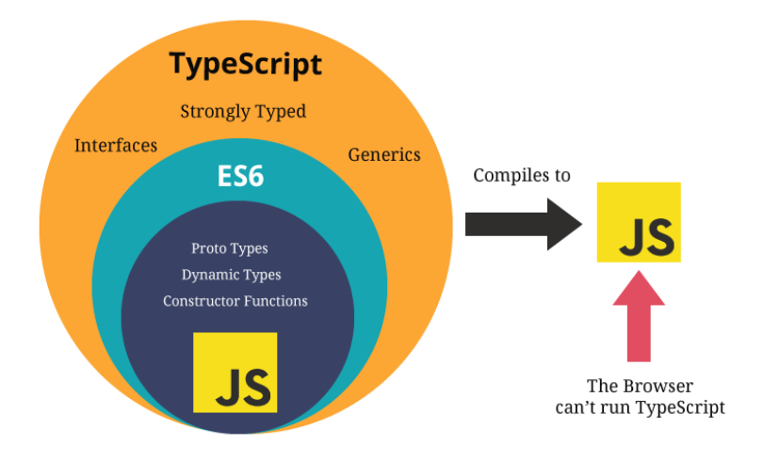
What is TypeScript?
TypeScript is wrapper around the JavaScript.
TypeScript is Strongly Typed Language which means you have to be specific with Variable type.
TypeScript doesn’t run in the browser. We need to compile it to JS to run.
TypeScript is a typed superset of JavaScript and pure Object oriented.
www.credosystemz.com © Copyright 2021 | credosystemz | All Rights Reserved

Slide 4
Why TypeScript?
Due to the static typing, code written in TypeScript is more predictable, and is generally easier to debug.
Makes it easier to organize the code for very large and complicated apps.
You can use TypeScript for other JS libraries, Because TS compiles plain JS.
TS is platform Independent.
www.credosystemz.com © Copyright 2021 | credosystemz | All Rights Reserved

Slide 5
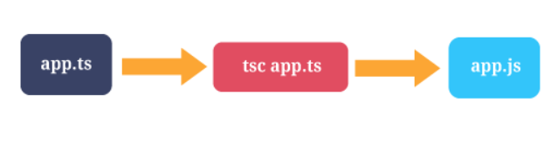
TypeScript Compilation
The file extension of TypeScript is “.ts”.
The TSC (TypeScript Compiler) is a source-to-source compiler (transcompiler / transpiler).
The TSC generates the equivalent JS code from the source TS code. This process is termed as transpilation.
tsc first.ts This will create a new file named first.js in the same location. Keep in mind that if you already had a file named first.js, it would be overwritten.
You can run multiple files at the time by using tsc first.ts second.ts third.ts
www.credosystemz.com © Copyright 2021 | credosystemz | All Rights Reserved

Slide 6
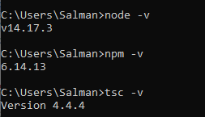
Environment Setup - TypeScript
Install Node.js – Node.js is the environment on which you will run the TypeScript compiler. Note that you don’t need to know node.js
To verify if the installation was successful, enter the command node –v in the terminal window
Type the following command in the terminal window to install TypeScript - npm install -g typescript
Install Visual studio if not installed
www.credosystemz.com © Copyright 2021 | credosystemz | All Rights Reserved

Slide 7
Run TypeScript File
Create a new file of your choice with file ext “.ts”
Add a function in the typescript file like below
Open command prompt on Windows and run this command - tsc add.ts
The above command will compile the TypeScript file add.ts and create the Javascript file named add.js at the same location
Refer add.js file in a web page using a script tag and see the result in the browser's developer console
function add(a:number,b:number){
return a+b;
}
let sum1: number = add(3,5)
console.log(sum1)
www.credosystemz.com © Copyright 2021 | credosystemz | All Rights Reserved

Slide 8
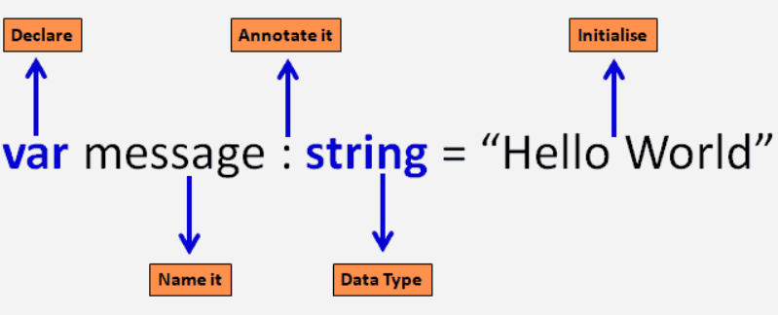
Type Annotations
TypeScript is a typed language, we can specify the type
Variables
Function parameters
Object properties
We cannot change the value using a different data type other than the declared data type of a variable.
If you try to do so, TypeScript compiler will show an error
Type annotations are used to enforce type checking
Type annotations helps compiler in checking types and helps avoid errors dealing with data types
It is also a good way of writing code for easier readability and maintenance
www.credosystemz.com © Copyright 2021 | credosystemz | All Rights Reserved

Slide 9
Type Annotations
Variables:
Type Annotation of Parameters:
var age: number = 32; // number variable
var name: string = "John";// string variable
var isUpdated: boolean = true;// Boolean variable
function display(id:number, name:string)
{
console.log("Id = " + id + ", Name = " + name);
}
Type Annotation in Object:
var employee : {
id: number;
name: string;
};
employee = {
id: 100,
name : "John"
}
If we try to assign a string value to id then the TypeScript compiler will give the following error.
www.credosystemz.com © Copyright 2021 | credosystemz | All Rights Reserved

Slide 10
Datatype
Number:
let first:number = 123;
let myNumber: number = 123;
myNumber.toString(); // returns '123'
let myNumber: number = 10.8788;
myNumber.toFixed(); // returns 11
myNumber.toFixed(1); //returns 10.9
myNumber.toFixed(2); //returns 10.88
String:
Template String:
let employeeName:string = 'John Smith';
//OR
let employeeName:string = "John Smith";
let firstName:string = “Mohit";
let lastName:string = “Kumar";
let fullName1: string = “My First Name is ” +firstName+” and Last Name is “ + lastName
let fullName2 : string = ` My First Name is ${firstName} and Last Name is ${lastName}`;
console.log(fullName1);
console.log(fullName2);
Boolean:
let isPresent:boolean = true;
www.credosystemz.com © Copyright 2021 | credosystemz | All Rights Reserved

Slide 11
Datatype
Array:
Any: - Dynamic Type
let fruits: string[] = ['Apple', 'Orange', 'Banana'];
let fruits: Array<string> = ['Apple', 'Orange', 'Banana']; // Generic array type
//Arrays can be declared and initialized separately
let fruits: Array<string>;
fruits = ['Apple', 'Orange', 'Banana'];
let ids: Array<number>;
ids = [23, 34, 100, 124, 44];
let something: any = "Hello World!";
something = 23;
something = true;
let arr: any[] = ["John", 212, true];
arr.push("Smith");
Void - void is used where there is no data
function sayHi(): void {
console.log('Hi!')
}
let speech= sayHi();
console.log(speech); //Output: undefined
www.credosystemz.com © Copyright 2021 | credosystemz | All Rights Reserved

Slide 12

Function
Functions are the primary blocks of any program, In TypeScript, functions can be of two types: named and anonymous
Named functions:
function display() {
console.log("Hello TypeScript!");
}
display(); //Output: Hello TypeScript
function Sum(x: number, y: number) : number {
return x + y;
}
Sum(2,3); // returns 5
Function Parameters
function Greet(greeting: string, name: string ) : string {
return greeting + ' ' + name + '!';
}
Greet('Hello','Steve');//OK, returns "Hello Steve!"
Greet('Hi'); // Compiler Error: Expected 2 arguments, but got 1.
Greet('Hi','Bill','Gates'); //Compiler Error: Expected 2 arguments, but got 3.
www.credosystemz.com © Copyright 2021 | credosystemz | All Rights Reserved

Slide 13

Function
Optional Parameters:
The parameters that may or may not receive a value can be appended with a '?' to mark them as optional
All optional parameters must follow required parameters and should be at the end.
function Greet(greeting: string, name?: string ) : string {
return greeting + ' ' + name + '!';
}
Greet('Hello','Steve');//OK, returns "Hello Steve!"
Greet('Hi'); // OK, returns "Hi undefined!".
Default Parameters:
TypeScript provides the option to add default values to parameters
if the user does not provide a value to an argument, TypeScript will initialize the parameter with the default value
function Greet(name: string, greeting: string = "Hello") : string {
return greeting + ' ' + name + '!';
}
Greet('Steve');//OK, returns "Hello Steve!"
Greet('Steve', 'Hi'); // OK, returns "Hi Steve!".
Greet('Bill'); //OK, returns "Hello Bill!"
www.credosystemz.com © Copyright 2021 | credosystemz | All Rights Reserved

Slide 14
Function
Anonymous functions:
let greeting = function() {
console.log("Hello TypeScript!");
};
greeting(); //Output: Hello TypeScript!
An anonymous function is one which is defined as an expression
Expression is stored in a variable. So, the function does not have a name
These functions are invoked using the variable name that the function is stored in
let Sum = function(x: number, y: number) : number
{
return x + y;
}
Sum(2,3); // returns 5
Arrow Functions
Fat arrow notations are used for anonymous functions
Using fat arrow =>, we dropped the need to use the function keyword
Parameters are passed in the parenthesis ()
function expression is enclosed within the curly brackets { }
(param1, param2, ..., paramN) => expression
let sum = (x: number, y: number): number => {
return x + y;
}
sum(10, 20); //returns 30
www.credosystemz.com © Copyright 2021 | credosystemz | All Rights Reserved

Slide 15
Classes
Classes are the fundamental entities used to create reusable components
Functionalities are passed down to classes and objects are created from classes
A class can include the following:
Constructor
Properties
Methods
Class name
class Employee {
empCode: number;
empName: string;
constructor(code: number, name: string) {
this.empName = name;
this.empCode = code;
}
getSalary() : number {
return 10000;
}
}
Properties
Constructor
Method
www.credosystemz.com © Copyright 2021 | credosystemz | All Rights Reserved

Slide 16
Classes - Constructor
The constructor is a special type of method which is called when creating an object
In TypeScript, the constructor method is always defined with the name "constructor“
It is not mandatory for a class to have a constructor
class Employee {
empCode: number;
empName: string;
constructor(empcode: number, name: string ) {
this.empCode = empcode;
this.name = name;
}
}
Class without Constructor
class Employee {
empCode: number;
empName: string;
}
Creating an Object of Class
An object of the class can be created using the new keyword
class Employee {
empCode: number;
empName: string;
}
let emp = new Employee();
www.credosystemz.com © Copyright 2021 | credosystemz | All Rights Reserved

Slide 17
Classes - Inheritance
One of the most fundamental patterns in class-based programming is being able to extend existing classes to create new ones using inheritance
TypeScript classes can be extended to create new classes with inheritance, using the keyword extends
class Animal {
move(distanceInMeters: number = 0) {
console.log(`Animal moved ${distanceInMeters}m.`);
}
}
class Dog extends Animal {
bark() {
console.log("Woof! Woof!");
}
}
let dog = new Dog();
dog.bark();
dog.move(10);
dog.bark();
www.credosystemz.com © Copyright 2021 | credosystemz | All Rights Reserved

Slide 18
Data Modifiers
Controlling the visibility of class data members is a concept of Encapsulation
There are three types of access modifiers in TypeScript:
public
private
protected
Public
By default, all members of a class in TypeScript are public.
All the public members can be accessed anywhere without any restrictions
class Employee {
public empCode: string;
empName: string;
}
let emp = new Employee();
emp.empCode = 123;
emp.empName = "Swati";
www.credosystemz.com © Copyright 2021 | credosystemz | All Rights Reserved

Slide 19
Data Modifiers
private
The private access modifier ensures that class members are visible only to that class and are not accessible outside the containing class
class Employee {
private empCode: number;
empName: string;
}
let emp = new Employee();
emp.empCode = 123; // Compiler Error
emp.empName = "Swati";//OK
protected
class Student {
public studCode: number;
protected studName: string;
}
class Person extends Student {
showStudentDetails():void{
console.log(this. studCode)
console.log(this. studName)
}
}
The protected access modifier is similar to the private access modifier,
except that protected members can be accessed using their deriving classes
www.credosystemz.com © Copyright 2021 | credosystemz | All Rights Reserved

Slide 20
Data Modifiers
readonly
TypeScript includes the readonly keyword that makes a property as read-only in the class
Prefix readonly is used to make a property as read-only. Read-only members can be accessed outside the class, but their value cannot be changed
class Employee {
readonly empCode: number;
empName: string;
}
let emp = new Employee();
emp.empCode = 20; //Compiler Error
emp.empName = 'Bill';
Static
class Circle {
static pi: number = 3.14;
static calculateArea(radius:number) {
return this.pi * radius * radius;
}
}
Circle.pi; // returns 3.14
Circle.calculateArea(5); // returns 78.5
The static members of a class are accessed using the class name and dot notation, without creating an object e.g. <ClassName>.<StaticMember>
www.credosystemz.com © Copyright 2021 | credosystemz | All Rights Reserved

Slide 21
Interface
An interface defines the syntax that any entity must adhere to
Interfaces define properties, methods, and events, which are the members of the interface
It often helps in providing a standard structure that the deriving classes would follow.
interface interface_name {
}
interface IPerson {
firstName:string,
lastName:string,
sayHi: ()=>string
}
var customer:IPerson = {
firstName:"Tom",
lastName:"Hanks",
sayHi: ():string =>{return "Hi there"}
}
console.log("Customer Object ")
console.log(customer.firstName)
console.log(customer.lastName)
console.log(customer.sayHi())
www.credosystemz.com © Copyright 2021 | credosystemz | All Rights Reserved

