Slide 1
Custom pipe
SALMAN AHMED G

Slide 2
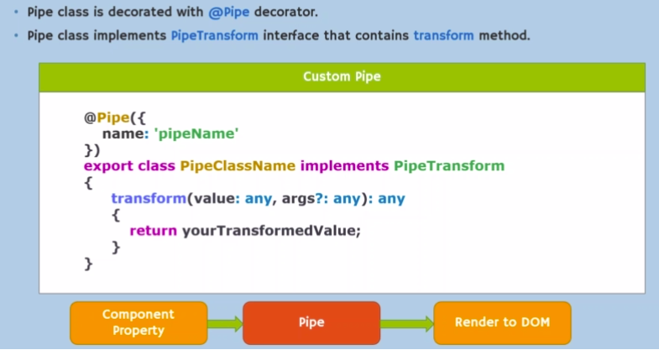
Custom pipe

Slide 3

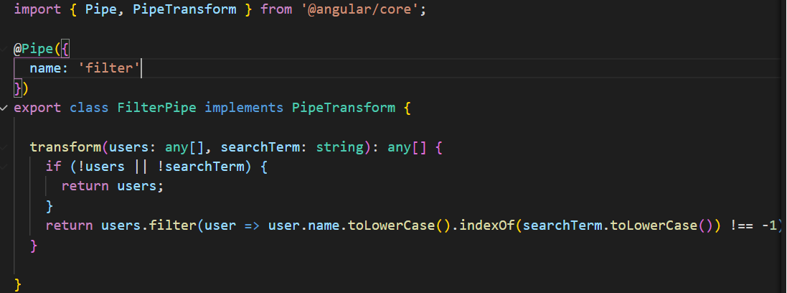
Pure pipe

Slide 4

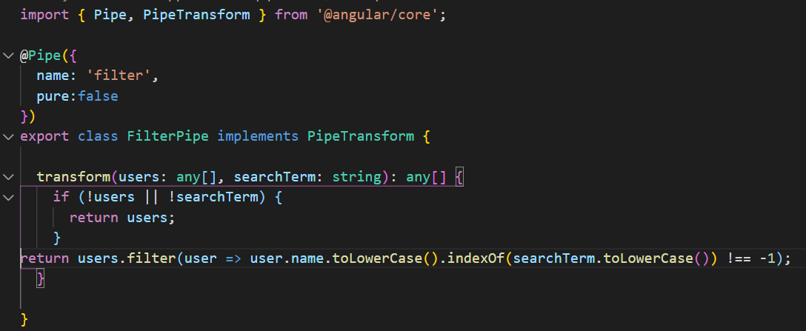
Impure pipe

