Slide 1
Custom diretive
SALMAN AHMED G

Slide 2
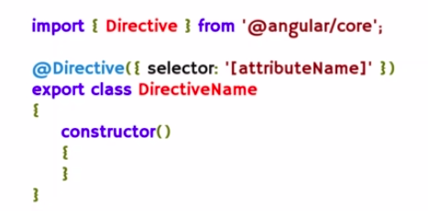
Custom directive

Slide 3
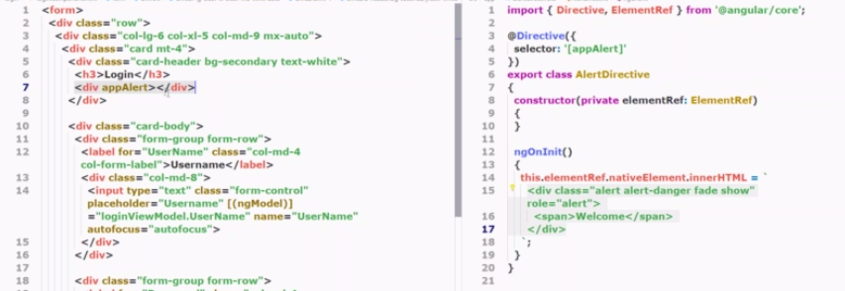
Custom directive example

Slide 4
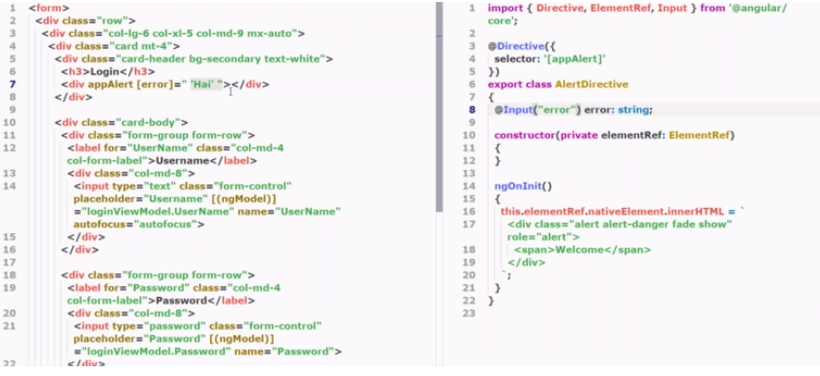
Custome directive input parameter example

Slide 5

hostlistener

Slide 6
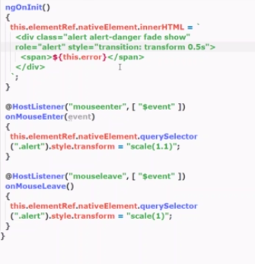
Hostlistener - example

Slide 7

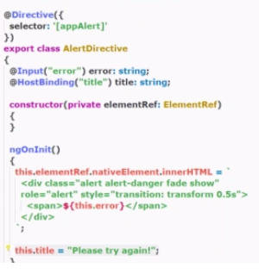
hostbinding

