Slide 1
File upload
SALMAN AHMED G

Slide 2
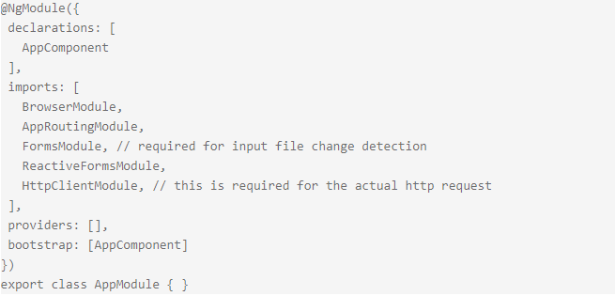
STEP1: IMPORT HTTPcLIENTmODULE

Slide 3
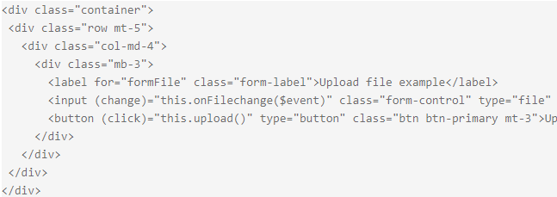
STEP2:UPLOAD FILE FROM HTML

Slide 4
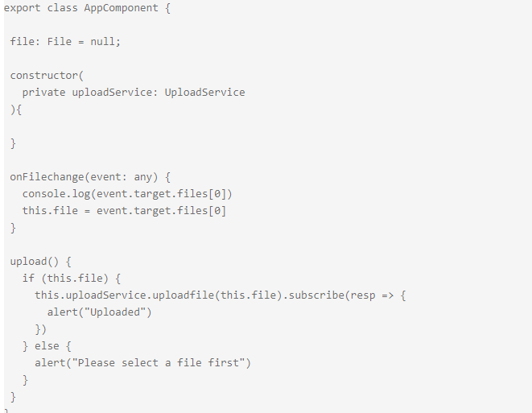
STEP 3: CLASS COMPONENT METHODS

Slide 5
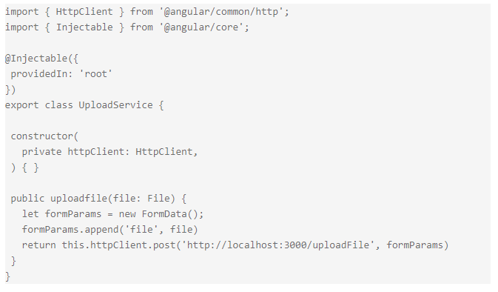
STEP 4 : SERVICE CLASS

