Slide 1
Introduction to Angular
SALMAN AHMED G

Slide 2
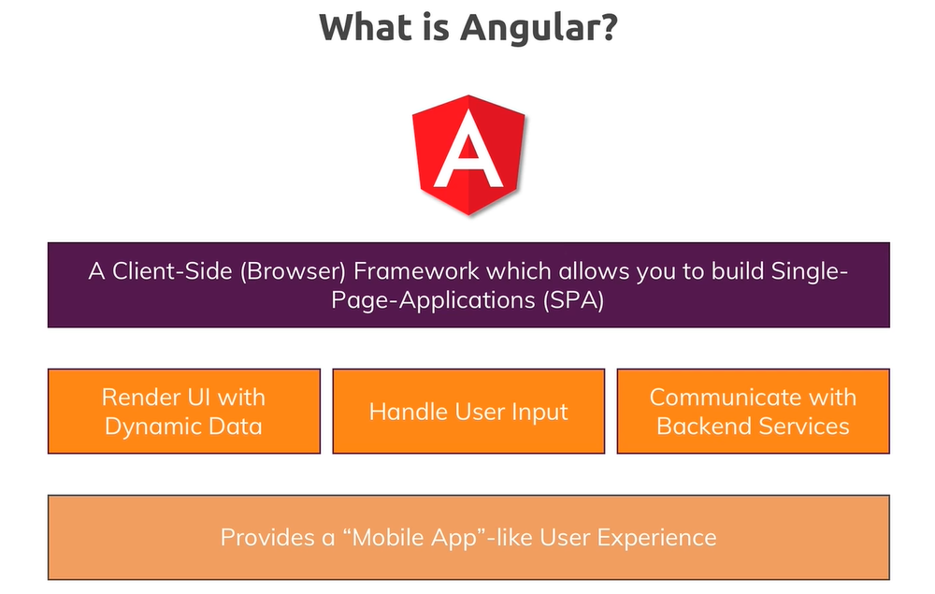
WHAT IS angular

Slide 3
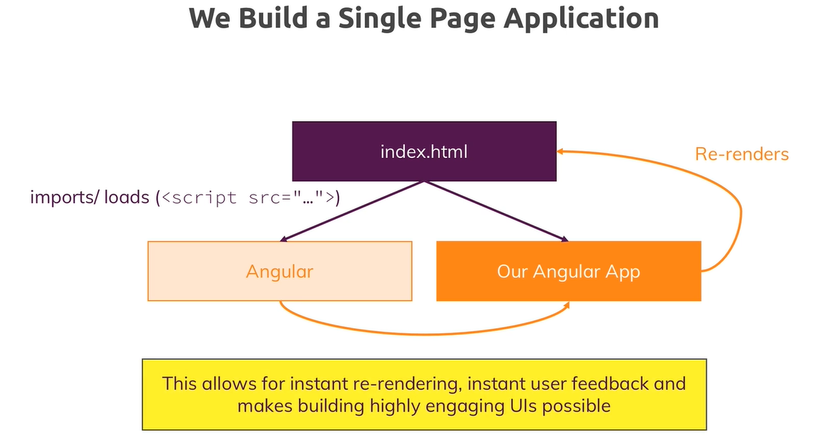
SPA

Slide 4
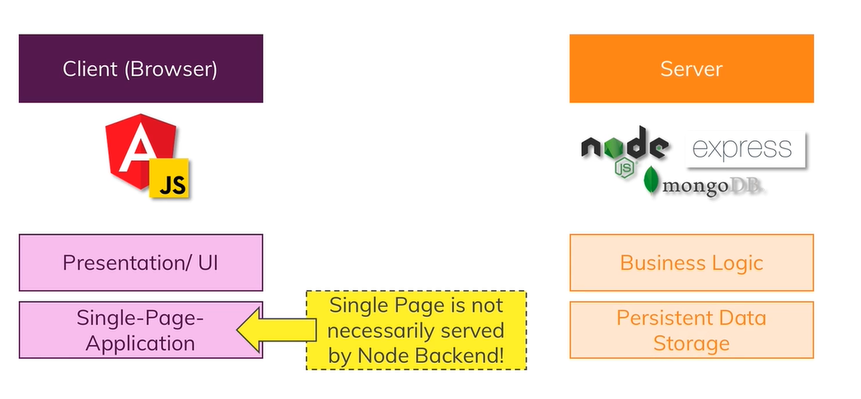
WEB DEVELOPMENT

Slide 5
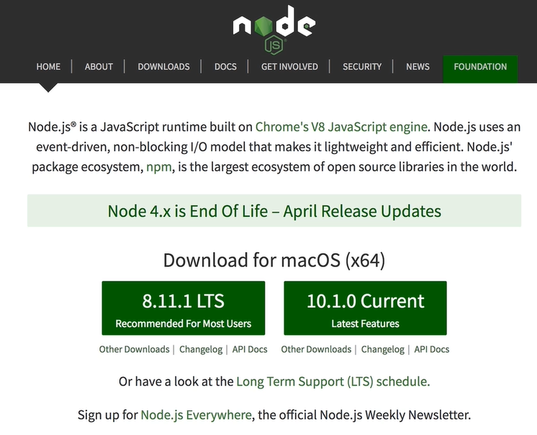
INSTALLING - 1

Slide 6
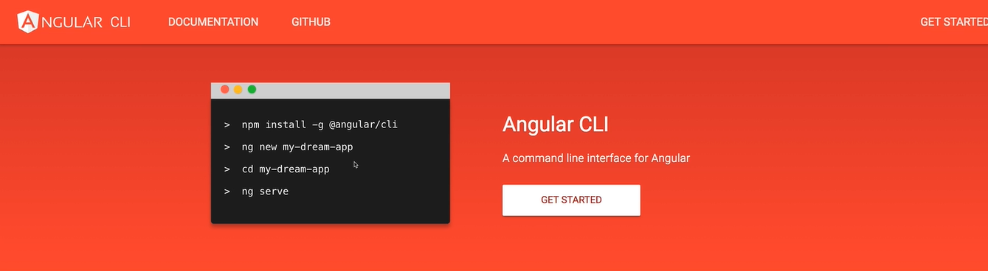
INSTALLING - 2

Slide 7
Angular cli
Latest version : npm install –g @angular/cli
Specific version: npm install –g @angular/cli@11
New project: ng new project-new
Running: ng serve

Slide 8
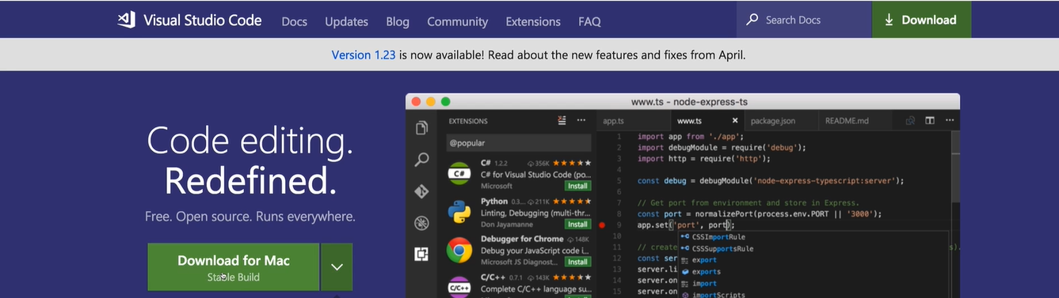
Installing - 3

Slide 9
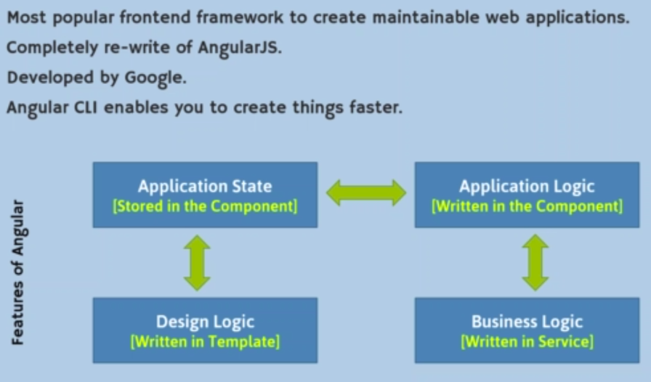
Core concepts of angular

Slide 10
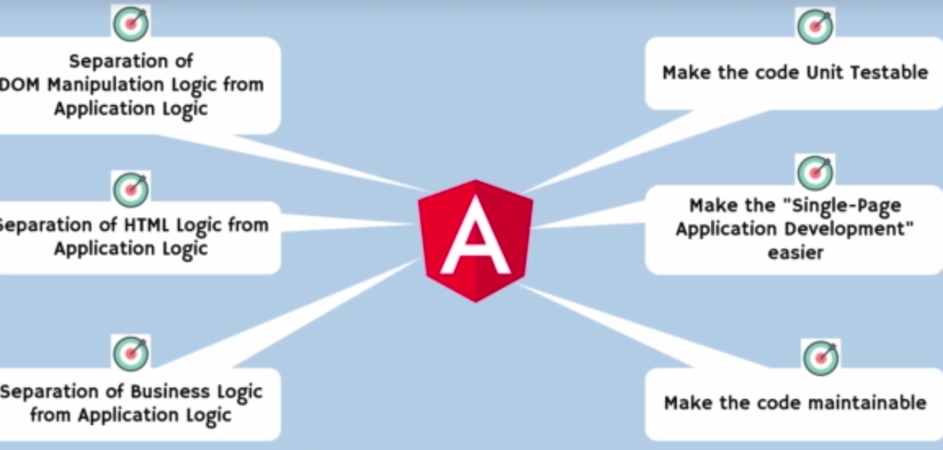
Advantages of angular

Slide 11
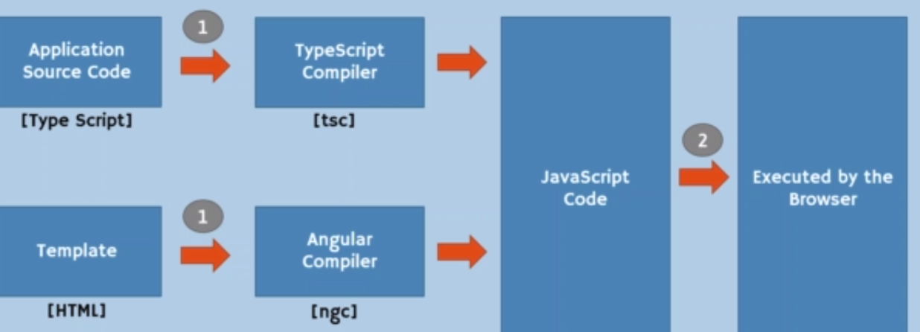
Compiler of angular

Slide 12
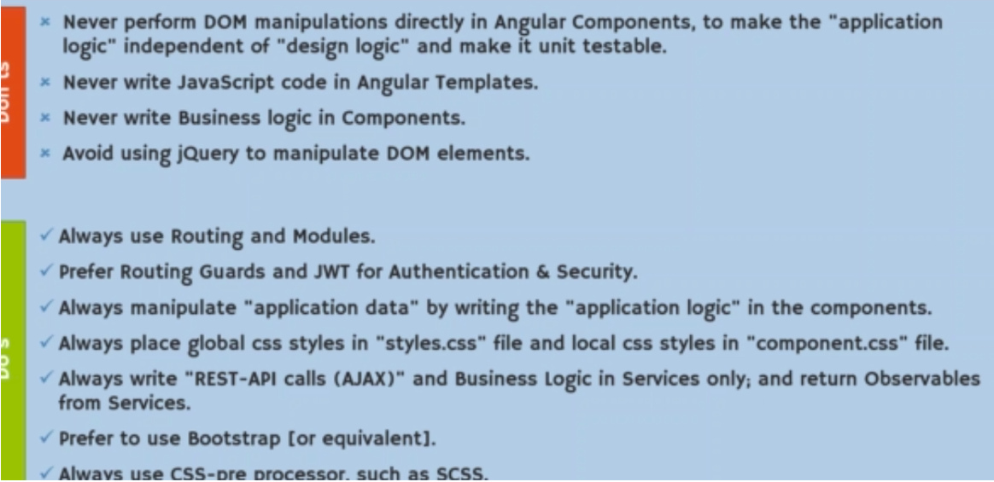
Do’s and don’ts in angular

Slide 13
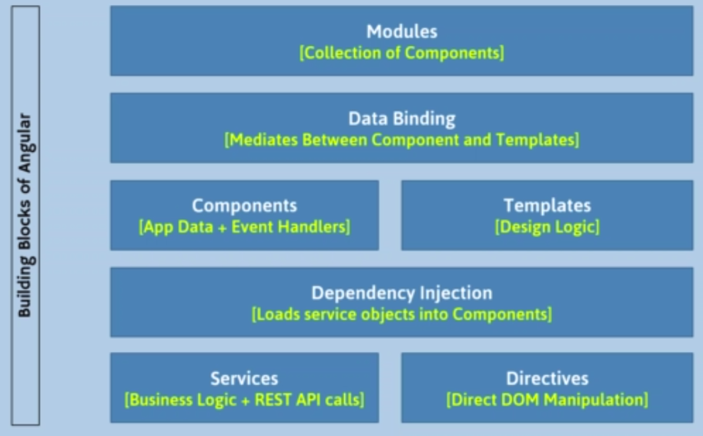
Building block of angular

Slide 14
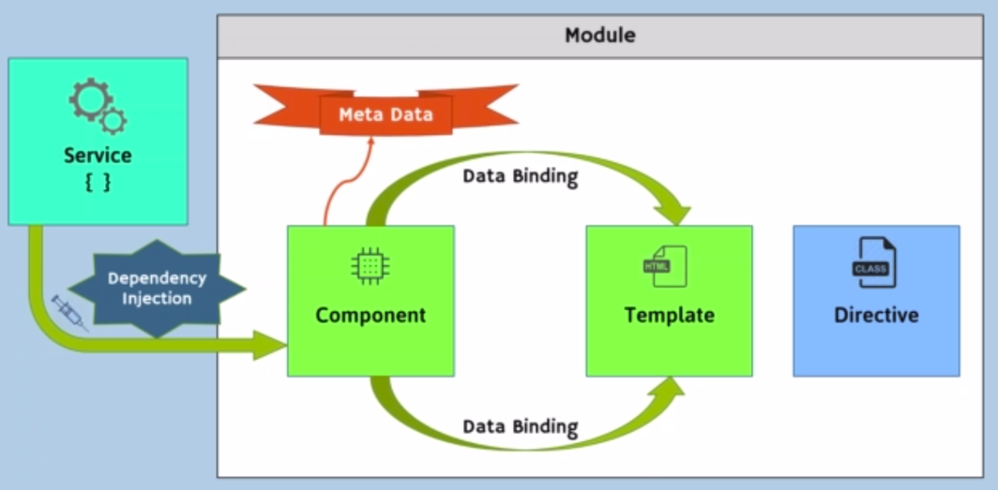
ANGULAR ARCHITECTURE

Slide 15
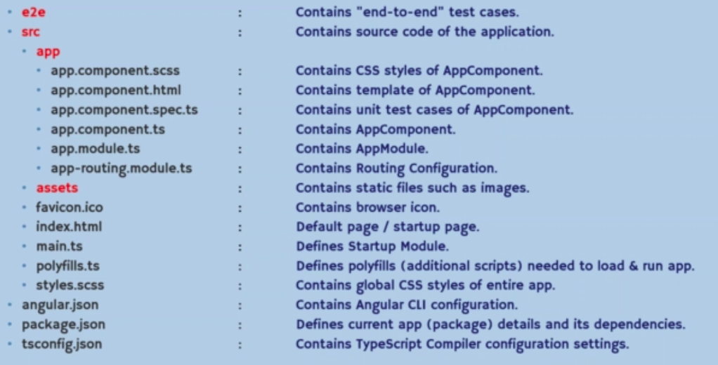
FOLDER STRUCTURE

Slide 16
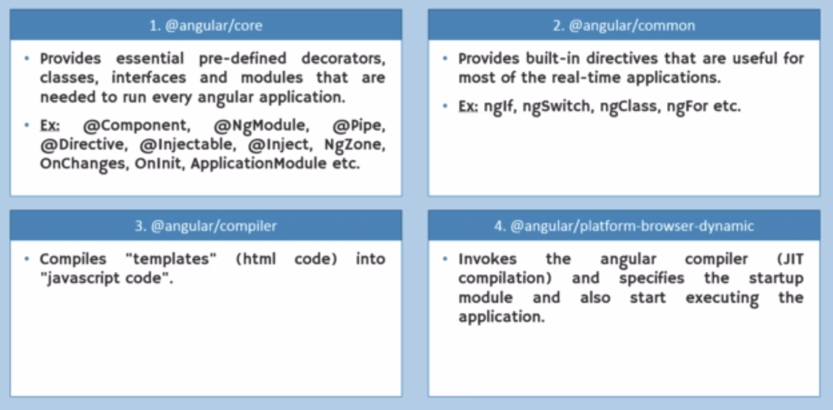
BUILD IN PACKAGE

Slide 17
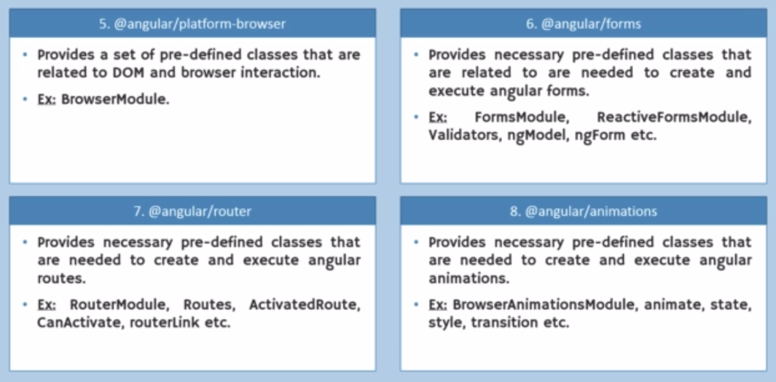
BUILD IN PACKAGE

Slide 18
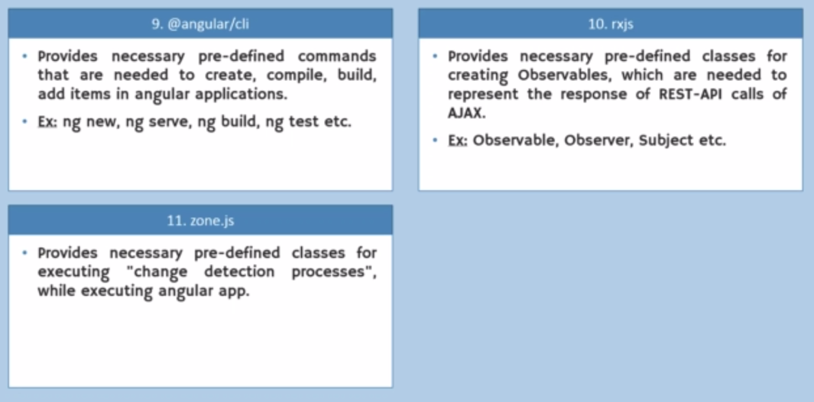
BUILD IN PACKAGE

