Slide 1
Building blocks of angular
SALMAN AHMED G

Slide 2
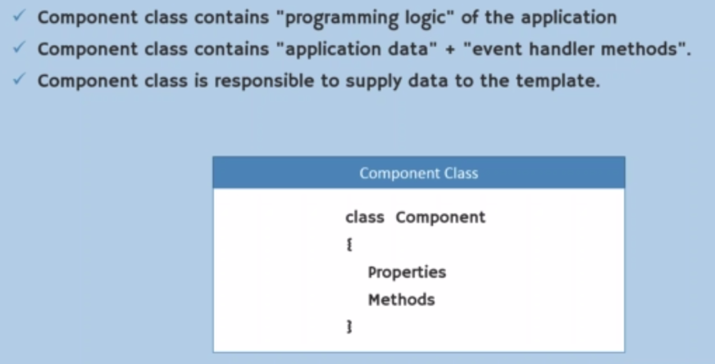
WHAT IS component

Slide 3
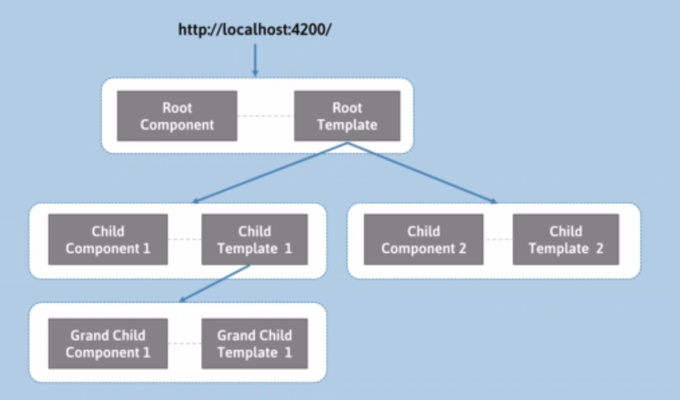
Component hierarchy

Slide 4
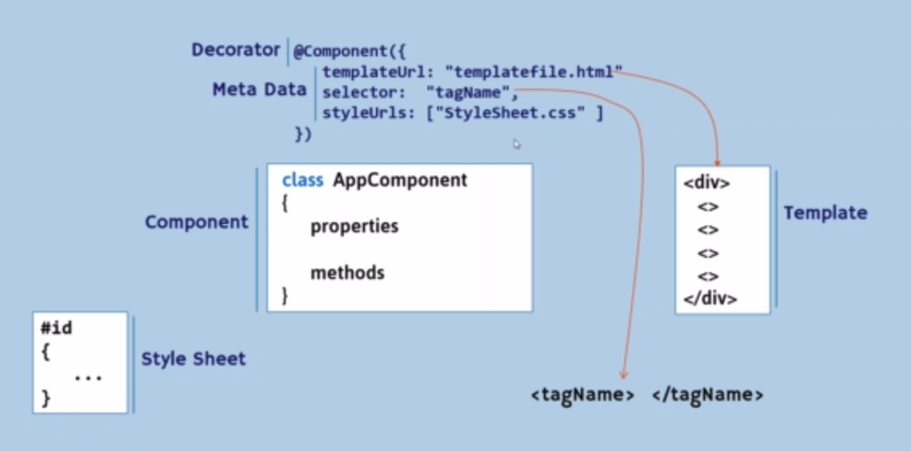
Component meta data

Slide 5
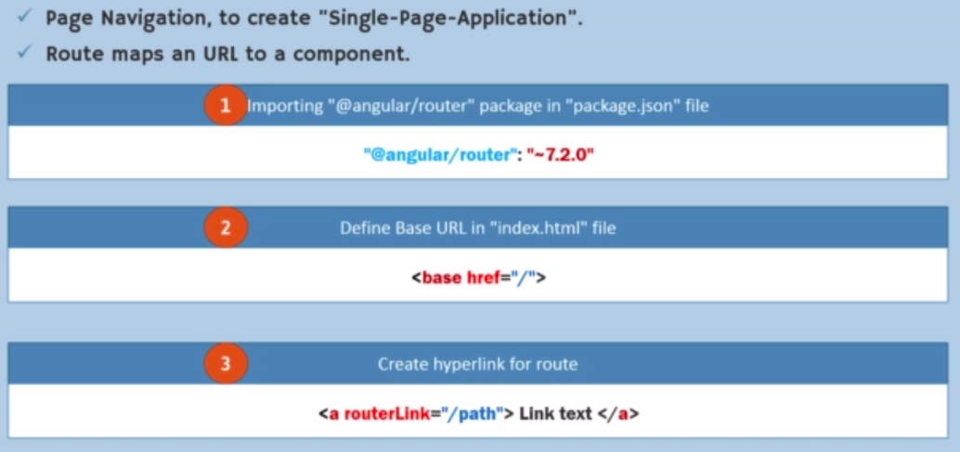
Introduction to routing

Slide 6
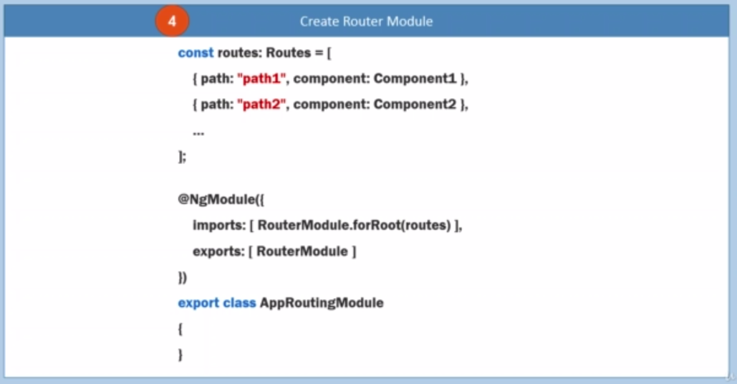
Creating routing

Slide 7

Creating routing

Slide 8
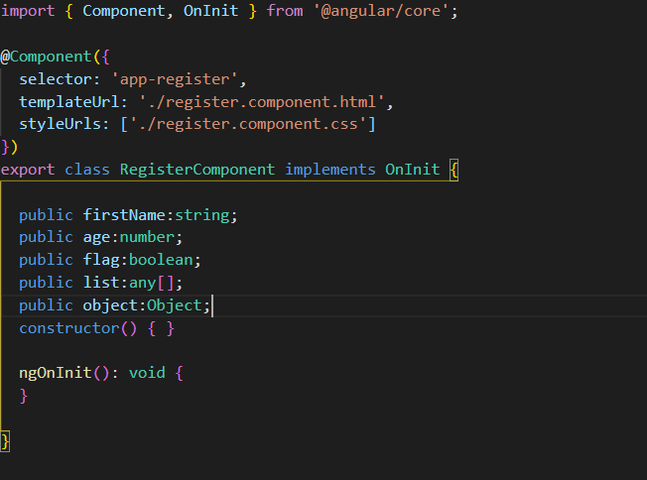
Variable declaration

Slide 9
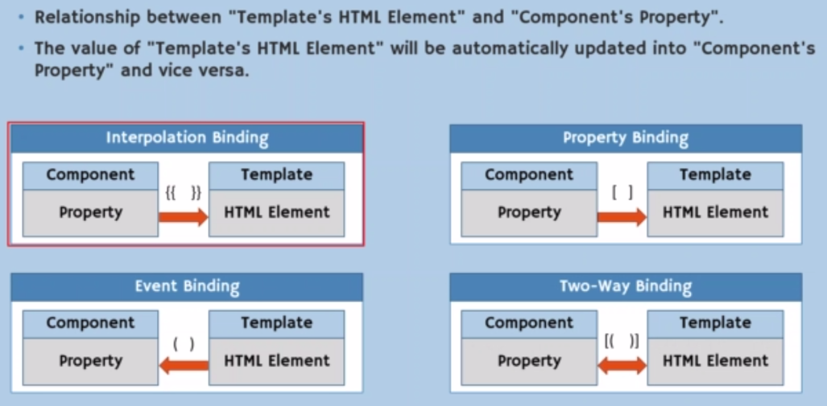
Data binding

Slide 10
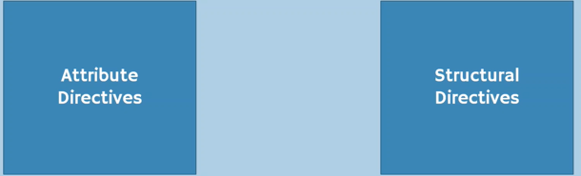
directive

Slide 11
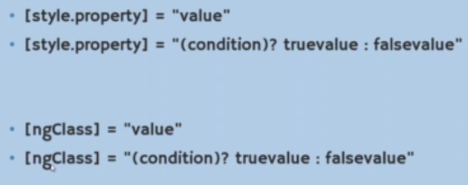
Attribute directive

Slide 12

Attribute directive example

Slide 13
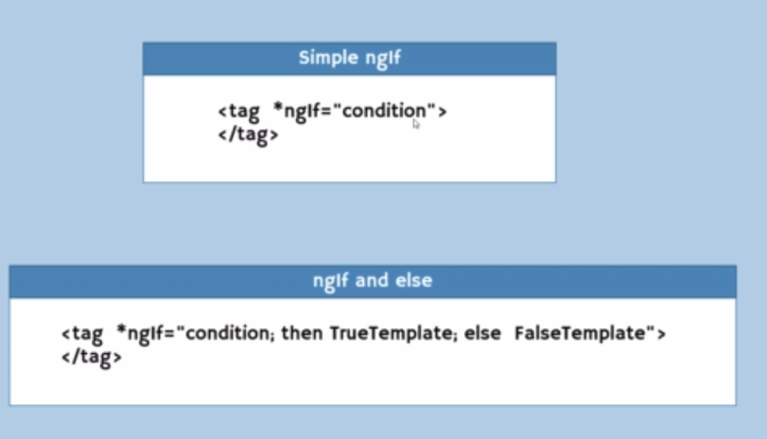
Structural directive - ngif

Slide 14
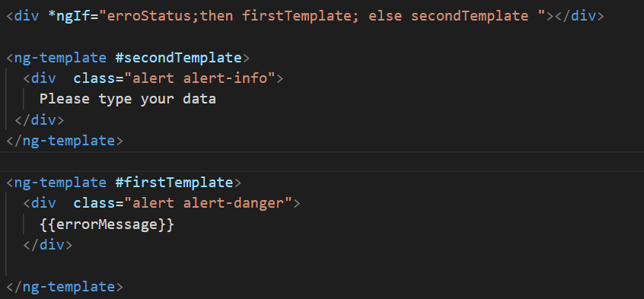
Structural directive - ngif

Slide 15
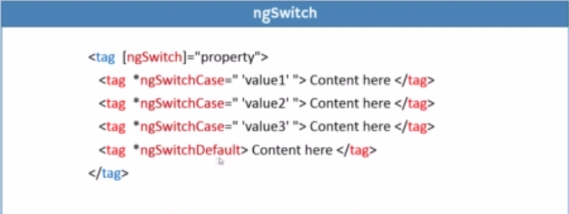
Structural directive - ngswitch

Slide 16
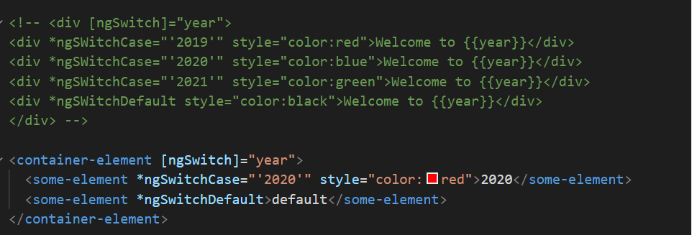
Structural directive - ngswitch

Slide 17
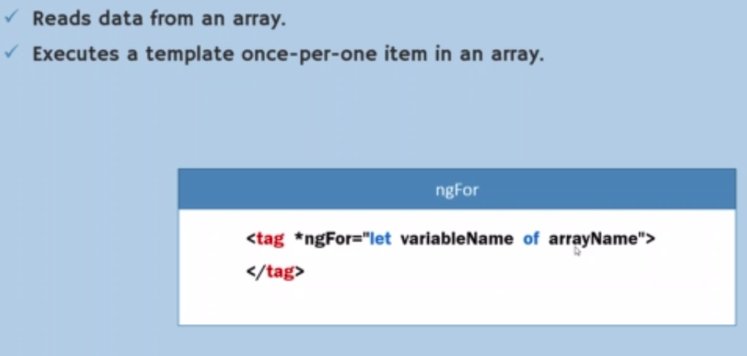
Structural directive - ngfor

Slide 18
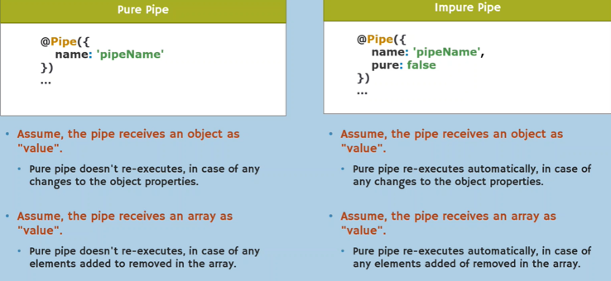
Types of pipe

Slide 19
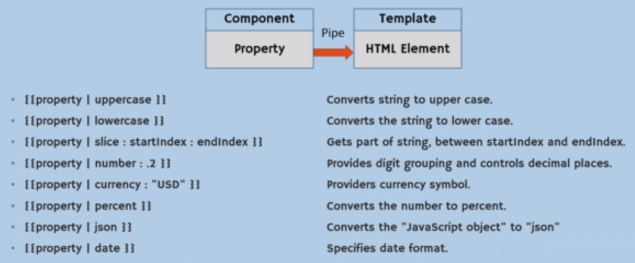
Built in pipe

Slide 20
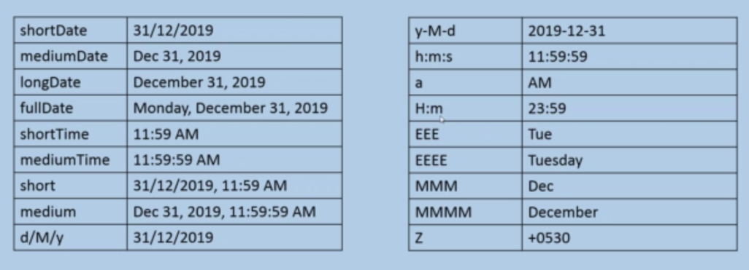
Date format pipe

Slide 21
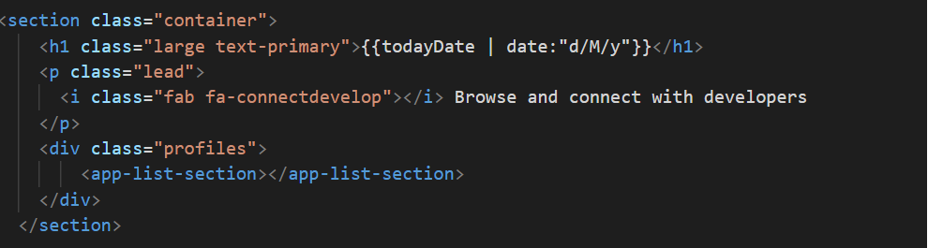
Date format pipe exmple

