Slide 1
Modules and services
SALMAN AHMED G

Slide 2
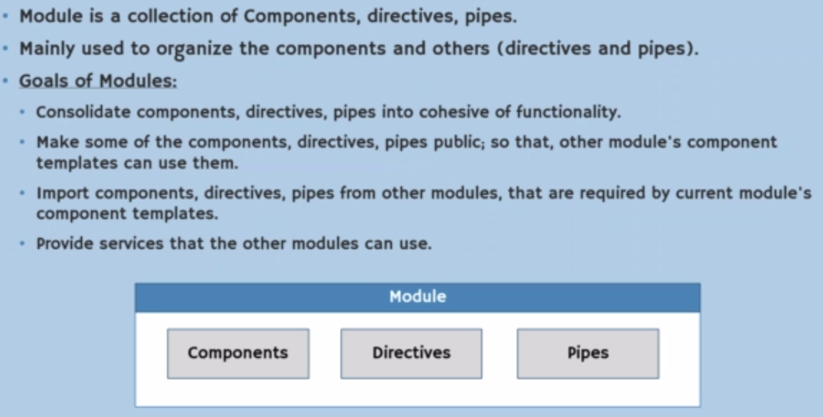
WHAT IS module

Slide 3
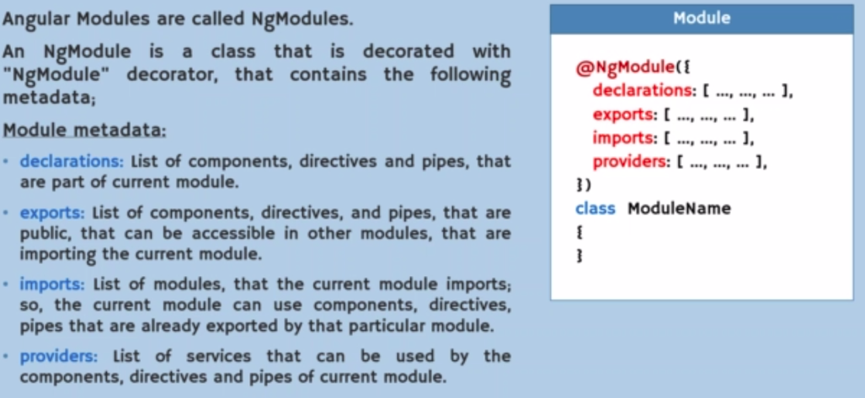
Module metadata

Slide 4
How to create module
Cmd: ng g module admin

Slide 5
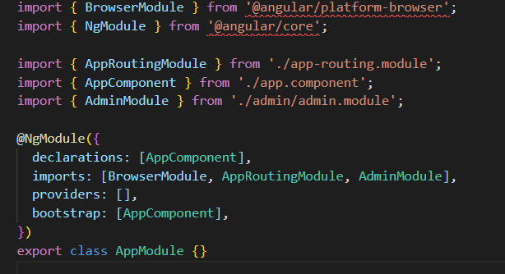
Import of module

Slide 6
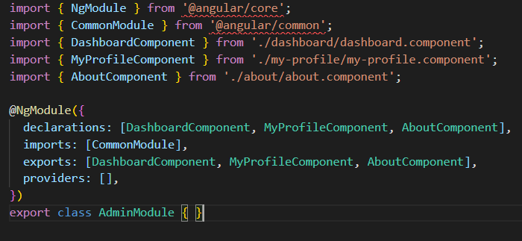
Export module

Slide 7
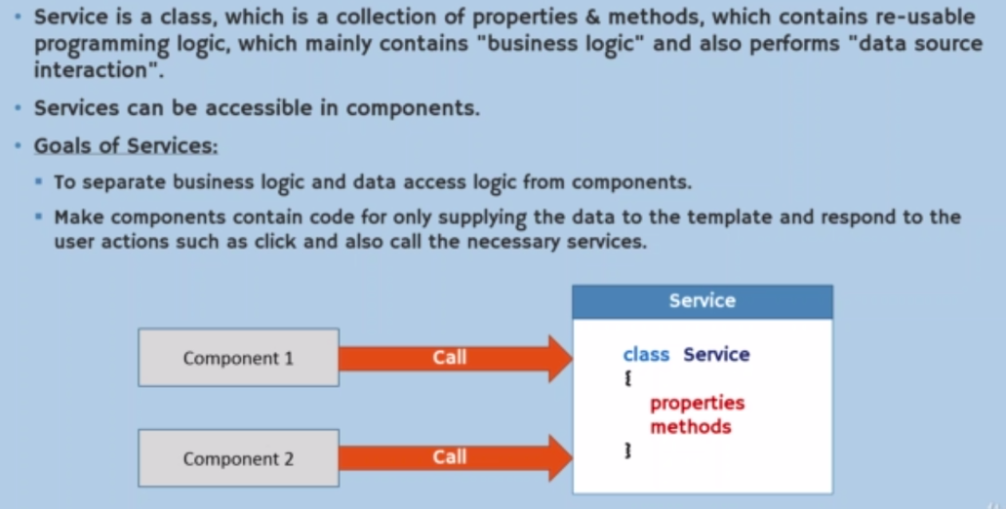
What is service

Slide 8
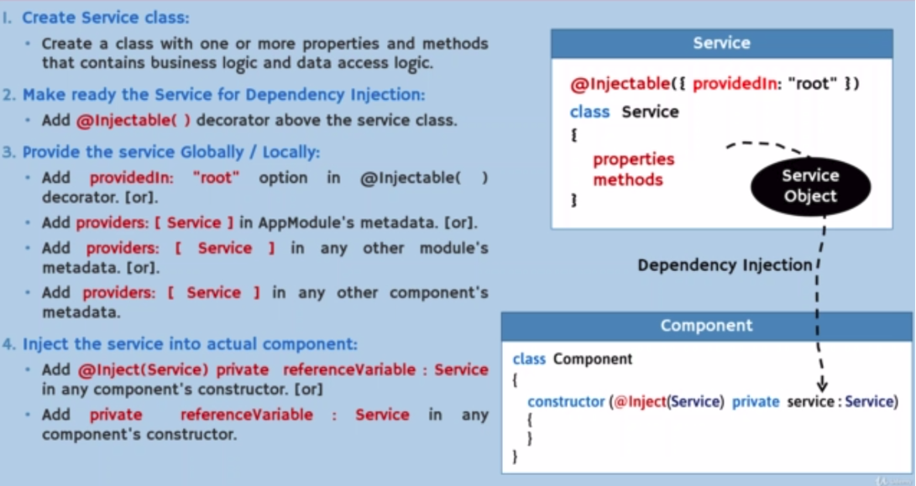
What is service

Slide 9
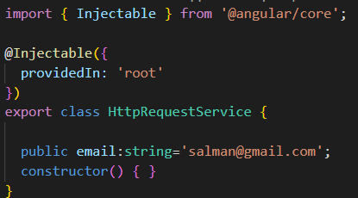
What is service

