Slide 1
Modules and services
SALMAN AHMED G

Slide 2
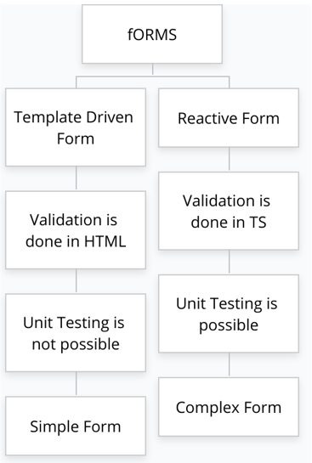
Types of form

Slide 3
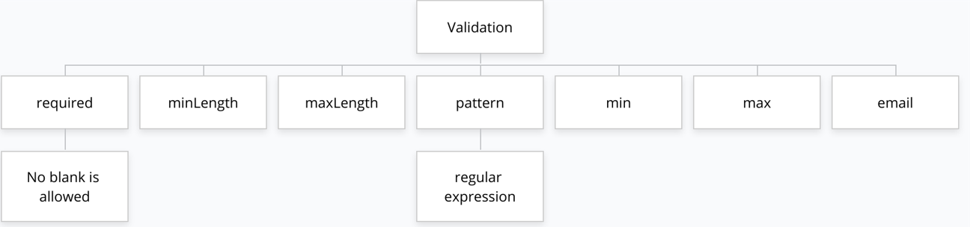
validation

Slide 4
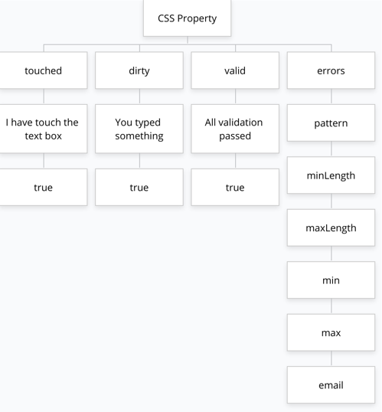
Css property

Slide 5
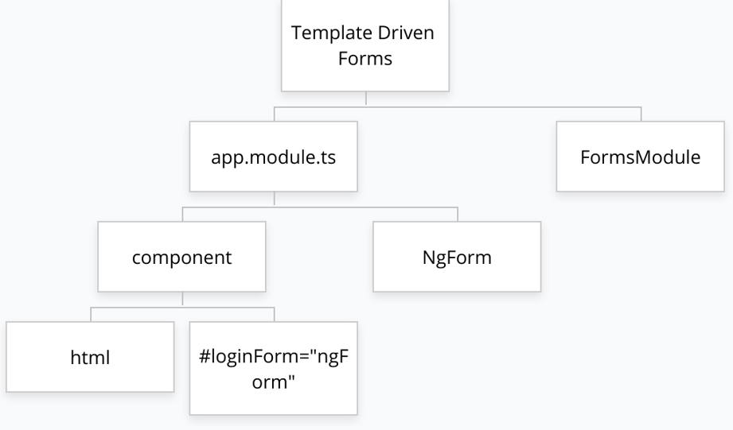
Template driven form

Slide 6
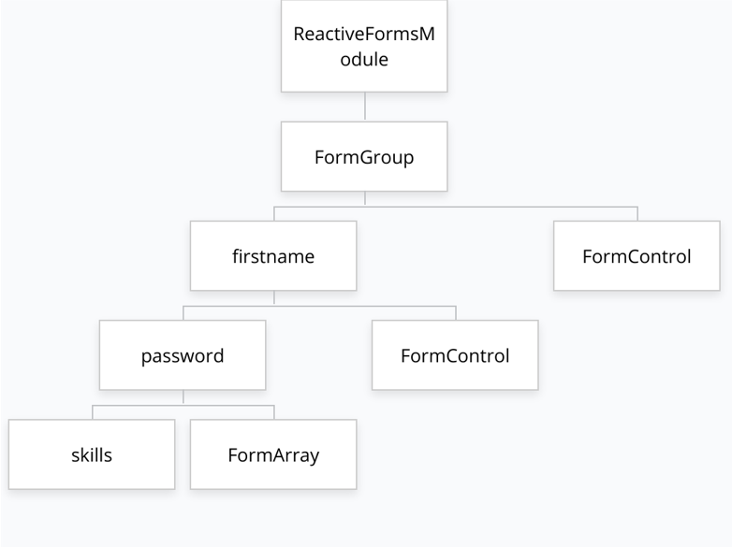
Reactive form

Slide 7
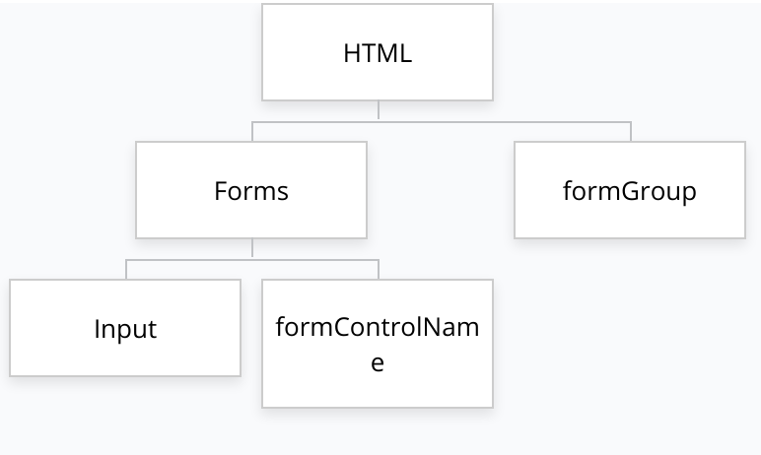
Reactive form

Slide 8
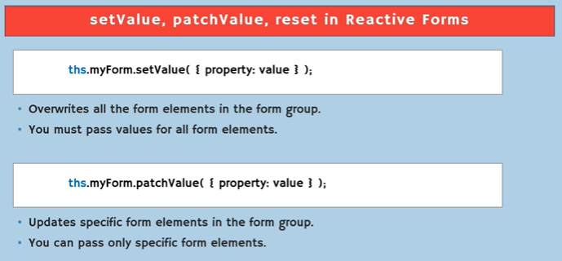
Setvalue patchvalu,reset

