Slide 1
restapi
SALMAN AHMED G

Slide 2
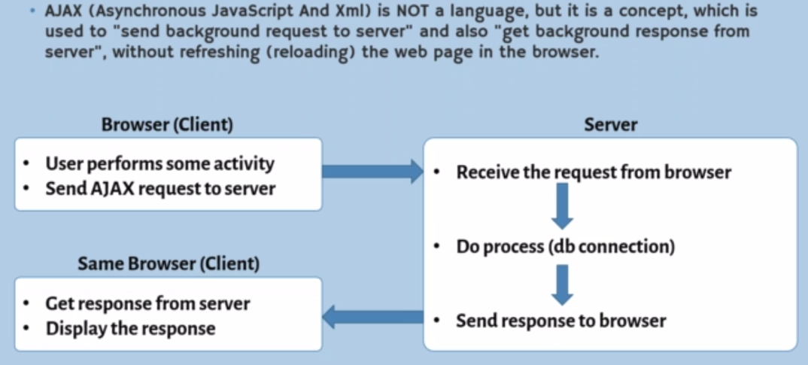
What is ajax

Slide 3
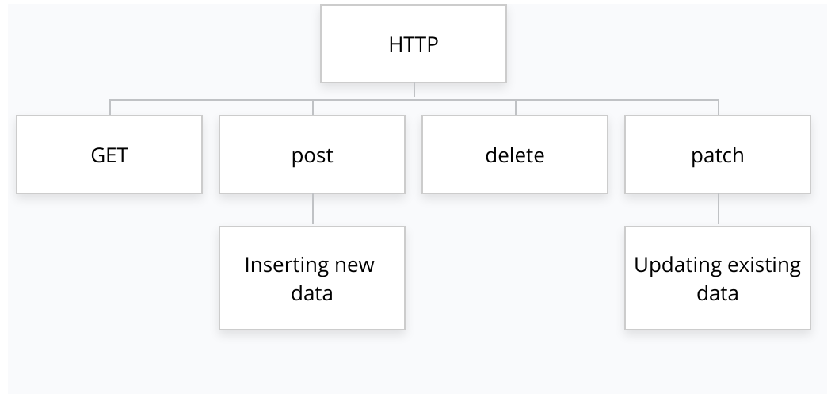
http

Slide 4
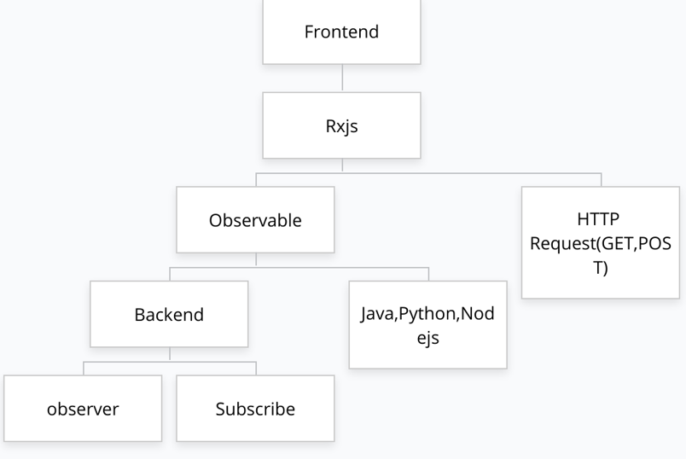
http frontend

Slide 5
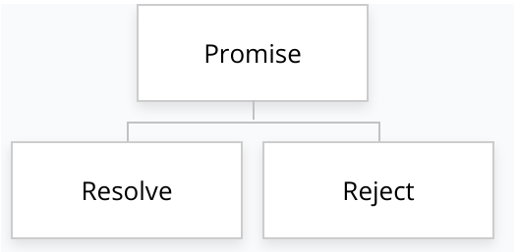
promise

Slide 6
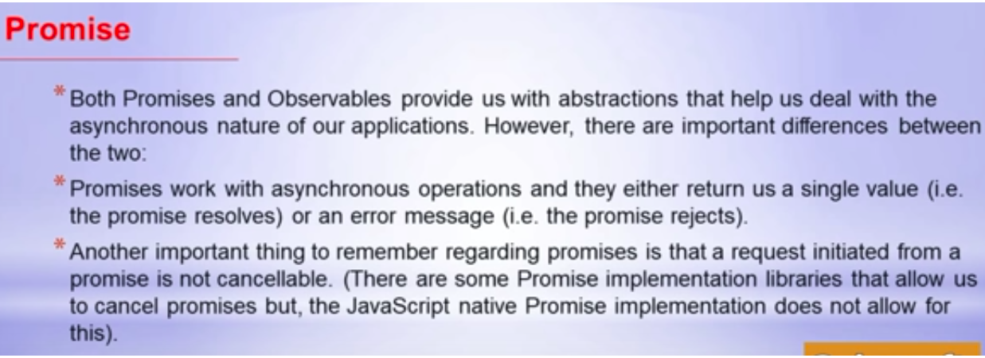
Promise

Slide 7

promise

Slide 8

observable

Slide 9
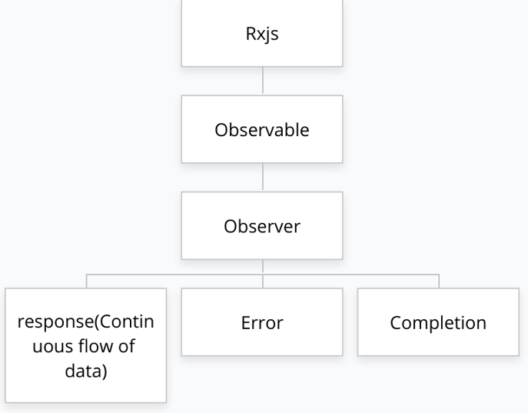
observable

Slide 10
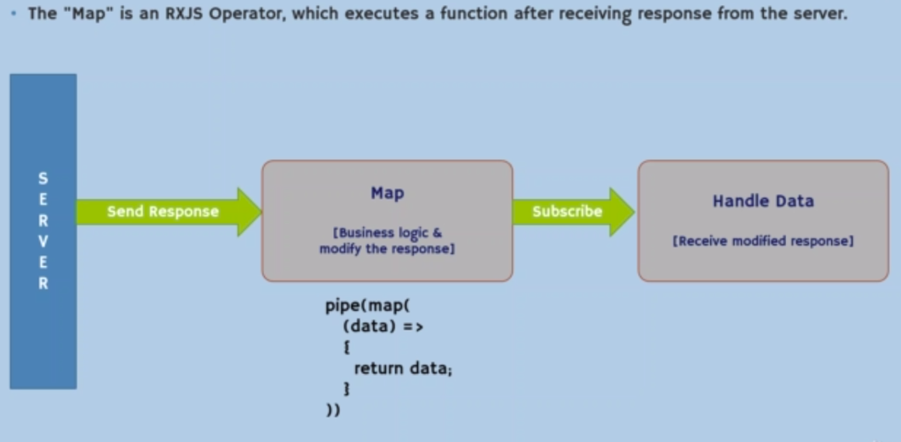
map

Slide 11

Web application

