Slide 1
Component Communication
SALMAN AHMED G

Slide 2
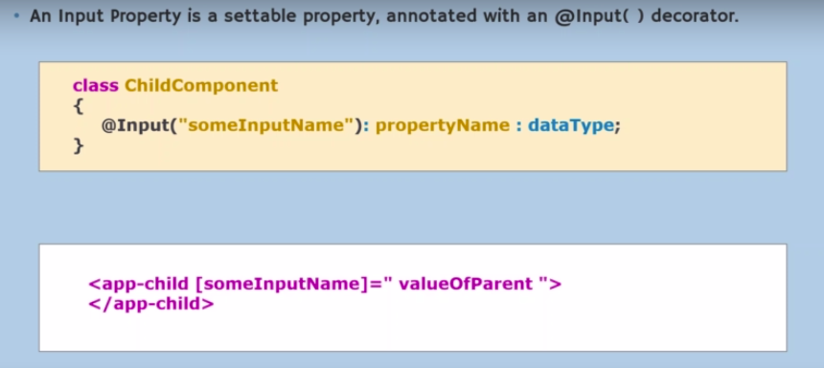
Input decorator

Slide 3
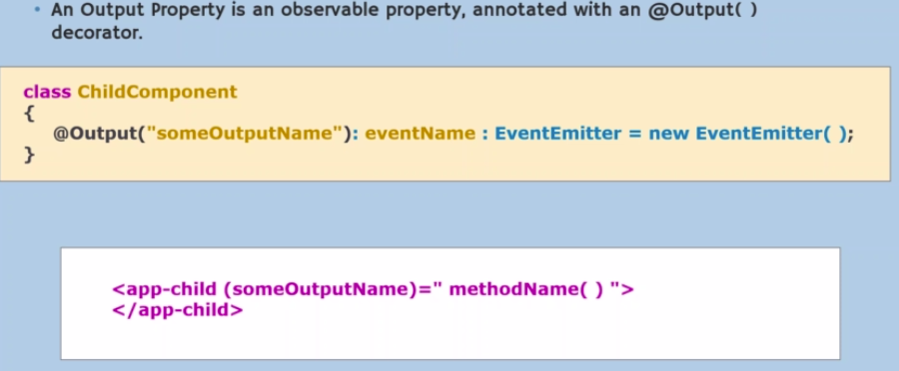
output decorator

Slide 4
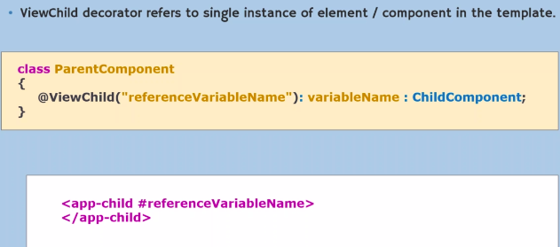
viewchild decorator

Slide 5
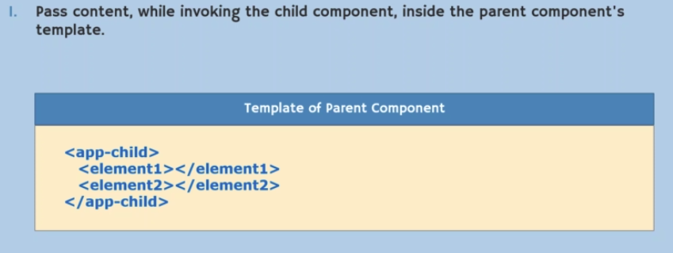
ngcontent

Slide 6
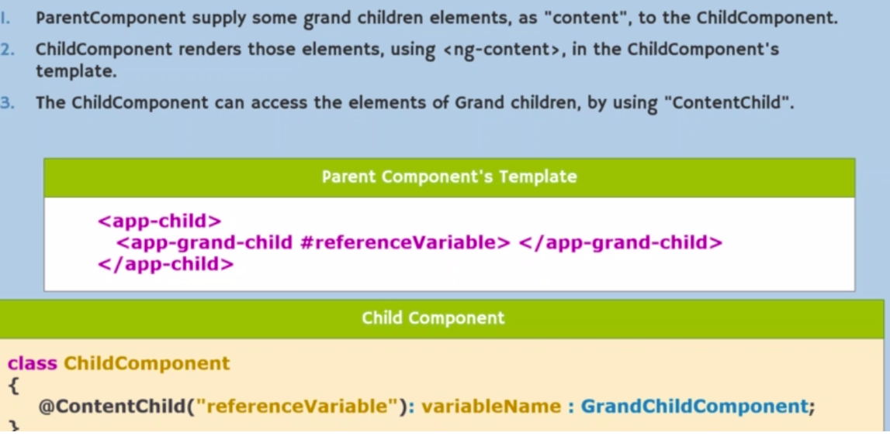
Content child

Slide 7
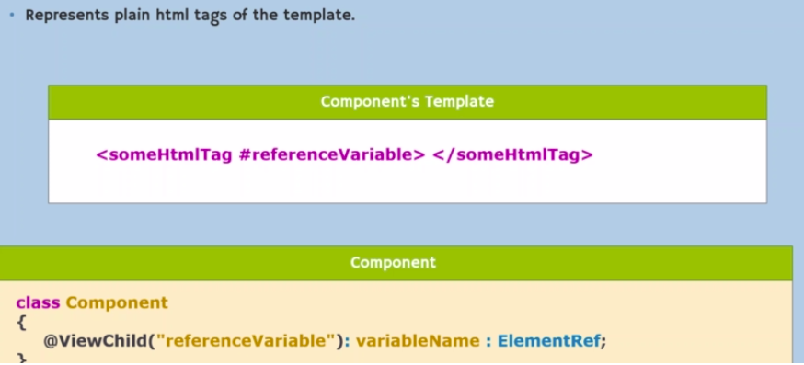
Element ref

