Slide 1
Lifecycle hooks
SALMAN AHMED G

Slide 2
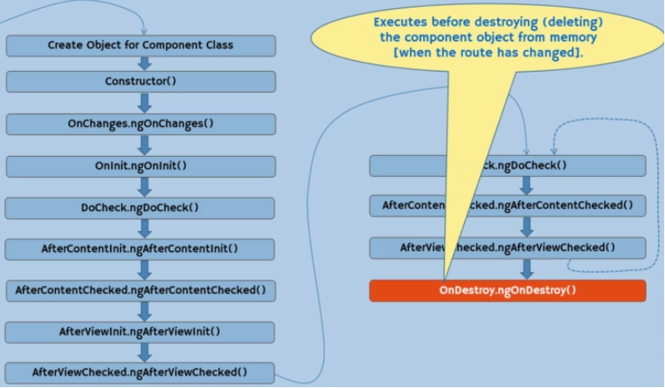
Life cycle hooks

Slide 3
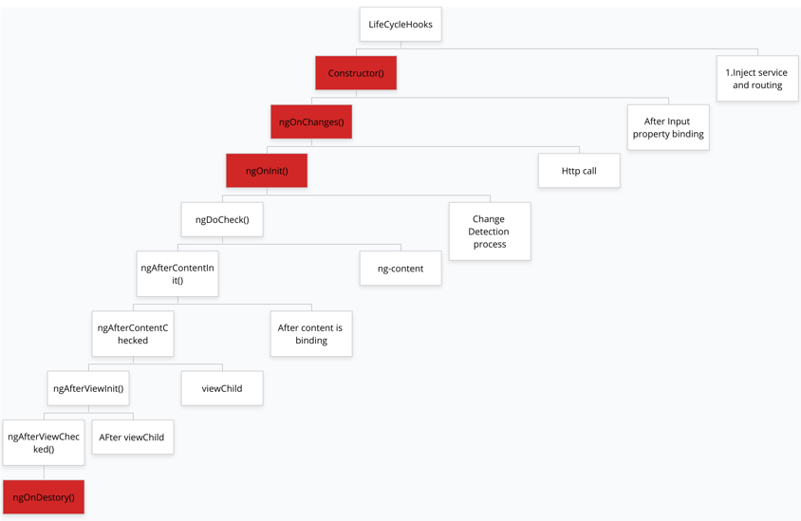
Usefull method

