Slide 1
Introduction to javascript
SALMAN AHMED G

Slide 2
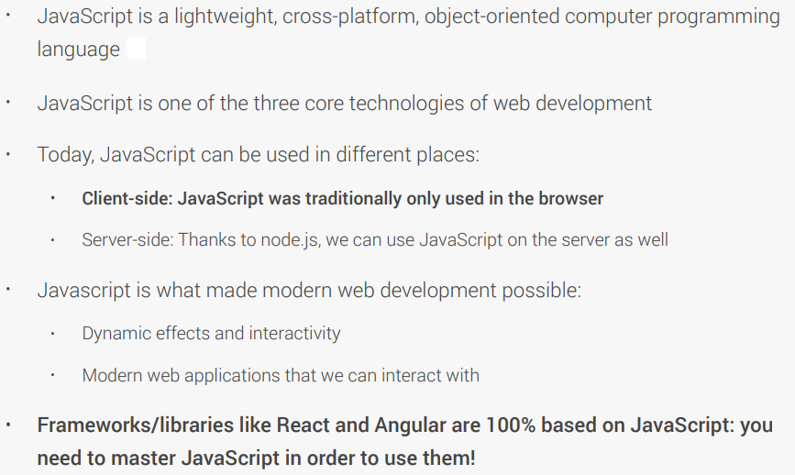
WHAT IS JAVASCRIPT

Slide 3
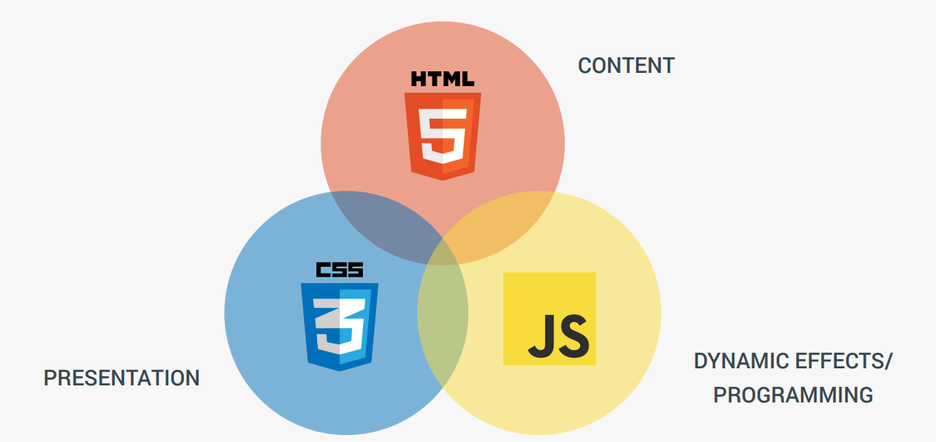
features

Slide 4
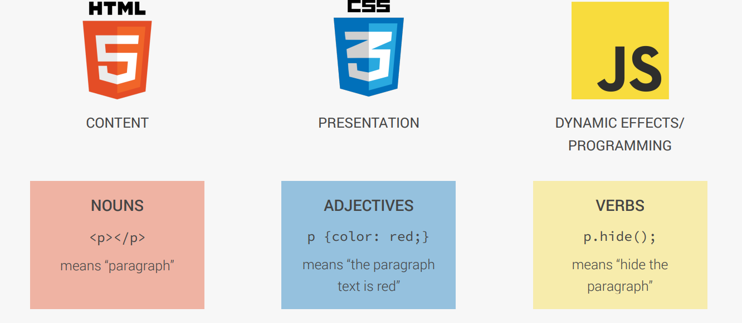
understanding

Slide 5
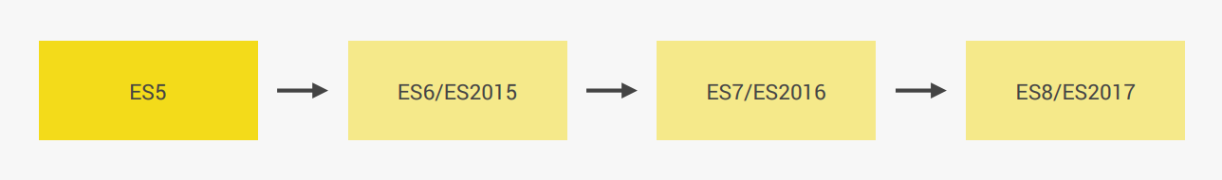
version

Slide 6
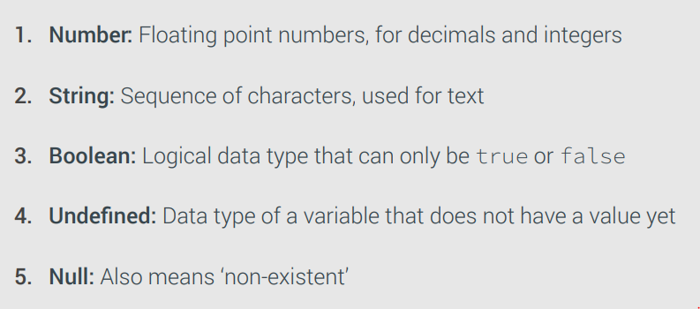
datatypes

Slide 7
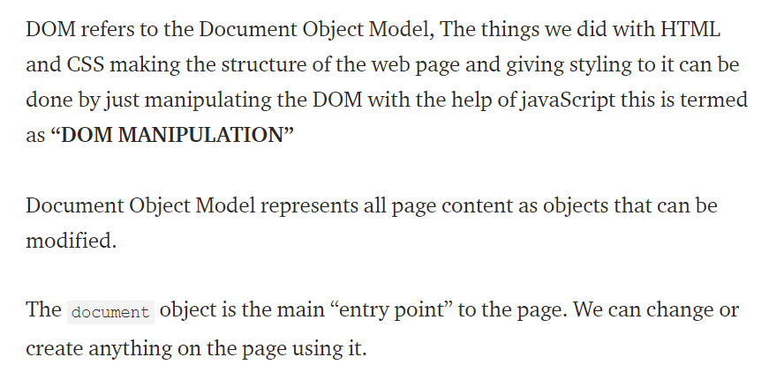
DOCUMENT OBJECT MODEL

Slide 8
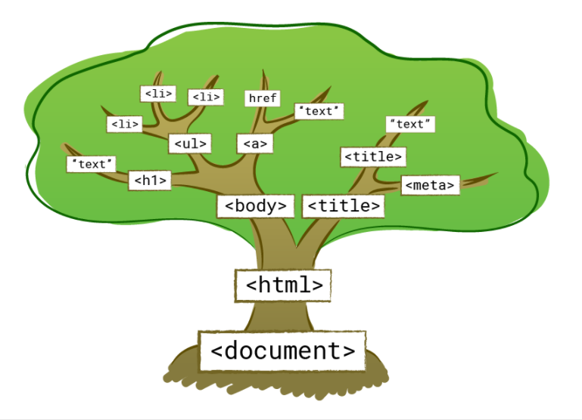
EXAMPLE

Slide 9
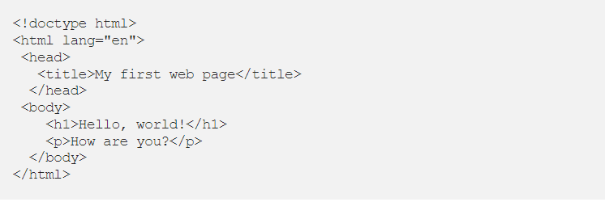
SAMPLE CODE

Slide 10
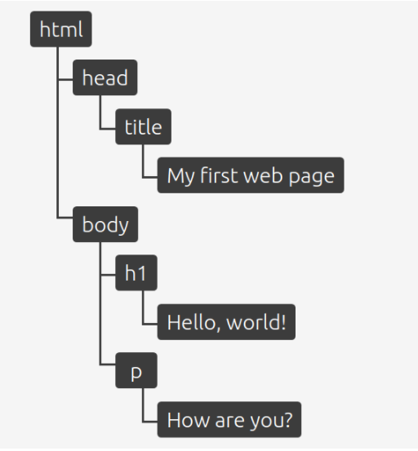
DOM HIERACHY

Slide 11
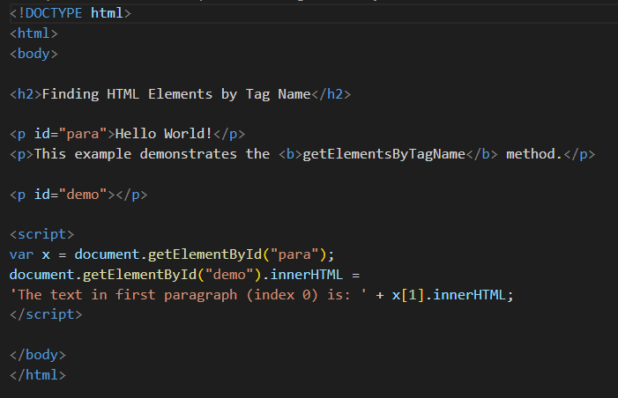
1.GETELEMENTBYID

Slide 12
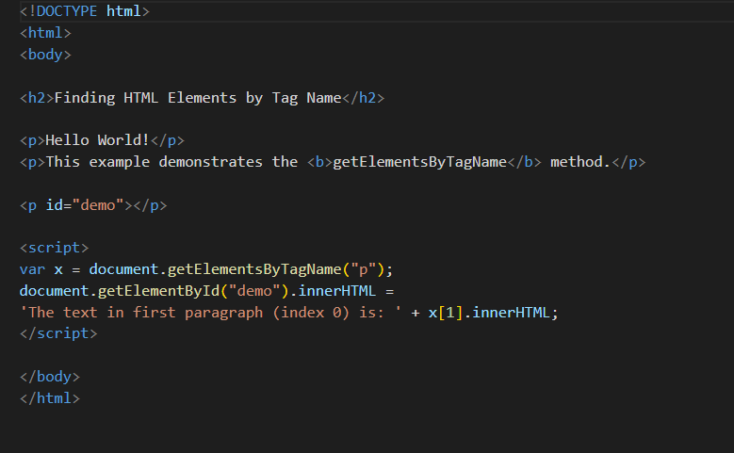
2.GETELEMENTBYTAGNAME

Slide 13
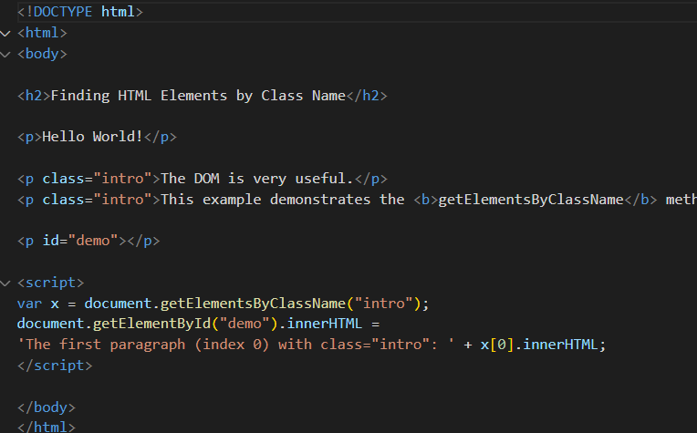
3.GETELEMENTBYCLASSNAME

Slide 14
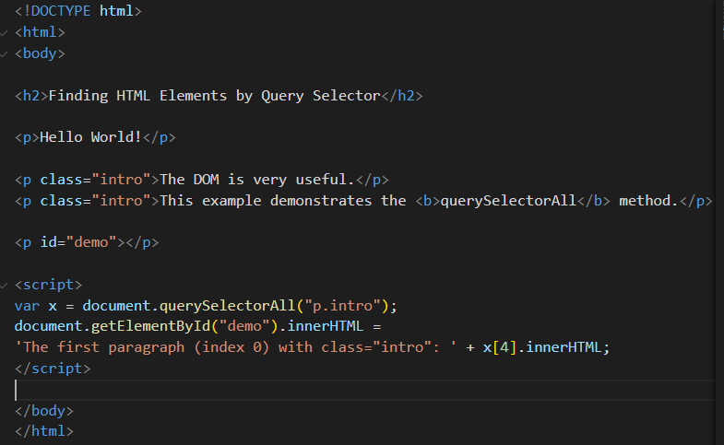
4.CSSSELECTOR

Slide 15
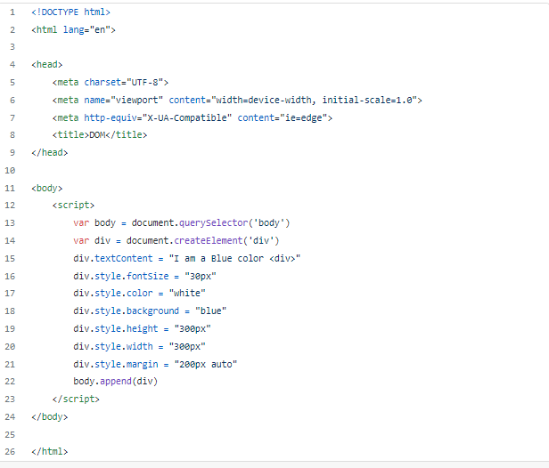
ADDING ELEMENT FROM JS

Slide 16
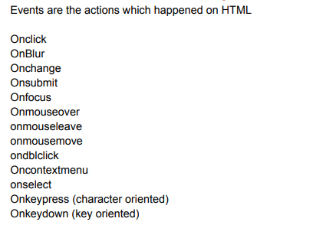
EVENTS IN JS

Slide 17
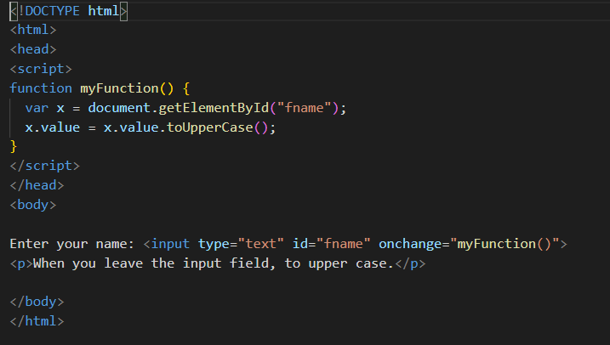
Onchange event

Slide 18
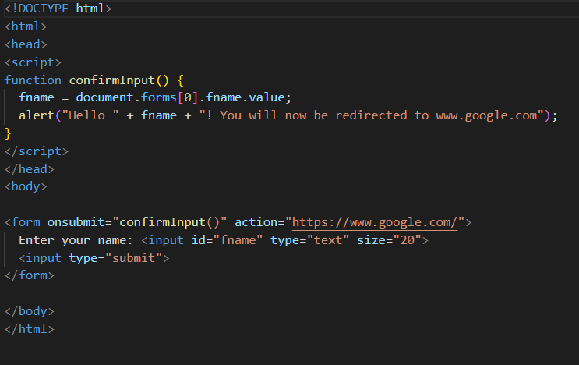
Onsubmit event

Slide 19
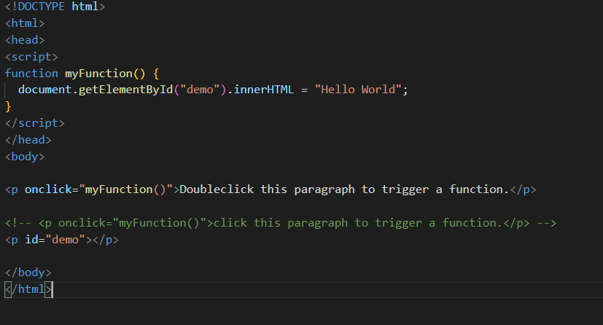
Onclick event

Slide 20
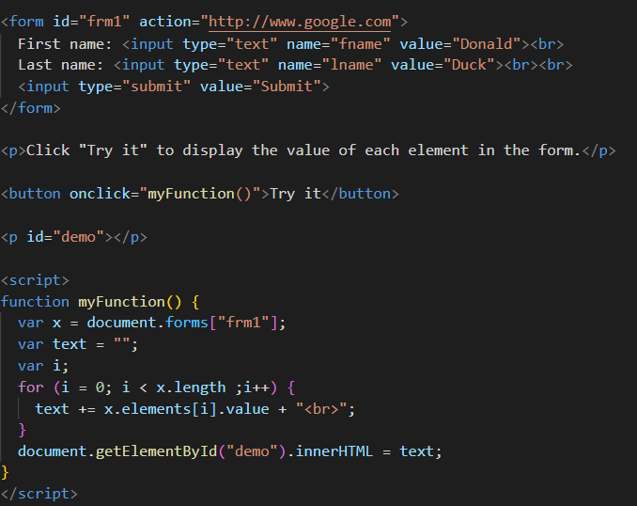
Accessing forms element

