Slide 1
Operators in javascript
Salman Ahmed G

Slide 2
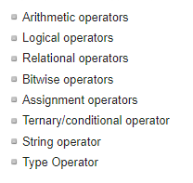
List of operator

Slide 3
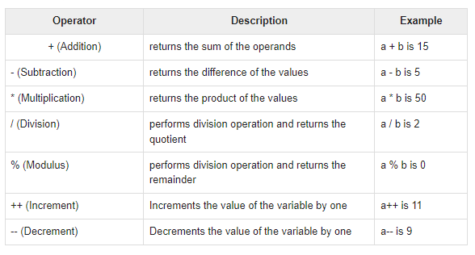
Arithmetic operator

Slide 4
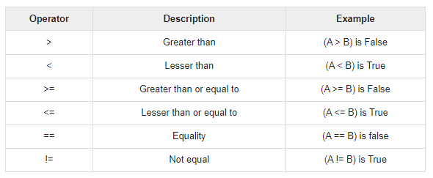
Relational operator

Slide 5
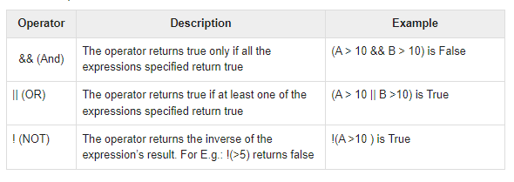
Logical operator

Slide 6
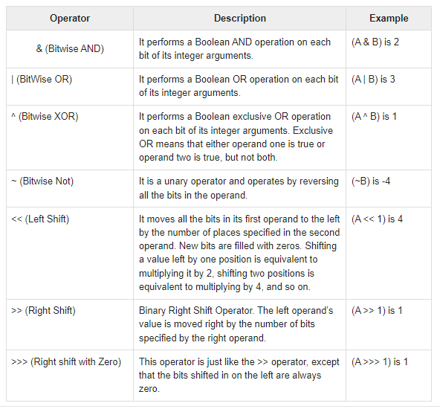
Bitwise operator

Slide 7
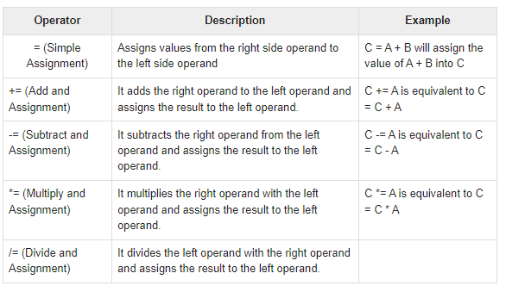
Assignment operator

Slide 8
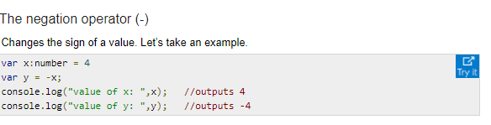
Miscellaneous operator

Slide 9
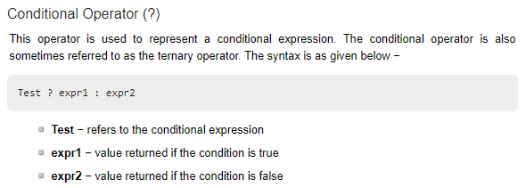
Conditional operator

Slide 10
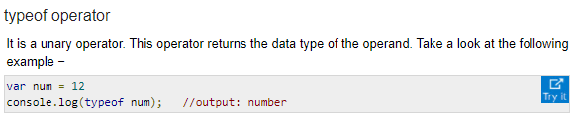
Type operator

