Slide 1
Introduction to REGULAR EXPRESSION
SALMAN AHMED G

Slide 2
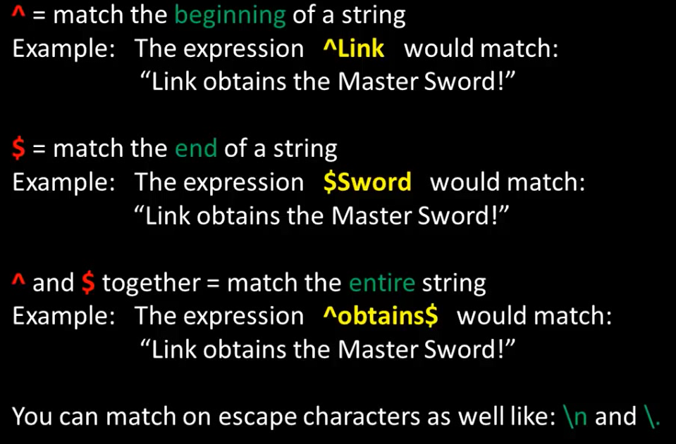
BASIC MATCH

Slide 3
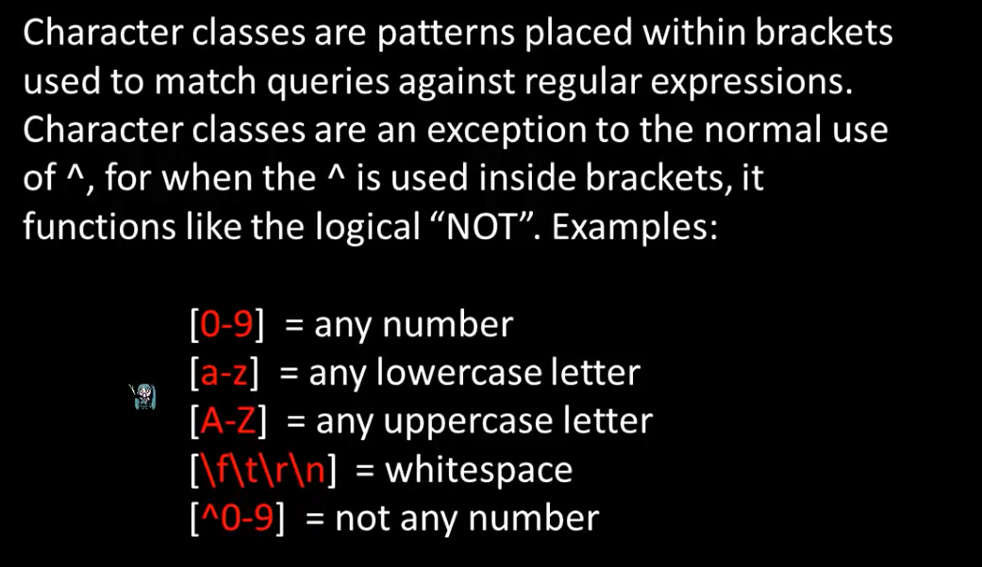
CHARACTER CLASS

Slide 4
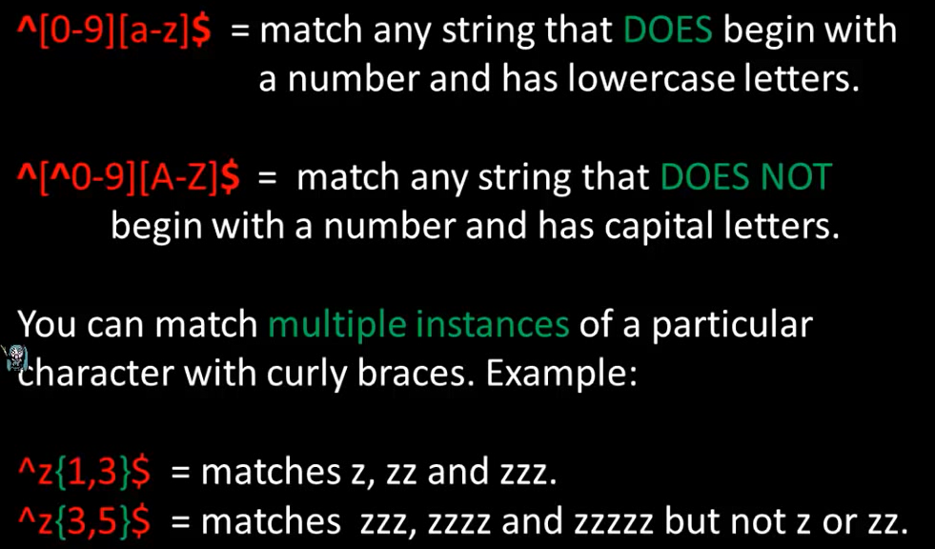
CHARACTER CLASS

Slide 5
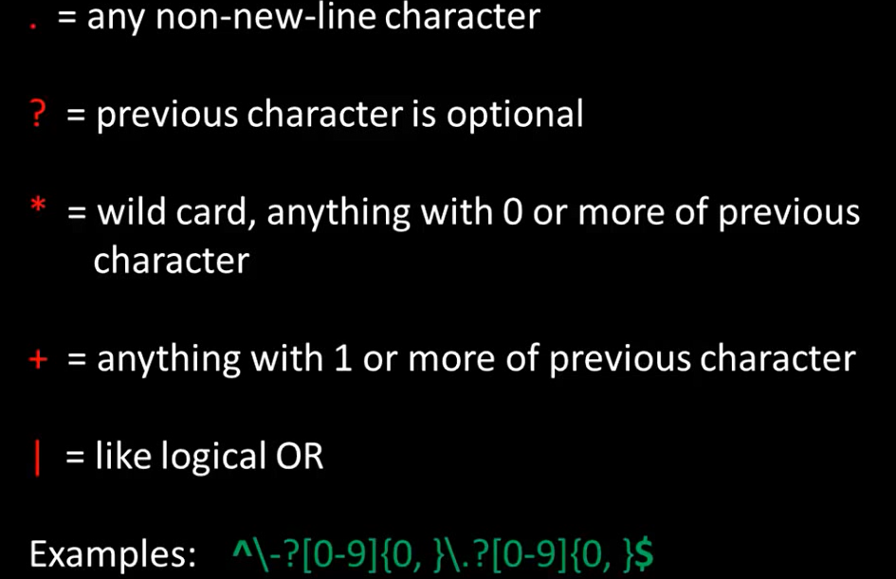
SPECIAL PATTERN CHARACTERS

Slide 6
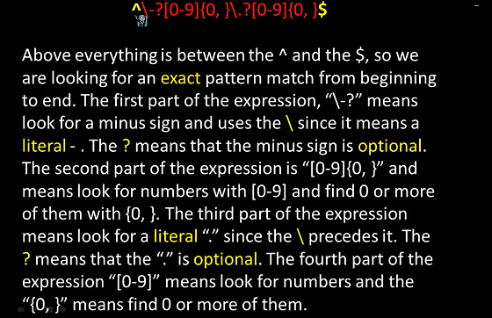
EXAMPLE:

Slide 7
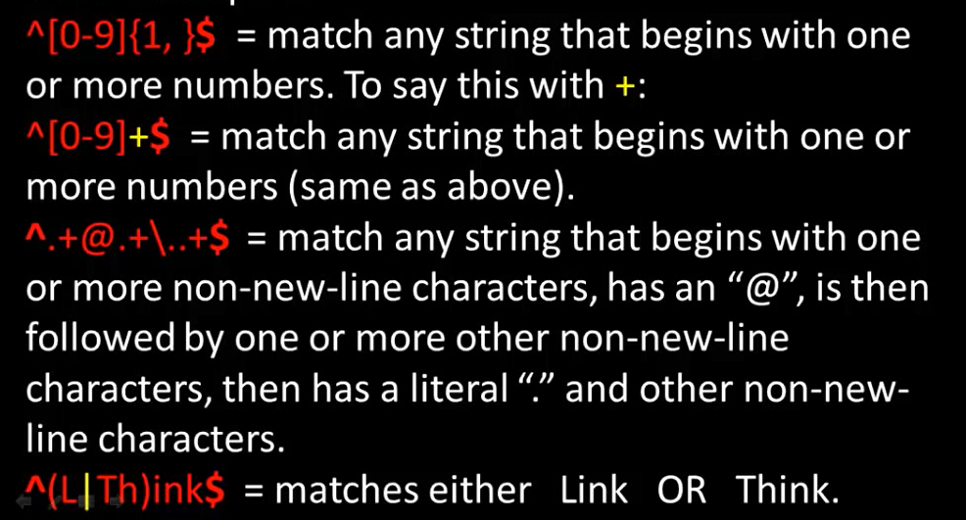
EXAMPLE

Slide 8
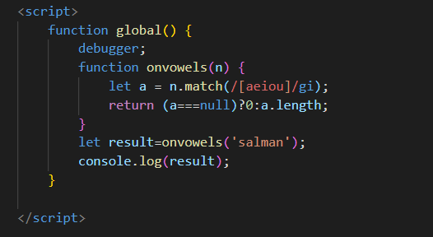
JS CODE EXAMPLE

Slide 9
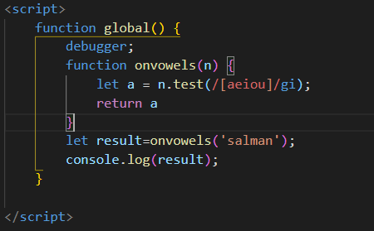
Js code example

Slide 10
example
1.Digits only ---> ^[0-9]*$
2.Alphabets only --> ^[a-zA-Z]*$
3.Indian Mobile Number -->^[789]{1}[0-9]{9}$
4.Email -->
\w+([-+.']\w+)*@\w+([-.]\w+)*\.\w+([-.]\w+)*
5.Username:Alphabets,Digits and Hyphens only-->([A-Za-z0-9]+)
6.Passwords:6 to 15 characters; atleast one upper case letter,one lower case letter and one digit-->
((?=.*\d)(?=.*[a-z])(?=.*[A-Z]).{6,15})

